Slide 1
CSEN20
Fall 2026
Introduction to Embedded Systems
Michael Schimpf, PhD, mschimpf@scu.edu

Slide 2
Chapter 2 Binary Number Systems

Slide 3
Kinds Of Data
Depending on interpretation!
Numbers
Integers
Unsigned
Signed
Reals
Fixed-Point
Floating-Point
Text
ASCII Characters
Strings
Other
Graphics
Images
Video
Audio

Slide 4
Number Representation
Computers use binary numbers (0's and 1's).
How many digits (bits) do I need to represent decimal 7 in bin? 1 + 2 + 4 = 7 -> 3 bits

Slide 5
Number Representation
2. Computers use numbers with fixed number of digits (“fixed-precision”).
Byte
Half-word
Word
Double-word
Why do we need all these data types?

Slide 6
Number Representation
3. Computers represents:
signed numbers using "2's complement" instead of “sign- and-magnitude” representation. Why?

Slide 7
Sign-and-Magnitude Representation
Two 0 representations?!?!?!
Dec | Binary
+0 | 0000
+1 | 0001
+2 | 0010
+3 | 0011
+4 | 0100
+5 | 0101
+6 | 0110
+7 | 0111
Dec | Binary
-0 | 1000
-1 | 1001
-2 | 1010
-3 | 1011
-4 | 1100
-5 | 1101
-6 | 1110
-7 | 1111
if (x == +0 && x == -0){
…
}

Slide 8
2’s Complement Representation
Dec | Binary
0 | 0000
1 | 0001
2 | 0010
3 | 0011
4 | 0100
5 | 0101
6 | 0110
7 | 0111
Dec | Binary
-1 | 1111
-2 | 1110
-3 | 1101
-4 | 1100
-5 | 1011
-6 | 1010
-7 | 1001
-8 | 1000
One “–” more

Slide 9
Why Not Sign + Magnitude?
+2₁₀ = 0010
+(-7₁₀) = +1111
????
111 > 010:
111
- 010
101
Complicates addition :
First check the signs!
if (same) add both and use the same sign;
else (!same) subtract the smaller from the larger; use the sign of the larger.
How do you determine which is smaller/larger?
larger
smaller
Use sign of 111:
1101
= -5₁₀

Slide 10
Why 2’s Complement?
Signed:
+2₁₀ = 0010
+(-7₁₀) = +1001 1011 = -5₁₀
Unsigned:
+2₁₀ = 0010
+(9₁₀) = +1001
1011
=11₁₀
Easy addition/subtractions

Slide 11
Why Not Sign+Magnitude?
Main reasons:
Two zero representations are very annoying (and a math problem!)
One value is wasted
Hardware implementation is complicated
Addition without check, which operand is larger.
Simply add numbers.
One hardware adder works for both signed and unsigned

Slide 12
Chapter 2 Binary Number Systems
Part 1: Polynomial Evaluation

Slide 13
Symbols and their values used in positional number systems
System | Radix | Digit Symbols | Corresponding Digit Values
Binary | 2 | 0,1 | 0,1
Decimal | 10 | 0,1,2,3,4, 5,6,7,8,9 | 0,1,2,3,4, 5,6,7,8,9
Hex | 16 | 0,1,2,3,4,5,6,7, 8,9,A,B,C,D,E,F | 0,1,2,3,4,5,6,7, 8,9,10,11,12,13,14,15

Slide 14
Positional Number Systems
Numeric values are represented by a sequence of digit symbols.
– Examples: 2354₁₀ , 1101_{2,} F8ED₁₆
Symbols represent numeric values.
Symbols are not limited to ‘0’-’9’ additional ‘A’ – ‘F’!
Example: AFED₁₆

Slide 15

POLYNOMIAL EVALUATION
Example: 3672₁₀
$v_{n−1}R^{n−1}$ +$⋯$ + $v_{1}R^{1}+v_{0}R^{0}$
where: $v_{i}$ are the corresponding digit values
and: $R$ is the radix (number base)
Ex: $3×{10}^{3}+6×{10}^{2}+7×{10}^{1}+2×{10}^{0}$ = 3672₁₀
These are the digit symbols
Subscript used to identify radix (R)

Slide 16
Polynomial Evaluation
Polynomial Evaluation can be used to convert:
A number in any base to base 10 (Base aka Radix)
***Important Note:
Polynomial evaluation only works when converting to base 10.
It doesn’t work if you convert it in the other direction I.e., from decimal to something else! In those cases, we use other techniques

Slide 17
POLYNOMIAL EVALUATION
547
Symbolic representation (What we write)
Digit values (coefficients)
→ 5×10² + 4×10¹ + 7×10⁰
10
Positional weights (powers of the radix)
Subscript indicate the radix (number base)
= 500 + 40 + 7
= 547
Numeric interpretation
(What we understand)
The result of polynomial evaluation is always a decimal number, regardless of the used radix used in the original representation.

Slide 18
Examples

Slide 19
Converting from ANY Radix to Decimal
Example: Converting from Radix 5 to Decimal
3124₅ → = 3×5³ + 1×5² + 2×5¹ + 4×5⁰
= 3×125 + 1×25 + 2×5 + 4×1
= 375 + 25 + 10 + 4
= 414₁₀
NOTE: Polynomial evaluation to convert from ANY radix to decimal.
The positional weights simply become powers of the radix.

Slide 20
CONVERT BINARY TO DECIMAL (Using Polynomial Evaluation)
1011₂ → = 1×2³ + 0×2² + 1×2¹ + 1×2⁰
= 1×8 + 1×2 + 1×1
= 8 + 2 + 1
= 11₁₀

Slide 21
EXTENDING POLYNOMIAL EVALUATION TO NUMBERS WITH A FRACTIONAL PART
10.010111₂ → = 1×2¹ + 0×2⁰ + 0×2⁻¹ + 1×2⁻² + 0×2⁻³ + 1×2⁻⁴ + 1×2⁻⁵ + 1×2⁻⁶
= 1×2¹ + 1×2⁻² + 1×2⁻⁴ + 1×2⁻⁵ + 1×2⁻⁶
= 2 + 1/4 + 1/16 + 1/32 + 1/64
= 2 + 0.25 + 0.0625 + 0.03125 + 0.015625
= 2.359375₁₀

Slide 22
Example Converting Radix 8 to Decimal
36.72₈
= 3 × 8¹ + 6 × 8⁰ + 7 × 8⁻¹ + 2 × 8⁻²
= 24 + 6 + 0.875 + 0.03125
= 30.90625₁₀
Another fractional example

Slide 23

AN EASIER METHOD
10.010111₂
= (1×2⁷ + 0×2⁶ + 0×2⁵ + 1×2⁴ + 0×2³ + 1×2² + 1×2¹ + 1×2⁰)/2⁶
= (128 + 16 + 4 + 2 + 1)/64
= 151/64
= 2.359375₁₀
= 10010111₂ / 2⁶
6 fractional digits
Only a single division!
Only a single division!

Slide 24
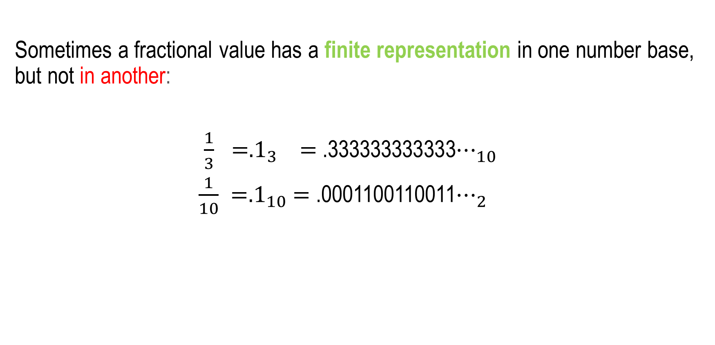
Converting Fractions
Sometimes a fractional value has a finite representation in one number base, but not in another:
$\frac{1}{3} ={.1}_{3}$ $=$ .333333333333$⋯_{10}$
$\frac{1}{10} ={.1}_{10}$ $=$ .0001100110011$⋯_{2}$

Slide 25
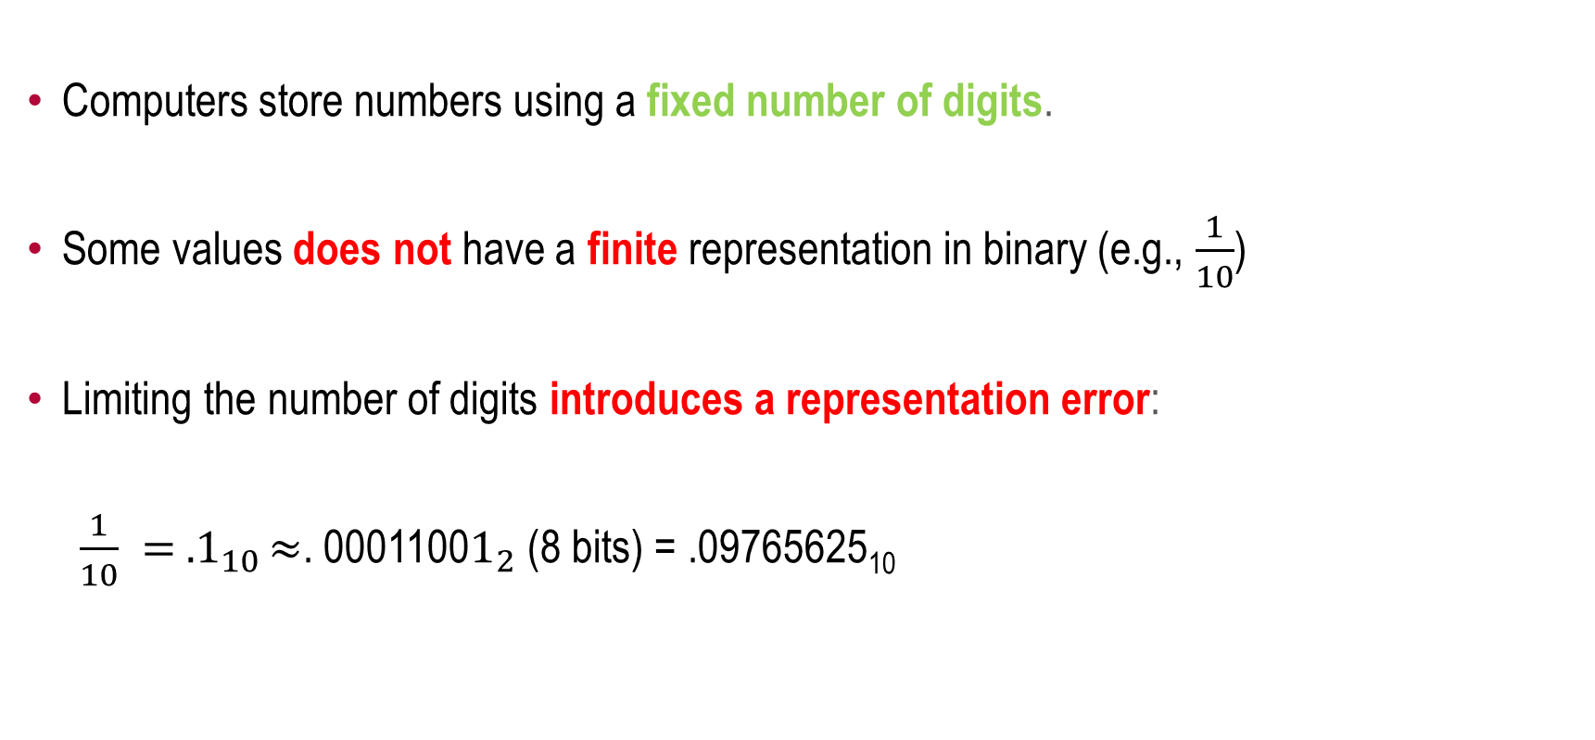
Representation Error
Computers store numbers using a fixed number of digits.
Some values does not have a finite representation in binary (e.g., $\frac{1}{10}$)
Limiting the number of digits introduces a representation error:
$\frac{1}{10} = {.1}_{10}≈$. 0001100$1_{2}$ (8 bits) = .09765625₁₀

Slide 26
Group Work
Convert to decimal using polynomial evaluation:
7676₈
(unsigned) 1101 1111 1100 1011₂

Slide 27
Group Work
Convert to decimal using polynomial evaluation:
7676₈ = 7×8³ + 6×8² + 7×8¹ + 6×8⁰
= 7×512 + 6×64 + 7×8 + 6×1
= 3,584 + 384 + 56 + 6
= 4,030₁₀
(unsigned) 1101 1111 1100 1011₂

Slide 28
Chapter 2 Binary Number Systems
Part 2: Unsigned Decimal to Binary Conversion

Slide 29
Decimal to Binary Conversion
Example: 97.25₁₀
Repeated multiplication
Repeated Division
1100001.01₂

Slide 30
UNSIGNED DECIMAL TO BINARY CONVERSION
Separate problem into two parts:
Integer Part: Use repeated division
Fractional Part: Use repeated multiplication

Slide 31
UNSIGNED DECIMAL TO BINARY Method 1: Integer Part (Repeated Division)
N N÷2 Remainder Result
13 6 1
6 3 0
3 1 1
1 0 1
1.
01.
101.
1101.
Digits are produced right-to-left starting from the radix point.
STOP
NOTE:
Repeated division may be used to convert from decimal to ANY radix.
Simply divide by the radix.

Slide 32
UNSIGNED DECIMAL TO BINARY Method 1: Fractional Part (Repeated Multiplication)
Product Whole Fractional
N (2×N) Part Part Result
.1 0.2 0 .2 .0
.2 0.4 0 .4 .00
.4 0.8 0 .8 .000
.8 1.6 1 .6 .0001
.6 1.2 1 .2 .00011
Digits are produced left-to-right starting from the radix point.
Begins to repeat!
NOTE:
Repeated multiplication may be used to convert from decimal to ANY radix.
Simply multiply by the.

Slide 33
Decimal to Binary Conversion (Whole Part: Repeated Division)
Convert 97₁₀ to base 2
97 ÷ 2 ➔ | quotient = 48, | remainder = 1 (LSB)
48 ÷ 2 ➔ | quotient = 24, | remainder = 0.
24 ÷ 2 ➔ | quotient = 12, | remainder = 0.
12 ÷ 2 ➔ | quotient = 6, | remainder = 0.
6 ÷ 2 ➔ | quotient = 3, | remainder = 0.
3 ÷ 2 ➔ | quotient = 1, | remainder = 1.
1 ÷ 2 ➔ | quotient = 0 (Stop) | remainder = 1 (MSB)
Result =
1
1
0
0
0
0
1₂

Slide 34
Decimal to Binary Conversion (Fractional Part: Repeated Multiplication)
Example: 0.25₁₀
.25 × 2 ➔0.5 (fractional part = .5, whole part = 0)
.5 × 2 ➔1.0 (fractional part = .0 (stop), whole part = 1)
Result = 0.0
Another example: 0.5₁₀
.5 × 2 ➔ 1.0 (fractional part = .0 (stop), whole part = 1)
Result = .
1₂
0
1₂

Slide 35
Decimal to Binary Conversion (Fractional Part: Repeated Multiplication)
.1 × 2 ➔
.2 × 2 ➔
.4 × 2 ➔
.8 × 2 ➔
.6 × 2 ➔
0.2 (fractional part = .2, whole part = 0)
0.4 (fractional part = .4, whole part = 0)
0.8 (fractional part = .8, whole part = 0)
1.6 (fractional part = .6, whole part = 1)
1.2 (fractional part = .2, whole part = 1)
Result = .00011001100110011₂…..
(How much should we keep?)

Slide 36
Group Work
Use repeated division & repeated multiplication:
145 . 625₁₀
244 . 7534₁₀

Slide 37
Group Work
Use repeated division & repeated multiplication:
145 . 625₁₀ = 1001 0001 . 1010 0000₂
244 . 7534₁₀ = 1111 0100 . 1100 0000₂

Slide 38
Chapter 2 Binary Number Systems
Part 4: Signed Number Conversions

Slide 39
Two Interpretations
unsigned signed
167₁₀ 1010 0111₂
-89₁₀
Signed vs. unsigned is a matter of interpretation
Allowing both interpretations is useful: why?
Some data (e.g., count, age) can never be negative, and having a greater range is useful.

Slide 40
Changing the Signs
Sign+Magnitude:
+5 = 0101
Change 1 bit (only)
-5 = 1101
2’s Complement:
+5 = 0101
Invert
1010
+1
-5 = 1011
Increment

Slide 41
Easier Hand Method (example 1)
Step 2:
Copy the inverse of the remaining bits.
+4 = 0100
Step 1:
Copy the bits from right to left and including the first 1.
-4 = 1100

Slide 42
Easier Hand Method (example 2)
Step 2:
Copy the inverse of the remaining bits.
+5 = 0101
Step 1:
Copy the bits from right to left, through and including the first 1.
-5 = 1011

Slide 43

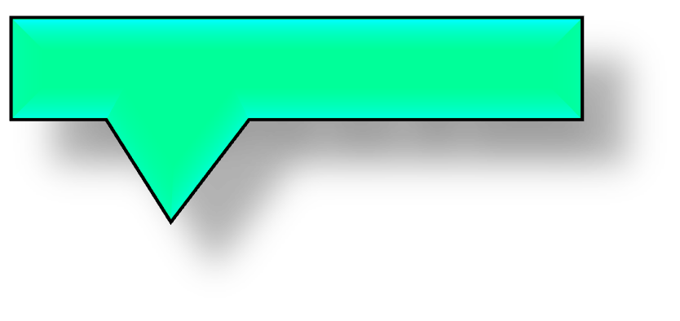
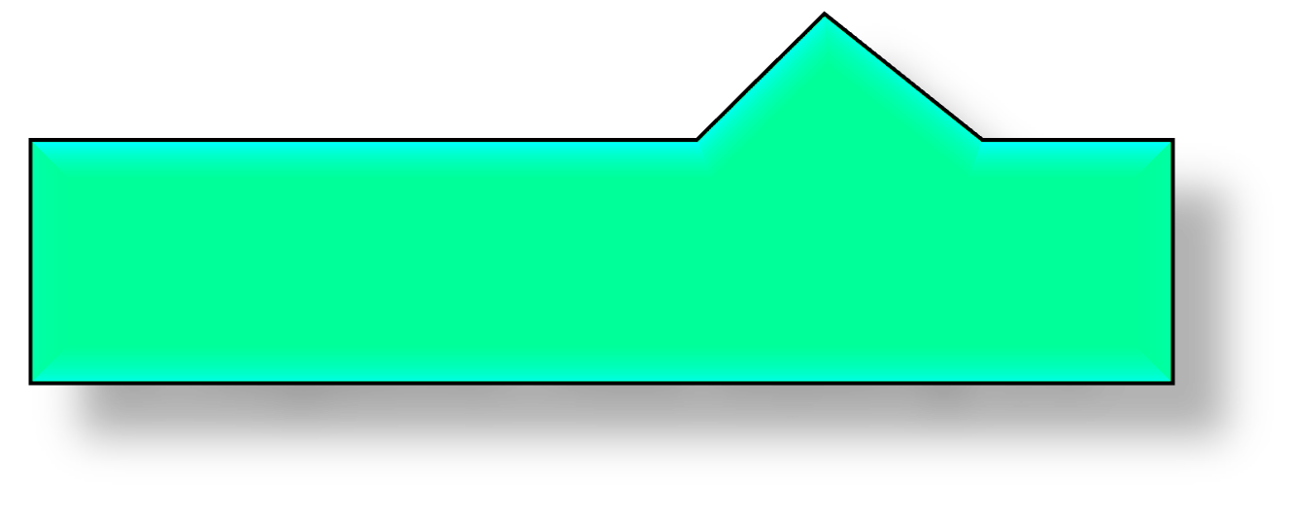
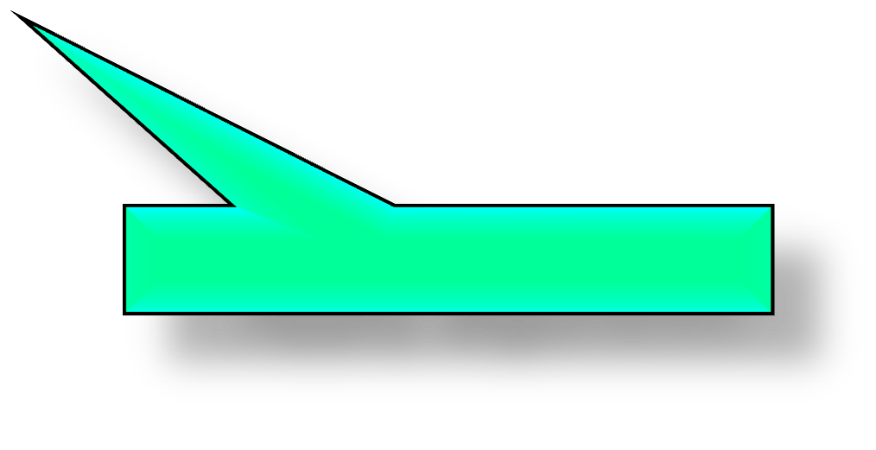
Representation Width
Be Careful! You must be sure to pad the original value out to the full representation width before applying the algorithm!
Apply algorithm Expand to 8-bits
Wrong: +25 = 1 1001 ➔ 0 0111 ➔ 0000 0111 = +7
Right: +25 = 1 1001 ➔ 0001 1001➔ 1110 0111 = -25
If positive: Add leading 0’s If negative: Add leading 1’s
Apply algorithm

Slide 44
Converting 2’s complement numbers to decimal
If MSB is 0, number is positive.→ convert as unsigned.
If MSB is 1, number is negative.
Apply 2’s comp. alg. to find bit pattern
Convert the bit pattern to decimal using polynomial evaluation.
Put a minus sign in front.

Slide 45
Converting 2’s complement numbers to decimal
Use polynomial evaluation, but make the contribution of the MSB be negative:
Example: 1011 0010₂ = ?₁₀
(-1x2⁷)+(1x2⁵)+(1x2⁴)+(1x2¹)
= -128 + 32 + 16 + 2 = -78₁₀

Slide 46
Finding 2’s complement of fraction numbers
Example: if +5.75 = 0101.1100₂ find -5.75 in binary.
Solution:
Step 1: Remove the binary point 0101 1100
Step 2: Find the 2’s complement of 1010 0100
Step 3: Replace the binary point 1010.0100 = -5.75

Slide 47
CONVERTING SIGNED DECIMAL TO TWO’S COMPLEMENT
Exercise: Find the 8-bit 2’s complement (minus) representation of:
25₁₀

Slide 48
CONVERTING SIGNED DECIMAL TO TWO’S COMPLEMENT
Convert the magnitude to unsigned binary:
25₁₀ = 16 + 8 + 1 → 1 1001₂
Zero extend to 8 bits:
1 1001 →0001 1001
Find the 2’s complement:
0001 1001 → 1110 0111₂

Slide 49

Converting 2’s complement numbers to decimal – Approach #1
Example: 10110010₂ = ?₁₀
Apply algorithm & add a negative sign
1. 10110010₂ → -01001110₂
2. -(01001110₂) = -(64 + 8 + 4 + 2) = -78₁₀
3. Answer: -78₁₀
10110010₂
01001110₂
inverse
inverse
inverse
inverse
inverse
inverse

Slide 50
Changing the Sign of a Two’s Complement Number (Method 1)
if +1.25₁₀ = 0001.0100₂
then -1.25₁₀ = ????.????₂
Change every bit: 0001.0100
1110.1011
Then add 1 to the +1 least-significant 1110.1100 bit position.
Simply changing the most-significant bit is NOT the same and doesn’t work!
. . .

Slide 51
Changing the Sign of a Two’s Complement Number (Method 2)
If +1.25₁₀ = 0001.0100₂
Then -1.25₁₀ = ????.????₂
Copy right-to-left 0001.0100
through first 1:
Copy opposite of all remaining bits:
. . .
. . .
1110.1
100

Slide 52
Chapter 2 Binary Number Systems
Part 6: Power Relationships

Slide 53
Hex

Slide 54
MOTIVATION
Hexadecimal is a convenient short-hand for binary:
Hex (radix 16) numbers require 1/4th as many digits than their equivalent binary (radix 2) representation
Easier for humans → reduces transcription errors

Slide 55
MOTIVATION
Conversion is trivial due to power relationship (16 = 2⁴):
Each hex digit corresponds to a group of 4 binary digits.
Easy to convert: Groups are independent of each other.

Slide 56
Hexadecimal Numbers (Radix = 16)
The number of digit symbols is determined by the radix (e.g., 16)
The value of the digit symbols range from 0 to 15 (0 to R-1).
The symbols are 0-9 followed by A-F.
Conversion between binary and hex is trivial!
Use as a shorthand for binary (significantly fewer digits are required for same magnitude).

Slide 57
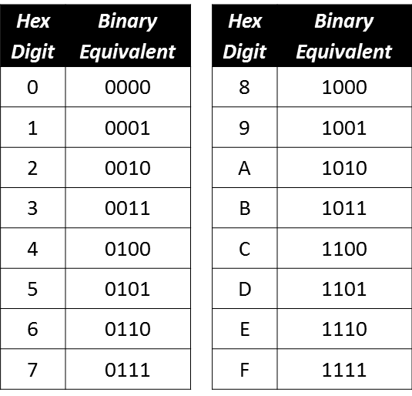
Hex/Binary Table

Slide 58
Binary to Hex Conversions
Hex digits are in one-to-one groups of four:
11 1010 0101 0110 . 1110 0010 1111 1
3 A 5 6 . E 2 F 8
Start at binary point and identify groups of 4 bits
Zero-fill on left and right ends to complete the groups!
Conversion is a simple table lookup!
Works because 16 = 2⁴ (power relationship)
000

Slide 59
Example: Binary to Hex
Hex | Binary
0 | 0000
1 | 0001
2 | 0010
3 | 0011
4 | 0100
5 | 0101
6 | 0110
7 | 0111
8 | 1000
9 | 1001
A | 1010
B | 1011
C | 1100
D | 1101
E | 1110
F | 1111
Split into groups of 4, starting at radix point:
101 1010 . 1001 011
Form groups working outward from the radix point!
Pad with 0’s to complete the groups:
0101 1010 . 1001 0110
3. Replace each group by equivalent hex digit:
5 A . 9 6₁₆

Slide 60
Example: Hex to Binary
Hex | Binary
0 | 0000
1 | 0001
2 | 0010
3 | 0011
4 | 0100
5 | 0101
6 | 0110
7 | 0111
8 | 1000
9 | 1001
A | 1010
B | 1011
C | 1100
D | 1101
E | 1110
F | 1111
Convert F1.2C₁₆ to Binary:
F 1 . 2 C
1111 0001 . 0010 1100₂

Slide 61
Example: 110101.010101₂ to Hex
Hex | Binary
0 | 0000
1 | 0001
2 | 0010
3 | 0011
4 | 0100
5 | 0101
6 | 0110
7 | 0111
8 | 1000
9 | 1001
A | 1010
B | 1011
C | 1100
D | 1101
E | 1110
F | 1111

Slide 62
Example: 110101.010101₂ to Hex
Use power relationship (16 = 2⁴)
Form groups of 4 bits, starting at radix point:
11 0101 . 0101 01
0011 0101 . 0101 0100
Use Table to convert each group:
0011 0101 . 0101 0100
3 5 . 5 4₁₆
Hex | Binary | Hex | Binary
0 | 0000 | 8 | 1000
1 | 0001 | 9 | 1001
2 | 0010 | A | 1010
3 | 0011 | B | 1011
4 | 0100 | C | 1100
5 | 0101 | D | 1101
6 | 0110 | E | 1110
7 | 0111 | F | 1111

Slide 63
Octal

Slide 64
Octal/Binary Table
Octal | Binary
0 | 000
1 | 001
2 | 010
3 | 011
4 | 100
5 | 101
6 | 110
7 | 111
Octal and hexadecimal is a compromise between binary and decimal
Easier to read for humans
Was more important in the early days
Octal is not really used a lot
One the rights of a Unix/Linux file it is used

Slide 65
Converting Octal (Base 8) to Hex
Hard way:
Convert octal to decimal (polynomial evaluation)
Convert decimal to hex (repeated division/multiplication)

Slide 66
Converting Octal (Base 8) to Hex
Easy way:
Convert octal to binary using short-cut (8 = 2³)
Convert binary to hex using short-cut (16 = 2⁴)

Slide 67
Converting Octal (Base 8) to Hex
Example: 12.65₈ → ?₁₆
12.65₈ = 001 010 . 110 101₂ = 001010.110101₂
001010.110101₂ = 0000 1010 . 1101 0100₂ = 0A.D4₁₆

Slide 68
Converting Octal (Base 8) to Hex
Convert octal to binary
Convert binary to hex

Slide 69
Convert 21.34₈ to Binary
Octal | Binary
0 | 000
1 | 001
2 | 010
3 | 011
4 | 100
5 | 101
6 | 110
7 | 111
2 1 . 3 4₈
010 001 . 011 100₂

Slide 70
Convert AB.CD₁₆ to base 8
Hex | Binary
0 | 0000
1 | 0001
2 | 0010
3 | 0011
4 | 0100
5 | 0101
6 | 0110
7 | 0111
8 | 1000
9 | 1001
A | 1010
B | 1011
C | 1100
D | 1101
E | 1110
F | 1111
1st: Base 16 to base 2 (16=2⁴)
2nd: Base 2 to base 8 (8=2³)
A B . C D₁₆
1010 1011 . 1100 1101₂
10101011.11001101₂
010 101 011 110 011 010
010 101 011 110 011 010
2 5 3 6 3 2₈
Octal | Binary
0 | 000
1 | 001
2 | 010
3 | 011
4 | 100
5 | 101
6 | 110
7 | 111
.
.

Slide 71
Convert FA.CE₁₆ to base 8
MOE
Hex | Binary
0 | 0000
1 | 0001
2 | 0010
3 | 0011
4 | 0100
5 | 0101
6 | 0110
7 | 0111
8 | 1000
9 | 1001
A | 1010
B | 1011
C | 1100
D | 1101
E | 1110
F | 1111
1st: Base 16 to base 2 (16=2⁴)
2nd: Base 2 to base 8 (8=2³)
Octal | Binary
0 | 000
1 | 001
2 | 010
3 | 011
4 | 100
5 | 101
6 | 110
7 | 111
F A . C
1111 1010 . 1100 1110₂
11111010.11001110₂
011 111 010 . 110 011 100
011 111 010 . 110 011 100
3 7 2 . 6 3 4₈
^{E}16
11111010.11001110₂

Slide 72
Chapter 2 Binary Number Systems
Part 5: Worked Examples

Slide 73
Convert unsigned 25₆ to decimal
Base R to Decimal → polynomial evaluation:
25₆ = 2x6¹ + 5x6⁰
= 2x6 + 5x1
= 12 + 5
= 17₁₀

Slide 74
Convert unsigned 25₁₀ to base 7
Whole #₁₀ to Base R → repeated division (by 7):
25÷7 → Q=3, R=4 3
2 → Q=0, R=3
4₇
3÷7
34₇
STOP

Slide 75
Convert unsigned .3₁₀ to base 7
Fractional #₁₀ to Base R → repeated multiplication:
7 x .3 = 2.1 .2
7 x .1 = 0.7 .20
7 x .7 = 4.9 .204
7 x .9 = 6.3 .2046
Repeats! .20462046···

Slide 76


Converting -25.75₁₀ to 2’s Comp.
-25: 25 = 16 + 8 + 1
→ 011001
-25 = 100111
.75: .75 = .5 + .25
→ .11
Combining results:
→ 100111.11₂
Checking (poly eval):
= -24.25₁₀
Correct Method:
+25.75 = 16 + 8 + 1 + .5 + .25
= 011001.11₂
Find the negative representation:
→ 100110.01
Check:
100110.01 = 10011001/2²
= (-128+16+8+1)/4
= -103/4
= -25.75₁₀

Slide 77
Convert -75.75₁₀ to 2’s complement
1st: Get Binary Magnitude
75₁₀ = 64 + 8 + 2 + 1
= 2⁶ + 2³ + 2¹ + 2⁰
= 1001011₂
.75₁₀ = .5 + .25
= 2⁻¹ + 2⁻²
= .11₂
75.75₁₀ = 1001011.11₂

Slide 78
Convert -75.75₁₀ to 2’s complement
2nd: Convert to 2’s Complement
+75.75₁₀ = 01001011.11₂
Find ─75.75₁₀:
2’s Comp: 10110100.01
Make sure the most-significant bit is 0.
The most-significant bit must be “1” (negative), so the minimum number of bits is 10.

Slide 79
Convert 2’s Comp. 1001.0110₂ to decimal
Method #1
1001.0110 (< 0) - Find pos. equiv:
2’s Comp: 0110.1010
Get decimal = 4+2+.5+.125
= 6.625₁₀
Add minus sign -6.625₁₀

Slide 80
Convert 2’s Comp. 1001.0110₂ to decimal
Method #2
Use poly. eval. w/neg. 1st term:
1001.0110:
= -8 + 1 + .25 + .125
= -7 + .375
= -6.625₁₀

Slide 81
Review Problems
MOE
Signed:
Convert -75.75₁₀ to signed 2’s complement
Convert 1001.0110₂ from 2’s comp. to decimal

Slide 82
Convert -75.75₁₀ to 2’s complement
MOE
1st: Get Binary Magnitude
2nd: Convert to 2’s Complement
75₁₀ = 64 + 8 + 2 + 1
= 2⁶ + 2³ + 2¹ + 2⁰
= 1001011₂
75₁₀ = .5 + .25
₌ ₂-1 ₊ ₂-2
= .11₂
75.75₁₀ = 1001011.11₂
+75.75₁₀ = 01001011.11₂
Find ─75.75 :
10
Ignore “.”: | 0100101111
2’s Comp: | 1011010001
Restore “.”: | 10110100.01
The minimum number of
bits to represent -75.75 in binary is 10.

Slide 83
Convert 2’s Comp. 1001.0110₂ to decimal
MOE
Method #1
Method #2
1001.0110 (< 0) - Find pos. equiv:
Use poly. eval. w/neg. 1st term:
1001.0110:
= -8 + 1 + .25 + .125
= -7 + .375
= -6.625₁₀
Ignore “.” 2’s Comp: Restore “.”
10010110
01101010
0110.1010
Get decimal
= 4+2+.5+.125
= 6.625₁₀
Add minus sign
-6.625₁₀

Slide 84
Practice Problems: N_{R1}→N_{R2}
MOE
Octal | Binary
0 | 000
1 | 001
2 | 010
3 | 011
4 | 100
5 | 101
6 | 110
7 | 111
Hex | Binary
0 | 0000
1 | 0001
2 | 0010
3 | 0011
4 | 0100
5 | 0101
6 | 0110
7 | 0111
8 | 1000
9 | 1001
A | 1010
B | 1011
C | 1100
D | 1101
E | 1110
F | 1111
1101011₂ → ?₁₆ 110 1011 → 0110 1011 →6B₁₆
11.01011₂ → ?₁₆ 11 . 0101 1 → 0011 . 0101 1000 → 3.58₁₆
1101011₂ → ?₈ 1 101 011 → 001 101 011 →153₈
11010.11₂ → ?₈ 11 010 . 11 → 011 010 . 110 →32.6₈
FACE₁₆ → ?₂ F A C E → 1111 1010 1100 1110₂ → 1111101011001110₂

Slide 85
Chapter 2 Binary Number Systems
Part 3: Number Representations that use a Fixed Number of Digits

Slide 86
Question:
Do you trust the used car salesman that tells you that the 1966 Mustang has only 13,000 miles that its odometer shows?
If not, what has happened?

Slide 87
Rollover
Consequence of fixed precision.
– Computers use fixed precision!
Digits are lost on the left-hand end.
1 | 1 | 1 | 1 | 1 | 1 | 1 | 1
1
Remaining digits are still correct.
0 | 0 | 0 | 0 | 0 | 0 | 0 | 0

Slide 88
Rollover in Unsigned Binary
Consider an 8-bit byte used to represent an unsigned integer:
– Range: 0000 0000 ➔ 1111 1111 (0 ➔ 255₁₀)
Incrementing a value of 255 should yield 256, but this exceeds the range.
Exceeding the range is known as rollover.

Slide 89
Rollover in Signed Binary
In signed two’s complement with 8 bits adding 1 to -1 should result in 0 and it does
1111 1111 +
0000 0001
Carry = 1 0000 0000
It is a rollover with an accidental correct result.

Slide 90
Rollover is not a synonym for overflow!
Rollover describes a pattern sequence behavior.
Overflow describes an arithmetic behavior.
– Resulted from an arithmetic operation
Whether or not rollover causes overflow depends on how the patterns are interpreted as numeric values!

Slide 91
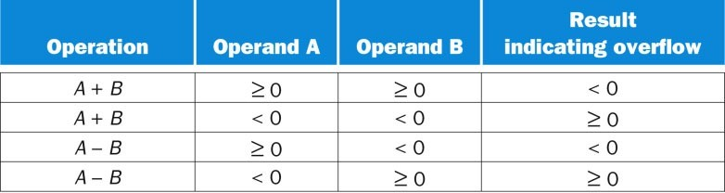
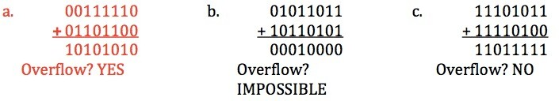
Rollover Causing Overflow

Slide 92
Rollovers Versus Overflows
Summary:
Rollovers, that do not result in an overflow are ok.
signed 1111 1111 + 1 = 0 (-1 + 1 = 0)
Overflows occur when you do some operation, and the result can not be represented with that many bits because the value is too large.
unsigned 1111 1111 + 1 = 0 (256 + 1 = 0)
Overflows must be handled

Slide 93

Example of Unsigned Overflow Using 4-bit
1100 (12)
+ 0111 ( 7)
1 0011
Range for 4 bits is 0 to 15
16 + 3 = 19
Lost
(Result limited by word size)
0011 ( 3) wrong!

Slide 94
Example of Signed Overflow Using 8-bit
Overflow is impossible when:
adding numbers that have different signs.
subtracting numbers that have same signs.
Overflow occurs when the magnitude of the result extends into the sign bit position:
0111 1111 (127) +
0000 0001 (1)
(0) 1000 0000 (-128)

Slide 95
Another Example of Signed Overflow Using 8-bit
-120₁₀ + ➔
-17₁₀
sum: -137₁₀
1000 1000₂ +
1110 1111₂
(1) 0111 0111₂
0111 0111₂ (keep 8 bits)
(+119₁₀) wrong result!

Slide 96
Done

