Slide 1
CSEN20
Fall 2026
Introduction to Embedded Systems
Michael Schimpf, PhD, mschimpf@scu.edu

Slide 2
Chapter 3 Writing Functions in Assembly
Part 1: Embedded Application Development

Slide 3
Assembler in General
Most of a program is written in a high-level language such as C
easier to implement
easier to understand
easier to maintain
Only a few functions are written in assembly
to improve performance, or
because it’s difficult or impossible to do in a high-level language.

Slide 4
Creating a Program
Library header files
Most of code, including function main
C sourcecode
Compiler
Object code
Linker
Executable Program
ASM sourcecode
Assembler
Object code
Library code
A few small functions

Slide 5
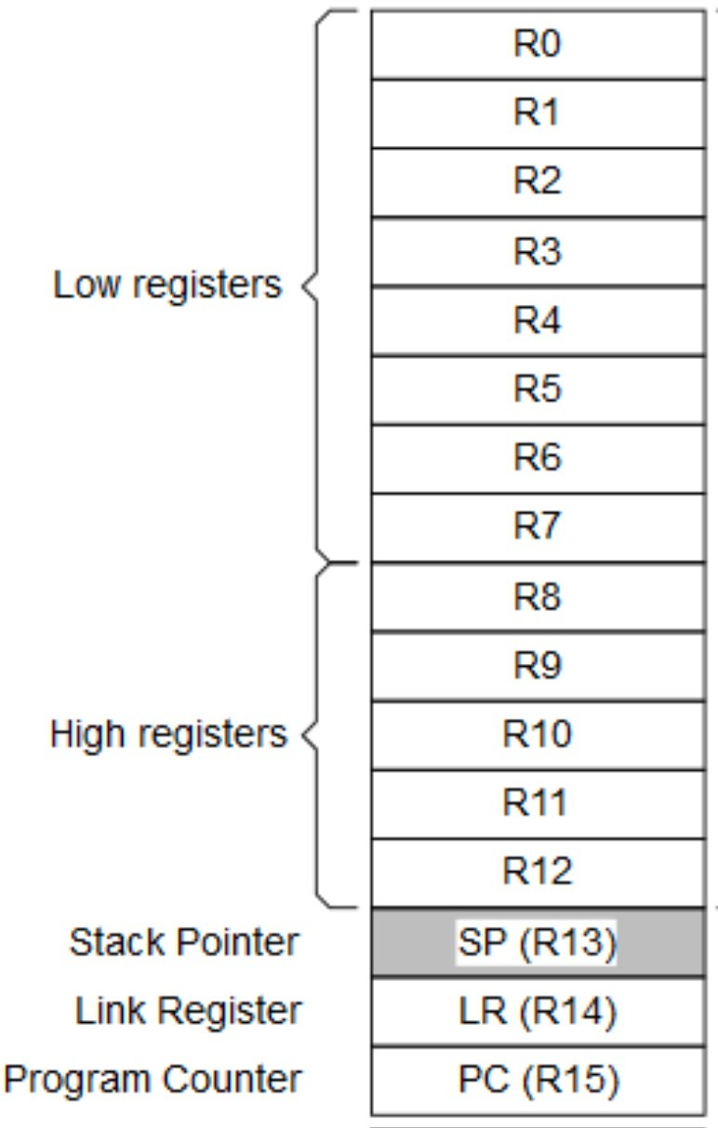
ARM Cortex M4 Core Registers
General-Purpose Register

Slide 6
Consequence
Assembly functions must be compatible with:
.c
How the C compiler invokes the execution of an assembly function (i.e. passes the execution control to the function)
How the C compiler passes parameters to assembly functions
How the C compiler expects to receive results from assembly functions
How the C compiler uses CPU registers
Knowing and agreeing on what register is used for what purpose.
.s

Slide 7
Consequence
Assembly functions must be compatible with the C compiler to:
Call a function (compiler/assembler BL funcName)
Pass parameters (R0,R1,R2,R3)
Use CPU registers (R0 to R12)
Receive return value (R0,R1)

Slide 8
Consequence
Assembly functions must be compatible with the C compiler to:
If you use R4 to R11, you need to preserve them!
Return with BX LR
If your function calls a function BL Label. You need to: PUSH {LR} and POP {LR}

Slide 9
Example Source Files
// Main Program written in
#include <stdio.h>
#include <stdint.h>
#include "library.h"
extern uint32_t Add1(uint32_t x);
int main(void){
uint32_t strt, stop, before, after;
InitializeHardware(HEADER, PROJECT_NAME);
before = 0;
while (1) { // Never exit
strt = GetClockCycleCount();
after = Add1(before);
stop = GetClockCycleCount();
printf("Before = %u\n", (unsigned) before);
printf(" After = %u\n", (unsigned) after);
printf("CPU Clock Cycles: %u\n", (unsigned) (stop - strt));
WaitForPushButton();
ClearDisplay();
before = after;
}
}
//Function written in Assembly
.syntax unified
.cpu cortex-m4
.text
.thumb_func
.align 2
// uint32_t Add1(uint32_t x);
.global Add1
Add1: ADD R0, R0,1 // Return x +1
BX LR
.end

Slide 10
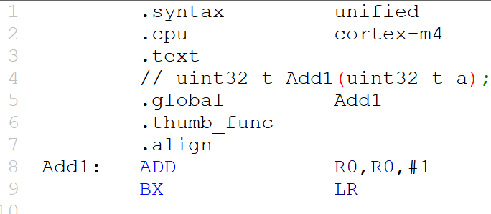
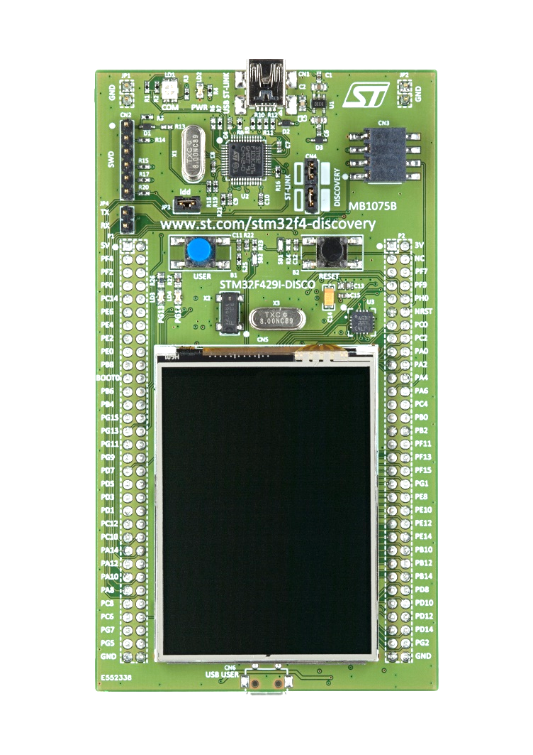
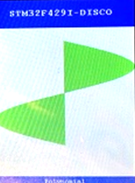
void InitializeHardware(char *, char *) ;
// Main Program written in
#include <stdio.h>
#include <stdint.h>
#include "library.h"
extern uint32_t Add1(uint32_t x);
int main(void){
uint32_t strt, stop, before, after;
InitializeHardware(HEADER, PROJECT_NAME);
before = 0;
while (1) { // Never exit
strt = GetClockCycleCount();
after = Add1(before);
stop = GetClockCycleCount();
printf("Before = %u\n", (unsigned) before);
printf(" After = %u\n", (unsigned) after);
printf("CPU Clock Cycles: %u\n", (unsigned) (stop - strt));
WaitForPushButton();
ClearDisplay();
before = after;
}
}
Must be executed first
Initializes:
Processor
CPU clock cycle counter
the display
user push button.
Creates stack and heap
Initializes static variables.
Formats display area

Slide 11
uint32_t GetClockCycleCount(void) ;
// Main Program written in
#include <stdio.h>
#include <stdint.h>
#include "library.h"
extern uint32_t Add1(uint32_t x);
int main(void){
uint32_t strt, stop, before, after;
InitializeHardware(HEADER, PROJECT_NAME);
before = 0;
while (1) { // Never exit
strt = GetClockCycleCount();
after = Add1(before);
stop = GetClockCycleCount();
printf("Before = %u\n", (unsigned) before);
printf(" After = %u\n", (unsigned) after);
printf("CPU Clock Cycles: %u\n", (unsigned) (stop - strt));
WaitForPushButton();
ClearDisplay();
before = after;
}
}
start = GetClockCycleCount();
// do some calculation here
stop = GetClockCycleCount();
printf("Cycles=%d\n", stop-start);
Returns the number of processor clock cycles since initialization.
Cycles=1788
STM32F429I-DISCO
GetClockCycles

Slide 12
void WaitForPushButton(void) ;
// Main Program written in
#include <stdio.h>
#include <stdint.h>
#include "library.h"
extern uint32_t Add1(uint32_t x);
int main(void){
uint32_t strt, stop, before, after;
InitializeHardware(HEADER, PROJECT_NAME);
before = 0;
while (1) { // Never exit
strt = GetClockCycleCount();
after = Add1(before);
stop = GetClockCycleCount();
printf("Before = %u\n", (unsigned) before);
printf(" After = %u\n", (unsigned) after);
printf("CPU Clock Cycles: %u\n", (unsigned) (stop - strt));
WaitForPushButton();
ClearDisplay();
before = after;
}
}
Causes program to pause and wait for user to push the blue push button on the board.

Slide 13
void ClearDisplay(void) ;
// Main Program written in
#include <stdio.h>
#include <stdint.h>
#include "library.h"
extern uint32_t Add1(uint32_t x);
int main(void){
uint32_t strt, stop, before, after;
InitializeHardware(HEADER, PROJECT_NAME);
before = 0;
while (1) { // Never exit
strt = GetClockCycleCount();
after = Add1(before);
stop = GetClockCycleCount();
printf("Before = %u\n", (unsigned) before);
printf(" After = %u\n", (unsigned) after);
printf("CPU Clock Cycles: %u\n", (unsigned) (stop - strt));
WaitForPushButton();
ClearDisplay();
before = after;
}
}
STM32F429I-DISCO
Sine Function
Erases the scrollable area of the display.

Slide 14
Chapter 3 Writing Functions in Assembly
Part 2: Function Call and Return

Slide 15
Instruction Fetch
CPU
Memory
Data
Instructions
(as well as any Data, the Stack, and the Heap)
Instruction Register
Address
+1
Program Counter (PC)

Slide 16
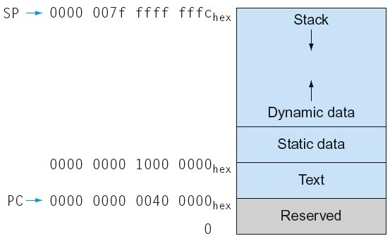
Memory Layout (Recall)
Stack: automatic storage (LIFO)
Dynamic data: heap
– i.e.: malloc in C, new in Java/C++
Static data: global variables
– e.g., static variables in C, constant arrays and strings
Text: program code

Slide 17
FUNCTION CALL AND RETURN Simple Call-Return in C
Suspend the current sequence
Record the return address
Transfer control to the function
Branch with Link Instruction (BL)
● ● ● f1(); ● ● ● | void f1(void){ ● ● ● return; }
Execute the function
Use the recorded return address to jump back.
Branch Indirect Instruction (BX)

Slide 18
FUNCTION CALL AND RETURN ARM instructions used to call and return from functions
Instruction | Format |  | Operation
Branch with Link | BL | label | Function Call: LR ← return address, PC ← address of label
Branch Indirect | BX | LR | Function Return: PC ← LR
LR (aka R14) and PC (aka R15) are two of the 16 registers inside the CPU.
LR is the “Link Register” – used w/function calls to hold the return address
PC is the “Program Counter” – holds the address of the next instruction.

Slide 19
FUNCTION CALL AND RETURN Simple Call-Return in Assembly
BL (Branch with Link) instruction saves the address in the Link Register (LR).
● ● ● BL f1 ● ● ● | f1: ● ● ● BX LR
Only one Link Register!
The “Branch Indirect” instruction (BX) copies the address from LR into PC.

Slide 20

FUNCTION CALL AND RETURN Nested Call-Return in Assembly
Saves LR on the stack.
Saves the return address in LR
● ● ● BL f1 ● ● ● | f1: ● ● ● BL f2 ● ● ● BX LR | f2: ● ● ● BX LR
Modifies the link register (LR), writing over f1’s return address!
PUSH {LR}
POP {LR}
Copies the return address from LR to PC
Restores LR from the stack.

Slide 21
FUNCTION CALL AND RETURN ARM instructions used in functions that call other functions
SP is one of the 16 CPU registers (R13)
holds the address of the top of the stack.
1000 | Pushed data
996 | Pushed data
992 | Top of stack
988
984
980
976
972
(register R13)
SP | 992
Instruction | Format |  | Operation
Push registers onto stack | PUSH | register list | SP = SP – 4 × #registers Copy registers to mem[SP]
Pop registers from stack | POP | register list | Copy mem[SP] to registers, SP = SP + 4 × #registers
Unused Stack
Space
(memory)
“register list” format: { reg, reg, reg-reg, …}
IMPORTANT! Registers in the list must be listed in numerical order.

Slide 22
Optimizing Function Calls
f1: PUSH {LR} // Stack←LR
●
●
●
BL f2
●
●
●
POP {LR} // LR←Stack
BX LR // PC=LR
f1: PUSH {LR} // Stack←LR
●
●
●
BL f2
●
●
●
POP {PC} // PC←Stack

Slide 23
Optimizing Function Calls
● ● ● BL f1 ● ● ● | f1: ● ● ● BL f2 BX LR | f2: ● ● ● BX LR
PUSH {LR}
POP {LR}
● ● ● BL f1 ● ● ● | f1: ● ● ● B f2 | f2: ● ● ● BX LR

Slide 24
Stack Alignment
Some library functions and functions compiled from a high-level language require that SP mod 8 = 0 when they are called – i.e., that the stack be double word (8-byte) aligned.
MyFunc: PUSH {LR}
...
BL printf
...
POP {PC}
Problem: The compiler ensures that the stack pointer is always a multiple of 8 when it calls a function.
This will not true if your function calls another function after pushing an odd number of registers.

Slide 25
Stack Alignment
Some library functions and functions compiled from a high-level language require that SP mod 8 = 0 when they are called – i.e., that the stack be double word (8-byte) aligned.
MyFunc: PUSH {R3,LR}
...
BL printf
...
POP {R3,PC}
Solution: When writing a function that calls a library function or a function that was compiled from a high-level language, always push and pop an even number of registers.
Register R3 is used since there is no other reason to push it.

Slide 26
Chapter 3 Writing Functions in Assembly
Part 3: Passing Parameters and Saving the Return Value

Slide 27
ARM PROCEDURE CALL STANDARD Registers used as input parameters
Register | AAPCS Name | Usage
R0 | A1 | 1st parameter
R1 | A2 | 2nd parameter
R2 | A3 | 3rd parameter
R3 | A4 | 4th parameter
APCS ARM Procedure Call Standard,
AAPCS of Procedure Call Standard for the ARM Architecture
One register is used for each 8, 16 or 32-bit parameter.
A sequential register pair is used for each 64-bit parameter.

Slide 28
PARAMETER PASSING void foo(int8_t, int32_t, int64_t) ;
C Function Call | Compiler Output
int8_t x8;
int32_t y32;
int64_t z64;
●
●
foo(x8, y32, z64);
●
●
foo(5, -10, 20);
●
●
LDR R0,=x8 // R0 <-- &x8
LDRSB R0,[R0] // R0 <-- x8
LDR R1,=y32 // R1 <-- &y32
LDR R1,[R1] // R1 <-- y32
LDR R2,=z64 // R2 <-- &z64
LDRD R2,R3,[R2] // R3.R2 <-- z64
BL foo
●
●
●
LDR R0,=5 // R0 <-- 5
LDR R1,=-10 // R1 <-- -10
LDR R2,=20 // R3.R2 <-- 20
LDR R3,=0
BL foo
Inside foo, you must use the register copies of the actual arguments.

Slide 29
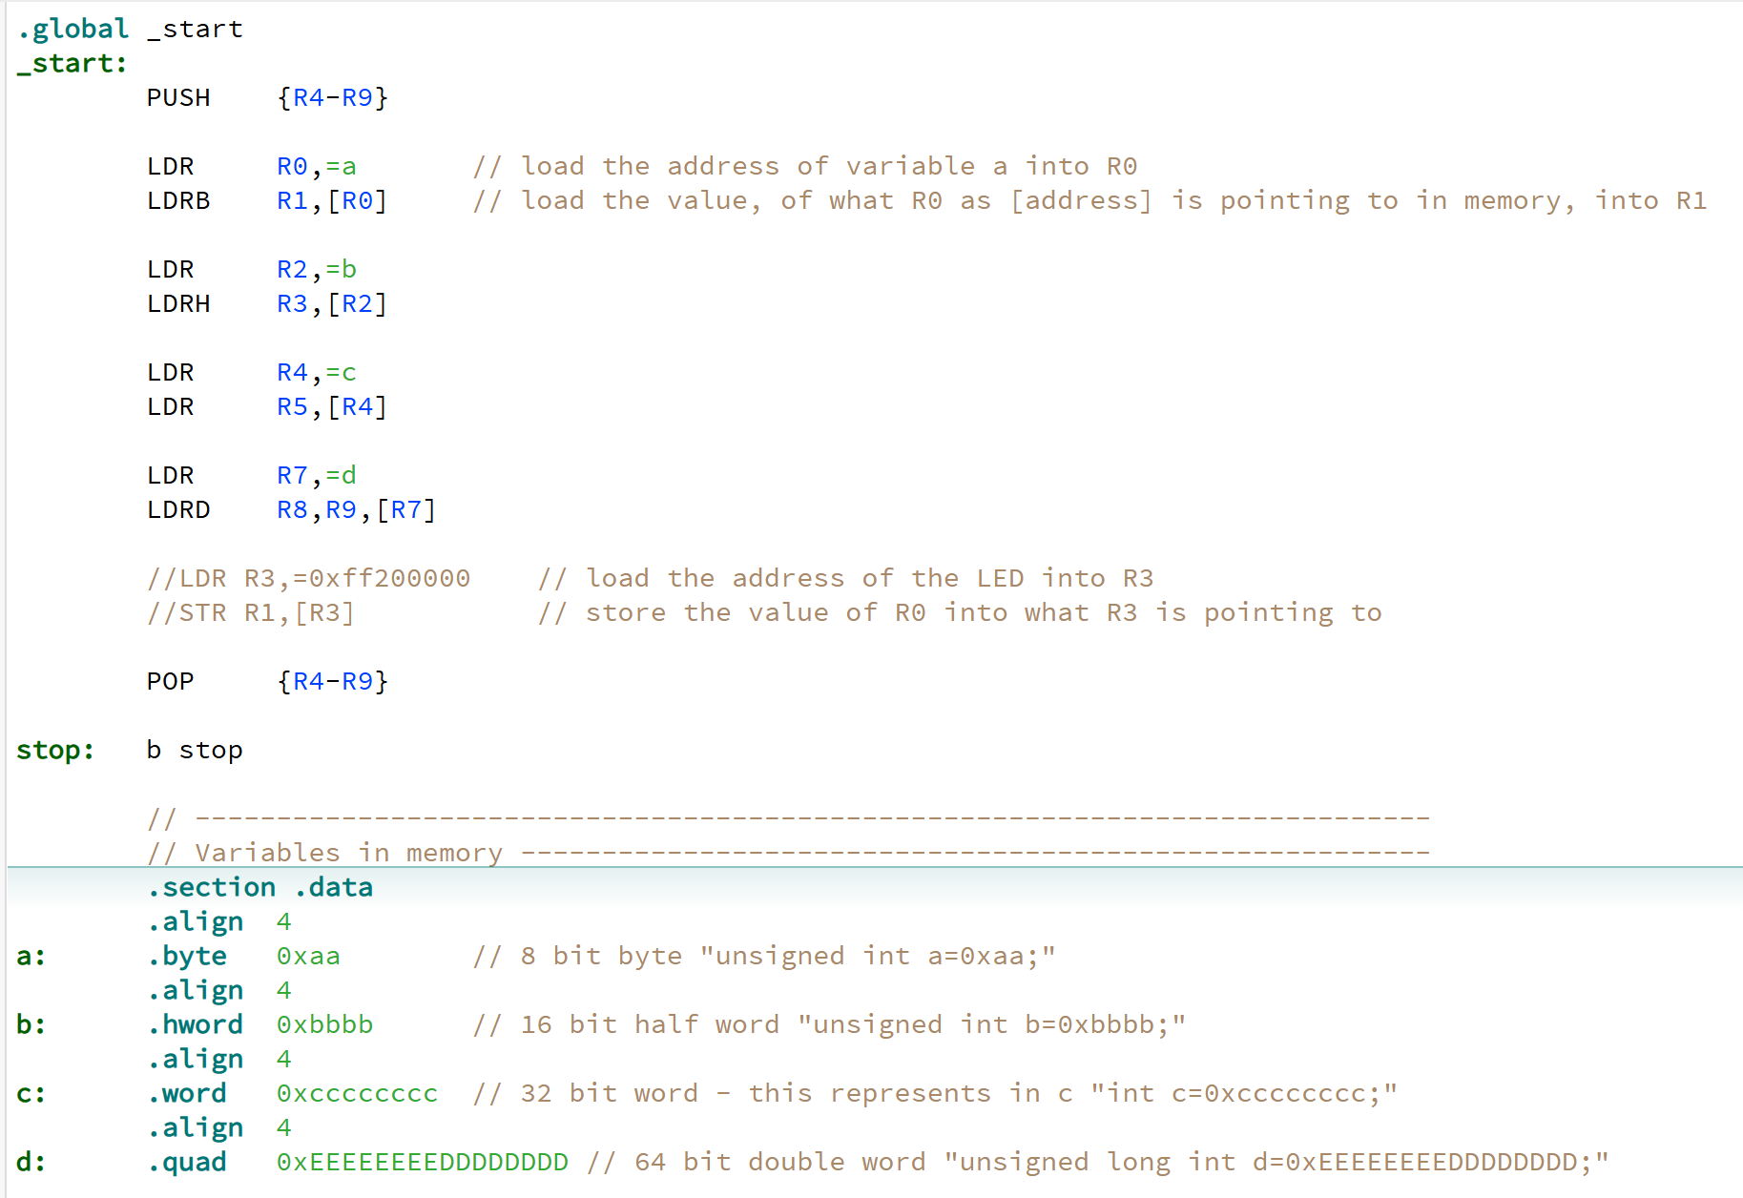
HOW COMPILER HANDLES RETURN VALUES Promoting a return value from 8 to 16, 32 or 64 bits
In C: int a=0xaa;
int b=0xbbbb;
int c=0xcccccccc;
Long int d=0xEEEEE...DDDD…;
If you do variables in Assembler

Slide 30
Why 2 Instructions to load a variable?
Instructions are at most 32 bits wide.
Some bits are used to specify the operation code
Some bits are used to specify register operands
All addresses are 32 bits wide.
Instructions itself have no room for a 32-bit address
31 |  |  | 0
LDR reg,x
LDR Opcode
Register #
NOT ENOUGH BITS LEFT OVER!
32 bits wide
31 | 0
Address of x

Slide 31
Why 2 Instructions to load a variable?
Solution: Use an address “displacement”
Displacement: Address distance from instruction to operand
Assumes operand is at an address near the instruction
Displacements = smaller numbers → fewer bits
Address 1000000 |  | LDR | R0,x
 |  | ●
 |  | ●
 |  | ●
Address 1000500 | x: | .word | 1000
Displacement = 500

Slide 32
Why 2 Instructions to load a variable?
Instructions are stored in read-only memory
Variables are stored in read/write memory
Instructions and variables are too far apart for a small displacement.
The magnitude of the displacement would require too many bits, to fit inside an instruction.
Address Range:
20000000-2002FFFF
Read/Write Memory
(Variables, Stack, and Heap)
400,556,032₁₀ bytes
(requires 29 bits!)
Address Range:
0800000-081FFFFF
Read-Only Memory
(Instructions & Constants)

Slide 33
Why 2 Instructions to load a variable?
“x” is a variable whose content is 1000
x: .word 1000
Unused Addresses
Solution:
Copy the operand address (which is a read-only constant) into a register
then …
Use that register to provide the address in a second instruction
Read/Write Memory
LDR R0,temp
LDR R1,[R0]
●
●
temp: .word x
LDR R0,=x
LDR R1,[R0]
Read-Only Memory
In assembly, the value represented by the identifier “x” comes from the symbol table, and is the address where the variable x is located.

Slide 34
ARM PROCEDURE CALL STANDARD Registers used to return function result
Register | AAPCS Name | Usage
R0 | A1 | 8, 16 or 32-bit result, or the least-significant half of a 64-bit result
R1 | A2 | The most-significant half of a 64-bit result

Slide 35
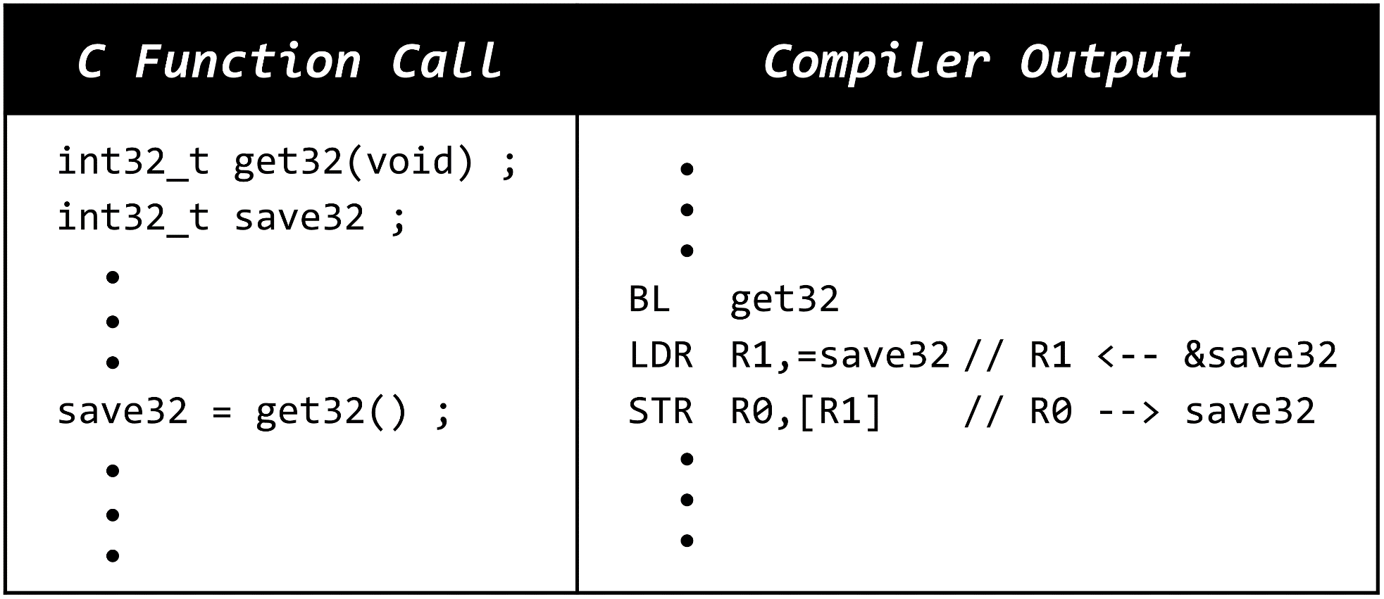
SAVING THE RETURN VALUE Functions that return an 8, 16 or 32-bit result
Functions must provide a full 32-bit representation of return value, even for 8 and 16-bit results.
UPDATE THIS SLIDE!! UPDATE THIS SLIDE!! UPDATE THIS SLIDE!!

Slide 36
PREPARING THE RETURN VALUE Functions that return an 8 or 16-bit result
uint32_t Add1(uint32_t x){
return x + 1;
}
Add1(254) = 255
Add1(255) = 256
Add1(256) = 257
uint8_t Add1(uint8_t x){
return x + 1;
}
Add1(254) = 255
Add1(255) = 0 Why?
Add1(256) = 1 Why?
$0 ≤ uint8_t ≤2^{8}$-1 = 255

Slide 37
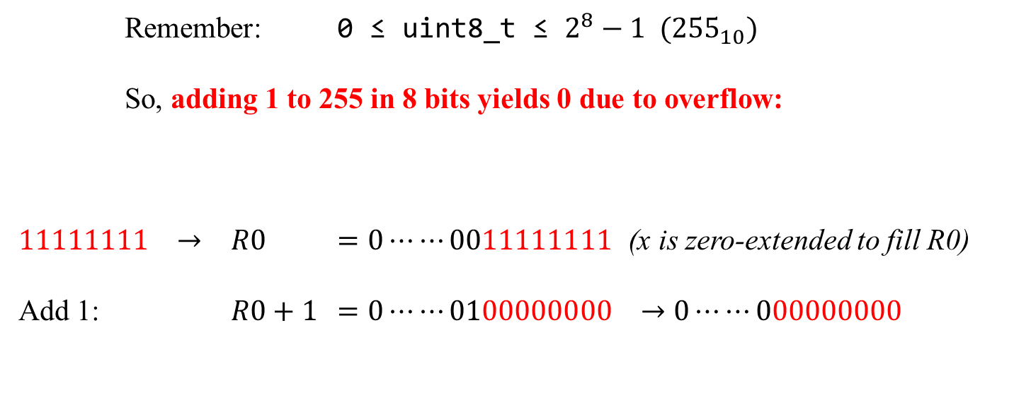
PREPARING THE RETURN VALUE Functions that return an 8 or 16-bit result
uint8_t Add1(uint8_t x){
return x + 1;
}
Add1: ADD R0,R0,1
UXTB R0,R0
BX LR
Remember: 0 ≤ uint8_t ≤ $2^{8}−1 {(255}_{10})$
So, adding 1 to 255 in 8 bits yields 0 due to overflow:
$11111111 →$ $R0$ $=0⋯⋯0011111111$ (x is zero-extended to fill R0)
Add 1: $R0+1$ $=0⋯⋯0100000000 →0⋯⋯000000000$
11111111 +00000001
00000000
Input parameter
Return value must be zero-extended from 8-bit result

Slide 38
Chapter 3 Writing Functions in Assembly
Part 4: Preparing and Using the Return Value

Slide 39
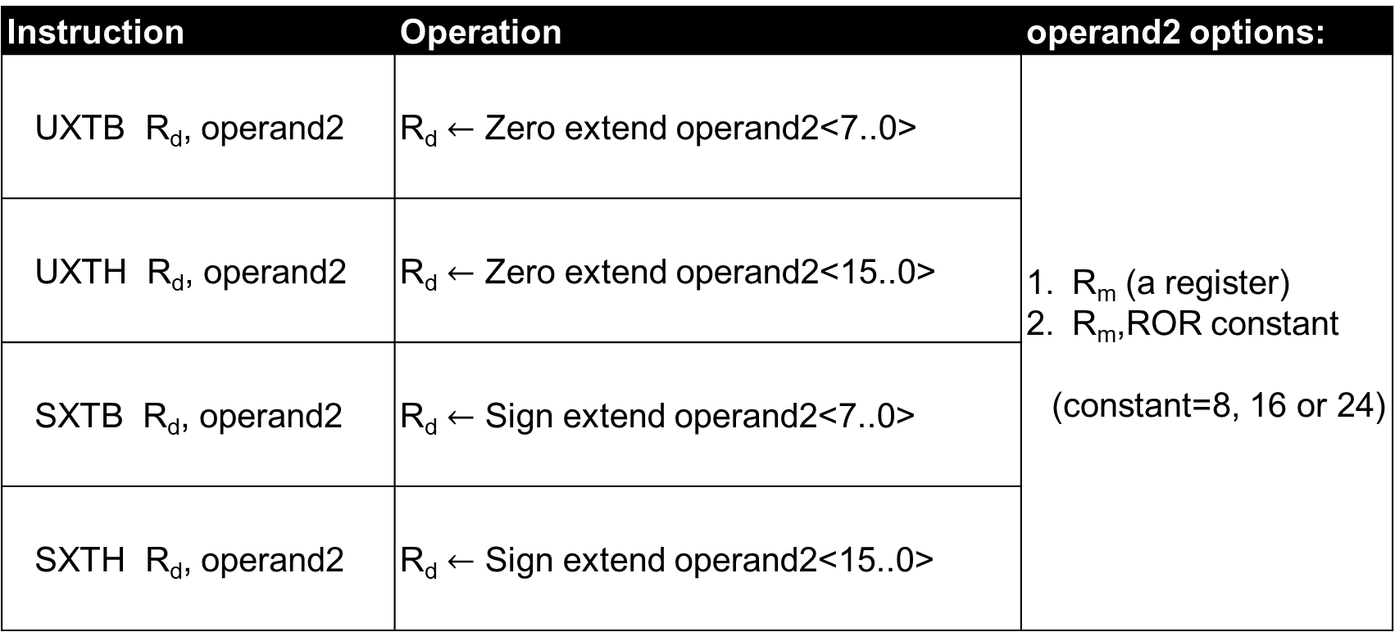
PREPARING THE RETURN VALUE Functions that return an 8 or 16-bit result
Instruction | Operation | operand2 options:
UXTB R_{d}, operand2 | R_{d} $←$ Zero extend operand2<7..0> | R_{m} (a register) R_{m},ROR constant (constant=8, 16 or 24)
UXTH R_{d}, operand2 | R_{d} $←$ Zero extend operand2<15..0>
SXTB R_{d}, operand2 | R_{d} $←$ Sign extend operand2<7..0>
SXTH R_{d}, operand2 | R_{d} $←$ Sign extend operand2<15..0>

Slide 40
Summary
Call functions using Branch with Link (BL)
Saves the return address in Link Register (LR)
Copies the target address into Program Counter (PC)
Return from a function using BX LR
Copies the return address from LR back into PC

Slide 41
Summary
Writing functions that call other functions:
Using BL to call another function changes LR
Use PUSH {LR} / POP {LR} to preserve LR
Pass parameters using registers R0-R3
64-bit parameters in consecutive register pairs
Return 8, 16 and 32 bit results using R0
64-bit result returned in R1.R0 register pair

Slide 42
Chapter 3 Writing Functions in Assembly
Part 5: Coding Conventions

Slide 43
REGISTER USAGE CONVENTIONS ARM PROCEDURE CALL STANDARD
Register | AAPCS Name | Usage | Notes
R0 | A1 | Argument / result /scratch register 1 | Do not have to preserve original contents
R1 | A2 | Argument / result /scratch register 2
R2 | A3 | Argument / scratch register 3
R3 | A4 | Argument / scratch register 4
R4 | V1 | Variable register 1 | Must preserve original contents
R5 | V2 | Variable register 2
R6 | V3 | Variable register 3
R7 | V4 | Variable register 4
R8 | V5 | Variable register 5
R9 | V6 | Variable register 6
R10 | V7 | Variable register 7
R11 | V8 | Variable register 8
R12 | IP | Intra-Procedure-call scratch register | Do not have to preserve
R13 | SP | Stack Pointer | Reserved, DO NOT USE
R14 | LR | Link Register
R15 | PC | Program Counter

Slide 44
FUNCTION CODING CONVENTIONS Functions that modify only registers R0 - R3, R12
Using only R0-R3, R12 and no function call |  | Using only R0-R3, R12 and calling another function
f1: ● ● ● OK to modify ● R0-R3 and R12 ● BX LR |  | f2: PUSH {R3,LR} // See footnote ● ● OK to modify R0–R3, R12 ● BL f3 ● ● OK to modify R0–R3, R12 ● POP {R3,PC}
Function f3 might modify R0 – R3, R12
Adding R3 to push list preserves stack alignment.

Slide 45
FUNCTION CODING CONVENTIONS Functions that modify for example registers R4 and R5
Using R4 and R5 and no function call |  | Using R4 and R5 and calling another function
f1: PUSH {R4,R5} ● ● OK to modify ● R0-R5 and R12 ● POP {R4,R5} BX LR |  | f2: PUSH {R3,R4,R5,LR} ● ● OK to modify ● R0–R5 and R12 ● BL f3 ● ● OK to modify ● R0–R5 and R12 ● POP {R3,R4,R5,PC}
Function f3 might modify R0-R3 and R12, but preserves R4-R11
Adding R3 to push list preserves stack alignment.

Slide 46
FUNCTION CODING CONVENTIONS Two functions with parameters, one calling the other
C Version | Assembly Version
int32_t f1(int32_t x){ return f2(4) + x; } | f1: PUSH {R4,LR} // Preserve R4 MOV R4,R0 // Keep x safe in R4 LDR R0,=4 // R0 <-- f2’s arg BL f2 // R0 <-- f2(4) ADD R0,R0,R4 // R0 <-- f2(4) + x POP {R4,PC} // Restore R4
Preserve X to R4. Of course need to PUSH POP R4
X is in R0, but R0 will be overwritten by f2!!!
ADD R4 and R4. And restore the original R4

Slide 47
Done

