Slide 1
CSEN20
Fall 2026
Introduction to Embedded Systems
Michael Schimpf, PhD, mschimpf@scu.edu

Slide 2
Writing Functions (Summary)
General Rules for Writing Assembler Functions:
You can use any CPU registers from R0 to R12
But If you use register R4-R11 you need to preserve them Example your function uses registers R4 and R5 then you need to PUSH {R4,R5} … POP {R4,R5}
Call a function: BL funcName
Passing parameters in: R0,R1,R2,R3
Return from a function: BX LR
If you call a function inside your function:
Preserve LR on the stack: PUSH {LR} … POP {LR}
Assume registers R0-R3 will be overwritten, no matter what
For example, If you have something important in R3 and you need it later, and you call another function; you need to move it to a save register i.e. R4
Return values are in R0 (32 bit) R0 and R1 (64 bit)

Slide 3
Chapter 4 Copying Data
Part 1: Loading Registers

Slide 4
LOAD/STORE ARCHITECTURE
Arithmetic & Logic Unit (ALU)
Registers
operands & results are in registers.
All computations (+, -, /, *, etc.) are done in the ALU.
“Store”: Copy the contents of a register back into a variable in memory.
“Load”: Copy the contents of a variable from memory into a register.
Main Memory
Variables reside in main memory.

Slide 5
INSTRUCTIONS FOR COPYING DATA
constant
“Immediate” Constant to Register:
MOV, MVN, MOVW, MOVT
Register to Register: MOV
Registers
“Store Register” Instructions:
STR, STRD, STRB, STRH
“Load Register” Instructions:
LDR, LDRD, LDRB, LDRH, LDRSB, LDRSH
Main Memory

Slide 6
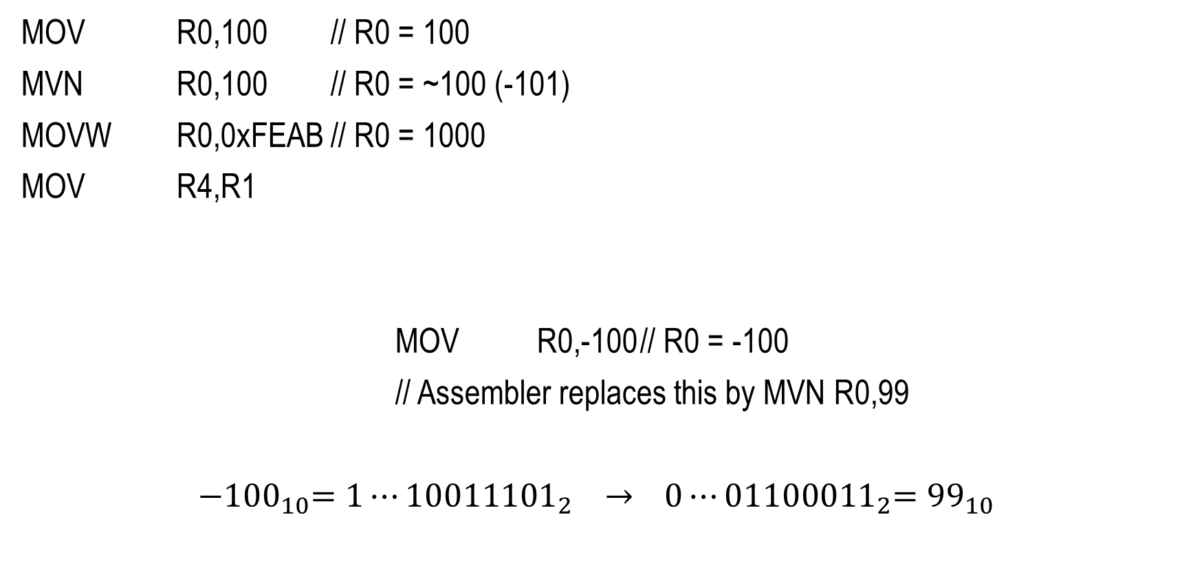
REGISTER ← IMMEDIATE CONSTANT
MOV R0,100 // R0 = 100
MVN R0,100 // R0 = ~100 (-101)
MOVW R0,0xFEAB // R0 = 1000
MOV R4,R1
MOV R0,-100 // R0 = -100
// Assembler replaces this by MVN R0,99
${−100}_{10}={1⋯10011101}_{2} →$ ${ 0⋯01100011}_{2}={99}_{10}$
16-bit instruction: 8-bit constant 0-255
16-bit instruction: 8-bit constant 0-255
32-bit instruction: 16-bit constant 0-65535
invert

Slide 7
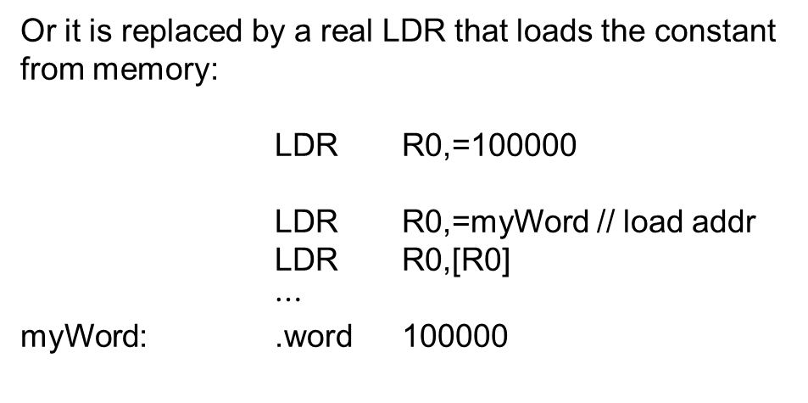
The LDR Pseudo-Instruction
A “pseudo-instruction” is not a real ARM instruction. The assembler replaces it with an equivalent operations.
Format: LDR Rd,=constant
The equals sign distinguishes this pseudo-instruction from a real LDR instruction.
Or it is replaced by a real LDR that loads the constant from memory:
LDR R0,=100000
LDR R0,=myWord // load addr
LDR R0,[R0]
$⋯$
myWord: .word 100000
The pseudo-instruction is replaced by :
Instruction Format and Width |  |  | Range
MOV | Rd,imm8 | 16 | 0-255
MOVW | Rd,imm16 | 32 | 0-65535
MVN | Rd,imm8 | 16 | 0-255

Slide 8
WRITING INTEGER CONSTANTS
Decimal: 123
Binary: 0b10110111
Octal: 0123
Hexadecimal: 0xFACE
ASCII Character ‘a‘
Constant-Valued Expressions 5*6-3

Slide 9
INSTRUCTIONS FOR COPYING DATA
constant
“Immediate” Constant to Register:
MOV, MVN, MOVW, MOVT
Register to Register: MOV
Registers
“Store Register” Instructions:
STR, STRD, STRB, STRH
“Load Register” Instructions:
LDR, LDRD, LDRB, LDRH, LDRSB, LDRSH
Main Memory

Slide 10
REGISTER ← MEMORY (32-BITS) Load Register from Word
LDR R0,[R1] // Copies a 32-bit word // from the memory location // whose address is in R1 // into register R0.
32-bit word
register R0
Used with data of type int32_t, uint32_t, and all pointers

Slide 11

REGISTER PAIR ← MEMORY (64-BITS) Load Register Pair from DoubleWord
LDRD R0,R1,[R2] // Copies the lower // half of the value // held in the 64-bit // memory location whose // address is in R2 // into register R0, // and the upper half // into R1.
Bits 32-63
Bits 0-31
register R1
register R0
Used with data of type int64_t and uint64_t
The 64-bit operand must be word aligned (located at a mod 4 adrs) or an address fault will occur.

Slide 12
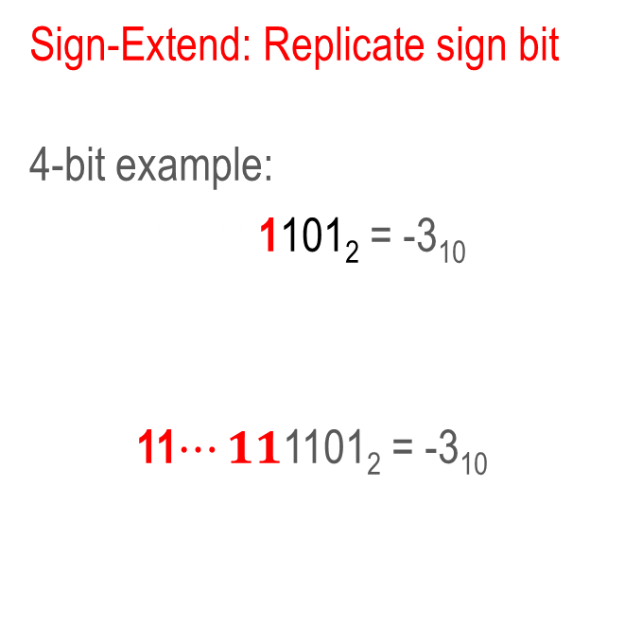
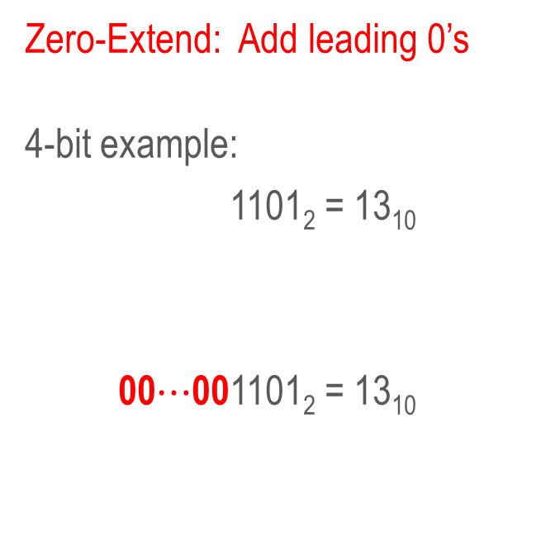
Copying variables < 32 bits wide (32-bit register copy must have same value)
Unsigned
Signed (2’s complement)
Zero-Extend: Add leading 0’s
4-bit example:
00$⋯$001101₂ = 13₁₀
00$⋯$001101₂ = 13₁₀
Sign-Extend: Replicate sign bit
4-bit example:
11$⋯$111101₂ = -3₁₀
11$⋯11$1101₂ = -3₁₀
Instructions that zero-extend:
UXTB, UXTH, LDRB, LDRH
Instructions that sign-extend:
SXTB, SXTH, LDRSB, LDRSH

Slide 13
REGISTER ← MEMORY (8-BITS UNSIGNED) Load Register from (Unsigned) Byte
LDRB R0,[R1] // Copies the unsigned // value held in the // 8-bit memory location // whose address is in R1 // into bits 0-7 of register // R0 and 0’s into bits 8-31.
24 zeroes
uint8_t
register R0
Used with data of type uint8_t

Slide 14
REGISTER ← MEMORY (16-BITS UNSIGNED) Load Register from (Unsigned) HalfWord
LDRH R0,[R1] // Copies the unsigned // value held in the // 16-bit memory location // whose address is in R1 // into bits 0-15 of register // R0 and 0’s into bits 16-31.
16 zeroes
uint16_t
register R0
Used with data of type uint16_t

Slide 15
REGISTER ← MEMORY (8-BITS SIGNED) Load Register from Signed Byte
LDRSB R0,[R1] // Copies the signed // value held in the // 8-bit memory location // whose address is in R1 // into bits 0-7 of // register R0 and 24 // copies of bit 7 of // sbyte8 into bits 8-31.
24 copies of bit 7
int8_t
register R0
Used with data of type int8_t

Slide 16
REGISTER ← MEMORY (16-BITS SIGNED) Load Register from Signed HalfWord
LDRSH R0,[R1] // Copies the signed // value held in the // 16-bit memory location // whose address is in R1 // into bits 0-15 of R0 and // 16 copies of bit 15 of // shalf16 into bits 16-31.
16 copies of bit 15
int16_t
register R0
Used with data of type int16_t

Slide 17
INSTRUCTIONS FOR COPYING DATA
constant
“Immediate” Constant to Register:
MOV, MVN, MOVW, MOVT
Register to Register: MOV
Registers
“Store Register” Instructions:
STR, STRD, STRB, STRH
“Load Register” Instructions:
LDR, LDRD, LDRB, LDRH, LDRSB, LDRSH
Main Memory

Slide 18
REGISTER ← REGISTER Move Instruction
MOV R0,R1
// Copies all 32 bits
// of the value held
// in register R1 into
// the register R0
register R1
register R0

Slide 19
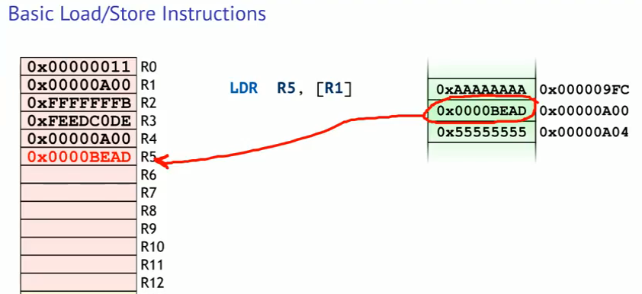
Instruction Sets
“Load/Store” Architecture
ARM processor must first load data into one of the general-purpose registers before processing it
Notes:
RISC = Reduced Instruction Set Computing
You can not directly read a content of a memory location or write directly to it.
Load the content memory location whose address is stored in R1 into R5.

Slide 20
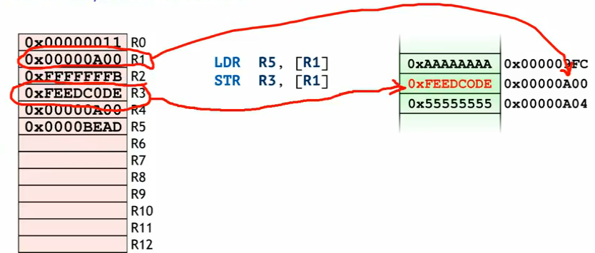
Instruction Sets
“Load/Store” Architecture
ARM processor must first load data into one of the general-purpose registers before processing it
Notes:
RISC = Reduced Instruction Set Computing
Store the content of R3 into a memory location whose address is in R1.

Slide 21
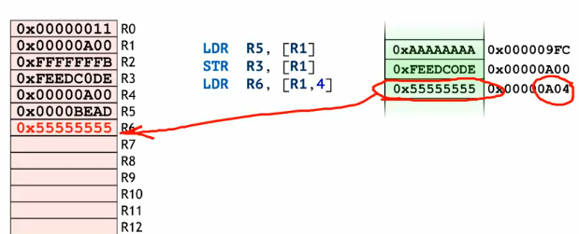
Instruction Sets
“Load/Store” Architecture
ARM processor must first load data into one of the general-purpose registers before processing it
Notes:
RISC = Reduced Instruction Set Computing
Load the content of memory location whose address is stored in (R1 plus 4 bytes) into R6.

Slide 22
Chapter 4 Copying Data
Part 2: Storing Registers

Slide 23
INSTRUCTIONS FOR COPYING DATA
constant
“Immediate” Constant to Register:
MOV, MVN, MOVW, MOVT
Register to Register: MOV
Registers
“Store Register” Instructions:
STR, STRD, STRB, STRH
“Load Register” Instructions:
LDR, LDRD, LDRB, LDRH, LDRSB, LDRSH
Main Memory

Slide 24
REGISTER → MEMORY (32-BITS) Store Register to Word
STR R0,[R1]
// Copies all 32 bits
// of the value held
// in register R0 into
// the 32-bit memory
// location whose address
// is in register R1
register R0
32-bit word
Used with data of type int32_t, uint32_t, and all pointers

Slide 25
REGISTER PAIR→ MEMORY (64-BITS) Store Register Pair to DoubleWord
STRD R0,R1,[R2]
// Copies the contents
// of register R0 into
// the lower half, and
// register R1 into the
// upper half, of the
// 64-bit memory location
// whose address is in
// register R2.
register R1
register R0
Bits 32-63
Bits 0-31
Used with data of type int64_t and uint64_t
The 64-bit operand must be word aligned (located at a mod 4 adrs) or an address fault will occur.

Slide 26
REGISTER → MEMORY (8-BITS) Store Register to Byte
STRB R0,[R1]
// Copies bits 0-7 of
// the value held in
// register R0 into
// the 8-bit memory
// location whose address
// is in register R1
register R0
Register bits 8-31 are not copied.
byte
Used with data of type int8_t and uint8_t

Slide 27
REGISTER → MEMORY (16-BITS) Store Register to HalfWord
STRH R0,[R1]
// Copies bits 0-15
// of the value held
// in register R0
// into the 16-bit
// memory location
// whose address is
// in register R1.
register R0
Register bits 16-31 are not copied.
Half word
Used with data of type int16_t and uint16_t

Slide 28
Y = X; (32 bits) Common Coding Mistake
Register R0
Register R1
x (in memory)
y (in memory)
// Assume R2=&x, R3=&y
?
?
1000
2000
Register R0
Register R1
LDR R0,[R2]
1000
?
1000
2000
Register R0
Register R1
LDR R1,[R3]
1000
2000
1000
2000
Register R0
Register R1
Not changed here!
MOV R1,R0
1000
1000
1000
2000
The second LDR instruction doesn’t move Y into R1, it merely makes a copy of its value. Thus, the MOV doesn’t change Y, it only changes the copy in R1.

Slide 29
Y = X; (32 bits) Correct Coding Solution
// Assume R2=&x, R3=&y
Register R0
x (in memory)
y (in memory)
0815
1000
2000
LDR R0,[R2]
1000
1000
2000
STR R0,[R3]
1000
1000
1000
Overwritten properly ☺

Slide 30
DATA COPYING INSTRUCTIONS
Pointers are always 32 bits wide. Copy with LDR and STR.
int32_t, uint32_t, pointer
uint8_t
uint16_t
LDR/STR
LDRB/STRB
LDRH/STRH
32-bit register(s)
LDRSB/STRB
LDRSH/STRH
int8_t
LDRD/STRD
int16_t
int64_t, uint64_t

Slide 31
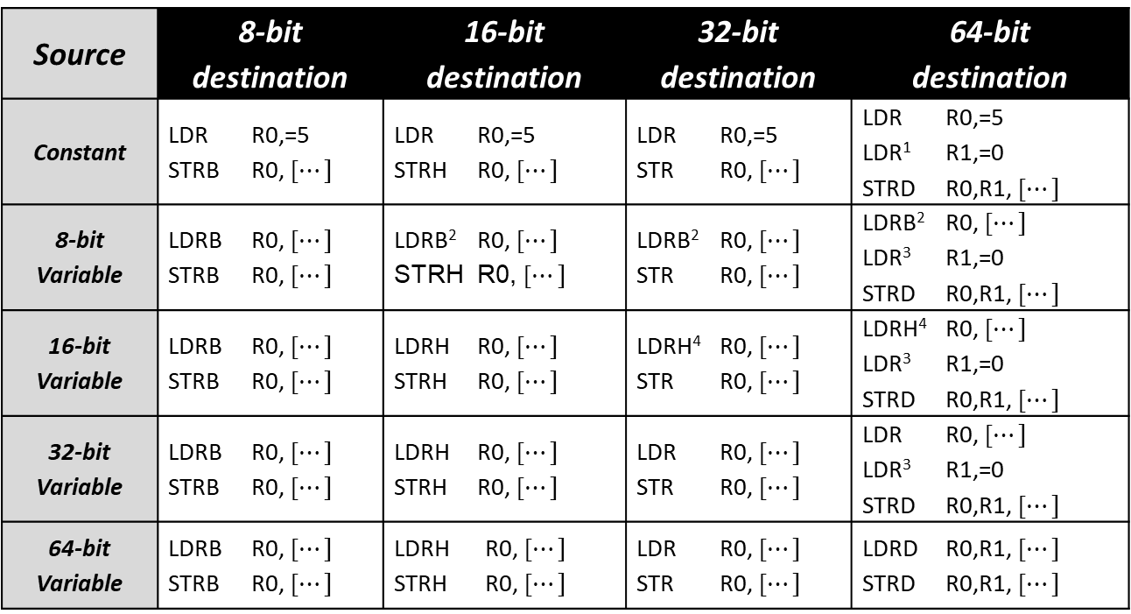
EXAMPLES OF COPYING DATA
Source | 8-bit destination | 16-bit destination | 32-bit destination | 64-bit destination
Constant | LDR R0,=5 STRB R0, [$⋯]$ | LDR R0,=5 STRH R0, [$⋯]$ | LDR R0,=5 STR R0, [$⋯]$ | LDR R0,=5 LDR¹ R1,=0 STRD R0,R1, [$⋯]$
8-bit Variable | LDRB R0, [$⋯]$ STRB R0, [$⋯]$ | LDRB² R0, [$⋯]$ STRH R0, [$⋯]$ | LDRB² R0, [$⋯]$ STR R0, [$⋯]$ | LDRB² R0, [$⋯]$ LDR³ R1,=0 STRD R0,R1, [$⋯]$
16-bit Variable | LDRB R0, [$⋯]$ STRB R0, [$⋯]$ | LDRH R0, [$⋯]$ STRH R0, [$⋯]$ | LDRH⁴ R0, [$⋯]$ STR R0, [$⋯]$ | LDRH⁴ R0, [$⋯]$ LDR³ R1,=0 STRD R0,R1, [$⋯]$
32-bit Variable | LDRB R0, [$⋯]$ STRB R0, [$⋯]$ | LDRH R0, [$⋯]$ STRH R0, [$⋯]$ | LDR R0, [$⋯]$ STR R0, [$⋯]$ | LDR R0, [$⋯]$ LDR³ R1,=0 STRD R0,R1, [$⋯]$
64-bit Variable | LDRB R0, [$⋯]$ STRB R0, [$⋯]$ | LDRH R0, [$⋯]$ STRH R0, [$⋯]$ | LDR R0, [$⋯]$ STR R0, [$⋯]$ | LDRD R0,R1, [$⋯]$ STRD R0,R1, [$⋯]$
¹ Replace with LDR R1,=-1 if source operand is a negative constant.
² Replace with LDRSB if source operand is signed.
³ Replace with ASR R1,R0,31 if source operand is signed.
⁴ Replace with LDRSH if source operand is signed.

Slide 32
Chapter 4 Copying Data
Part 3: Addressing

Slide 33
Contents versus Address
Works always ☺
LDR R3,=x // Copies the address of a variable ‘x’ into a register LDR R0,[R3] // Copies what R0 is pointing to R0
LDR R0,x // Copies the contents of constant ‘x’ from memory into a
// register, but x must be within $±4095$ bytes of the instruction
Seldom works ☹
Function call in C | Code produced by the compiler
void f1(int8_t *); int8_t s8; ● ● ● f1(&s8); ● ● ● | ● ● ● LDR R0,=s8 // load R0 with &s8 BL f1 // call function f1 ● ● ●

Slide 34
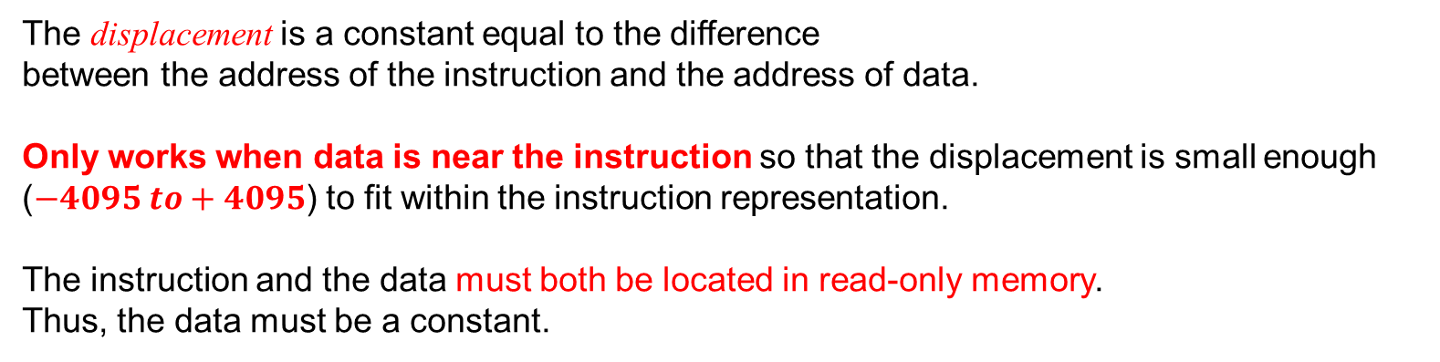
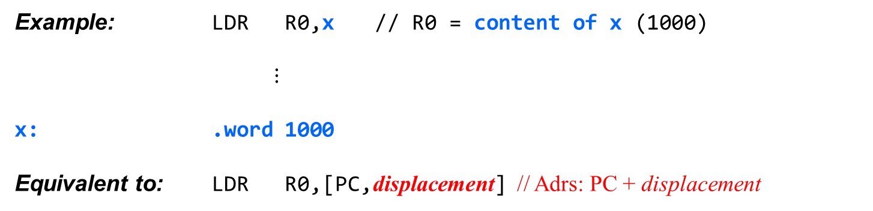
PC-Relative Addressing (A Special Case of Immediate Offset)
Example: LDR R0,x // R0 = content of x (1000)
$⋮$
x: .word 1000
Equivalent to: LDR R0,[PC,displacement] // Adrs: PC + displacement
The displacement is a constant equal to the difference between the address of the instruction and the address of data.
Only works when data is near the instruction so that the displacement is small enough ($−4095 to+4095$) to fit within the instruction representation.
The instruction and the data must both be located in read-only memory. Thus, the data must be a constant.

Slide 35
ADDRESSING MODES (Calculating a Memory Address)
Immediate Offset Mode:
[R0] // Adrs: R0
[R0,4] // Adrs: R0+4
Register Offset Mode:
[R0,R1] // Adrs: R0+R1
[R0,R1,LSL 2] // Adrs: R0+4xR1
Pre-Indexed Mode (++var):
[R0,4]!
Post-Indexed Mode (var++):
[R0],4
1. R0 = R0 + 4
2. Adrs: R0
1. Adrs: R0
2. R0 = R0 + 4
Use these in ”loops” to reduce the number of instructions.

Slide 36
IMMEDIATE OFFSET MODE
Syntax | Address | Examples
[R_{n}{,constant}] | R_{n} + constant | [R5,100] [R5]
Instruction Register
constant
R_{n}
+
Immediate Offset Address

Slide 37
Review: Pointer Arithmetic
a16[4] |  | a16[3] |  | a16[2] |  | a16[1] |  | a16[0]
1009 | 1008 | 1007 | 1006 | 1005 | 1004 | 1003 | 1002 | 1001 | 1000
int16_t a16[5] ;
Note: Each element of the array is an object of 2 bytes.
p16
1002
2003 | 2002 | 2001 | 2000
p16
2003 | 2002 | 2001 | 2000
p16
1000
2003 | 2002 | 2001 | 2000
A pointer holds an address.
Address always 32-bits.
int16_t *p16;
p16 = &a16[0];
p16 = (p16 + 1);
32 bits
int16_t indicates the size and signees of the objects.
Plus 1 to a pointer, points to the next object.
Since each object is 2 bytes, the address must increase by 2.

Slide 38
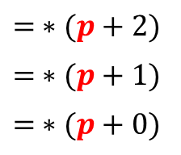
Pointer Dereferencing
int32_t numbers[3]; // integer 32-bit array, 3 elements
int32_t *p = numbers; // pointer to a he 32-bit integer array
address to
the numbers integer array
pointer address
address
values
for (int i = 0; i < 3; i++) {
*(p + i) = 0;
}
*(p + 0) = 720;
*(p + 1) = -3185;
*(p + 2) = 1340;
p (2000) | 1000
1008 | 1340
1004 | -3185
1000 | 720
$$= ∗(p+2)$$
$$= ∗(p+1)$$
$$= ∗(p+0)$$
LDR R0,=p // R0 = &p (R0 = 2000)
LDR R1,[R0] // R1 = p (R1 = 1000)
LDR R2,[R1,#0] // R2 = *(p + 0) (R2 = 720)
LDR R3,[R1,#4] // R3 = *(p + 1) (R3 = -3185)
LDR R4,[R1,#8] // R4 = *(p + 2) (R4 = 1340)

Slide 39
REGISTER OFFSET MODE
Syntax | Address | Example
[R_{n},R_{m}] | R_{n} + R_{m} | [R4,R5]
[R_{n},R_{m},LSL constant] | R_{n} + (R_{m} << constant) | [R4,R5,LSL 2]
Instruction Register
z
R_{m}
R_{n}
constant
Index
Base Address
left shifter
#bits to shift left:
Only 0, 1, 2, or 3
(Multiply by 1, 2, 4, or 8)
Multiplication by 2, 4 or 8
+
Register Offset
Address

Slide 40
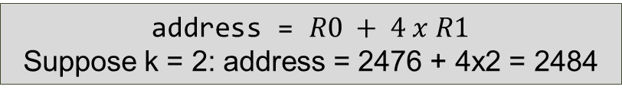
Subscripted Array Reference
32 bits
int32_t a[4]; // ‘a’ is an array of four 32-bit integers. // Each 32-bit integer is four bytes.
2488 | a[3]
2484 | a[2]
2480 | a[1]
2476 | a[0]
Address of a[k] must be computed at run-time:
LDR R0,=a // R0 = &a[0] LDR R1,=k // R1 = &k
LDR R1,[R1] // R1 = k
LDR R2,[R0,R1,LSL 2] // R2 = a[k]
4 bytes
address = $R0 + 4 x R1$ Suppose k = 2: address = 2476 + 4x2 = 2484
But it’s simpler when the subscript is a constant:
The symbol ‘a’ = &a[0], thus ‘a+8’ = &a[2]
LDR R1,=a+8 // R1 = &a[2]
LDR R2,[R1] // R2 = a[2]

Slide 41
POINTERS & ARRAYS
Function in C | Function in assembly
// Init two arrays void f1(int8_t *p8, int16_t *p16, int32_t k32){ *(p8 + k32) = 0; *(p16 + k32) = 0; } | // Init two arrays f1: LDR R3,=0 STRB R3,[R0,R2] STRH R3,[R1,R2,LSL 1] BX LR
Parameters are pointers
Identical code!
Function in C | Function in assembly
void f2(int8_t a8[], int16_t a16[], int32_t k32){ a8[k32] = 0; a16[k32] = 0; } | f2: LDR R3,=0 STRB R3,[R0,R2] STRH R3,[R1,R2,LSL 1] BX LR
Parameters are arrays

Slide 42
Chapter 4 Copying Data
Part 4: Examples

Slide 43
// Return the value *ps16 is pointing to
int16_t foo(int16_t *ps16){
return *ps16;
}
CPUlator week3: 06_one
Note:
ps16 is a pointer to [an int16_t]
*ps16 is an int16_t
// R0 = ps16 (a 32-bit ptr to int16_t)
foo: LDRSH R0,[R0] // R0 = *ps16
BX LR

Slide 44
// return the value **pps16 is pointing to
int16_t foo(int16_t **pps16){
return **pps16 ; // Parsed as *(*pps16)
}
CPUlator week3: 07_two
Note:
pps16 is a pointer to [a pointer to an int16_t]
*pps16 is a pointer to [an int16_t]
**pps16 is an int16_t
// R0 = pps16 (a 32-bit ptr to int16_t *)
foo: LDR R0,[R0] // R0 = *pps16
LDRSH R0,[R0] // R0 = **pps16
BX LR

Slide 45
// next address to next element
int16_t *foo(int16_t *ps16){
return ps16 + 1; // pointer arithmetic!
}
Note:
ps16 is a pointer to [an int16_t]
ps16+1 is a pointer to [the next int16_t]
// R0 = ps16 (a 32-bit ptr to int16_t)
foo: ADD R0,R0,#2 // R0 = ps16 + 1
BX LR

Slide 46
// Get the value ps16 is pointing to and add 1
int16_t foo(int16_t *ps16){
return *ps16 + 1 ; // parsed as (*ps16) + 1
}
Note:
ps16 is a pointer to [an int16_t]
*ps16 is an int16_t
*ps16+1 is regular integer arithmetic
// R0 = ps16 (a 32-bit ptr to int16_t)
foo: LDRSH R0,[R0] // R0 = *ps16
ADD R0,R0,#1 // R0 = *ps16 + 1
BX LR

Slide 47
int16_t foo(int16_t *ps16){
return *(ps16 + 1); // pointer arithmetic
}
Note:
ps16 is a pointer to [an int16_t]
ps16+1 is a pointer to [the next int16_t]
*(ps16+1) is the next int16_t
// R0 = ps16 (a 32-bit ptr to int16_t)
foo: ADD R0,R0,#2 // R0 = ps16 + 1
LDRSH R0,[R0] // R0 = *(ps16 + 1)
BX LR
OR
foo: LDRSH R0,[R0,#2]
BX LR

Slide 48
int32_t foo(int32_t a32[]){
return a32[1];
}
Note:
a32 is (same as) a pointer to [an int32_t]
a32[1] is same as *(a32+1)
a32+1 is a a pointer to [next int32_t]
*(a32+1) is the next int32_t
// R0 = a32 (a 32-bit ptr to int32_t)
foo: ADD R0,R0,#4 // R0 = a32 + 1
LDR R0,[R0] // R0 = a32[1]
BX LR
OR
foo: LDR R0,[R0,#4]
BX LR

Slide 49
int32_t foo(int32_t a32[], int32_t k32){
return a32[k32];
}
CPUlator week3: 08_loopByteArray.s 09_loopWordArray.s
Note:
a32 is (same as) a pointer to [an int32_t]
a32[k32] is same as *(a32+k32)
a32+k32 is a pointer to [the k32th int32_t]
*(a32+k32) is the k32th int32_t
// R0 = a32 (a 32-bit ptr to int32_t)
// R1 = k32 (a 32-bit int)
foo: LSL R1,R1,#2 // R1 = 4*k32
ADD R0,R0,R1 // R0 = a32 + 4*k32
LDR R0,[R0] // R0 = a32[k32]
BX LR
OR
foo: LDR R0,[R0,R1,LSL #2]
BX LR

Slide 50
Chapter 4 Copying Data
Part 5: Pre and Post Indexing

Slide 51
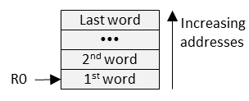
COPYING A BLOCK OF DATA QUICKLY
Instruction | Syntax |  | Operation | Notes
Load Multiple registers, Increment After | LDMIA | R_{n}!,{register list} | registers = memory[R_{n}] R_{n} = R_{n} + 4 x #registers | Addresses start with the address in R_{n} Updates R_{n} only if write-back flag (!) is appended to R_{n}.
Store Multiple registers, Increment After | STMIA | R_{n}!,{register list} | memory[R_{n}] = registers R_{n} = R_{n} + 4 x #registers
Mem Address
Mem Address
// Copy 44 bytes: mem[R1] = mem[R0] LDMIA R0,{R2-R12} // regs = mem[R0] STMIA R1,{R2-R12} // mem[R1] = regs
Data must be word aligned (located at a mod 4 adrs) or an address fault will occur.

Slide 52
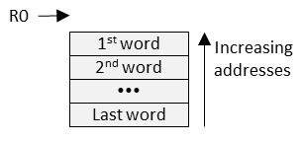
COPYING A BLOCK OF DATA QUICKLY
Instruction | Syntax |  | Operation | Notes
Load Multiple registers, Decrement Before | LDMDB | R_{n}!,{register list} | R_{n} ← R_{n} - 4 x #registers registers ← memory[R_{n}] | Addresses end just before address in R_{n} Updates R_{n} only if write-back flag (!) is appended to R_{n}.
Store Multiple registers, Decrement Before | STMDB | R_{n}!,{register list} | R_{n} ← R_{n} - 4 x #registers registers → memory[R_{n}]
Mem Address
Mem Address
// Copy 44 bytes: mem[R1-44] ← mem[R0-44] LDMDB R0,{R2-R12} // regs <-- mem[R0] STMDB R1,{R2-R12} // regs --> mem[R1]
Data must be word aligned (located at a mod 4 adrs) or an address fault will occur.

Slide 53
COPYING A BLOCK OF DATA QUICKLY
// void Copy512Bytes(void *dst, const void *src) .global Copy512Bytes .align .thumb_func Copy512Bytes: PUSH {R4-R11} // Preserve registers R4 - R11 .rept 11 LDMIA R1!,{R2-R12} STMIA R0!,{R2-R12} .endr // Copy the remaining 7*4 = 28 bytes LDMIA R1,{R2-R8} STMIA R0,{R2-R8} POP {R4-R11} // Restore registers R4 - R11 BX LR // Return .end
Each LDMIA/STMIA pair copies 11 words of 4 bytes (44 bytes) from mem[R1] to mem[R0], and adds 44 to R0 and R1 in preparation for the next pair.
The .rept 11 and .endr directives insert 11 copies of the LDMIA/STMIA instruction pair, copying 484 bytes total.
This leaves 28 more bytes (for a total of 512) to be copied.
This approach trades memory for speed. A loop would use fewer instructions, but each repetition of a loop requires executing a branch instruction that takes time to flush and refill the instruction pipeline.

Slide 54
Chapter 4 Copying Data
Part 6: Memory Performance

Slide 55
PHYSICAL MEMORY DESIGN
PROCESSOR
Address bits 0 & 1 select 1 of 4 bytes
8-bits
8-bits
8-bits
8-bits
1028
1024
1020
1016 | adrs 1019 | adrs 1018 | adrs 1017 | adrs 1016
1012
1008
1004
1000
address bits 30-2 select one 32-bit physical word
(bits 0 & 1 of word address = 00)
32-bits

Slide 56
Memory Addressing
Logically, memory is organized into bytes
Every byte has its own 32-bit address.
Every memory read retrieves a 32-bit physical word.

Slide 57
Address Alignment
Word-Alignment = Address is multiple of 4
Word-Aligned 32-bit operand:
Fully contained within a single physical word
Only 1 memory cycle to read (load) or write (store)
Unaligned 32-bit operand:
Split across 2 physical words
Requires 2 memory cycles to read or write
Halfword-Alignment = Address is multiple of 2

Slide 58
The .align assembler directive
Format: .align constant
constant is the number of least-significant bits of the next address that must be zeroes.
Examples:
.align 1 // Next address is a multiple of 2 (halfword-aligned)
.align 2 // Next address is a multiple of 4 (word-aligned)
.align 4 // Next address is a multiple of 8 (double word-aligned)
.align // Default (no constant) → word-aligned
Inserts a 16-bit NOP (“No Operation”) instruction if needed to force word-alignment.

Slide 59
Instruction Fetch
Processor requires instructions to be (at least) halfword-aligned
Every instruction starts on a mod 2 address (even address)
Every instruction fetch retrieves 32 bits from memory:
One 32-bit instruction, or
Two 16-bit instructions, or
One 16-bit instruction and first half of a 32-bit instruction, or
Second half of a 32-bit instruction and a 16-bit instruction

Slide 60

Optimizing Instruction Fetch
Use a .align directive at the entry point of every function to force the function to start on a word-aligned (mod 4) address.
Each Instruction is either: 2 or 4 bytes in length.
N 32-bit or 2N 16-bit instructions = 4N bytes
Word-alignment allows 4N instruction bytes to be fetched in N memory read cycles rather than N+1.
.global Func1
.align
Func1: PUSH {R4,LR}
$⋯$
POP {R4,PC}
.global Func2
.align
Func2: PUSH {R4,LR}
$⋯$
POP {R4,PC}

Slide 61

Optimizing Instruction Fetch
Use a .align directive at the top of every loop to force the loop to start on a word-aligned address.
Word-alignment allows a loop of 4N instruction bytes that is repeated R times to be fetched in R*N rather than R*(N+1) memory read cycles.
OK to place .align between two instructions
No effect if already word-aligned
Otherwise inserts a NOP (NOP = “No Operation” instruction)
.global Func3
.align
Func3: PUSH {R4,LR}
$⋯$
.align
L1: CBZ R0,L2
$⋯$
B L1
L2: $⋯$
POP {R4,PC}

Slide 62
Done

