Slide 1

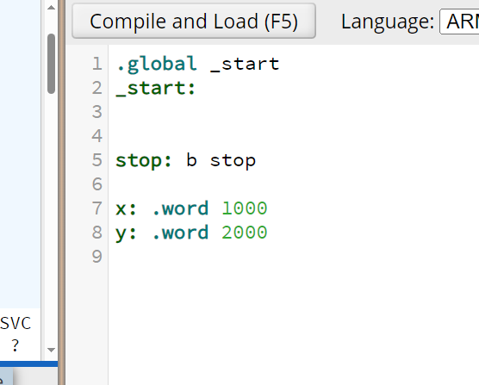
EXAMPLE Implementing y = x + 5 ;
https://cpulator.01xz.net/?sys=arm-de1soc&d_audio=48000
https://cpulator.01xz.net/
LDR R0,=x // R0 <-- &x (get the address of x)
LDR R0,[R0] // R0 <-- x (load the value of what R0 points)
ADD R0,R0,#5 // R0 <-- R0 + 5 (add 5)
LDR R1,=y // R1 <-- &y (get the address of y)
STR R0,[R1] // R0 --> y (store R0 to address of y)
Try it with CPULator
Common mistake:
LDR R0,=x+5 // R0 $≠x+5$
“x+5” is an address expression evaluated at time of assembly; its value is a constant and does not depend on the content of variable x.

