Slide 1
CSEN20
Fall 2026
Introduction to Embedded Systems
Michael Schimpf, PhD, mschimpf@scu.edu

Slide 2
Chapter 6 Making Decisions and Writing Loops
Part 1: Decisions in Assembly

Slide 3
Consider
By default, statements are executed sequentially in both C and assembly:
statement
statement
…
statement
Order of execution

Slide 4
However,….
Decisions imply departure from sequential execution:
if
if (var < 100){ var = var + 10;
}
TRUE
Then statement
FALSE
Program continues …

Slide 5
If-then-else in Assembly
if (var >= 100){
goto L1; }
var = var + 10;
L1: Program continues …
In assembly, all statements must be arranged vertically:
if (var < 100){ var = var + 10;
} L1: Program continues …
if
FALSE
if
TRUE
Then statement
TRUE
FALSE
Then statement
L1: Program continues …
L1: Program continues …

Slide 6
This arrangement requires a “goto”
if (test == FALSE)
goto L1;
Then-statement
L1: ….
if
FALSE
TRUE
Then statement
L1:
Program continues …
The decisions are implemented as:
CMP compare followed by a
B branch instruction + condition code

Slide 7
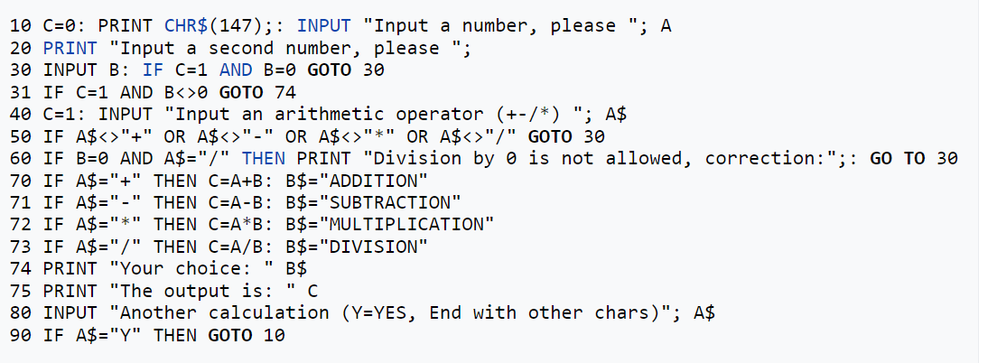
This arrangement requires a “goto”
if (test == FALSE)
goto L1
Then-statement
L1: ….
What does goto actually mean?
Where does it come from?

Slide 8
FLAGS Current Program Status Register (APSR)
This subset is the Application Processor Status Register (APSR)
31
30
29
28
27
26
0
N
Z
C
V
reserved
Overflow during addition:
Unsigned: C flag = 1
2’s Comp: V flag = 1
Overflow flag: A value of 1 indicates a 2’s complement overflow during an addition, subtraction or compare.
Carry flag: A value of 1 indicates a carry out during addition.
Overflow during subtraction:
Unsigned: C flag = 0
2’s Comp: V flag = 1
Zero flag: A value of 1 indicates a result (or difference) of zero
Negative flag: A value of 1 indicates a negative result

Slide 9
Making Decisions in Assembly
CMP instructions are used to “compare” two values
APSR Flags: records the characteristics of the comparison

Slide 10
Making Decisions in Assembly
“Conditional Branch” depend on APSR Flags:
FALSE: Execution continues sequentially
TRUE: Execution “branches” to some other label.
Example: “BEQ L1” means go to label L1 if equal.

Slide 11
Making Decisions in Assembly
CMP R0,R1 -> R0 - R1 then set flags:
C(arry)
Z(erro)
N(egative)

Slide 12
Chapter 6 Making Decisions and Writing Loops
Part 2: Compare and Branch Instructions

Slide 13
COMPARE INSTRUCTIONS
Decisions in assembly require a two-instruction sequence:
A compare instruction compares two operands
Followed by a conditional branch instruction.
Instruction | Syntax | Operation | Notes
Compare | CMP R_{n},Op2 | R_{n} – Op2 | Updates flags N,Z,C and V according to the difference
Compare Negative | CMN R_{n},Op2 | R_{n} + Op2
Op2 may be:
a constant
a register
shifted register.
CMP is identical to the SUBS instruction, but discards the actual difference.
The assembler automatically replaces CMP R_{n},─constant by CMN R_{n},constant

Slide 14
SPECIAL LOOP INSTRUCTIONS
CPULator: 4. CBZ example(not supported).s
Instruction | Syntax | Operation
Compare and Branch if Zero | CBZ R_{n},label | Branch to label If R_{n}=0
Compare and Branch if Non-Zero | CBNZ R_{n},label | Branch to label If R_{n}≠0
CMP R0,#0 CBZ R0,L1
BEQ L1
CMP R0,#0 CBNZ R0,L1
BNE L1
Sometimes used at the top of a while or for loop
Sometimes used at the bottom of a do-while loop

Slide 15

CONDITIONAL BRANCH INSTRUCTIONS
If-then statement in C
int32_t s32 ; if (s32 > 10) •••
Equivalent C code using goto and label
int32_t s32 ; if (s32 <= 10) goto L1 ; L1: •••
then statement
then statement
Equivalent if-then statement in assembly
LDR R0,=s32 // R0 <-- &s32 LDR R0,[R0] // CMP requires operand to be in a register CMP R0,#10 // Compare s32 to 10 and ... BLE L1 // if (s32 <= 10) goto L1 L1: •••
CPULator #1
then statement
Decisions in assembly are “if statement with a goto”.
A conditional branch instruction is written as “B” followed a condition code.

Slide 16
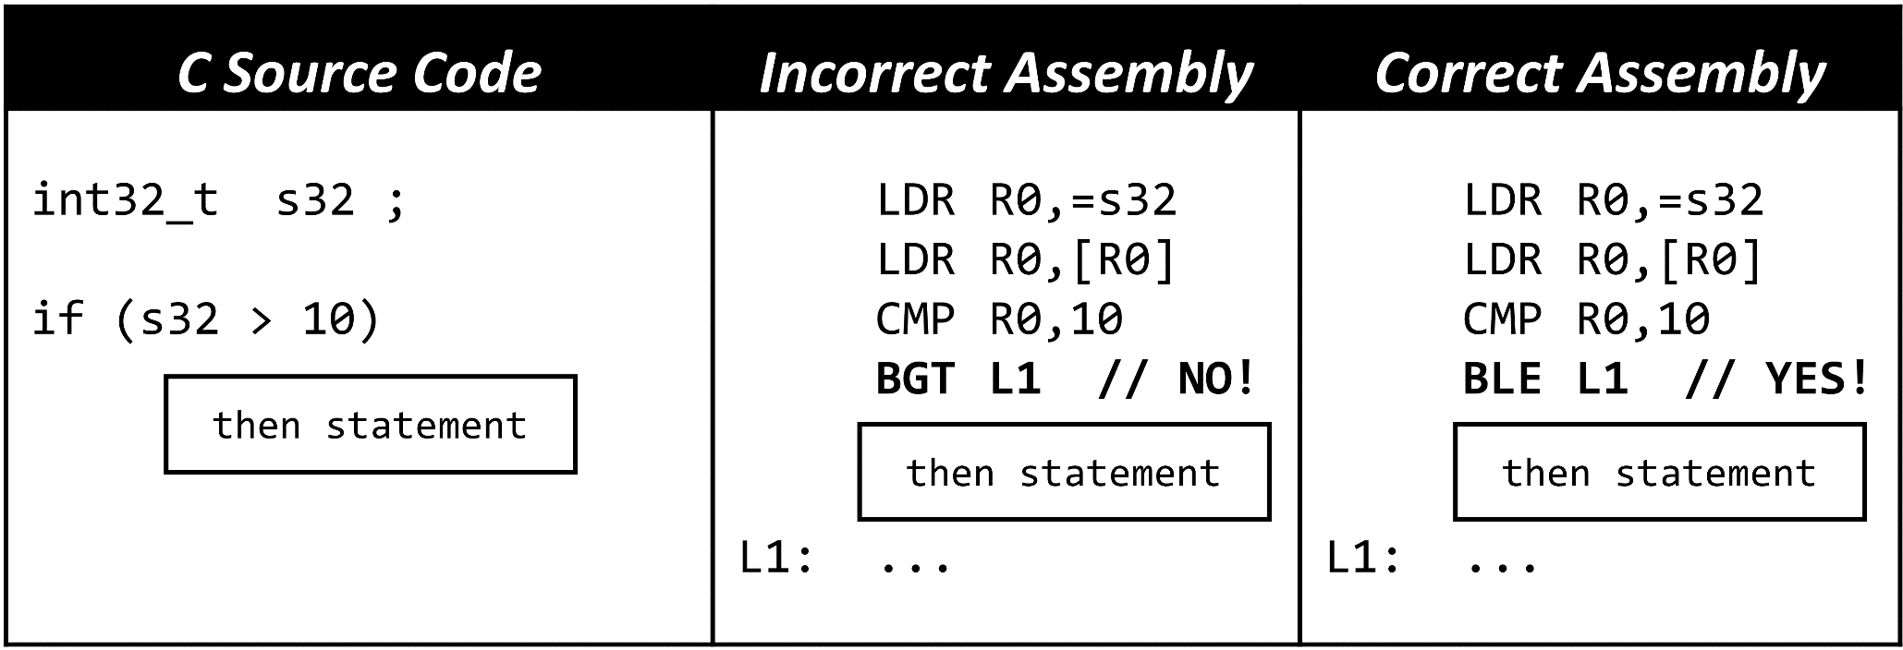
CHOOSING THE CONDITION
In assembly, we must branch around the “then statement”, so we have to use a conditional branch that specifies the opposite of the condition used in C.
Don’t forget - The opposite of “greater than” is NOT “less than”!

Slide 17
CONDITIONAL BRANCH INSTRUCTIONS
unsigned
signed
7 > 12 ?
0111₂ > 1100₂ ?
+7 > -4 ?
(FALSE)
(TRUE)
Signed and unsigned operands require different conditionals!
Condition | For Unsigned Operands: | For Signed Operands:
> | BHI (Higher Than) | BGT (Greater Than)
>= | BHS (Higher Than or Same) | BGE (Greater Than or Equal)
< | BLO (Lower Than) | BLT (Less Than)
<= | BLS (Lower Than or Same) | BLE (Less Than or Equal)
== | BEQ (Equal)
!= | BNE (Not Equal)

Slide 18
ALL CONDITION CODES
Condition | Meaning | Requires
EQ | Equal | Z = 1
NE | Not equal | Z = 0
GE | Signed ≥ ("Greater than or Equal") | N = V
LT | Signed < ("Less Than") | N ≠ V
GT | Signed > ("Greater Than") | Z = 0 && N = V
LE | Signed ≤ ("Less than or Equal") | Z = 1 || N ≠ V
HS (CS) | Unsigned ≥ ("Higher or Same") or Carry Set | C = 1
LO (CC) | Unsigned < ("Lower") or Carry Clear | C = 0
HI | Unsigned > ("Higher") | C = 1 && Z = 0
LS | Unsigned ≤ ("Lower or Same") | C = 0 || Z = 1
MI | Minus/negative | N = 1
PL | Plus - positive or zero (non-negative) | N = 0
VS | Overflow | V = 1
VC | No overflow | V = 0
AL | Always (unconditional) | (Rarely used)
EQ and NE are same for signed and unsigned.
These are used for signed comparisons
These are used for unsigned comparisons

Slide 19
CHOOSING THE CONDITION
In assembly, we must branch around the “then statement”, so we have to use a conditional branch with the opposite of the condition used in C.
Don’t forget - The opposite of “greater than” is NOT “less than”!

Slide 20
TEST INSTRUCTIONS
Instruction | Syntax | Operation | Notes
Test | TST R_{n}, Op2 | R_{n} & Op2 | Updates flags N and Z; if shifted, Op2 may affect C flag
Test Equivalence | TEQ R_{n}, Op2 | R_{n} ^ Op2
TST is used to test whether any of the bits in R_{n} specified by Op2 are 1’s.
TEQ is used to test whether R_{n} = Op2 without affecting the C or V flags, but will set the Z flag (Z=1) if R_{n} = Op2.

Slide 21
Compare/Test Instructions
TST R1, R2
R1 | 000001000010000001000000100001
R2 | 000000000000000000000000000001 | bit mask (Testing bit 0)
R1 & R2 | 000000000000000000000000000001
 | If the result of (R1&R2) is the same as R2 set the Z flag (Z = 1) to confirm that bit 0 in R1 is indeed a 1

Slide 22
UNDERSTANDING CONDITION CODES
LO (C=0): Comparing A to B requires computing unsigned difference A – B.
C=0 means the subtraction generated a borrow out of 1, thus
A must have been lower than B when computing A - B.
HI (C=1 && Z=0): C=1 (no borrow out, meaning A was higher than or equal to B), and
Z=0 (unsigned difference A – B is non-zero, so A is not equal to B,
thus A must be higher than B).
LT (N ≠ V): A negative difference would mean that A was less than B.
N=1 (Negative) and V=0 (no overflow: negative result is valid), or
N=0 (Positive) but V=1 (overflow: a 33-bit result would be negative)
GT (Z=0 && N=V): A positive non-zero difference would mean that A was greater than B.
Z=0 means that the result is non-zero.
N=0 (positive) and V=0 (no overflow: positive result is valid), or
N=1 (negative) but V=1 (overflow: a 33-bit result would be positive)

Slide 23
Chapter 6 Making Decisions and Writing Loops
Part 3: If-Then-Else Structures

Slide 24
IF-THEN-ELSE SEQUENCES
C Source Code
int32_t s32; if (s32 > 0) then state else else stat
Converted to goto
int32_t s32; if (s32 <= 0) goto L2; goto L3; L2: L3: // end of if
Assembly Code
LDR R0,=s32 // is s32 > 0 ? LDR R0,[R0] CMP R0,#0 BLE L2 B L3 // skip over else!! L2: else statement L3: // end of the if
then statement
then statement
then statement
else statement
else statement
else statement
Without the unconditional branch, the else statement will always be executed!

Slide 25
IF-THEN-ELSE SEQUENCES
C Source Code | Assembly Code
int32_t s32; if (s32 == 1) statement #1 else if (s32 == 2) statement #2 else if (s32 == 3) statement #3 | LDR R0,=s32 // R0 <-- &s32 LDR R0,[R0] // Is s32 > 0 ? CMP R0,#1 BNE L2 statement #1 B L4 // skip to end! L2: CMP R0,#2 BNE L3 statement #2 B L4 // skip to end! L3: CMP R0,#3 BNE L4 statement #3 L4: ... // end of chain
statement #1
statement #1
CPULator #2
statement #2
statement #2
statement #3
These branches insure that only one statement is executed.
statement #3

Slide 26
COMPARING 64-BIT INTEGERS Method #1
if (a64 > b64) else C
then statement
else statement
LDR R0,=a64 // R0 <-- &a64
LDRD R0,R1,[R0] // get a64 (R0=LS Half; R1=MS Half)
LDR R2,=b64 // R2 <-- &b64
LDRD R2,R3,[R2] // get b64 (R2=LS Half; R3=MS Half)
CMP R1,R3 // compare most-significant halves
BGT L1 // use BHI if operands are unsigned
BLT L2 // use BLO if operands are unsigned
CMP R0,R2 // MS halves ==, compare LS halves
BLS L2 // use BLS for both signed and unsigned
L1: // a64 > b64
B L3
L2: // a64 <= b64
L3: ...
------------------------SKIP ---------------
then statement
This solution is based on comparing digits in a most-to-least significant order.
else statement

Slide 27
Using 64-bit Subtraction to Compare
Speeding up 64-bit compares: A straight-line code sequence is always faster than one that involves branching!
// Although a CMP instruction is simply a subtraction that
// discards the difference and is only used to set the flags,
// we can’t always simply use a 64-bit subtraction to implememt
// a 64-bit compare:
... // load operands as before
SUBS R0,R0,R2 // subtract LS halves, capture borrow
SBCS R1,R1,R3 // subtract MS halves w/brw; set flags
BGT ... // this depends on Z flag and may fail
// N, C and V flags are correct, but Z is not.
// Z only depends here on whether or not R1 is all zeroes.
------------------------SKIP ---------------

Slide 28
COMPARING 64-BIT INTEGERS Method #2: When Z is not needed
// Using a 64-bit subtraction is OK if compare doesn’t need Z:
... // Load operands as before
SUBS R0,R0,R2 // subtract LS halves, capture borrow
SBCS R1,R1,R3 // subtract MS halves w/brw; set flags
... // OK to test GE,LT,HS,LO,MI,PL,VS,VC,AL
// but EQ,NE,GT,LE,HI,LS won’t work!
------------------------SKIP ---------------
Note: SUBS R0,R0,R2 may be replaced by CMP R0,R2 to avoid modifying R0.

Slide 29
COMPARING 64-BIT INTEGERS Method #2: Special Case (EQ, NE)
// If simply testing for equality (EQ) or inequality (NE),
// the following is the most efficient solution:
... // load operands as before
SUBS R0,R0,R2 // compute LS half of difference
SBC R1,R1,R3 // compute MS half of difference
ORRS R12,R0,R1 // Z=1 iff both halves are zero
... // Now OK to test for EQ or NE
------------------------SKIP ---------------
Note: SUBS R0,R0,R2 may be replaced by CMP R0,R2 to avoid modifying R0.

Slide 30
COMPARING 64-BIT INTEGERS Method #2: Special Case (GT,LE,HI,LS)
// NOTES: (1) x <= y is equivalent to y >= x, and
// (2) <= (LE/LS) requires testing Z (can’t use!)
// (3) >= (GE/HS) does NOT test Z (an alternative)
... // Load operands as before
SUBS R2,R2,R0 // subtract LS halves (reversed)
SBCS R3,R3,R1 // subtract MS halves (reversed)
... // Replace LE/GT by GE/LT, or
... // Replace LS/HI by HS/LO.
------------------------SKIP ---------------
Note: SUBS R2,R2,R0 may be replaced by CMP R2,R0 to avoid modifying R2.

Slide 31
IT BLOCKS
Every branch taken causes a delay to refill the instruction pipeline
If-Then (IT) blocks avoid this.
Append 1-3 letters to the IT instruction to control 1-3 more instructions:
CMP R1,#5
IT GT
ADDGT R0,R0,#4
Operand is a condition code
CMP R1,#5
ITET GT
ADDGT R0,R0,#4
SUBLE R0,R0,#4
MULGT R0,R0,R1
This is called the “IT Block”
The same condition code must be appended to this instruction.
ADD only executes if R1 > 5.
T → “Then”: Execute if TRUE (append IT condition)
E → “Else”: Execute if FALSE (append opposite)

Slide 32
IT BLOCKS A fast 64-bit unsigned max function
// uint64_t uMax64(uint64_t u1, uint64_t u2) .global uMax64 .align .thumb_func uMax64: SUBS R12,R2,R0 // perform a 64-bit subtract SBCS R12,R3,R1 // set flags, discard result ITT HI // if (u2 > u1) ... MOVHI R1,R3 // then return u2 instead of u1 MOVHI R0,R2 // by copying u2 into R1.R0 BX LR // return .end

Slide 33
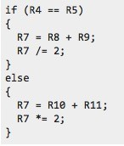
Another IT BLOCK Example
CPULator #3new
EQ implies Z = 1, NE implies Z = 0
CMP ITTEE | R4, R5 EQ | // Is R4 == R5 ?
ADDEQ | R7, R8, R9 | // if R4 == R5, R7 = R8 + R9
ASREQ | R7, R7, #1 | // if R4 == R5, R7 /= 2
ADDNE | R7, R10, R11 | // if R4 != R5, R7 = R10 + R11
LSLNE | R7, R7, #1 | // if R4 != R5, R7 *=2

Slide 34
IT BLOCK LIMITATIONS
Only 1 to 4 instructions may be controlled.
Only the IT condition or its opposite may be used.
IT blocks can’t contain another IT instruction
You can’t branch to an instruction inside an IT block
Only the last instruction in an IT block may be a branch of any kind.

Slide 35
IT BLOCK LIMITATIONS (cont’d)
16-bit instructions inside an IT block never affect the flags (except CMP, CMN and TST).
Thus inside an IT block, the assembler:
Replaces a instructions like “ADD R0,R0,1” by “ADDS R0,R0,1”
Replaces a 16-bit instruction like “ADDS R0,R0,1” by the equivalent 32-bit instruction.
Issues a syntax error for 16-bit instructions such as “MULS R0,R1,R2” that have no 32-bit equivalent.

Slide 36
Using IT Blocks to Reduce Code Size
MUL and ADD are 32-bits (4 bytes) outside of an IT block
MUL and ADD are 16-bits (2 bytes) inside an IT block
(Assembler replaces MUL and ADD inside IT block with the 16-bit instructions MULS and ADDS.)
16 instruction bytes | 10 instruction bytes
// Compute quadratic equation // (Each instruction is 4 bytes) MUL R1,R1,R0 // ax ADD R1,R1,R2 // ax+b MUL R0,R0,R1 // (ax+b)x ADD R0,R0,R3 // (ax+b)x+c | // Compute quadratic equation // (Each instruction is 2 bytes) ITTTT AL // 2 bytes MULAL R1,R1,R0 // 2 bytes ADDAL R1,R1,R2 // 2 bytes MULAL R0,R0,R1 // 2 bytes ADDAL R0,R0,R3 // 2 bytes

Slide 37
Chapter 6 Making Decisions and Writing Loops
Part 4: Compound Conditionals

Slide 38
COMPOUND CONDITIONALS
Something wrong!
Example: if (x > 10 && x < 20) y = 0;
In assembly, this must be separated into two separate “compare – conditional branch” sequences, similar to:
if (x <= 10)
goto L1;
if (x >= 20) {
goto L2;
y = 0;
L2:
}
L1:
if (x > 10)
if (x < 20)
y = 0;
if (x <= 10)
goto L1;
if (x < 20)
y = 0;
L1:

Slide 39
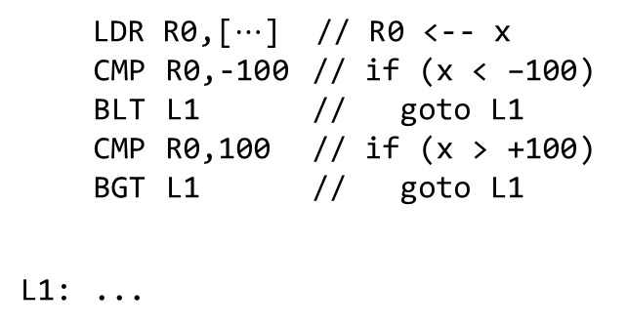
COMPOUND LOGICAL AND
Something wrong!
if (x >= –100 && x <= +100)
then statement
Invert the entire condition so the if controls a goto.
if (!(x >= –100 && x <= +100)) goto L1 ;
L1: ...
then statement
Use DeMorgan’s Law to replace && by ||.
if (x < –100 || x > +100) goto L1 ;
L1: ...
then statement
C statements now easily map 1-to-1 into assembly
Separate the conditions as we did before.
LDR R0,[$⋯$] // R0 <-- x
CMP R0,-100 // if (x < –100)
BLT L1 // goto L1
CMP R0,100 // if (x > +100)
BGT L1 // goto L1
L1: ...
if (x < –100) goto L1 ;
if (x > +100) goto L1 ;
L1: ...
then statement
then statement

Slide 40
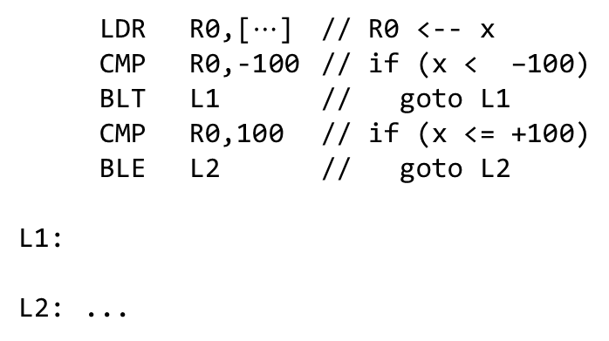
COMPOUND LOGICAL OR
Something wrong!
if (x < –100 || x > +100)
then statement
if (x < –100) goto L1 ;
if (x > +100) goto L1 ;
goto L2 ;
L1:
L2: ...
One condition per statement, each controlling a goto.
then statement
When you see this pattern, you can reduce the number of goto’s by one.
last goto eliminated by reversing the last compare.
C statements now easily map 1-to-1 into assembly
LDR R0,[$⋯$] // R0 <-- x
CMP R0,-100 // if (x < –100)
BLT L1 // goto L1
CMP R0,100 // if (x <= +100)
BLE L2 // goto L2
L1:
L2: ...
if (x < –100) goto L1 ;
if (x <= +100) goto L2 ;
L1:
L2: ...
then statement
then statement

Slide 41
COMPOUND CONDITIONALS Summary with else statements
Compound Conditional in C | Rewritten with goto’s and labels | Assembly language version
if (x > 0 && x < 9) else | if (x <= 0) goto L1; if (x >= 9) goto L1; goto L2; L1: L2: ... | LDR R0,[$⋯$] // R0 ← x CMP R0,0 BLE L1 // less eqal CMP R0,9 BGE L1 // greater equal B L2 L1: L2: ...
if (x == 0 || x == 9) else | if (x == 0) goto L1; if (x != 9) goto L2; L1: goto L3; L2: L3: | LDR R0,[$⋯$] // R0 ← x CMP R0,0 BEQ L1 // equal CMP R0,9 BNE L2 // not equal L1: B L3 L2: L3: ...
then statement
then statement
CPULator: 1. Compound_1.s
else statement
else statement
then statement
else statement
then statement
CPULator: 2. Compound_2.s
then statement
else statement
then statement
else statement
else statement

Slide 42
Graphical Approach: Compound AND
if (x >= –100 && x <= +100)
then statement
(3) Identify the conditional branch instructions that are needed
BLT L1 // less than <
X >= -100?
No
Layout the flowchart items vertically.
(4) Translate into assembly
Yes
BGT L1 // greater than >
X <= +100?
No
LDR R0,[$⋯$] // R0 ← x CMP R0,-100
BLT L1
CMP R0,+100
BGT L1
then-statement
L1: …
Yes
then statement
(2) Identify labels needed for branch destinations.
then statement
L1:

Slide 43
Graphical Approach: Compound OR
if (x < –100 || x > +100)
then statement
(1) Initial flowchart
(2) Rearrange flowchart vertically.
(4) Identify conditional branch instructions
X < -100?
Yes
X < -100?
Yes
BLT L1
(5) Translate to assembly
No
No
LDR R0,[$⋯$]
CMP R0,-100
BLT L1
CMP R0,+100
BLE L2
L1: then-statement
L2: …
X > +100?
Yes
X > +100?
No
BLE L2
No
Yes
L1:
then statement
then statement
then statement
(3) Identify needed labels
L2:

Slide 44
Chapter 6 Making Decisions and Writing Loops
Part 5: Writing Loops

Slide 45
WHILE LOOP WITH COMPOUND CONDITIONAL
while (condition){
loopBody;
}
while (1){
if (!condition)
break;
loopBody ;
}
L0: if (!condition)
goto L1;
loopBody;
goto L0;
L1:
while (1){
if (!condition)
goto L1;
loopBody ;
}
L1:

Slide 46
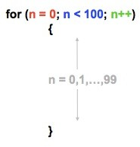
Loops: Predetermined #Iterations
CPULator: 7. n-loop.s
//assume &n is in R1
 | LDR STR | R0,=0 R0,[R1]
top: | LDR | R0,[R1]
 | CMP | R0,#100
 | BGE | done
 | …
 | …
 | LDR | R0,[R1]
 | ADD | R0,R0,#1
 | STR | R0,[R1]
 | B | top
done:
// initialize n=0
// Load n from memory
// if n >= 100 done (end loop)
// body of the loop (do something)
increment n by 1
goto top

Slide 47
SPECIAL LOOP INSTRUCTIONS
CPULator: 4. CBZ example(not supported).s
Instruction | Syntax | Operation
Compare and Branch if Zero | CBZ R_{n},label | Branch to label If R_{n}=0
Compare and Branch if Non-Zero | CBNZ R_{n},label | Branch to label If R_{n}≠0
CMP R0,0 CBZ R0,L1
BEQ L1
CMP R0,0 CBNZ R0,L1
BNE L1
Sometimes used at the top of a while or for loop
Sometimes used at the bottom of a do-while loop

Slide 48
If – Else Example
uint64_t a, b, c;
if (a == b) c = 0; else c = a - b;
//Assume a is in R0.R1
//Assume b is in R2.R3
//a and b are loaded from memory to registers
SUBS R0,R0,R2
SBCS R1,R1,R3
LDR R2,&c
ITTE EQ
//R0 and R1 have LH & UH of 64-bit (a-b)
//also if this (a-b) == 0 then the Z flag is set
//prepare to write into c in memory
LDREQ R0,=0
//If a-b == 0 (i.e., a=b) then reset c
//If a-b != 0 (i.e., a!=b) then store this difference in c
STRDEQ R0,R0,[R2] STRDNE R0,R1,[R2]

Slide 49
DO-WHILE LOOP WITH COMPOUND CONDITIONAL
do{ loopBody ; } while (condition);
do{
loopBody;
if (!condition)
continue;
break;
} while (1);
L0: loopBody ;
if (!condition)
goto L1;
goto L0;
L1:
do{
loopBody;
if (!condition)
break;
} while(1);

Slide 50
FOR LOOPS (in general)
CPULator: 3. Stupid loop.s
for (initialization; condition; update){
loopBody;
}
initialization;
while (condition){
loopBody;
update;
}
initialization;
L1: if (!condition)
goto L2;
loopBody;
update;
goto L1;
L2:
initialization ;
while (1){
if (!condition)
break;
loopBody;
update;
}

Slide 51
For Loops Example
CPULator: 8. SpecialLoop.s
x = | 0;
for | (y | = | 1; | y | < | 1000; |  | y | = | 2*y) |  | x | += | y;
//assume |  |  | &x | is | in |  | R2 | and | &y |  | is | in | R3
 | LDR STR LDR STR | R0,=0 R0,[R2] R0,=1 R0,[R3]
Top: | LDR | R0,[R3]
 | CMP | R0,1000
 | BGE | Done
 | LDR | R1,[R2]
 | ADD | R1,R1,R0
 | STR | R1,[R2]
 | LSL | R0,R0,1
 | STR | R0,[R3]
 | B | Top
Done:
initialize x=0 and y=1
Is y >= 1000 ?
Accumulate x with values in y
Multiply y by 2
Go back to the top of the loop

Slide 52
Ex: Factorial (Example of a for loop)
CPULator: 5. Factorial.s
Factorial: // uint32_t Factorial(uint32_t n) {
// R0=n, R1=result // uint32_t result;
LDR R1,=1 // result = 1; // initialization
top: CMP R0,0 // while (n != 0) { // condition
BEQ done //
MUL R1,R1,R0 // result *= n ; // loopBody
SUB R0,R0,#1 // n = n – 1 ; // update
B top // }
done: MOV R0,R1 // return result ;
BX LR // }

Slide 53
Ex: Greatest Common Divisor (Example of a while loop)
CPULator: 6. GCD.s
gcd: // uint32_t gcd(uint32_t u1, uint32_t u2) {
//
CMP R0,R1 // while (u1 != u2) {
BEQ done
//
ITE HI // if (u1 > u2)
SUBHI R0,R0,R1 // u1 = u1 – u2 ;
// else SUBLS R1,R1,R0 // u2 = u2 – u1 ;
B gcd // }
done: BX LR // return u1 ;
// }

Slide 54
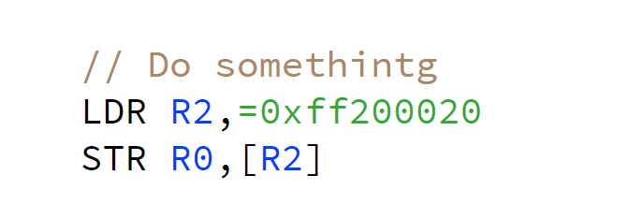
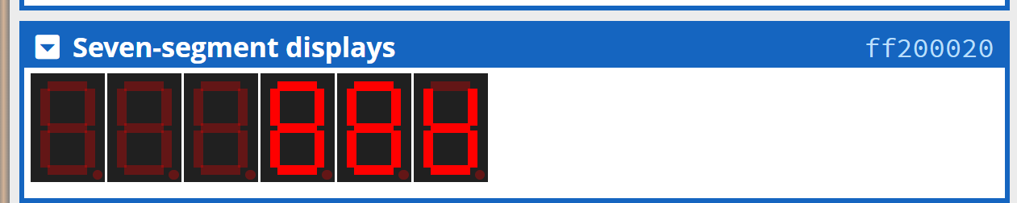

Create a loop
https://cpulator.01xz.net/?sys=arm-de1soc
CPULator
Implement with CPULator
CPULator: 9. Excercise.s
Create a loop:
Counts up from 0x0 to 0xfffff
Or counts down from 0xfffff to 0x0
Or counts from 0x0 to 0x1000
And store this counter into 0xff200020

Slide 55
Done

