Slide 1
CSEN20
Fall 2026
Introduction to Embedded Systems
Michael Schimpf, PhD, mschimpf@scu.edu

Slide 2
Chapter 7 Manipulating Bits
Part 1: Specifying Bit Patterns

Slide 3
Bit Patterns
A bit pattern (“mask”) is a string of 1’s and 0’s designed to select a subset of bits.
Bit patterns are used to:
Test the value of one bit while ignoring others
Set, clear, or invert the value of one bit without affecting others
Extract or Insert a value stored in a subset of the bits of a word

Slide 4
Useful Bit Patterns: (1 << k) = 2^{k} (A single 1 shifted left k bits)
(1₂ << 4) = 00000001₂
00010000₂
= 16₁₀
= 2⁴
LDR R0,=(1<<4)
C++ Example 1

Slide 5
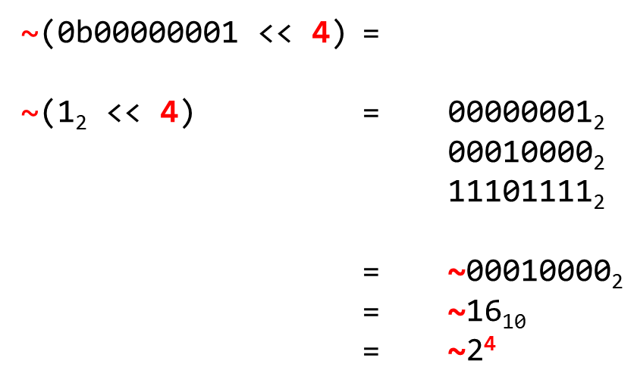
Useful Bit Patterns: ~(1 << k) = ~2^{k} (A single 0 shifted left k bits)
~(0b00000001 << 4) =
~(1₂ << 4) = 00000001₂
00010000₂
1$\text{1}$101111₂
= ~0$\text{0}$010000₂
= ~16₁₀
= ~2⁴
LDR R0,=~(1<<4)
C++ Example 1

Slide 6
Useful Bit Patterns: (1 << k)-1 = 2^{k}-1 (A string of k 1’s, preceded by all 0's)
2⁶ = 01000000₂
-00000001
2⁶-1 = 00111111₂
LDR R0,=(1<<6)-1
Six 1’s
C++ Example 1

Slide 7
Chapter 7 Manipulating Bits
Part 2: Shift Instructions

Slide 8
APPLICATIONS OF SHIFTING
Multiplication by 2^{k}: 2^{k}×A = A << k
Division by 2^{k}: A÷2^{k} = A >> k
Subscript Scaling: &a32[k] = &a32[0] + 4×k (LSL #2)
Creating Multiples: 7×A = 8×A - 1×A
7 = 8 - 1

Slide 9

SHIFT INSTRUCTIONS
Instruction | Syntax | Operation | Flags | Notes
Logical Shift Left | LSL{S} R_{d},R_{n},bits | R_{d} = R_{n} << bits | N,Z,C | Zero fills
Logical Shift Right | LSR{S} R_{d},R_{n},bits | R_{d} = R_{n} >> bits | N,Z,C | Zero fills
Arithmetic Shift Right | ASR{S} R_{d},R_{n},bits | R_{d} = R_{n} >> bits | N,Z,C | Sign extends
Rotate Right | ROR{S} R_{d},R_{n},bits | R_{d} = R_{n} >> bits | N,Z,C | right rotate
Rotate Right w/Extend | RRX{S} R_{d},R_{n} | R_{d} = R_{n} >> 1 | N,Z,C | right shift, fill with Carry
Only Rotate Right!
Append "S" to capture the last bit shifted out in the carry (C) flag.

Slide 10
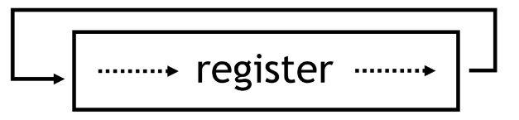
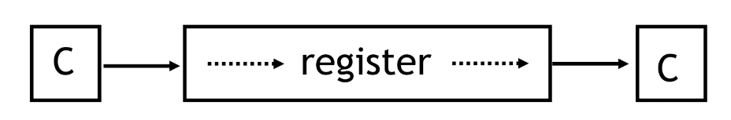
Rotate Right
ROR
RRX
No Rotate Left!

Slide 11
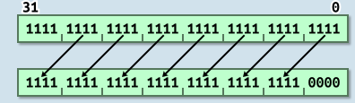
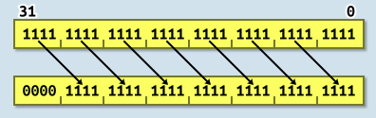
Instruction Sets
An inline barrel shifter to preprocess one of the input registers (Operand2).
It provides many types of shifts and rotates which can be applied to Operand2
LSL R0,R0,#4 Logical left shift (<< in C)
LSR R0,R0,#4 Logical shift right (>> in C)

Slide 12
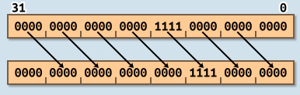
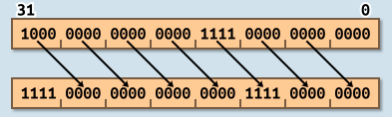
Instruction Sets
ASR R0,R0,#4 - Arithmetic Shift Right (C signed division by a power of 2)
ASR R0,R0,#4 - Arithmetic Shift Right
Positive Numbers
Negative Numbers

Slide 13
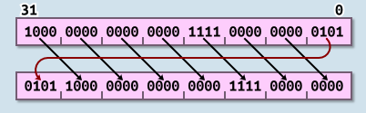
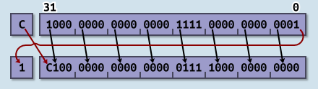
Instruction Sets
ROR R0,R0,#4 Rotate right (Bit rotate with wrap-around)
RRX R0,R0,#1 Rotate Right Extended (33-bit rotate with wrap-around through carry bit)

Slide 14
3 PLACES WHERE SHIFT CAN BE USED
ROR R0,R1,R2 // R0 = R1 rotated right R2 times
ADD R0,R1,R2,LSR 3 // R0 = R1 + (R2 >> 3)
STR R0,[R1,R2,LSL 2] // R0 = mem₃₂[R1+(R2*4)]
1. As a regular shift instruction.
The only context in which the shift count may be a variable (e.g., R2 here).
2. To provide a pre-shifted copy of the value in a register as the last operand of an instruction.
Only a Logical Shift Left (LSL) by 1, 2 or 3 bits may be used in this context.
3. To multiply a subscript (R2) by the # of bytes per element in a subscripted array reference.

Slide 15
Constants Dependent on Sign of R0
Instruction Sequence | Result left in R1:
 | When R0 < 0 | When R0 ≥ 0
LSR R1,R0,31 | +1 | 0
ASR R1,R0,31 | -1 | 0
MVN R1,R0,ASR 31 | 0 | -1
MVN R1,R0,LSR 31 | -2 | -1
LSR R1,R0,31 LSL R1,R1,k | +2^{k} | 0
ASR R1,R0,31 LSL R1,R1,k | -2^{k} | 0
ASR R1,R0,k-1 LSR R1,R1,32-k | +2^{k}-1 | 0
SIGNED VALUES!
CPULator: 10 LSRexamples.s
CPULator:
Experiment a bit
Check if correct

Slide 16
Chapter 7 Manipulating Bits
Part 3: 64-bit Shifts

Slide 17
64-BIT LOGICAL SHIFT LEFT (By 1 bit)
// uint64_t LSL64x1(uint64_t dword64) LSL64x1: LSLS R0,R0,1 // Shift LS 32 bits left by 1, capture C ADC R1,R1,R1 // Shift MS 32 bits left by 1, add C BX LR // Return
Only one example!
R1
R0
C
b₆₃
• • •
b₃₂
b₃₁
• • •
b₀
?
LSLS R0,R0,1
b₆₃
• • •
b₃₂
b₃₀
• • •
b₀0
b₃₁
ADC R1,R1,R1
b₆₂
• • •
b₃₁
b₃₀
• • •
b₀0
b₃₁

Slide 18
Chapter 7 Manipulating Bits
Part 4: Bitwise Operations

Slide 19
Review: Bitwise Operators
a = | a₇ | a₆ | a₅ | a₄ | a₃ | a₂ | a₁ | a₀
b = | b₇ | b₆ | b₅ | b₄ | b₃ | b₂ | b₁ | b₀
result = | c₇ | c₆ | c₅ | c₄ | c₃ | c₂ | c₁ | c₀
Each bit position of the result depends only on bits in the same position within the operands.

Slide 20
Bitwise AND
a | b | a AND b
0 | 0 | 0
0 | 1 | 0
1 | 0 | 0
1 | 1 | 1
b
If a=0, output = 0
If a=1, output = b
a = 0
0
a = 1
b
a
Use bitwise AND to clear a single bit to 0
bits & ~(1 << 2)
Example
 | b₃ | b₂ | b₁ | b₀
& | 1 | 0 | 1 | 1
 | b₃ | 0 | b₁ | b₀
 | 1 | 1 | 1 | 1
& | 1 | 0 | 1 | 1
 | 1 | 0 | 1 | 1
Your number
Bit mask
Result

Slide 21
Bitwise AND
a | b | a AND b
0 | 0 | 0
0 | 1 | 0
1 | 0 | 0
1 | 1 | 1
b
If a=0, output = 0
If a=1, output = b
a = 0
0
a = 1
b
a
Use bitwise AND to isolate/test a single bit
bits & (1 << 2)
Example
 | b₃ | b₂ | b₁ | b₀
& | 0 | 1 | 0 | 0
 | 0 | b₂ | 0 | 0
 | 1 | 1 | 1 | 1
& | 0 | 1 | 0 | 0
 | 0 | 1 | 0 | 0
Your number
Bit mask
Result

Slide 22
Bitwise OR
a | b | a OR b
0 | 0 | 0
0 | 1 | 1
1 | 0 | 1
1 | 1 | 1
b
If a=0, output = b
If a=1, output = 1
a = 0
b
a = 1
1
a
Use bitwise OR to set a single bit to 1
bits | (1 << 2)
Example
 | b₃ | b₂ | b₁ | b₀
| | 0 | 1 | 0 | 0
 | b₃ | 1 | b₁ | b₀
 | 0 | 0 | 0 | 1
| | 0 | 1 | 0 | 0
 | 0 | 1 | 0 | 1
Your number
Bit mask
Result

Slide 23
Bitwise Exclusive-OR
CPULator: XOE_EOR.s
a | b | a XOR b
0 | 0 | 0
0 | 1 | 1
1 | 0 | 1
1 | 1 | 0
b
If a=0, output = b
If a=1, output = b
a = 0
b
a = 1
b
a
Example
Use bitwise XOR to change a single bit
bits ^ (1 << 2)
 | 1 | 0 | 0 | 1
^ | 0 | 1 | 0 | 0
 | 1 | 1 | 0 | 1
Your number
Bit mask
Result
 | b₃ | b₂ | b₁ | b₀
^ | 0 | 1 | 0 | 0
 | b₃ | b₂ | b₁ | b₀
Example
 | 1 | 1 | 0 | 1
^ | 0 | 1 | 0 | 0
 | 1 | 0 | 0 | 1
Your number
Bit mask
Result

Slide 24
BITWISE INSTRUCTIONS
Instruction | Syntax | Operation | Flags
Bitwise AND | AND{S} R_{d},R_{n},Op2 | R_{d} = R_{n} & Op2 | N,Z,C
Bit Clear | BIC{S} R_{d},R_{n},Op2 | R_{d} = R_{n} & ~Op2 | N,Z,C
Bitwise OR | ORR{S} R_{d},R_{n},Op2 | R_{d} = R_{n} | Op2 | N,Z,C
Exclusive OR | EOR{S} R_{d},R_{n},Op2 | R_{d} = R_{n} ^ Op2 | N,Z,C
Bitwise OR NOT | ORN{S} R_{d},R_{n},Op2 | R_{d} = R_{n} | ~Op2 | N,Z,C
Move NOT | MVN{S} R_{d},R_{n} | R_{d} = ~R_{n} | N,Z,C

Slide 25
USING BITWISE INSTRUCTIONS
Set a bit to 1 without affecting other bits:
X |= (1 << 5);
Clear a bit to 0 without affecting other bits:
X &= ~(1 << 5);
Change a bit without affecting other bits.
X ^= (1 << 5);
LDR R1,=x
LDR R0,[R1] ORR R0,R0,1<<5
STR R0,[R1]
LDR R1,=x LDR R0,[R1] BIC R0,R0,1<<5
STR R0,[R1]
LDR R1,=x
LDR R0,[R1] EOR R0,R0,1<<5
STR R0,[R1]
C++ Example 2

Slide 26
USING C BITWISE OPERATIONS
Test the value of a single bit in a word
if ((word & (1 << 5)) != 0) …
Calculate remainder n%d when n≥0 and d= 2^{k}
rem = n % 16 → rem = n & 0xF
Determine if an integer is an odd number
(a % 2) == 1 → (a & 1) != 0
Calculating % takes more ARM CPU instructions than calculating &.
C++ Example 2

Slide 27
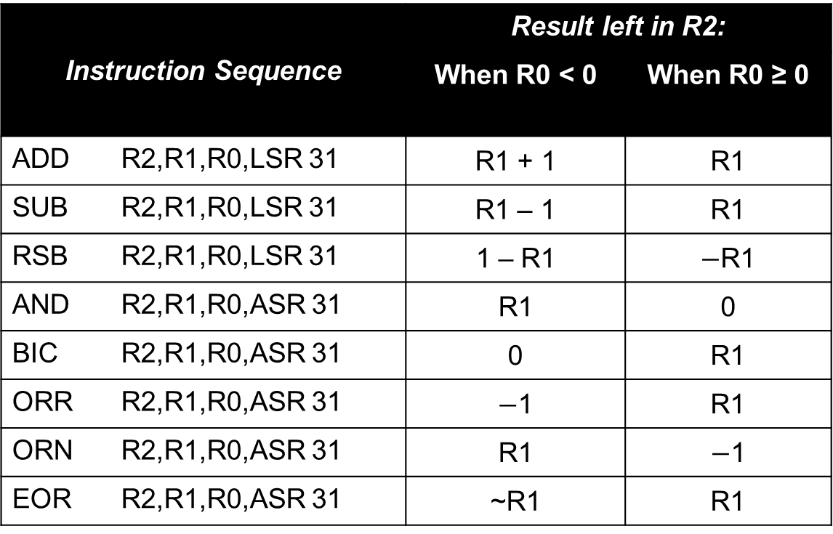
Other Values Dependent on Sign of R0
Instruction Sequence | Result left in R2:
 | When R0 < 0 | When R0 ≥ 0
ADD R2,R1,R0,LSR 31 | R1 + 1 | R1
SUB R2,R1,R0,LSR 31 | R1 – 1 | R1
RSB R2,R1,R0,LSR 31 | 1 – R1 | $−$R1
AND R2,R1,R0,ASR 31 | R1 | 0
BIC R2,R1,R0,ASR 31 | 0 | R1
ORR R2,R1,R0,ASR 31 | $−$1 | R1
ORN R2,R1,R0,ASR 31 | R1 | $−$1
EOR R2,R1,R0,ASR 31 | ~R1 | R1

Slide 28
Chapter 7 Manipulating Bits
Part 5: Bitfields

Slide 29
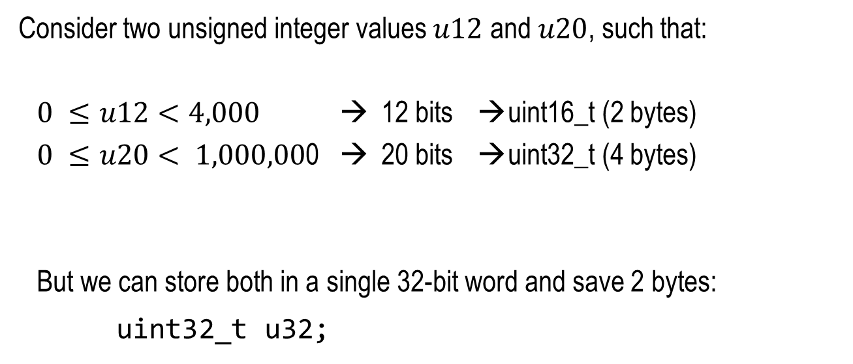
Trading Execution Time for Memory
Consider two unsigned integer values $u12$ and $u20$, such that:
$0 ≤u12<4,000$ → 12 bits → uint16_t (2 bytes)
$0 ≤u20< 1,000,00$0 → 20 bits → uint32_t (4 bytes)
But we can store both in a single 32-bit word and save 2 bytes:
uint32_t u32;
31 | 20 | 19 | 0
$$u12$$ |  | $$u20$$

Slide 30
Structure Bitfields
31 |  |  |  |  |  | 25 | 24 |  | 22 | 21 |  |  | 18 | 17 |  |  |  |  |  |  |  | 9 | 8 | 7 | 6 | 5 | 4 |  |  | 1 | 0
age |  |  |  |  |  |  | unused |  |  | ethnicity |  |  |  | weight |  |  |  |  |  |  |  |  | eyes |  | hair |  | siblings
struct {
unsigned gender : 1; // 0 = male, 1 = female
unsigned siblings : 4; // 0-15
unsigned hair : 2; // 0=black, 1=brown, etc.
unsigned eyes : 2; // 0=brown, 1=blue, 2=green
unsigned weight : 9; // 0-511
unsigned ethnicity : 4; // 0=Caucasian,1=Asian, etc…
unsigned : 3; // unused
unsigned age : 7; // 0-127
} packed;
packed.eyes = color_code;
LDR R2,=packed
LDR R0,[R2]
AND R0,R0,~(0b11 << 7)
LDR R1,=color_code
LDR R1,[R1]
AND R1,R1,0b11
ORR R0,R0,R1,LSL 7
STR R0,[R2]

Slide 31
Extracting Unsigned Bitfield (Using LSL and LSR)
CPULator: LSRexamples.s
width = 9
31 |  |  |  |  |  |  | 24 | 23 |  |  |  |  |  |  |  | 15 | 14 |  |  |  |  |  |  |  |  |  |  |  |  |  | 0
R0
32 – (lsb + width) = 8
lsb = 15
LSL R1,R0,#8
31 |  |  |  |  |  |  |  | 23 | 22 |  |  |  |  |  |  |  |  |  |  |  |  |  | 8 | 7 |  |  |  |  |  |  | 0
 |  |  |  |  |  |  |  |  |  |  |  |  |  |  |  |  |  |  |  |  |  |  |  | 0 | 0 | 0 | 0 | 0 | 0 | 0 | 0
R1
32 – len = 23
LSR R1,R1,#23
31 |  |  |  |  |  |  |  |  |  |  |  |  |  |  |  |  |  |  |  |  |  | 9 | 8 |  |  |  |  |  |  |  | 0
0 | 0 | 0 | 0 | 0 | 0 | 0 | 0 | 0 | 0 | 0 | 0 | 0 | 0 | 0 | 0 | 0 | 0 | 0 | 0 | 0 | 0 | 0
R1
unsigned zero-extension (all 0’s)
Extracted
bit-field
C++ Example 3

Slide 32
Extracting Signed Bitfield (Using LSL and ASR)
width = 9
31 |  |  |  |  |  |  | 24 | 23 |  |  |  |  |  |  |  | 15 | 14 |  |  |  |  |  |  |  |  |  |  |  |  |  | 0
 |  |  |  |  |  |  |  | s
R0
32 – (lsb + width) = 8
sign bit
lsb = 15
LSL R1,R0,#8
31 |  |  |  |  |  |  |  | 23 | 22 |  |  |  |  |  |  |  |  |  |  |  |  |  | 8 | 7 |  |  |  |  |  |  | 0
s |  |  |  |  |  |  |  |  |  |  |  |  |  |  |  |  |  |  |  |  |  |  |  | 0 | 0 | 0 | 0 | 0 | 0 | 0 | 0
R1
32 – len = 23
ASR R1,R1,#23
31 |  |  |  |  |  |  |  |  |  |  |  |  |  |  |  |  |  |  |  |  |  | 9 | 8 |  |  |  |  |  |  |  | 0
s | s | s | s | s | s | s | s | s | s | s | s | s | s | s | s | s | s | s | s | s | s | s | s
R1
2’s complement sign-extension
Extracted bit-field

Slide 33
Extracting Unsigned Bitfield (Using the UBFX instruction)
CPULator: UBFX.s
width = 9
31 |  |  |  |  |  |  | 24 | 23 |  |  |  |  |  |  |  | 15 | 14 |  |  |  |  |  |  |  |  |  |  |  |  |  | 0
R0
lsb = 15
UBFX R1,R0,#15,#9
31 |  |  |  |  |  |  |  |  |  |  |  |  |  |  |  |  |  |  |  |  |  | 9 | 8 |  |  |  |  |  |  |  | 0
0 | 0 | 0 | 0 | 0 | 0 | 0 | 0 | 0 | 0 | 0 | 0 | 0 | 0 | 0 | 0 | 0 | 0 | 0 | 0 | 0 | 0 | 0
R1
unsigned zero-extension (all 0’s)
Extracted
bit-field

Slide 34
Extracting Signed Bitfield (Using the SBFX instruction)
width = 9
31 |  |  |  |  |  |  | 24 | 23 |  |  |  |  |  |  |  | 15 | 14 |  |  |  |  |  |  |  |  |  |  |  |  |  | 0
 |  |  |  |  |  |  |  | s
R0
sign bit
lsb = 15
SBFX R1,R0,#15,#9
31 |  |  |  |  |  |  |  |  |  |  |  |  |  |  |  |  |  |  |  |  |  | 9 | 8 |  |  |  |  |  |  |  | 0
s | s | s | s | s | s | s | s | s | s | s | s | s | s | s | s | s | s | s | s | s | s | s | s
R1
2’s complement sign-extension
Extracted bit-field

Slide 35
Inserting Bitfield from R0 into R1 (Using AND, LSL, LSR and ORR)
31 |  |  |  |  |  |  |  |  |  |  |  |  |  |  |  |  |  |  |  |  |  | 9 | 8 |  |  |  |  |  |  |  | 0
 |  |  |  |  |  |  |  |  |  |  |  |  |  |  |  |  |  |  |  |  |  |  | source
R0
23 bits
31 |  |  |  |  |  |  | 24 | 23 |  |  |  |  |  |  |  | 15 | 14 |  |  |  |  |  |  |  |  |  |  |  |  |  | 0
do not change |  |  |  |  |  |  |  | destination |  |  |  |  |  |  |  |  | do not change
R1
8 bits
// Clear the destination field of R0 to all 0’s:
LDR R2,=0xFF007FFF
AND R1,R1,R2
31 |  |  |  |  |  |  | 24 | 23 |  |  |  |  |  |  |  | 15 | 14 |  |  |  |  |  |  |  |  |  |  |  |  |  | 0
unchanged |  |  |  |  |  |  |  | 0 0 0 0 0 0 0 0 0 |  |  |  |  |  |  |  |  | unchanged
R1
// Align a copy of source in R2; fill the rest with 0’s:
LSL R2,R0,#23
LSR R2,R2,#8
31 |  |  |  |  |  |  | 24 | 23 |  |  |  |  |  |  |  | 15 | 14 |  |  |  |  |  |  |  |  |  |  |  |  |  | 0
0 0 0 0 0 0 0 0 |  |  |  |  |  |  |  | source |  |  |  |  |  |  |  |  | 0 0 0 0 0 0 0 0 0 0 0 0 0 0 0
R2
// Insert source from R2 into destinat- ion (R1):
ORR R1,R1,R2
31 |  |  |  |  |  |  | 24 | 23 |  |  |  |  |  |  |  | 15 | 14 |  |  |  |  |  |  |  |  |  |  |  |  |  | 0
unchanged |  |  |  |  |  |  |  | source |  |  |  |  |  |  |  |  | unchanged
R1

Slide 36
Inserting Bitfield from R0 into R1 (Using the BFI instruction)
width = 9
31 |  |  |  |  |  |  |  |  |  |  |  |  |  |  |  |  |  |  |  |  |  | 9 | 8 |  |  |  |  |  |  |  | 0
R0
CPULator: BFI.s & BFI2.s
BFI R1,R0,#15,#9
lsb = 15
31 |  |  |  |  |  |  | 24 | 23 |  |  |  |  |  |  |  | 15 | 14 |  |  |  |  |  |  |  |  |  |  |  |  |  | 0
R1
width = 9

Slide 37
BITFIELD INSTRUCTIONS & APPLICATIONS
Instruction | Syntax | Operation | Notes
Bit Field Clear | BFC R_{d},lsb,width | R_{d}<bits> ← 0
Bit Field Insert | BFI R_{d},R_{n},lsb,width | R_{d}<bits> ← R_{n}<lsb’s>
Signed Bit Field Extract | SBFX R_{d},R_{n},lsb,width | R_{d} ← R_{n}<bits> | Sign extends
Unsigned Bit Field Extract | UBFX R_{d},R_{n},lsb,width | R_{d} ← R_{n}<bits> | Zero extends
CPULator: BFC.s

Slide 38
Examples

Slide 39
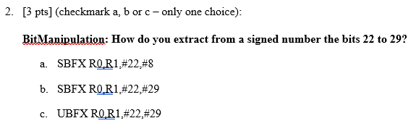
Examples (Implement in CPULator)

Slide 40
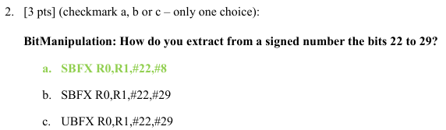
Examples (Implement in CPULator)

Slide 41
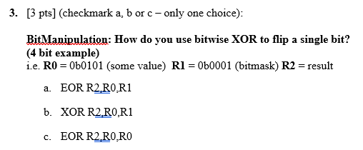
Examples (Implement in CPULator)

Slide 42
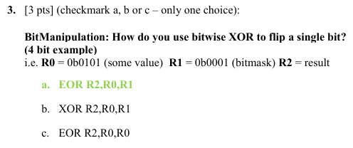
Examples (Implement in CPULator)

Slide 43
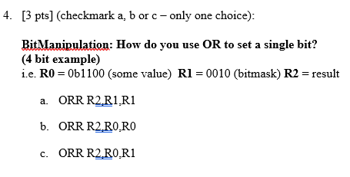
Examples (Implement in CPULator)

Slide 44
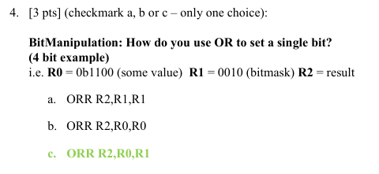
Examples (Implement in CPULator)

Slide 45
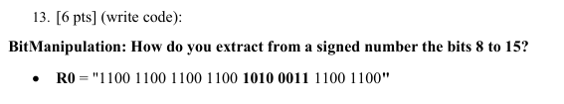
Examples (Implement in CPULator)
stop: B stop

Slide 46
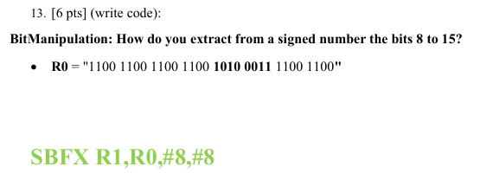
Examples (Implement in CPULator)

Slide 47
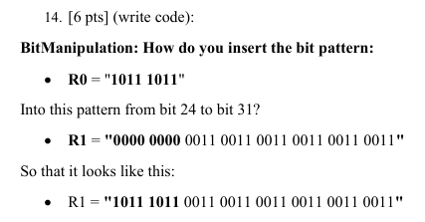
Examples
https://cpulator.01xz.net/?sys=arm
(0xBB₁₆)
(0x00333333₁₆)
(0xBB333333₁₆)

Slide 48
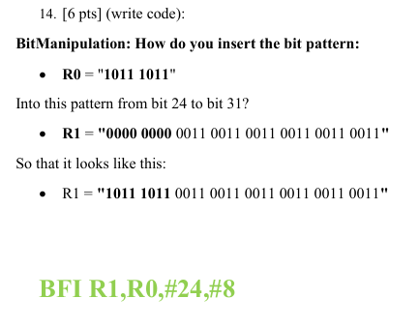
Examples (Implement in CPULator)

Slide 49
Chapter 7 Manipulating Bits
Part 6: Programming Tricks

Slide 50
Register Swap Using Exclusive-OR (Uses 1 less register and no additional instructions)
Exclusive-OR is 1 wherever the bits are different
// Standard method
// (requires 3rd register)
MOV R2,R0
MOV R0,R1
MOV R1,R2
// Exclusive-OR method
// No extra registers needed
EOR R0,R0,R1
EOR R1,R0,R1
EOR R0,R0,R1
R0
R1
1011
0011
1000
1011
0011

Slide 51
Selection Without a Branch
Consider Bitwise OR when at least one input is 0:
a | b | a OR b
0 | 0 | 0
0 | 1 | 1
1 | 0 | 1
1 | 1 | 1
When a=0, output = b
When b=0, output = a
// Selection: R5 = (R0 < 0) ? R1 : R2
AND R3,R1,R0,ASR 31 // R3 = (R0 < 0) ? R1 : 0
BIC R4,R2,R0,ASR 31 // R4 = (R0 < 0) ? 0 : R2
ORR R5,R3,R4 // One of R3 or R4 will be all 0’s

Slide 52
A Fast Absolute Value Function
a | b | a XOR b
0 | 0 | 0
0 | 1 | 1
1 | 0 | 1
1 | 1 | 0
a = 0
b
Recall that exclusive OR can be used to pass an operand through unmodified or inverted
a = 1
b
All 1’s if s32 < 0
All 0’s if s32 ≥ 0
// uint32_t AbsValue(int32_t s32) AbsValue: // s32 < 0: else: EOR R1,R0,R0,ASR 31 // R1 = ~s32 R1 = s32 ADD R0,R1,R0,LSR 31 // R0 = ~s32 + 1 R0 = s32 + 0 BX LR // Return
Fast! Avoids using making a compare and branch so that the instruction pipeline never stalls.
1 if s32 < 0
0 if s32 ≥ 0

Slide 53
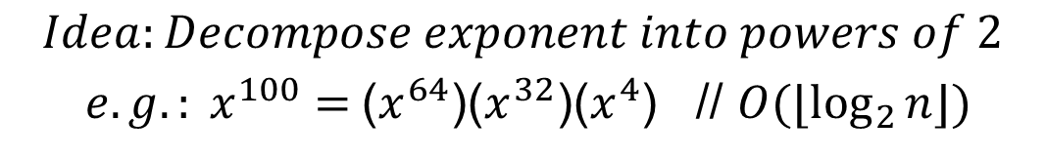
An Integer Power Function
$$Idea:Decompose exponent into powers of 2$$
${e.g.: x}^{100}=$($x^{64}$)($x^{32}$)($x^{4}$) // $O(⌊\log_{2}{n}⌋)$
uint32_t ipow(uint32_t x, uint32_t n){
uint32_t result;
result = 1;
while (n != 0){
if (n & 1) result *= x ;
n >>= 1 ;
x *= x ; // x¹, x², x⁴, x⁸, x¹⁶, etc.
}
return result;
}
// R0=x, R1=n,R2=result
ipow: LDR R2,=1
loop: CBZ R1,done
LSRS R1,R1,1
IT CS
MULCS R2,R2,R0
MUL R0,R0,R0
B loop
done: MOV R0,R2
BX LR

Slide 54
Chapter 7 Manipulating Bits
Part 7: Bit-Banding

Slide 55
APPLICATIONS OF BIT-BANDING
Fast access to individual bits in memory or I/O
Only 1 instruction required to access a single bit
No bitwise-AND, bitwise-OR, or shifting required

Slide 56
APPLICATIONS OF BIT-BANDING
"Atomic" access to manage a "mutex".
Atomic: An atomic operation completes without preemption / interruption.
Mutex: Used in operating systems, networking and multi-threaded software to arbitrate access to a shared resource.

Slide 57

BIT-BAND REGIONS & ALIASES
32MB Bit-Band Alias
22000000-23FFFFFF₁₆
32MB Bit-Band Alias
42000000-43FFFFFF₁₆
1 word
64 MB of R/W Address Space
1 word
64 MB of I/O Address Space
Each individual bit in a bit-band region corresponds to an entire word in its bit-band alias.
31MB of RAM
20100000-21FFFFFF₁₆
31MB of I/O
40100000-41FFFFFF₁₆
1MB Bit-Band Region
20000000-200FFFFF₁₆
1MB Bit-Band Region
40000000-400FFFFF₁₆
1 bit
1 bit

Slide 58
BIT-BAND MAPPING
 | 7 | 6 | 5 | 4 | 3 | 2 | 1 | 0
20001000₁₆ | 1 | 0 | 1 | 1 | 0 | 0 | 1 | 0
A byte in the "bit-band region"
…
2202001C₁₆ | 00000000 00000000 00000000 00000001
22020018₁₆ | 00000000 00000000 00000000 00000000
22020014₁₆ | 00000000 00000000 00000000 00000001
22020010₁₆ | 00000000 00000000 00000000 00000001
2202000C₁₆ | 00000000 00000000 00000000 00000000
22020008₁₆ | 00000000 00000000 00000000 00000000
22020004₁₆ | 00000000 00000000 00000000 00000001
22020000₁₆ | 00000000 00000000 00000000 00000000
Corresponding 32-bit word(s) in the "bit-band alias region”

Slide 59
FINDING THE ALIAS ADDRESS
Bit-Band Alias address = 22000000₁₆ + 32 × Bit-Band Region offset + 4 × bit number
31 |  |  |  |  |  | 25 | 24 |  |  |  |  |  |  |  |  |  |  |  |  |  |  |  |  |  |  | 5 | 4 |  | 2 | 1 | 0
0 | 0 | 1 | 0 | 0 | 0 | 1 |  |  |  |  |  |  |  |  |  |  |  |  |  |  |  |  |  |  |  |  |  |  |  | 0 | 0
0 | 0 | 0 | 0 | 0 | 0 | 0 | 1 | 0 | 0 | 0 | 0 | 0 | 0 | 0 | 0 | 0 | 0 | 0 | 0
0 | 1 | 1
7 | 6 | 5 | 4 | 3 | 2 | 1 | 0
Example: Access bit 3 in 20001000₁₆
Bit-Band Region offset = 20001000₁₆ – 20000000₁₆ = 01000₁₆
Bit-Band Alias address = 22000000₁₆ + 32₁₀ × 01000₁₆ + 4 × 3
= 22000000₁₆ + (01000₁₆ << 5) + (3 << 2)
= 2202000C₁₆
Recheck It is not correct!
Starting address of Bit-Band Region
Read or write to this address accesses bit 3 at address 20001000₁₆

Slide 60
BIT-BAND FUNCTION
// uint32_t *BitBandAliasAddress(void *BitBandAdrs, int BitNum) ; // BitBandAdrs: The address of data in the bit band region // BitNum: The number (0-31) of the bit within the data .global BitBandAliasAddress .align .thumb_func BitBandAliasAddress: SUB R0,R0,0x20000000 // compute bit band offset LSL R0,R0,5 // insert offset into alias address ADD R0,R0,R1,LSL 2 // add 4 times the bit number (0-31) ADD R0,R0,0x22000000 // add base adrs of alias region BX LR .end

Slide 61
Done

