Slide 1
CSEN20
Fall 2026
Introduction to Embedded Systems
Michael Schimpf, PhD, mschimpf@scu.edu

Slide 2
IEEE Exercise

Slide 3
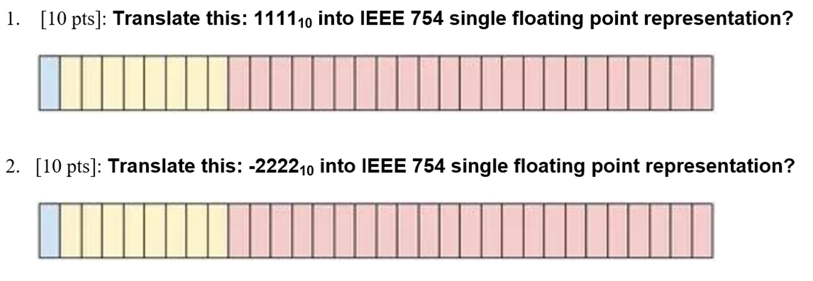
Calculate

Slide 4
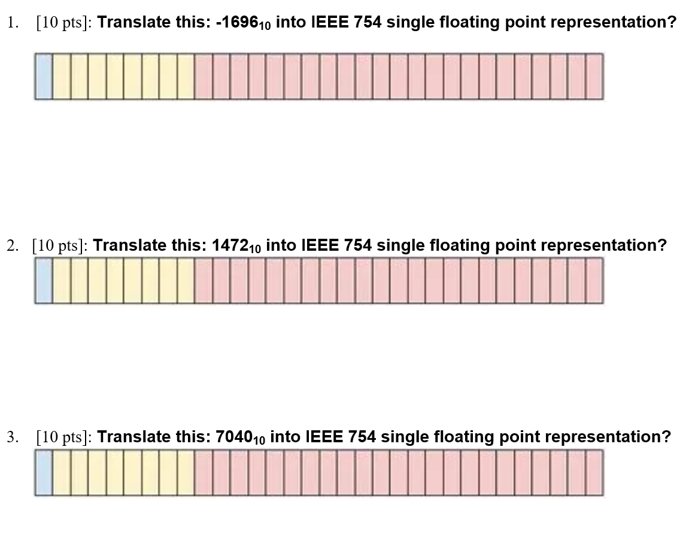
Exercise
https://www.h-schmidt.net/FloatConverter/IEEE754.html

Slide 5
FPU Exercises

Slide 6
Pythagorean Theorem

Slide 7
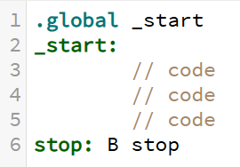
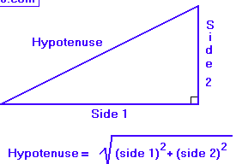
Pythagorean Theorem
Exercise
// S0 S1
// float Hypotenuse(float side1, float side2)
Hypotenuse:
// Implement_me
// Implement_me
// Implement_me
BX LR // Return
https://cpulator.01xz.net/?sys=arm
Notes:
Assembly language function to compute the Hypotenuse of a triangle.

Slide 8

Example: Pythagorean Theorem
// S0 S1
// float Hypotenuse(float side1, float side2)
Hypotenuse:
VMUL.F32 S0,S0,S0 // S0 = side1 * side1
VMLA.F32 S0,S1,S1 // S0 += side2 * side2
VSQRT.F32 S0,S0 // S0 = square root of S0
BX LR // Return
A function prototype declaration is needed when called to be sure parameters are single precision float.
Notes:
Assembly language function to compute the Hypotenuse of a triangle.

Slide 9
Volume of a Cube

Slide 10
Another Floating-Point Example
CPULator: 02-VolumOfaCube.s
// S0 S1 S2
float VolumeOfCube(float height, float width, float depth){
return height * width * depth;
}
VolumeOfCube: // S0 = height, S1 = width, S2 = depth
// Implement me
// Implement me BX LR

Slide 11
Another Floating-Point Example
CPULator: 02-VolumOfaCube.s
// S0 S1 S2
float VolumeOfCube(float height, float width, float depth){
return height * width * depth;
}
VolumeOfCube: // S0 = height, S1 = width, S2 = depth
VMUL.F32 S0,S0,S1 // S0 = height * width
VMUL.F32 S0,S0,S2 // S0 = height * width * depth
BX LR

Slide 12
Discriminant

Slide 13
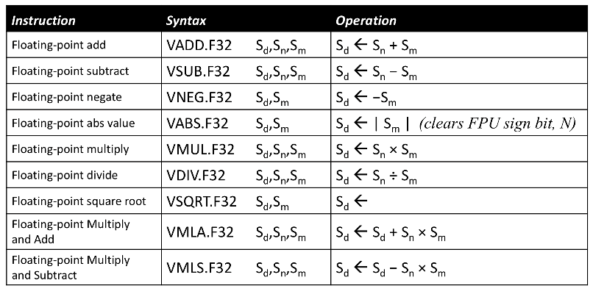
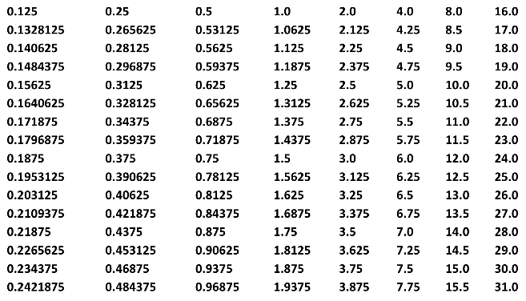
Special Floating-Point Constants
CPULator: 03-Discriminant.s
// S0 S1
float Discriminant(float a, float b, float c){
return b * b – 4.0 * a * c ;
}
Discriminant: // S0 = a, S1 = b, S2 = c
// Implement me
// Implement me // Implement me
// Implement me
BX LR
VMOV works for constants equal to ±m × 2^{-n}, where 16 ≤ m ≤ 31 and 0 ≤ n ≤ 7
Notes:
m = 16 and n = -2 so 16 x 2⁻² = 4.0

Slide 14
Special Floating-Point Constants
CPULator: 03-Discriminant.s
// S0 S1
float Discriminant(float a, float b, float c){
return b * b – 4.0 * a * c ;
}
Discriminant: // S0 = a, S1 = b, S2 = c
VMUL.F32 S1,S1,S1 // S1 = b*b
VMOV S3,4.0 // S3 = 4.0
VMUL.F32 S3,S3,S0 // S3 = 4.0*a
VMUL.F32 S3,S3,S2 // S3 = 4.0*a*c
VSUB.F32 S0,S1,S3 // S0 = b*b – 4.0*a*c
BX LR
VMOV works for constants equal to ±m × 2^{-n}, where 16 ≤ m ≤ 31 and 0 ≤ n ≤ 7
Notes:
m = 16 and n = -2 so 16 x 2⁻² = 4.0

Slide 15
Are of a Circle

Slide 16
Arbitrary Floating-Point Constants
CPULator: 04-AreaOfCircle.s
// S0
float AreaOfCircle(float radius){
return 3.14159 * radius * radius; }
AreaOfCircle: // S0 = radius
// Implement me
// Implement me // Implement me
// Implement me BX LR
pi: .float 3.14159

Slide 17
Arbitrary Floating-Point Constants
CPULator: 04-AreaOfCircle.s
// S0
float AreaOfCircle(float radius){
return 3.14159 * radius * radius; }
AreaOfCircle: // S0 = radius
VMUL.F32 S0,S0,S0 // S0 = radius*radius
LDR R0,=pi // S1 = 3.14159
VLDR S1,[R0]
VMUL.F32 S0,S0,S1 // S0 = 3.14159*radius*radius
BX LR
pi: .float 3.14159
Place data near the corresponding instruction – preferably below the function

Slide 18
Are of a Circle For an array

Slide 19
Arbitrary Floating-Point Constants
CPULator: xxxx
// S0
float AreaOfCircle(float radius){
return 3.14159 * radius * radius; }
AreaOfCircle: // S0 = radius
VMUL.F32 S0,S0,S0 // S0 = radius*radius
LDR R0,=pi // S1 = 3.14159
VLDR S1,[R0]
VMUL.F32 S0,S0,S1 // S0 = 3.14159*radius*radius
BX LR
pi: .float 3.14159

Slide 20
Volume of Sphere

Slide 21
Using Expressions to Create Constants
CPULator: 05-VolumeOfSphere.s
// S0
float VolumeOfSphere(float radius){
return (4.0 / 3.0) * 3.14159 * radius * radius * radius;
}
VolumeOfSphere: // S0 = radius
// Implement me
// Implement me // Implement me
// Implement me BX LR
factor: .float 4.18879 // (4.0/3.0)*3.14159
You can't use expressions in the .float directive like you can with .word

Slide 22
Using Expressions to Create Constants
CPULator: 05-VolumeOfSphere.s
// S0
float VolumeOfSphere(float radius){
return (4.0 / 3.0) * 3.14159 * radius * radius * radius;
}
VolumeOfSphere: // S0 = radius
VMUL.F32 S1,S0,S0 // S1 = radius * radius
VMUL.F32 S0,S0,S1 // S0 = radius * radius * radius
LDR R0,=factor
VLDR S1,[R0] // S1 = (4.0/3.0)*3.14159
VMUL.F32 S0,S0,S1 // S0 = ((4.0*3.14159)/3.0)*radius^3
BX LR
factor: .float 4.18879 // (4.0/3.0)*3.14159
You can't use expressions in the .float directive like you can with .word

Slide 23
Volume of Cone

Slide 24
Preserving Floating-Point Registers
CPULator: 06-VolumeOfCone.s
S0
S1
float VolumeOfCone(float radius, float height){
return AreaOfCircle(radius) * height / 3.0 ;
}
VolumeOfCone: // S0 = radius, S1 = height
// Implement me
// Implement me // Implement me
// Implement me POP {R4,PC} // Restore R4 and return
Easiest to preserve FPU registers in core registers.
Notes:
Pi * r² * h / 3

Slide 25
Preserving Floating-Point Registers
CPULator: 06-VolumeOfCone.s
S0
S1
float VolumeOfCone(float radius, float height){
return AreaOfCircle(radius) * height / 3.0 ;
}
VolumeOfCone: // S0 = radius, S1 = height
PUSH {R4,LR} // Preserve R4 and LR
VMOV R4,S1 // R4 = height (S1 could be used // inside the AreaOfCircle function as // a scratch register
BL AreaOfCircle // S0 = area of base of cone
VMOV S1,R4 // S1 = height
VMUL.F32 S0,S0,S1 // S0 = height * (area of base)
VMOV S1,3.0 // S1 = 3.0
VDIV.F32 S0,S0,S1 // S0 = (height * (area of base))/3.0
POP {R4,PC} // Restore R4 and return
Easiest to preserve FPU registers in core registers.
Notes:
Pi * r² * h / 3

Slide 26
Imaginary Roots

Slide 27
Floating-Point Compare & Flags
CPULator: 07-ImaginaryRoots.s
int32_t ImaginaryRoots(float a, float b, float c){
return Discriminant(a, b, c) < 0.0 ; // returns 1 or 0
}
ImaginaryRoots: // S0=a, S1=b, S2=c
// Implement me
// Implement me // Implement me
// Implement me BX LR
After a VCMP, you have to copy the FPU flags before you can test them.
Notes:
If discriminant is negative return 1 (indicating we will have imaginary roots) otherwise return 0

Slide 28
Floating-Point Compare & Flags
CPULator: 07-ImaginaryRoots.s
int32_t ImaginaryRoots(float a, float b, float c){
return Discriminant(a, b, c) < 0.0 ; // returns 1 or 0
}
ImaginaryRoots: // S0=a, S1=b, S2=c
PUSH {LR}
BL Discriminant // S0 = b*b – 4.0*a*c
VCMP.F32 S0,0.0 // S0 < 0.0 ? // DOUBLE CHECK AND CHANGE
VMRS APSR_nzcv,FPSCR // Core Flags <-- FPU Flags
ITE LT
MOVLT R0,1 // Discriminant < 0: return 1 (True)
MOVGE R0,0 // Discriminant >= 0: return 0 (False)
POP {PC}
After a VCMP, you have to copy the FPU flags before you can test them.
Notes:
If discriminant is negative return 1 (indicating we will have imaginary roots) otherwise return 0

Slide 29
Limited Increment

Slide 30
FPU Instructions in IT Blocks
CPULator: 08-LimitedIncrement.s
float LimitedIncrement(float a, float b){
if (a < b) a += 1.0;
return a;
}
LimitedIncrement: // S0 = a, S1 = b
// Implement me
// Implement me // Implement me
// Implement me BX LR
FPU instructions within IT blocks: Append condition before other modifiers.
Notes:
If a – b < 0.0 then LT is true.
Please note that the LT is appended to the VADD instruction and not after the F32.

Slide 31

FPU Instructions in IT Blocks
CPULator: 08-LimitedIncrement.s
float LimitedIncrement(float a, float b){
if (a < b) a += 1.0;
return a;
}
LimitedIncrement: // S0 = a, S1 = b
VCMP.F32 S0,S1 // a < b ?
VMRS APSR_nzcv,FPSCR // Core Flags ← FPU Flags
ITT LT
VMOVLT S1,1.0 // S1 = 1.0
VADDLT.F32 S0,S0,S1 // S0 = a + 1.0
BX LR
FPU instructions within IT blocks: Append condition before other modifiers.
VADD.F32LT S0,S0,S1 // Common Mistake (wrong)
Notes:
If a – b < 0.0 then LT is true.
Please note that the LT is appended to the VADD instruction and not after the F32.

Slide 32
Close Enough

Slide 33
Floating-Point Equality Test
CPULator: 09-CloseEnough.s
int32_t CloseEnough(float x, float y, float threshold){
return absval(x – y) < threshold ;
}
CloseEnough: // S0 = x, S1 = y, S2 = threshold
// Implement me
// Implement me // Implement me
// Implement me BX LR
x
y
TH
y
x
Notes:
If absval(x-y) is < threshold return true (or 1)
If not return false (or 0)

Slide 34
Floating-Point Equality Test
CPULator: 09-CloseEnough.s
int32_t CloseEnough(float x, float y, float threshold){
return absval(x – y) < threshold ;
}
CloseEnough: // S0 = x, S1 = y, S2 = threshold
VSUB.F32 S0,S0,S1 // S0 = x - y
VABS.F32 S0,S0 // S0 = | x – y |
VCMP.F32 S0,S2 // | x – y | < threshold
VMRS APSR_nzcv,FPSCR // Core Flags ← FPU Flags
ITE LT
MOVLT R0,1 // Return 1 if LT (close enough)
MOVGE R0,0 // Return 0 if GE (not close enough)
BX LR
x
y
TH
y
x
Notes:
If absval(x-y) is < threshold return true (or 1)
If not return false (or 0)

Slide 35
Quadratic Root

Slide 36
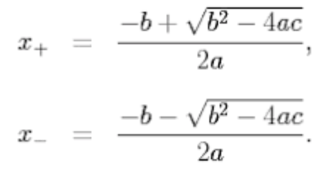
Extended Floating-Point Example
float QuadraticRoot(float a, float b, float c, int minus){
float root = sqrt(Discriminant(a, b, c));
float top;
if (minus)
top = -b – root;
else
top = -b + root;
return top / 2*a;
}
f (x) = ax² + bx + c
ax² + bx + c = 0
Notes:
If minus = 0 then x₊ root is returned
If minus = 1 then x₋ root is returned

Slide 37
QuadraticRoot: // S0 = a, S1 = b, S2 = c, R0 = minus
PUSH {R4-R6,LR} // Preserve R4, R5, R6, LR
VMOV R4,S0 // Save S0 = a
VMOV R5,S1 // Save S1 = b
MOV R6,R0 // Save R0 = minus
BL Discriminant // S0 = b*b – 4*a*c
VSQRT.F32 S0,S0 // S0 = sqrt(b*b – 4*a*c)
VMOV S1,R5 // S1 = b
VNEG.F32 S1,S1 // S1 = -b
CMP R6,0 // minus? If minus = 0 then x₊ root is returned
BEQ Divide // S0 = +sqrt(b*b – 4*a*c)
VNEG.F32 S0,S0 // S0 = -sqrt(b*b – 4*a*c)
Divide: VADD.F32 S1,S1,S0 // S1 = -b +/- sqrt(b*b – 4*a*c)
VMOV S0,R4 // S0 = a
VMOV S2,2.0 // S2 = 2.0
VMUL.F32 S0,S0,S2 // S0 = 2*a
VDIV.F32 S0,S1,S0 // S0 = (-b +/- sqrt(b*b–4*a*c))/2*a
POP {R4-R6,PC}
CPULator: 10-QuadraticRoot.s

Slide 38
Area of a Triangle

Slide 39
Floating-Point Equality Test
CPULator: 11-AreaOfTriangle.s
// S0 S1
float areaOfTriangle(float base, float height) {
return 0.5f * base * height;
}
areaOfTriangle: // S0 = base, S1 = height
// Implement me
// Implement me
BX LR
.global _start
_start: LDR R12,=two
VLDR S0,[R12]
LDR R12,=five
VLDR S1,[R12]
BL areaOfTriangle
stop: B stop
.data
half: .float 0.5
two: .float 2.0
five: .float 5.0
Notes:
If absval(x-y) is < threshold return true (or 1)
If not return false (or 0)

Slide 40
Floating-Point Equality Test
CPULator: xxxxx
// S0 S1
float areaOfTriangle(float base, float height) {
return 0.5f * base * height;
}
areaOfTriangle: // S0 = base, S1 = height
VMUL.F32 S0, S0, S1 // Multiply base * height
VMOV.F32 S1, #0.5 // Load 0.5 into S1
VMUL.F32 S0, S0, S1 // Multiply result by 0.5 (divide by 2)
BX LR // Return (result is in S0)
Notes:
If absval(x-y) is < threshold return true (or 1)
If not return false (or 0)

Slide 41
Done

