Slide 1
CSEN20
Fall 2026
Introduction to Embedded Systems
Michael Schimpf, PhD, mschimpf@scu.edu

Slide 2
Convert

Slide 3
Calculate
Convert: 0110 0111₂ = 103₁₀
To decimal:
Q6.2 =
Q5.3 =
Q4.4 =
Q3.5 =
Q2.6 =
Q1.7 =

Slide 4
Calculate
Convert: 0110 0111₂ = 103₁₀
To decimal:
Q6.2 = 103 / 2² = 25.75
Q5.3 = 103 / 2³ = 12.88
Q4.4 = 103 / 2⁴ = 6.44
Q3.5 = 103 / 2⁵ = 3.22
Q2.6 = 103 / 2⁶ = 1.61
Q1.7 = 103 / 2⁷ = 0.80

Slide 5
Add

Slide 6
Calculate
Add:
Q2 (010110.11₂)[ 91₁₀]{22.75₁₀} + Q3 (01011.101₂)[93₁₀]{11.625₁₀} =
Q5 (001.10101₂)[ 53₁₀]{1.656₁₀} + Q7 (0.1010101₂)[85₁₀]{0.664₁₀} =

Slide 7
Calculate
Add:
Q2 (010110.11₂)[ 91₁₀]{22.75₁₀} + Q3 (01011.101₂)[93₁₀]{11.625₁₀} =
Q3 (10110.110₂)[182₁₀]{22.75₁₀} + Q3 (01011.101₂)[93₁₀]{11.625₁₀} = 275 / 2³ = 34.375₁₀
Q5 (001.10101₂)[ 53₁₀]{1.656₁₀} + Q7 (0.1010101₂)[85₁₀]{0.664₁₀} =
Q7 (0.1010100₂)[212₁₀]{1.656₁₀} + Q7 (0.1010101₂)[85₁₀]{0.664₁₀} = 297 / 2⁷ = 2.32₁₀

Slide 8
Subtract

Slide 9
Calculate
Subtract:
Q2 (000110.11₂)[27₁₀]{6.75₁₀} - Q3 (00011.101₂)[29₁₀]{3.625₁₀} =
Q5 (000.10101₂)[21₁₀]{0.65625₁₀} - Q7 (0.1010000₂)[80₁₀]{0.625₁₀} =

Slide 10
Calculate
Subtract:
Q2 (000110.11₂)[27₁₀]{6.75₁₀} - Q3 (00011.101₂)[29₁₀]{3.625₁₀} =
Q3 (00110.110₂)[54₁₀]{6.75₁₀} - Q3 (00011.101₂)[29₁₀]{3.625₁₀} = 25 / 2³ = 3.125₁₀
Q5 (000.10101₂)[21₁₀]{0.656₁₀} - Q7 (0.1010000₂)[80₁₀]{0.625₁₀} =
Q7 (0.1010100₂)[84₁₀]{0.656₁₀} - Q7 (0.1010000₂)[80₁₀]{0.625₁₀} = 4 / 2⁷ = 0.031₁₀

Slide 11
Multiply

Slide 12
Calculate
Multiply:
Q2 (000011.11₂)[15₁₀]{3.75₁₀} * Q3 (00001.101₂)[13₁₀]{1.625₁₀} =
Q5 (000.11000₂)[24₁₀]{0.75₁₀} * Q7 (0.0010000₂)[16₁₀]{0.125₁₀} =

Slide 13
Calculate
Multiply:
Q2 (000011.11₂)[15₁₀]{3.75₁₀} * Q3 (00001.101₂)[13₁₀]{1.625₁₀} = 195 / 2⁵ = 6.094₁₀
Q5 (000.11000₂)[24₁₀]{0.75₁₀} * Q7 (0.0010000₂)[16₁₀]{0.125₁₀} = 384 / 2¹² = 0.094₁₀

Slide 14
Divide

Slide 15
Calculate
Divide:
Q4 (0001.1001₂)[25₁₀]{1.563₁₀} - Q3 (00000.101₂)[5₁₀]{0.625₁₀} =
Q5 (000.10100₂)[20₁₀]{0.625₁₀} – Q2 (000000.10₂)[2₁₀]{0.500₁₀} =

Slide 16
Calculate
Divide:
Q4 (0001.1001₂)[25₁₀]{1.563₁₀} - Q3 (00000.101₂)[5₁₀]{0.625₁₀} = 5 / 2¹ = 2.5₁₀
Q5 (000.10100₂)[20₁₀]{0.625₁₀} – Q2 (000000.10₂)[2₁₀]{0.500₁₀} = 10 / 2³ = 1.250₁₀

Slide 17
CPUlator

Slide 18
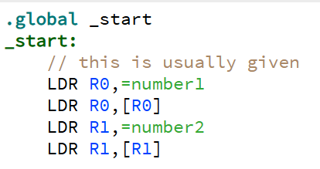
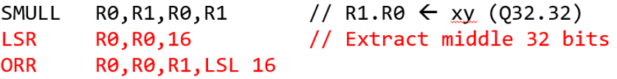
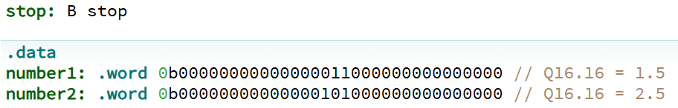
Implement this example with CPUlator
https://cpulator.01xz.net/?sys=arm
CPULator: 01_FixedReal_SMULL.s
Imaginary point
.
.

Slide 19
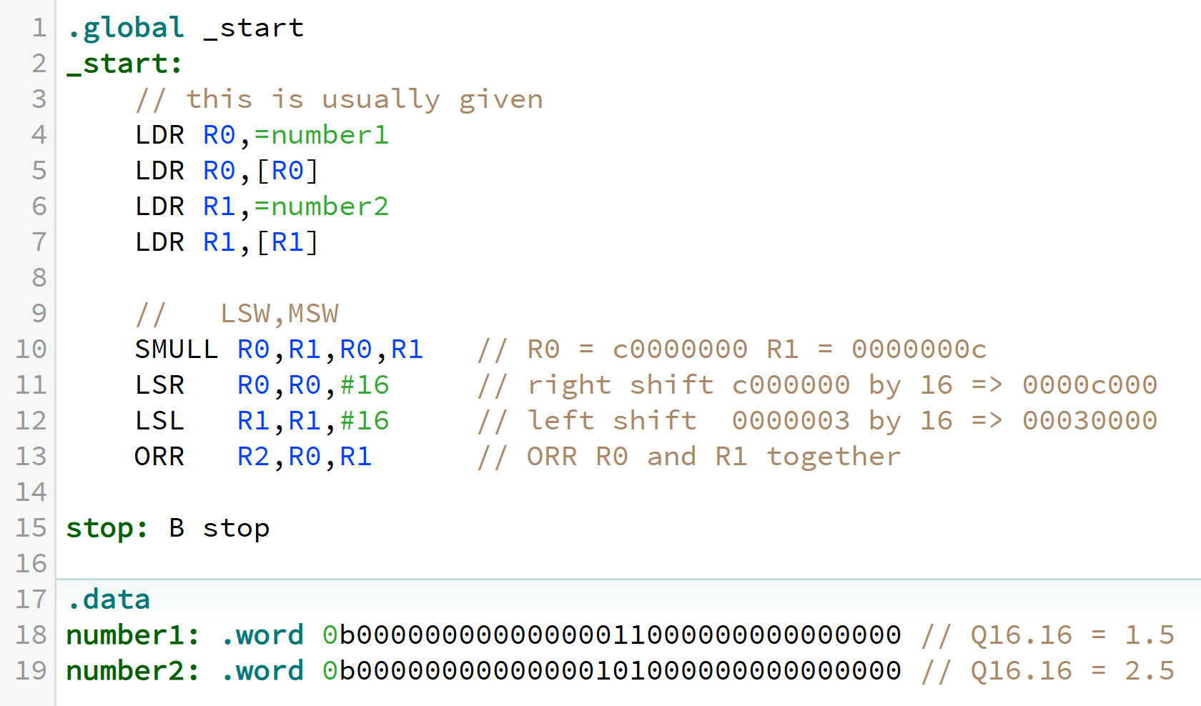
Implement this example with CPUlator
CPULator: 01_FixedReal_SMULL.s
Imaginary point
.
.

Slide 20
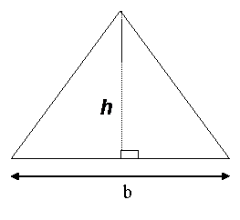
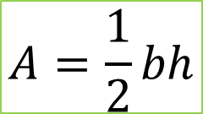
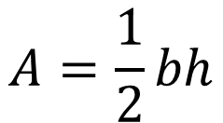
Example: Q16 Area of a Triangle
CPULator: 02_FixedReal_AreaOfTriangle.s
Example:
b = 1.5
h = 2.5
½ * 1.5 * 2.5 =1.875 = 0x1.e
$$A=\frac{1}{2}bh$$
Q16 AreaOfTriangle(Q16 b, Q16 h) ;
AreaOfTriangle:
SMULL R0,R1,R0,R1 // R1.R0 = Q32.32 product b x h
LSR R0,R0,#16 // Extract middle 32 bits
ORR R0,R0,R1,LSL#16
LSR R0,R0,#1 // Divide by 2
BX LR
$$A=\frac{1}{2}bh$$
The second LSR can be eliminated by shifting right by 17 bits instead of 16.

Slide 21
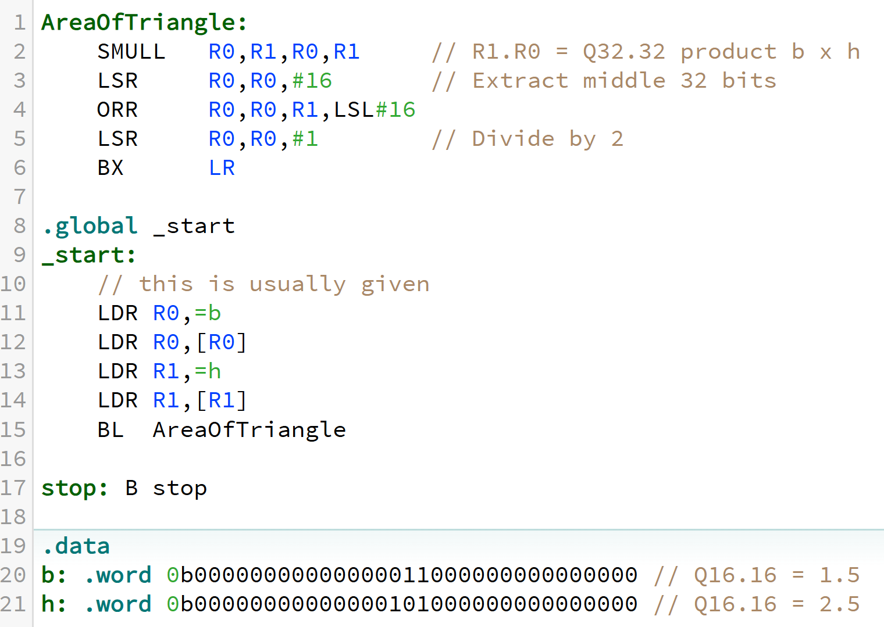
AreaOfTriangle CPUlator
CPULator: 02_FixedReal_AreaOfTriangle.s

Slide 22



Ex: Q16 Volume of a Sphere
CPULator: 03_FixedReal_VolumeOfSphere.s
$$V= \frac{4}{3}πr^{3}$$
Q16 VolumeOfSphere(Q16 r) ;
VolumeOfSphere:
SMULL R1,R2,R0,R0 // R2.R1 = Q32.32 product r squared
LSR R1,R1,#16 // Extract Q16.16 product into R1
ORR R1,R1,R2,LSL#16
SMULL R0,R1,R1,R0 // R1.R0 = Q32.32 product r cubed
LSR R0,R0,#16 // Extract Q16.16 product into R0
ORR R0,R0,R1,LSL#16
LDR R1,=274516 // R1 = (4*pi)/3 x 65536 = 274,516.5548…
SMULL R0,R1,R0,R1 // R1.R0 = Q32.32 volume
LSR R0,R0,#16 // Extract Q16.16 product into R0
ORR R0,R0,R1,LSL#16
BX LR
$$V= \frac{4}{3}πr^{3}$$
$$V= \frac{4}{3}πr^{3}$$
Example: (4 * pi) / 3 = 4.188790205 * (1.25 * 1.25 * 1.25) = 8.181230469
1000 . 0010 1110 0110 0100
8 . 2 e 6 4

Slide 23
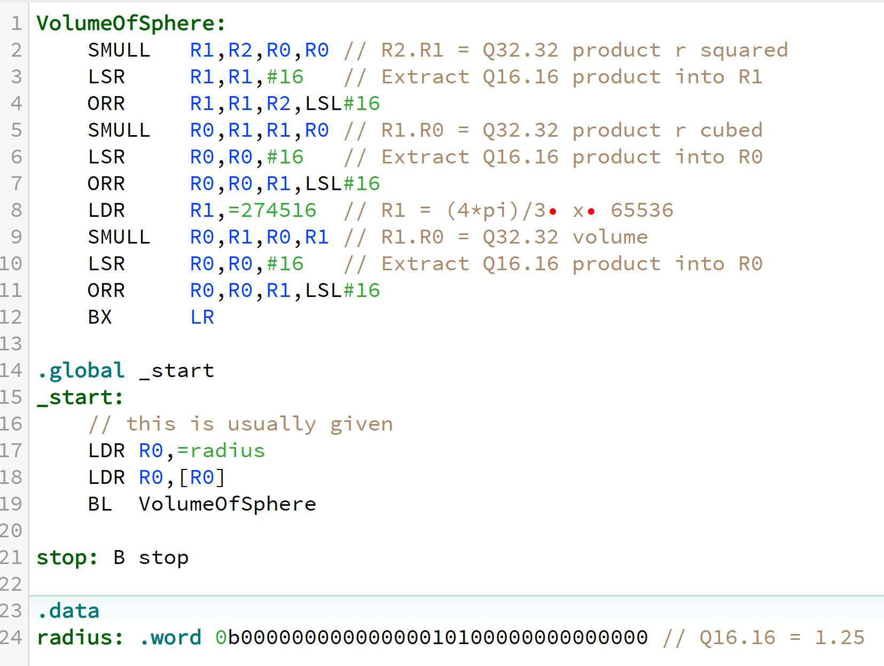
VolumeOfSphere CPUlator
CPULator: 03_FixedReal_VolumeOfSphere.s

Slide 24
Done

