Slide 1
CSEN20
Fall 2026
Introduction to Embedded Systems
Michael Schimpf, PhD, mschimpf@scu.edu

Slide 2
ARM Instruction Set Architecture History

Slide 3
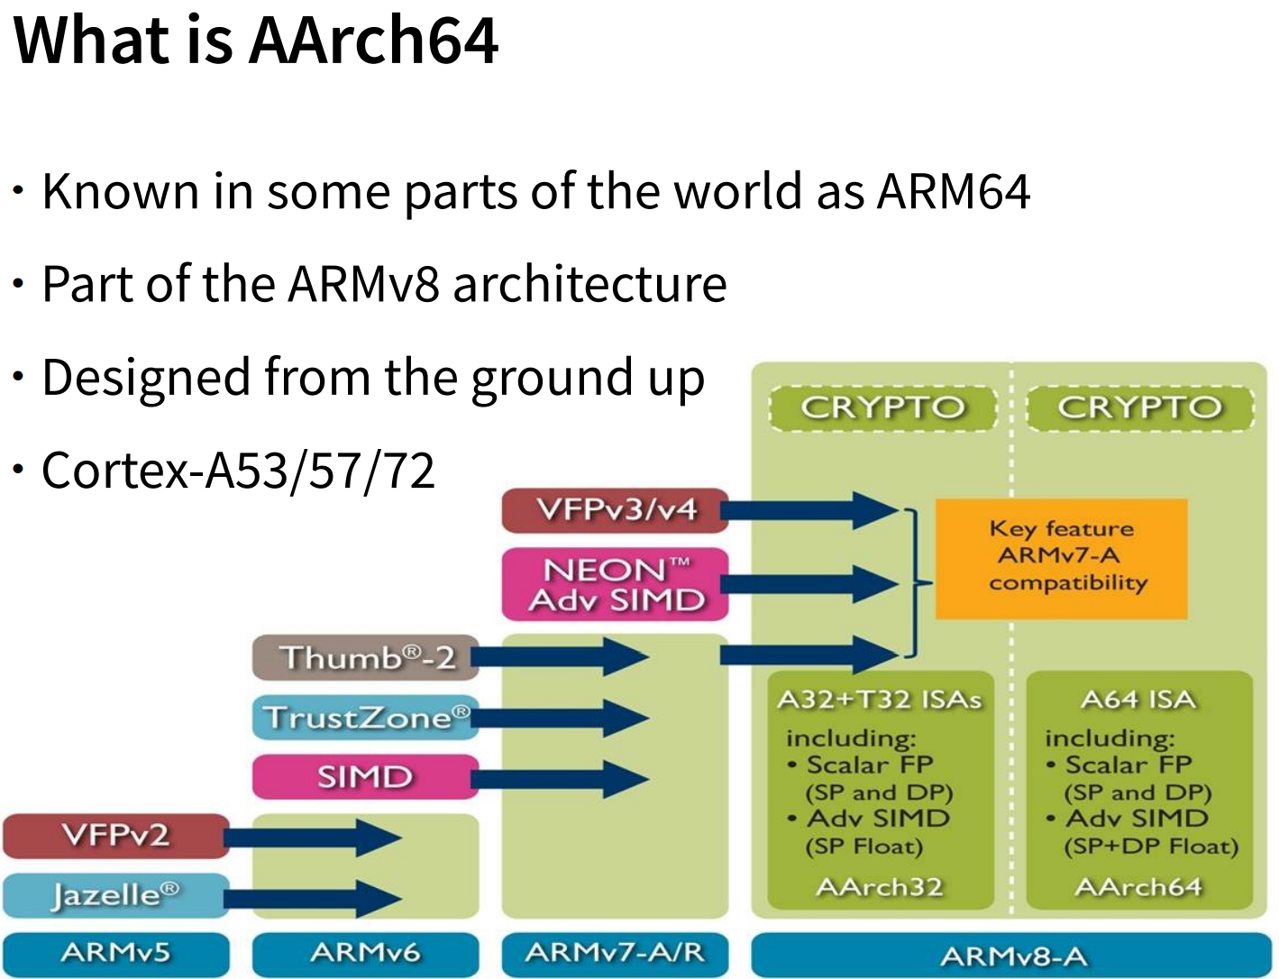
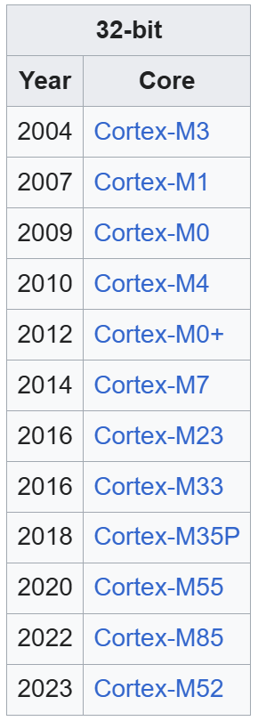
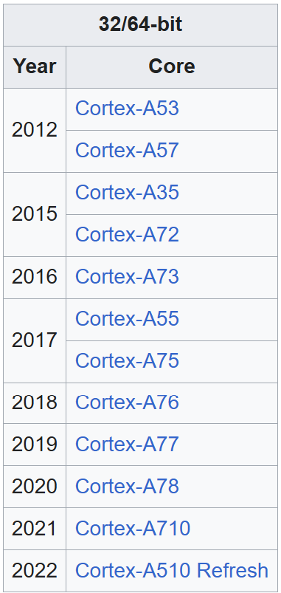
Our board:
ARM Cortex-M4F: latest is M85/M52

Slide 4
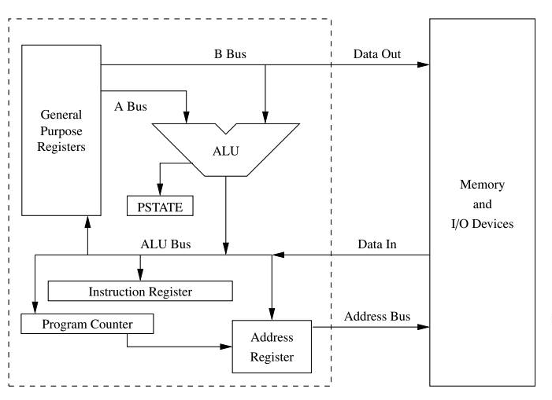
The ARMv8 Instruction Set

Slide 5
The ARMv8 Instruction Set
ARM processors list:
Classic or Cortext-A (application): DSP, Floating Point, TrustZone, Jazelle extensions. ARMv5, ARM6 (2001)
Cortex-M (micro-controller -> mobile): ARM Thumb®-2 code density. Extended to include 32-bit instructions. First Multi-core. (2004)
Cortex-R (real time): ARMv7 Deeply pipelined micro-architecture, Flexible Multi-Processor Core (MPCore) configurations: Symmetric Multi-Processing (SMP) & Asymmetric Multi-Processing (AMP), LPAE extension.

Slide 6
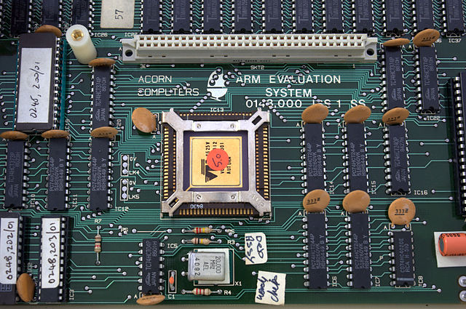
The ARMv8 Instruction Set
ARM instructions sets:
Development board/computer
1985
ARM1 ARMv1 (ISA)
32-bit RISC architecture
26-bit addressing
16 general-purpose registers (R0–R15)
R15 serving as the program counter (PC).
Conditional execution for most instructions.
No hardware multiply instruction!
No FPU
https://en.wikipedia.org/wiki/ARM_architecture_family

Slide 7
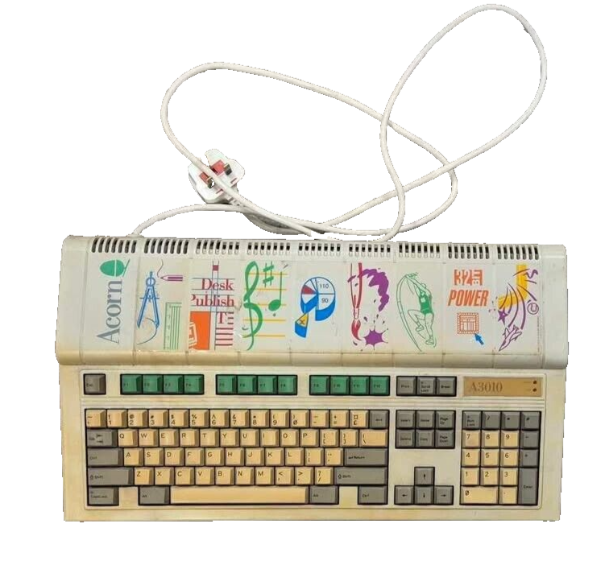
The ARMv8 Instruction Set
ARM instructions sets:
Acorn A3010
1992
ARM2 ARMv2 (ISA)
32-bit RISC architecture
26-bit addressing
16 general-purpose registers (R0–R15)
R15 serving as the program counter (PC).
Conditional execution of instructions.
No FPU

Slide 8
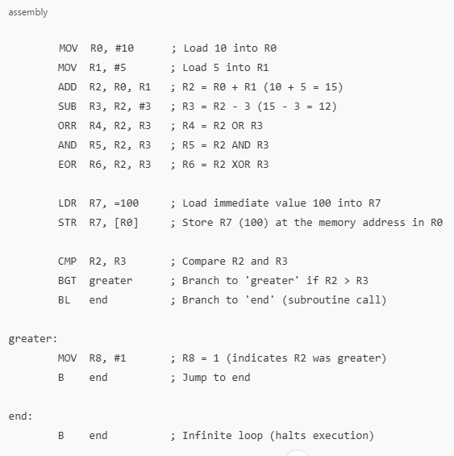
The ARMv8 Instruction Set
ARMv1
New Instructions in ARMv7 (Compared to ARMv1)
MUL, MLA
SMULL, UMULL
LDRH, STRH→ Load/store doubleword (16-bit).
LDRD, STRD → Load/store doubleword (64-bit).
BX, BLX → Branch & exchange
IT → If-Then block
MSR, MRS → Move to/from system registers.
NOP → No operation
FPU & SIMD (NEON)
VADD, VSUB, VMUL, VDIV → Vector floating-point arithmetic.
VLDR, VSTR → Load/store floating-point registers.
VCEQ, VCGE, VCGT → Vector comparisons.
Some others …

Slide 9
ARM64 / AArch64 / ARMv8

Slide 10
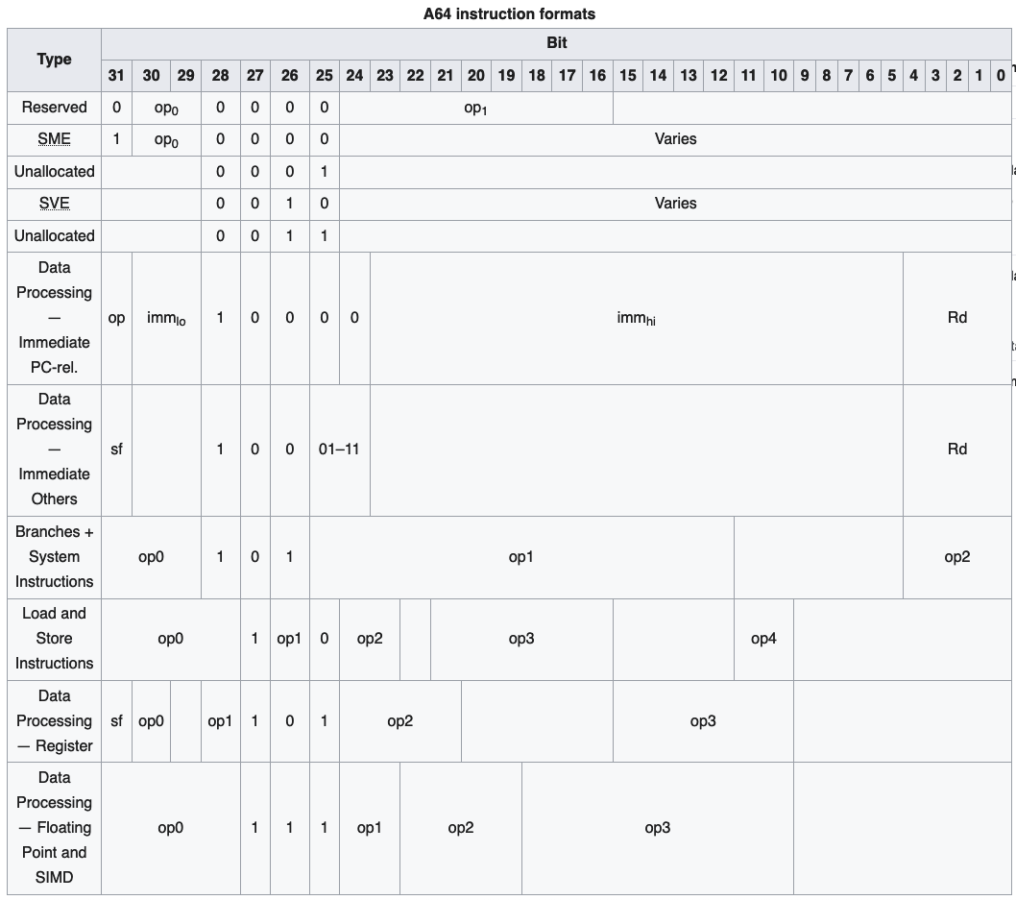
ARMv8
Instruction set:
Apple was the first to release an ARMv8-A compatible core (Cyclone) for iPhone 5S Apple A7 2013
Each instruction is 32 bit (not more, not less)
4 bit for opcode = 16 major instructions
In contrast to Intel variable instruction size
Pipeline: 4 stages for integer instructions
Pipeline: 5 stages for floating point (FP)

Slide 11
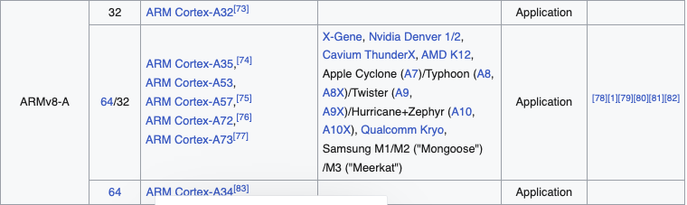
ARMv8
Instruction set:
Apple was the first to release an ARMv8-A compatible core (Cyclone) for iPhone 5S Apple A7 2013
https://en.wikipedia.org/wiki/ARM_architecture_family

Slide 12
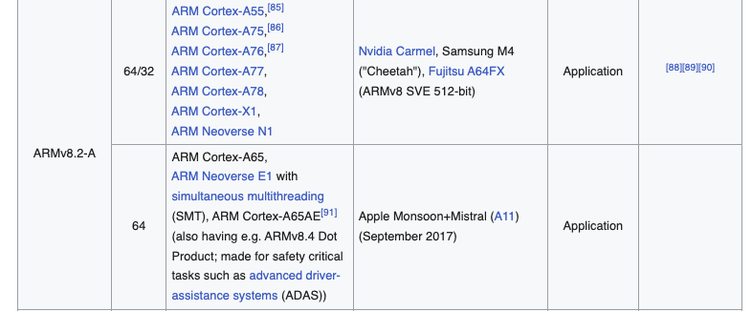
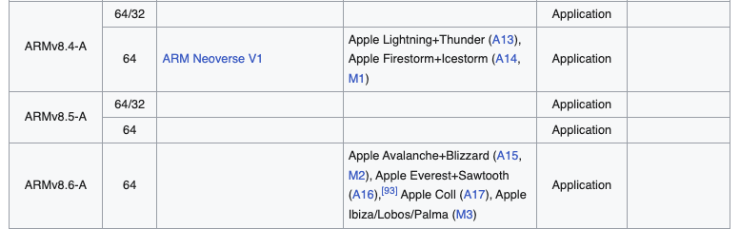
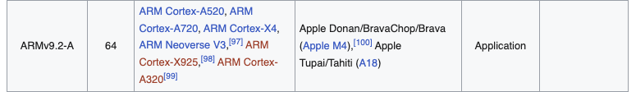
ARMv8
https://en.wikipedia.org/wiki/ARM_architecture_family

Slide 13
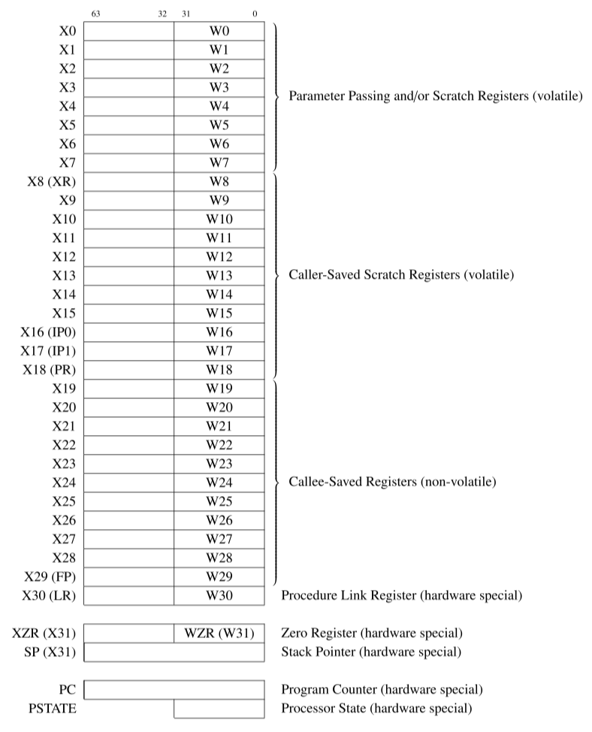
Registers
X0 - X30: General Purpose (64bit)
W0 - W30: General purpose (32bit)
(lower 32 bits)
SP: Stack Pointer
XZR: Zero Register (64bit)
WZR: Zero Register (32bit)
X30, LR: Link Register
PC: Program Counter

Slide 14
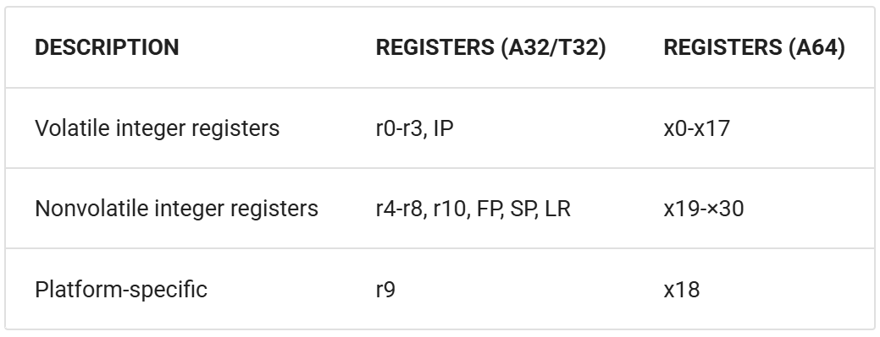
ARM64
Volatile/Nonvolatile
Registers which can be used freely are referred to as volatile
Registers which must be preserved are referred to as non-volatile.
Registers x0-x18 are volatile
Registers x19-x29 are non-volatile

Slide 15
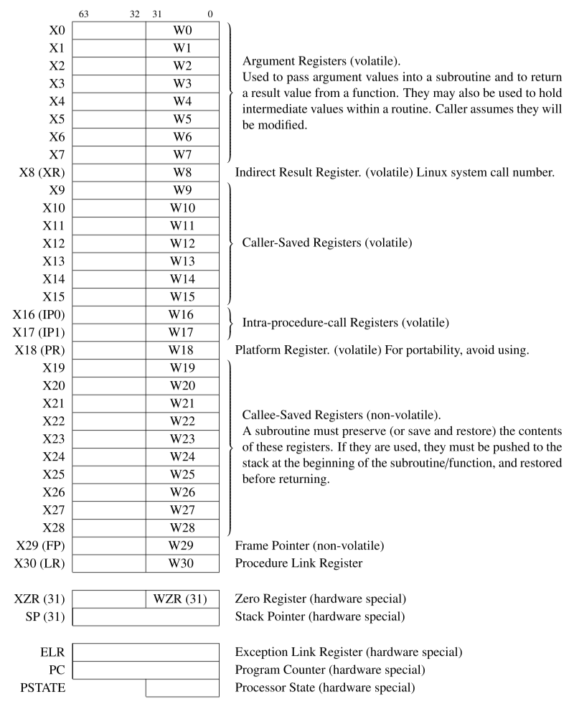
Registers
Registers X0-X7, are volatile, because they can be changed by subroutines.
Registers X8-X17 are volatile, used for holding local variables:
Some of these are used for special purposes by the OS and/or compiler.
Registers X19-X28, used for local variables:
Before using them, the subroutine must preserve them.
They are non-volatile because their contents cannot be changed by a subroutine.

Slide 16
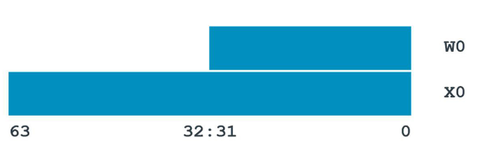
ARM64
General-Purpose Registers
ARM64 provides 31 general purpose registers.
Each register can be used as a 64-bit X-register (X0..X30)
Or as a 32-bit W-register (W0..W30).
Two ways of looking at the same register. W0 is the bottom 32 bits of X0:

Slide 17
ARM64
Arithmetic Instructions:
The choice of X or W determines the size of the operation.
Using X registers will result in 64-bit calculations
Using W registers will result in 32-bit calculations.
This performs a 32-bit integer addition:
ADD W0, W1, W2
This performs a 64-bit integer addition:
ADD X0, X1, X2
All registers in an instruction must be W or X, mixing is not allowed
When a W register is used, the top 32-bits of the 64-bit register are zeroed.

Slide 18
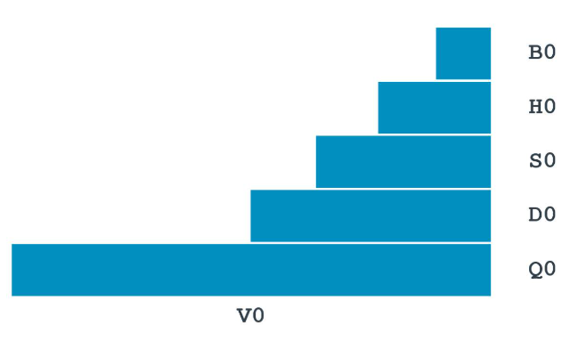
ARM64
Floating-Point
Separate set of 32 registers used for floating point and vector operations.
These registers are 128-bit
But they can be accessed in several ways:
Bx is 8 bits
Hx is 16 bits
Sx is 32 bits
Dx is 64 bits
Qx is 128 bits
1-bit sign
3-bit exponent (+3 -> -3)
4-bit fractional

Slide 19
ARM64
Other Registers
The zero registers, XZR and WZR, always read as 0 and ignore writes.
You can use the stack pointer (SP) as the base address for loads and stores.
X30 is used as the Link Register and can be referred to as LR.
The Program Counter (PC) is not a general-purpose register in A64

Slide 20
Differences between ARMv7 and ARMv8

Slide 21
ARM64
Overview
Fixed length 32bit instructions
Unaligned memory access, is now possible
Memory is byte addressed
Each address identifies an 8-bit byte

Slide 22
ARM64
Traditional features
No conditional instructions IT
No explicit co-processors
Everything one processor now
No load/store multiple instructions:
LDM
STM
PUSH
POP

Slide 23
ARM64
some_func:
stp x29, x30, [sp, #-0x10]!
ldp x29, x30, [sp], #0x10
ret
WAIT, no PUSH/POP?!?! ☹
Broken AArch64 implementation of `push {x1}; push {x0};`
The required stack pointer alignment is two x or four w registers
It is not possible to push individual registers
str x1, [sp, #-8]! // This works, but leaves `sp` with only 8-byte alignment ...
str x0, [sp, #-8]! // ... so the second `str` will fail.
It is wasteful – but the simplest way to handle the stack pointer to a 16-byte slot:
str x0, [sp, #-16]! // push {x0}
ldr x0, [sp], #16 // pop {x0}

Slide 24
ARM64
Traditional features
FPU is integrated and mandatory
Floating-point commands are mostly the same (VADD, VMUL, …)
Weakly ordered memory
Integer Arithmetic basically the same

Slide 25
ARM64
New Features
Crypto (AES and SHA) instructions
AdvSIMD for general purpose float math
Larger PC-relative addressing and branching
Conditional branches +/-1MB
Unconditional branches +/-128MB

Slide 26
ARM64
Conditional Instructions
Conditional branches
CBZ, B.cond
Add/subtract with carry
ADC, SBC
Conditional compare
CCMP
Conditional select/set with increment, negate or invert
CSEL, CSET (new IT block kinda)

Slide 27
ARM64
Bit shifting
64-bit registers (X0-X30) in addition to 32-bit (W0-W30).
Shift amount is 6-bit (0-63 range for X registers, 0-31 for W registers).
Explicit shift instructions exist but support both 32-bit and 64-bit values:
LSL X0, X1, #4 // X0 = X1 << 4 (64-bit shift)
LSR W2, W3, #1 // W2 = W3 >> 1 (32-bit shift)

Slide 28
Operations

Slide 29
Arithmetic Operations
Add and subtract, three operands
Two sources and one destination
ADD w0, w1, w2 // w0 gets w1 + w2
All arithmetic operations have this form

Slide 30
Arithmetic Example
C code: f = (g + h) - (i + j);
Compiled LEGv8 code:
ADD t0, g, h // temp t0 = g + h
ADD t1, i, j // temp t1 = i + j
SUB f, t0, t1 // f = t0 - t1

Slide 31
Register Operand Example
C code:
f = (g + h) - (i + j);
f, g, h, i, and j in X19, X20, X21, X22, and X23 respectively.
Compiled code:
ADD X9, X20, X21 ADD X10, X22, X23 SUB X19, X9, X10
Notes:
X19 – X27: saved
X9 – X15: temporaries

Slide 32
Immediate Operands
Constant data specified in an instruction
ADDI X22, X22, #4 // Immediate

Slide 33
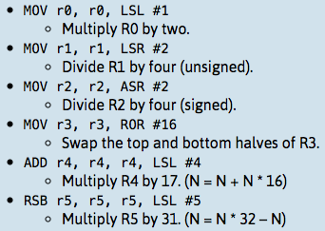
Instruction Sets
An inline barrel shifter to preprocess one of the input registers (Operand2).
Examples:
Notes:
RSB R5 Operand 2 (Revers Subtract) = subtracts the value of R5 from Operand 2.
Flexible addressing of operand 2.

Slide 34
Examples

Slide 35
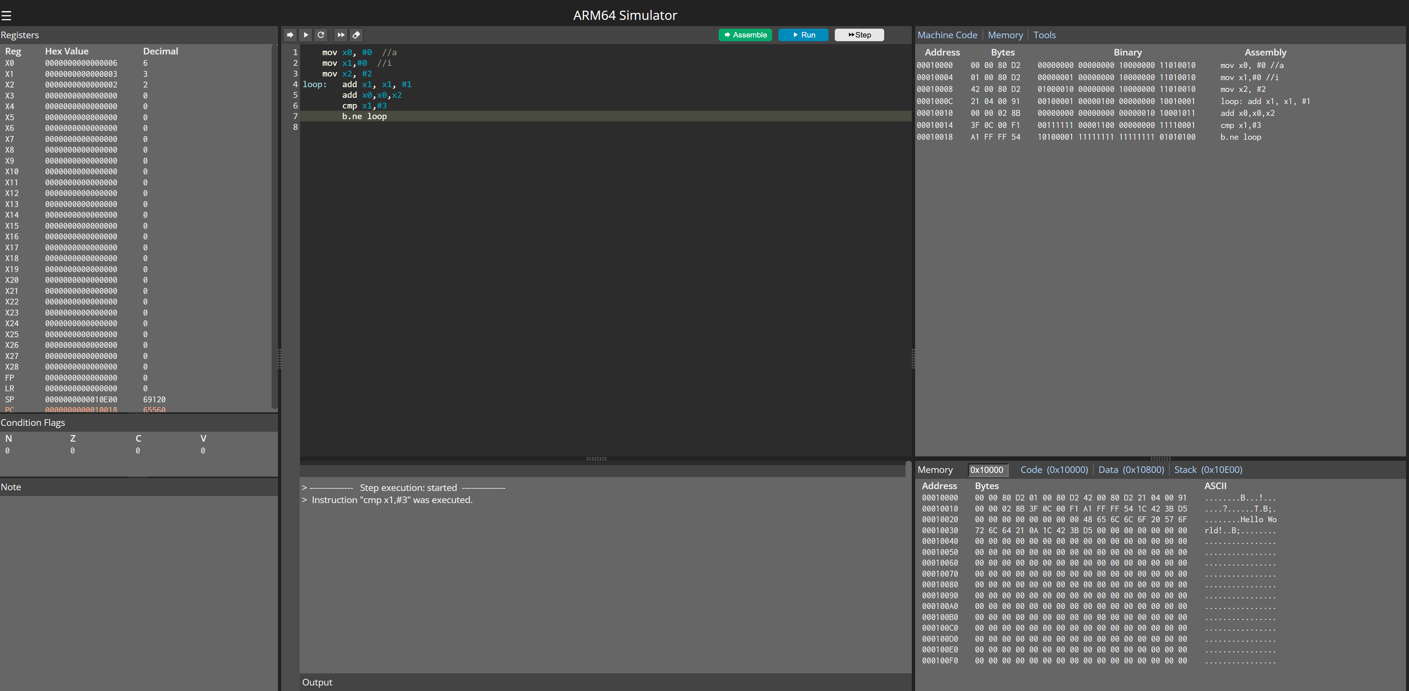
Examples
ARM64 Simulator:
http://163.238.35.161/~zhangs/arm64simulator/
Not a good simulator. Missing:
All data directives
FPU instructions
FPU registers
Registers Hex/Dec
Loading or saving examples
…
Very limited ☹

Slide 36
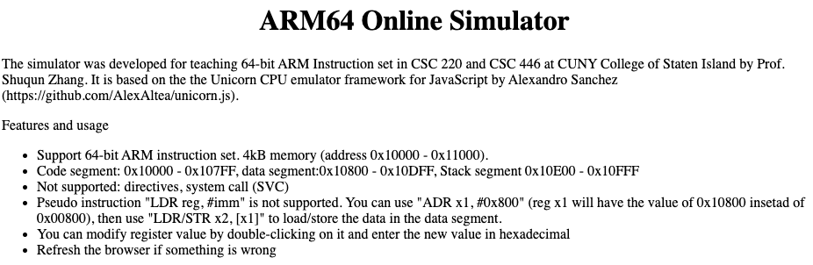
Examples
ARM64 Simulator:
http://163.238.35.161/~zhangs/arm64simulator/

Slide 37
Examples
1. first program: arithmetic instructions:
mov x0, #2
mov x1, #-3
add x2, x0, x1 // 2+(-3)
sub x3, x0, x1 // 2-(3)
mul x4, x0, x1 // 2*(-3)
udiv x5, x1, x0 // 2/(-3)
sdiv x6, x1, x0 // 2/(-3)

Slide 38
Examples
2. multiply: 9*7 - 5*3
mov x1, #9 //x0 <- 9
mov x2, #7 //x1 <- 7
mul x0, x1, x2 //x0 <- x1 * x2
mov x2, #5 // x1 <- 5
mov x3, #3 // x2 <- 3
mul x1, x2, x3 // x1 <- x2 * x3
sub x0, x0, x1 // x0 <- x0 - x1

Slide 39
Examples
3. logic instructions:
mov x0, #6
mov x1, #10
and x2, x0, x1
orr x3, x0, x1
eor x4, x0, x1

Slide 40
Examples
4. shift instructions (show equivalence of shift to multiplication/division):
mov x0, #8
lsl x5, x0, #3 // x0*8
lsr x6, x0, #2 // x0/4
asr x7, x0, #3 // x0/8
ror x8, x0, #1

Slide 41
Examples
5. memory access: load/store data in data segment:
first store 5 and 3 into data segment (starting address 0x800) and then load and add them together
mov x0, #5
adr x1, #0x800 //can't use mov because of 16-bit imm limit for mov
str x0, [x1]
ldr x4, [x1]
mov x0, #3
add x1, x1, #8
str x0, [x1]
ldr x5, [x1]
add x6, x4, x5
start: MOV r0,#10
ADR r4,start // SUB r4,pc,#0xc

Slide 42
Examples
6. load/store data in stack using stack pointer sp:
mov w0, #19
str w0, [sp, #12]
ldr w0, [sp, #12]
add w0, w0, #02
add sp, sp, #0x10

Slide 43
Examples
7. simple loop: a=0; for (i=0; i<3) a=a+2;
mov x0, #0 //a
mov x1,#0 //i
mov x2, #2
loop: add x1, x1, #1
add x0,x0,x2
cmp x1,#3
b.ne loop

Slide 44
Examples
8. Branch instructions: if (a == 3) b=a-2; else b=a+2;
mov x0, #2
mov x1, #3 //a
cmp x1, #3
b.eq equal
add x2, x0, x1
b end
equal: sub x2, x0, x1
end:

Slide 45
Examples
9. find the largest and put in x0
main:
mov x1, #34
mov x2, #54
mov x3, #91
mov x0, x1 // start with x1
cmp x0, x2
b.ge test_r3
mov x0, x2
test_r3:
cmp x0, x3
b.ge end
mov x0, x3
end:

Slide 46
Examples
10. function call: main() { a=0; adder2(a);}, int adder2(int a) { return a + 2;}
main: mov w0, #0
bl adder2
ret //important, infinity loop without it
adder2: sub sp, sp, #0x10
str w0, [sp, #12]
ldr w0, [sp, #12]
add w0, w0, #0x2
add sp, sp, #0x10
ret

Slide 47
Examples
11. computer fibonacci sequence:
main:
mov x0, 0 //answer
mov x1, 9 // find 9th number
mov x2, 0 //first number
mov x3, 1 //second number
mov x4, 0 //i=0
loop:
add x4, x4, 1
cmp x1, x4
b.le exit
mov x5, x0
add x0, x2, x3
mov x2, x0
mov x3, x5
b.al loop
exit:

Slide 48
Done

