Slide 1
TDD
Test Driven Development

Slide 2
Tdd (Test Driven Development)
TDD is a development methodology where requirements for stories are turned into very specific tests that are written first (causing the newly added tests to fail). Then the changes to the software are added to allow only those new tests to pass (all existing tests should also pass).

Slide 3
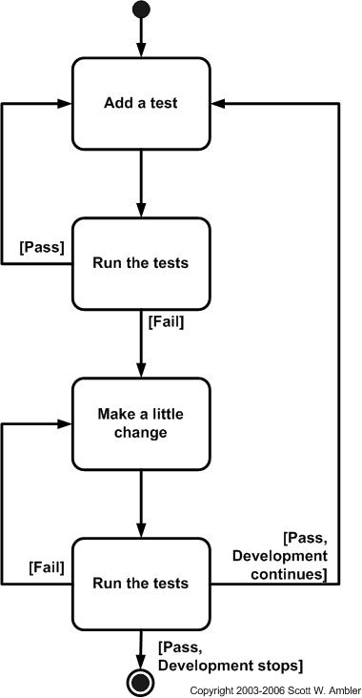
Basic methodology
Turn a requirement into a test and add the test
Run Tests (only your new test should fail)
write minimal code so that the new test passes
Run all tests again (all should now pass)
Refactor and cleanup the code to be organized and to remove duplication
repeat

Slide 4
Pros
Enforces well-defined requirements
Smaller units of work for faster turn arounds
Reduced coverage gaps
Small changes result in quicker fixes.
Code produced should be simpler and easier to understand

Slide 5
Cons
Lots of code refactoring
Doesn't handle integrated testing well
Large number of tests
maintenance of these tests over time grows
new features get added and can break hundreds of tests.
false sense of security.
typically the developer writing the tests is also writing the code, in this case if the developer misinterprets the requirement, both the test and code will be wrong, and incorrectly show that the test passes
Narrow focus can sometimes create overall design issues over time.
Lots of context switching, change in thinking patterns

Slide 6
Example
User Info
GetUserId should return the string “mgregory”
GetPassword for the User should return “password123”

