Slide 1
Intro to Flexbox
Basic terminology
Basic operation
Flex-grow, flex-shrink, flex-basis
Wrapping
Varying individual flex items
Does CSS Grid replace flexbox?
Bootstrap 4
Getting started with flexbox in your website

Slide 2
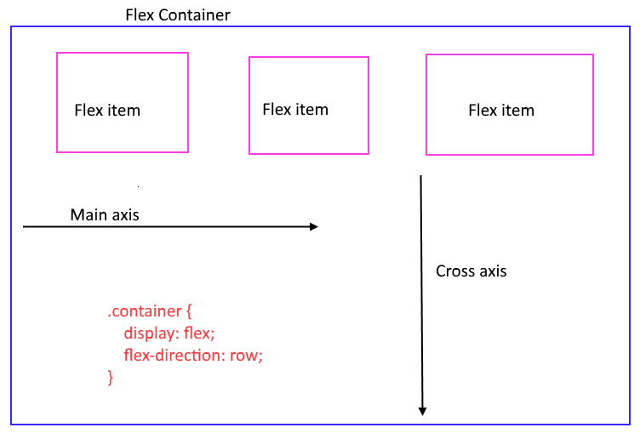
Basic terminology
Flex container
Flex item
Main axis
Cross axis

Slide 3
Basic operation
Apply to the flex container
Turn flexbox on
display: flex;
Set the layout direction
flex-direction: [row, column, row-reverse, column-reverse];
Set main axis alignment
justify-content: [flex-start, flex-end, center, stretch, space-around, space-between];
Set cross axis alignment
align-items: [flex-start, flex-end, center, stretch, space-around, space-between];
Demo1\flex-directions.html
Demo1\align-justify.html

Slide 4
flex-grow, flex-shrink, flex-basis
All of these operate on the main axis
Flex-grow
Controls how an item grows to occupy extra space
Flex-shrink
Controls how an item shrinks when there isn’t enough space
Flex-basis
Sets the ideal width of an item
May be constrained by min-width and min-height

Slide 5
Flex-grow
Applies to each row of the flex container (default: 0)
To calculate:
calculate unused space in the flex container
add up all the flex-grow values
divide each flex item's flex-grow by the total to get a ratio for growth
allocate free space to each flex item according to the ratio

Slide 6
Flex-grow examples
flex container 400px
3 items
100px each
each with flex-grow: 1;
free space = 100px
total of flex-grow values = 3
each item gains 100px * 1/3 = 33.3px
flex container 400px
3 items
100px each
DIVs 1 & 2 with flex-grow: 1;
DIV 3 with flex-grow: 2;
free space = 100px
total of flex-grow values = 4
DIVs 1 & 2 gains 100px * 1/4 = 25px
DIV 3 gains 100px * 2/4 = 50px
Extra width = free space * (ratio of flex-grow to total flex-grow)

Slide 7
Flex-shrink
Applies to each row of the flex container (default: 1)
Like flex-grow, shrink will be governed by the ratio of each flex item’s flex-shrink to the others.
To calculate:
Calculate how much space has to be shaved off the flex items to fit the container
Add up all the flex-shrink values
For each flex item, shave off width according to the ratio of the flex-shrink
Amount to shave off = total amount to shave * (flex-shrink / total of flex-shrink)

Slide 8
Flex-basis
Determines the ideal of an item
Constrained by min-width and max-width
How is width determined
Flex-basis wins
Width property of the item
Content width
Default: auto
Defers to the rules above

Slide 9
Wrapping
Turn wrapping on
flex-wrap: [wrap, wrap-reverse];
Set spacing between rows
align-content: [fl..-s...., fl..-e.., ce...., st....., sp...-ar...., sp...-b......];
Alignment (justify-content and align-items)
Applies to each row individually

Slide 10
Varying individual flex items
Over-ride cross axis alignment
align-self: [flex-start, flex-end, center, stretch, space-around, space-between];
Re-ordering display
order: [integer];

Slide 11
Does CSS Grid replace flexbox?
No
CSS Grid is a 2 dimensional layout tool. Flexbox is 1 dimensional
Currently has less support than flexbox
Each can do things the other cannot
Each has similarities
Jen Simmons on YouTube Flexbox vs CSS Grid
https://www.youtube.com/watch?v=hs3piaN4b5I

Slide 12
Bootstrap 4
What’s good in Bootstrap 4?
It will support IE10 and iOS 7
Non-objectionable default look for the graphically challenged
Usable set of components
CSS Properties!
Package.json is all npm scripts
What’s not so good?
For IE11 or later
Nothing compelling in its layout system to warrant its use
!important soup
Lots of classes that do very little
d-flex
Applies display: flex;
justify-content-center
Applies justify-content: center;

Slide 13
Getting started
browser support
caniuse.com: http://caniuse.com/#feat=flexbox
start small
center a single element on both axes
add an optional element beside another
no matter whether 1 or both elements are displayed, you need to center them vertically and horizontally
you could use it to layout a menu
perhaps the menu needs to display horizontally for wide displays and vertically on mobile

Slide 14
Resources
Flexbox Zombies
https://mastery.games/p/flexbox-zombies
MDN Flexible Box Layout
https://developer.mozilla.org/en-US/docs/Web/CSS/CSS_Flexible_Box_Layout
3 Superpowers of the Flex-Box Model — How flex-basis, flex-shrink and flex-grow work
https://www.codecamps.com/3-superpowers-of-the-flex-box-model/?utm_source=frontendfocus&utm_medium=email
Jen Simmons Layout Land YouTube channel
https://www.youtube.com/channel/UC7TizprGknbDalbHplROtag
Flexbugs repo on GitHub
https://github.com/philipwalton/flexbugs
CSS-Tricks Complete Guide to Flexbox
https://css-tricks.com/snippets/css/a-guide-to-flexbox/
This talk on GitHub: github.com/mikehans/FE-meetup-flexbox
https://github.com/mikehans/FE-meetup-flexbox

