Slide 1
Science Education
for the 21st Century
Using the insights of science to teach/learn science
Carl Wieman UBC & CU
Nobel
Prize
Data!!
Colorado physics & chem education research group:
W. Adams, K. Perkins, K. Gray, L. Koch, J. Barbera, S. McKagan, N. Finkelstein, S. Pollock, R. Lemaster, S. Reid, C. Malley, M. Dubson... $$ NSF, Hewlett)

Slide 2
The Vision
Guided by research on learning
All students much better educated.
⇒ many benefits to society.
Scientifically literate public
Modern economy
Teaching more effective and more efficient and rewarding for the teacher.

Slide 3
How to achieve?
I. 2 models for teaching.
II. Research on science learning
a. Components of scientific expertise
b. Measuring development of expertise
c. Effective teaching and learning

Slide 4
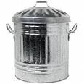
Science teaching Model 1 (I used for many years)
think hard, figure out subject
tell students how to understand it
give problem to solve
tell again
Louder
yes
no
done
students lazy or poorly prepared

Slide 5

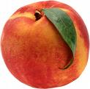
Model 1 (figure out and tell) Strengths & Weaknesses
Works well for basic knowledge, prepared brain:
bad,
avoid
good,
seek
Easy to test. ⇒ Effective feedback on results.
See problems if learning:
involves complex analysis or judgment
organize large amount of information
ability to learn new information and apply
Complex learning-- different.

Slide 6
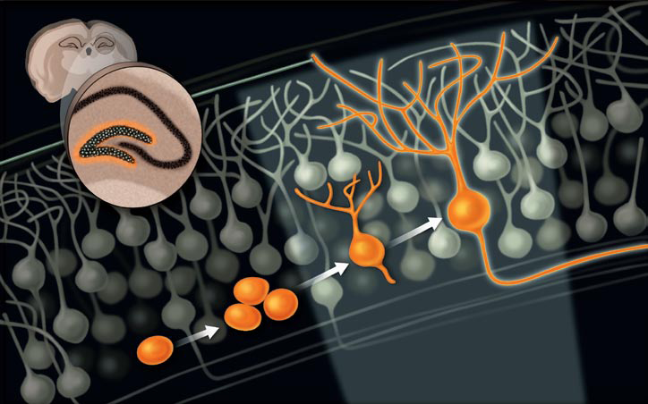
Significantly changing the brain, not just adding bits of knowledge.
Growing neurons & building proteins ⇒ enhance neuron connections, ...
How to teach and measure this complex learning?

Slide 7
Model 2 --scientific approach to science education
Methods based on careful measurements of
desired expert performance.
Guided by research on learning.
Experiment & iterate until achieve desired result.
⇒New opportunities for improving teaching.

Slide 8

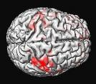
Major advances past 1-2 decades
Consistent picture ⇒ Achieving learning
classroom
studies
brain
research
cognitive
psychology

Slide 9
Model 2-- scientific approach
What has been learned?
1. Identifying components of expertise (thinking scientifically), and how expertise is developed.
2. How to measure components of science expertise.
(and what traditional exams have been missing)
3. Components of effective teaching and learning.

Slide 10


Expert competence research*
historians, scientists, chess players, software engineers,...
Expert competence =
factual knowledge
Organizational framework ⇒ effective retrieval and application
patterns, associations,
scientific concepts
or ?
Ability to monitor own thinking and learning
("Do I understand this? How can I check?")
New ways of thinking-- require MANY hours of intense practice with guidance/reflection. Change brain “wiring”
*Cambridge Handbook on Expertise and Expert Performance

Slide 11
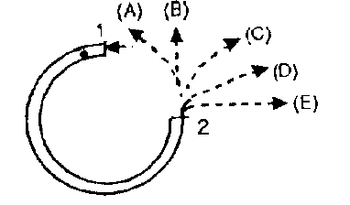
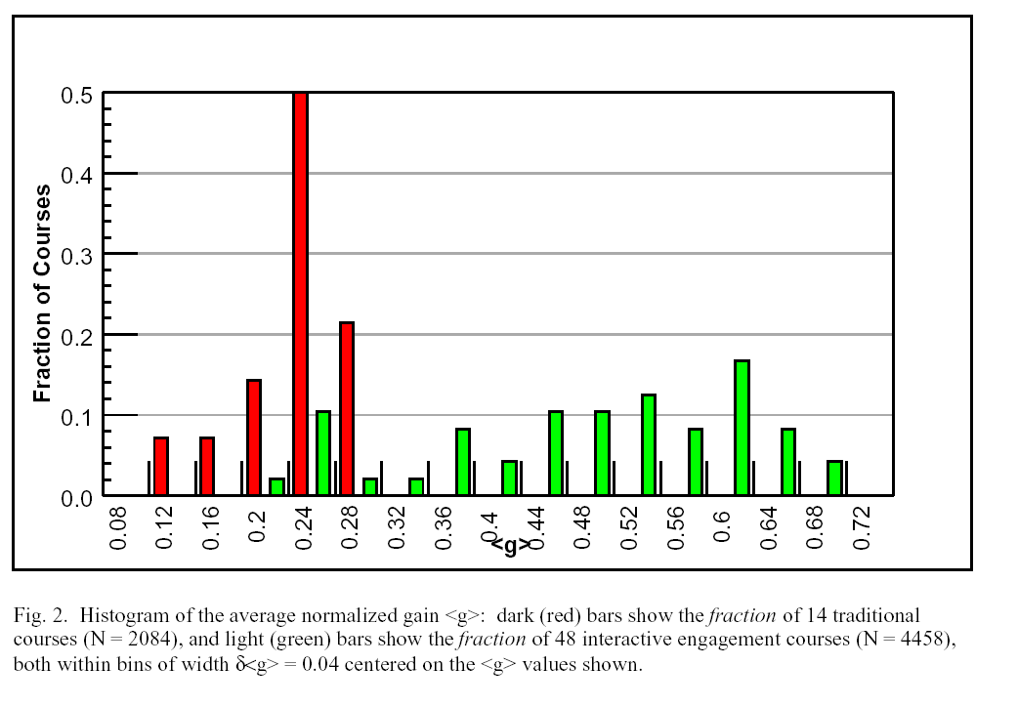
Measuring conceptual mastery
Force Concept Inventory- basic concepts of force and motion 1st semester physics
Ask at start and end of semester--
What % learned? (100’s of courses)
Average learned/course
16 traditional Lecture
courses
improved
methods
Fraction of unknown basic concepts learned
On average learn <30% of concepts did not already know.
Lecturer quality, class size, institution,...doesn't matter!
Similar data for conceptual learning in other courses.
R. Hake, ”…A six-thousand-student survey…” AJP 66, 64-74 (‘98).

Slide 12
Lister, Simon, Thompson, Whalley, Prasad,
ITiCSE'06, June 26–28, 2006, Bologna, Italy. pg 118
In plain English, explain what the following segment of Java code does:
bool bValid = true;
for (int i = 0; i < iMAX-1; i++)
{
if (iNumbers[i] > iNumbers[i+1])
bValid = false;
}
computer scientist-- see in terms of overall function.
“The code checks whether the array is sorted.”
Students completed CS course--
<1/3 see in terms of this coherent overall structure
success in courses ≠ thinking like expert

Slide 13
Perceptions about subject
highly relevant to:
interest/recruitment
retention in major
attracting under-represented groups
public literacy

Slide 14
Experts in a science have unique perception
Novice
Expert
Content: isolated pieces of information to be memorized.
Handed down by an authority. Unrelated to world.
Problem solving: pattern matching to memorized recipes.
Content: coherent structure of concepts.
Describes nature, established by experiment.
Prob. Solving: Systematic concept-based strategies. Widely applicable.
measure student perceptions with surveys
intro physics ⇒ more novice
chem. & bio as bad
understand why, how to change
*adapted from D. Hammer

Slide 15
Model 2-- scientific approach
What has been learned?
1. Identifying components of expertise,
and how expertise developed.
2. How to measure components of science expertise.
(and what traditional exams have been missing)
⇒3. Components of effective teaching and learning.

Slide 16
Components of effective learning/teaching
apply to all levels, all settings, all subjects
1. Motivation (essential & often neglected)
2. Connect with and build on prior thinking
*3. Apply what is known about memory
*4. Explicit authentic practice of expert thinking. Extended & strenuous
(brain development like muscle development)
Research provides guidance on all.
Today just those with *.
Principle + example application

Slide 17
Components of effective teaching/learning
apply to all levels, all settings, all sciences
1. Motivation
2. Connect with and build on prior thinking
3. Apply what is known about memory
a. achieving long term retention
b. short term limitations
4. Explicit authentic practice of expert thinking. Extended & strenuous
(brain development like muscle development)

Slide 18
a. Long term memory retention
(R. Bjork-- accessible summaries of research)
Main finding-- Must retrieve and apply (“test”)
Do repeatedly, spaced in time.
Relevant common teaching error:
exams mostly what counts
⇒ encourages cramming for exams.
Maximizes performance on exam,
but terrible long term retention.

Slide 19
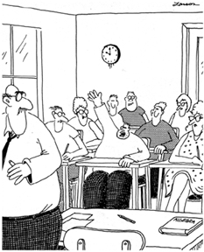
b. Limits on working memory--best established, most ignored result from cognitive science
Working memory capacity
VERY LIMITED!
(remember & process
<7 distinct new items)
MUCH less than in
typical science lecture
Mr Anderson, May I be excused?
My brain is full.

Slide 20
⇒ processing and retention from lecture tiny
(for novice)
repeatedly shown in research
Also true in technical talks!
Notes:
(Hrepic, Zollman, Rebello). I thought you might be interested that the full paper was accepted for publication in Journal of Science Education and Technology and it is currently in print.

Slide 21
“Curse of knowledge” common teaching mistake
step 1-- teach all the pieces of background knowledge
and math procedures.
step 2-- give problem and show how pieces are put together to solve.
Makes sense only if already know subject!
For student, pieces are disconnected facts to memorize.
Requires lots of working memory (and is boring).
Better Approach:
step 1-- present interesting problem
step 2-- bring in facts and procedures as parts of solution.
Reduces working memory demands & more motivating.
Builds expert connections and mental framework.

Slide 22
Components of effective teaching/learning
apply to all levels, all settings
1. Motivation
2. Connect with and build on prior thinking
3. Apply what is known about memory
4. Explicit authentic practice of expert thinking. Extended & strenuous
(brain development like muscle development)

Slide 23
Practicing expert-like thinking--
Challenging but doable tasks/questions
Explicit focus on expert-like thinking
concepts and mental models
recognizing relevant & irrelevant information
self-checking, sense making, & reflection
Teacher provide effective feedback (timely and specific)
Research shows time and effort not enough-- need to know what and how to practice.

Slide 24
Components of expertise-- software design
Sonnentag, et al, Chap. 21,
Cambridge Handbook of Expertise
Two conspicuously missing from most CS teaching:
Debugging and testing
Communication and collaboration

Slide 25
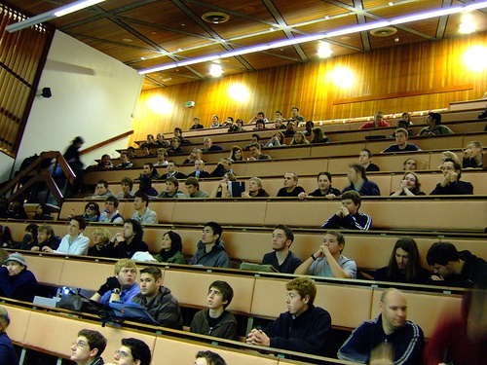
How to actually do in class?
Hundreds of students???
use technology to help
Example from a class--practicing expert thinking with effective guidance/feedback
1. Assignment--Read chapter on electric current. Learn basic facts and terminology. Short quiz to check/reward.
2. Class built around series of questions.

Slide 26
When switch is closed, bulb 2 will
a. stay same brightness, b. get brighter
c. get dimmer,
d. go out.
1
2
3
(%)
A B C D E
3. Individual answer with clicker
(accountability, primed to learn)
4. Discuss with “consensus group”, revote. (prof listen in!)
5. Elicit student reasoning. Show responses.
Do “experiment.”-- simulation.

Slide 27
Follow up instructor discussion--
review correct and incorrect thinking, extend ideas.
Respond to student questions & suggestions.
(additional student learning)
Example 2. 10 minute in-class activity.
“ Divide into groups of 3 and create algorithm (or code) that will accomplish this task...
Write down on piece of paper to share and discuss. Include how to test that it is correct.”

Slide 28
How practicing expert thinking--
Challenging but doable question
(difficult concept, prior thinking)
Explicit focus on expert-like thinking
actively developing concepts and mental models
recognizing relevant & irrelevant information
self-checking, sense making, & reflection
Getting timely and specific feedback
(peers, clicker histogram, instructor)
Highly engaged-- “exercising” brain in optimum way

Slide 29
good start, but not enough time in class!
further practice-- well designed homework
Require expert thinking & feedback,
⇒ true expertise

Slide 30
Some Data (from science classrooms):
Model 1 (telling)
traditional lecture method scientific teaching
Retention of information from lecture
10% after 15 minutes
⇒ >90 % after 2 days
Fraction of concepts mastered in course
15-25%
⇒ 50-70% with retention
Perceptions of science-- what it is, how to learn
significantly less
(5-10%) like scientist
⇒ more like scientist
improve for future nonscientists and scientists

Slide 31
Summary:
Scientific model for science education
Much more effective. (and more fun)
Good Refs.:
NAS Press “How people learn”
Redish, “Teaching Physics” (Phys. Ed. Res.)
Handelsman, et al. “Scientific Teaching”
Wieman, Change Magazine-Oct. 07
at www.carnegiefoundation.org/change/
CLASS belief survey: CLASS.colorado.edu
phet simulations: phet.colorado.edu
cwsei.ubc.ca-- resources, Guide to effective use of clickers

Slide 32
extra unused slides below

Slide 33
How to get into every classroom?

Slide 34
Motivation-- essential
(complex- depends on previous experiences, ...)
Enhancing motivation to learn
a. Relevant/useful/interesting to learner
(meaningful context-- connect to what they know and value)
b. Sense that can master subject and how to master
c. Sense of personal control/choice

Slide 35
UBC CW Science Education Initiative and U. Col. SEI
Changing educational culture in major research university science departments
necessary first step for science education overall
Departmental level
⇒scientific approach to teaching, all undergrad courses = learning goals, measures, tested best practices
Dissemination and duplication.
All materials, assessment tools, etc to be available on web

Slide 36
Science teaching Model 2.
Goals. What students will be able to do.
(solve, design, analyze, capacity to learn,...)
prior
research
Create activities and feedback targeting desired expertise.
prior
research
Use, and measure results.
modify
no
yes
why?
done
goals unrealistic
wrong treatment

Slide 37
Is model for doing science
Goals. Question to be answered.
What data will answer it.
prior
research
Design and build experiment.
prior
research
Run and measure results.
modify
no
yes
why?
done
goals unrealistic
wrong experiment

Slide 38
Model 2 --scientific approach to science education
Goals. What students will be able to do.
(solve, design, analyze, learn,...)
prior
research
Create activities and feedback targeting desired expertise.
prior
research
Run and measure results.
modify
no
yes
why?
done
goals unrealistic
wrong treatment
⇒New opportunities for improving teaching.

Slide 39
Measuring student perceptions about science
Novice
Expert
Survey instruments--
MPEX--1st yr physics, CLASS--physics, chem, bio tests
~40 statements, strongly agree to strongly disagree--
Understanding physics basically means being able to recall something you've read or been shown.
I do not expect physics equations to help my understanding of the ideas; they are just for doing calculations.
pre & post
% shift?
5-10%
intro physics ⇒ more novice
ref.s Redish et al, CU work--Adams, Perkins, MD, NF, SP, CW
Intro Chemistry and biology just as bad!
*adapted from D. Hammer

Slide 40
clickers*--
Not automatically helpful--
give accountability, anonymity, fast response
Used/perceived as expensive attendance and testing device⇒ little benefit, student resentment.
Used/perceived to enhance engagement, communication, and learning ⇒ transformative
challenging questions-- concepts
student-student discussion (“peer instruction”) & responses (learning and feedback)
follow up instructor discussion- timely specific feedback
minimal but nonzero grade impact
*An instructor's guide to the effective use of personal response systems ("clickers") in teaching-- www.cwsei.ubc.ca
Notes:
Putting research into practice in classroom
(and homework, and exams, etc.)
Knowing what students are thinking in classroom and connecting to that.
Enhanced communication and feedback.
Not about more quizes/test… not just because more alert.
Clickers provide powerful psychological combination:
personal accountability/commitment
peer anonymity
1. Feedback to instructor.
2. Feedback to students.
3. Students intellectually active-- a dialogue.
Using clickers for max benefits
communication system
Class built around series of questions to students: challenging concepts or applications, predictions or explanations of demonstration experiments, ...
Small group discussion ("peer instruct."), consensus answers
Explicit focus on novice/expert views, reasoning, problem solving.
Collaborative problem solving/scientific discourse, self-monitoring.

Slide 41
how to cover as much material?
transfer information gathering outside of class

Slide 42
IV. Institutionalizing improved research-based
teaching practices. (From bloodletting to antibiotics)
Univ. of Brit. Col. CW Science Education Initiative
(CWSEI.ubc.ca)
& Univ. of Col. Sci. Ed. Init.
Departmental level, widespread sustained change
at major research universities
⇒scientific approach to teaching, all undergrad courses
Departments selected competitively
Substantial one-time $$$ and guidance
Extensive development of educational materials, assessment tools, data, etc. Available on web.
Visitors program

Slide 43
Characteristics of expert tutors*
(Which can be duplicated in classroom?)
Motivation major focus (context, pique curiosity,...)
Never praise person-- limited praise, all for process
Understands what students do and do not know.
⇒ timely, specific, interactive feedback
Almost never tell students anything-- pose questions.
Mostly students answering questions and explaining.
Asking right questions so students challenged but can figure out. Systematic progression.
Let students make mistakes, then discover and fix.
Require reflection: how solved, explain, generalize, etc.
*Lepper and Woolverton pg 135 in Improving Academic Perfomance

Slide 44
Student beliefs about science and science problem solving important!
Implications for instruction
Beliefs ←→ content learning
Beliefs -- powerful filter → choice of major & retention
Teaching practices → students’ beliefs
typical significant decline (phys and chem)
(and less interest)
Avoid decline if explicitly address beliefs.
Why is this worth learning?
How does it connect to real world?
How connects to things student knows/makes sense?
Notes:
Not course-specific, Short – 10 minutes, Give online, score readily in excel
Reliability and validity tested, Statistically robust belief categories
Score agree or disagree with expert view
(% favorable or % unfavorable)

Slide 45
Data 2. Conceptual understanding in traditional course
electricity
Eric Mazur (Harvard Univ.)
1 Ω
8 V
B
End of course.
70% can calculate currents and voltages in this circuit.
A
2 Ω
12
V
1 Ω
only 40% correctly predict change in brightness of bulbs when switch closed!

Slide 46
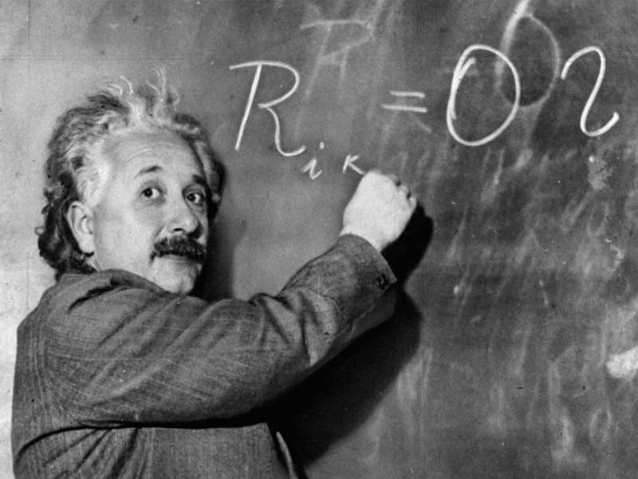
Developing expertise-- transforming brain
Think about and use science like a scientist.
What does that mean?
How is it accomplished?

