Slide 1
Teaching as Design Fred Brooks University of North Carolina at Chapel Hill
brooks@cs.unc.edu

Slide 2

Traditional Western Formal Education
Plato’s Academy 385 B.C.
Univ. of Bologna 1088 A.D.
Student books rare
Teacher lectures to deliver information

Slide 3

Printing Press ~1440 A.D.
Radical change in teaching possible: Reading assignment
But still we lecture!

Slide 4
More Media for Info Delivery >1800
Photos
Recordings
Movies
Videos
But still we lecture!

Slide 5
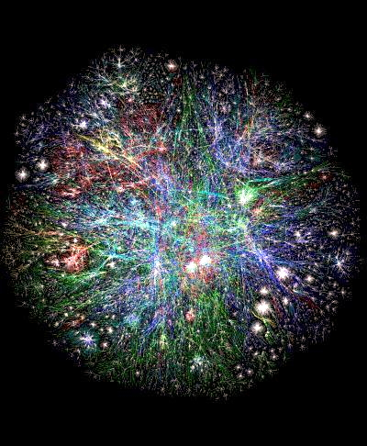
The World-Wide Web 1990
Interactive teleprocesing
Incredible connectivity
Fast search
Wikipedia
Totally new means of information delivery
But still we lecture!

Slide 6
Assertion (after Dewey)
Most of us learned most that we know well by
What we did,
not by
What we read or heard explained.
But still we lecture!

Slide 7
Paradox
We learn chiefly by Induction
But
We teach chiefly by
Deduction!

Slide 8
Including this dictum!
Including this whole talk!

Slide 9
The Teacher’s Job is to Design Learning Experiences not principally to Deliver Information

Slide 10
So, Focus is on
LEARNING, not TEACHING
STUDENT, not TEACHER EXPERIENCE, not TEXT SKILLS, not INFORMATION DESIGN, not PREPARE

Slide 11
Teaching is a Design Task and Computer Scientists are Designers!

Slide 12
The Scarcest Commodity
In education, the scarcest commodity, whose allocation causes the most heated debate, is not money, it is:
Student Time

Slide 13
CS Education Content
Background: e.g., number systems
Theory: e.g. big O concept
Description of practice: e.g. computer architecture
Skills for practice: e.g. programming
CS information obsolesces fast
CS skills stay

Slide 14
Donald Schön’s Insight
All professional education teaches the skills of the profession by critiqued practice.
E.g., law, medicine, architecture, the ministry, art, music, social work, and indeed engineering.
Educating the Reflective Practioner [1984]

Slide 15
How Does This Play Out?
Assignments
Flipped classroom
Quizzes & Tests
Student-designed lessons
Project-based learning
Learning new skills, resources
Yes, some old-fashioned lectures

Slide 16
Flipped Classroom for Critiqued Practice
Information uptake at home
On-line and/or book
Homework at school
In pairs, often
Teacher walking around, giving dynamic critique

Slide 17
A Quiz for Learning Illumination Models
You are flying at high altitude over a (really) flat river delta. The terrain below consists of
• meandering streams networking the delta: kd=0.0 ks=0.9 n=100
dry sand islands among the streams: 0.5 0.0 1
damp sand islands among the streams 0.2 0.5 8
ocean, with small waves 0.1 0.8 4

Slide 18
Quiz Assumptions
Assume the earth’s surface is planar and all terrain is at the elevation 0.
Assume the ambient+Lambertian+ Phong illumination model accurately describes this real-world situation.

Slide 19
Quiz Question 1.
30 min. You are over the delta, near the ocean. Describe qualitatively what you see as you look down and out towards the horizon, moonward. Be as complete and precise as you can.

Slide 20
Quiz Question 2
15 min. Give an equation for f, the fraction of the incident moonlight reflected to you, as a function of ß, the angle between your line-of-sight and the vertical. (Here, assume the moon is a point source.)

Slide 21
Projects
Costly in time
Deep vs. broad?
Make the curriculum broad, the courses deep
Collaborative?
2 is magical, so is 1

Slide 22
Architecture Course Project
Special-purpose machine
Milestones with early deliverables:
Application description—Precise
Programming manual—End first month
Intensive critique
Early turn-in of complete project
Intensive critique
Do it over!

Slide 23
Software Engineering Lab
22x since Spring, 1966
Real projects for real clients
Teams of 3, 4, 5
Self-formed or prescribed
Menu of project choices, 2x teams
Mandatory role separation: boss, chief designer

Slide 24
Software Engineering Lab (cont)
Eliciting client requirements (!)
Weekly coaching
Early deliverable to client, meeting
Something running early!
Public presentation
Team grade+individual grade
Point budget for teammates

Slide 25
The Teacher’s Job is to Design Learning Experiences not principally to Deliver Information

