Slide 1


BEYOND THE INTRO TO R&D TODAY’S AGENDA
LET’S GET TO KNOW THE CREDIT!
History of the R&D Tax Credit
R&D Tax Refresher
Ideal Candidates
Case Studies

Slide 2
HISTORY OF THE R&D TAX CREDIT
The R&D Tax Credit was introduced in 1981 as part of the Economic Recovery Tax Act to incentivize U.S. companies to invest in innovation, research, and technological advancement.
Temporary Credit
1981
2014
2017
Reagan Administration
Enacts R&D tax credit
Section 174 & Internal
Use Software Changes
TAX CUTS & JOBS ACT
2025 BBB
20x Better
2003
2015
2022
Elimination of “Discovery
Test” & “Leading Industry”
Criteria
P.A.T.H. ACT
Inflation reduction act
Became Permanent Law
Requires businesses to amortize (Section 174)

Slide 3
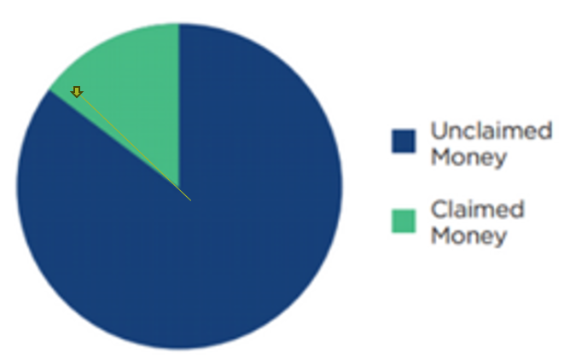
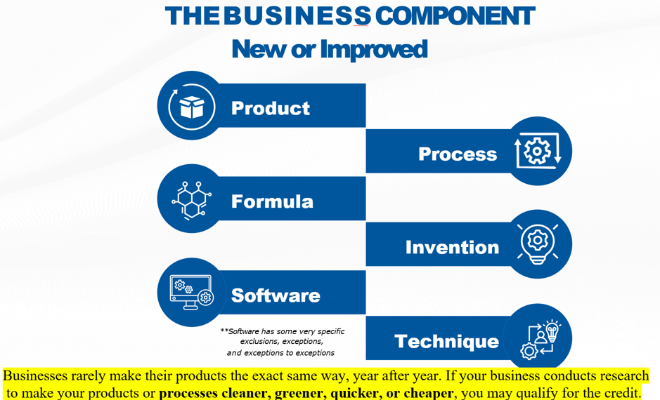

Slide 4





Slide 5





T H E B U S I N E S S COMPONENT
New or Improved
Product
Process
Formula
Invention
Software
**Software has some very specific exclusions, exceptions,
and exceptions to exceptions
Technique
Businesses rarely make their products the exact same way, year after year. If your business conducts research
to make your products or processes cleaner, greener, quicker, or cheaper, you may qualify for the credit.

Slide 6
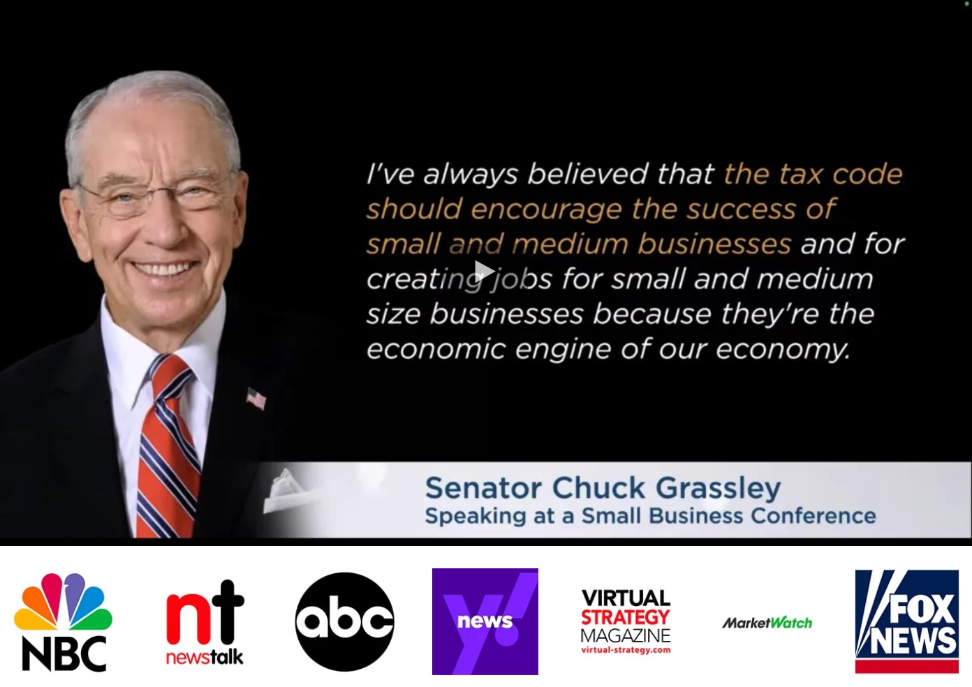

Slide 7
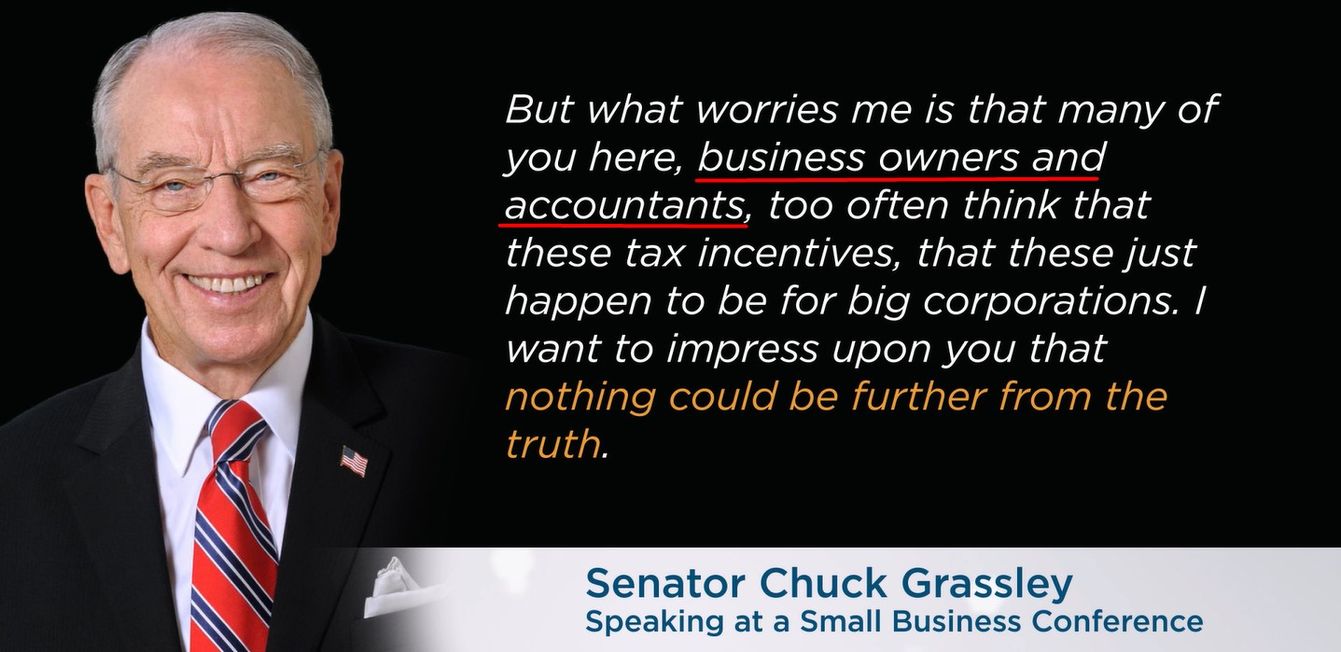

Slide 8
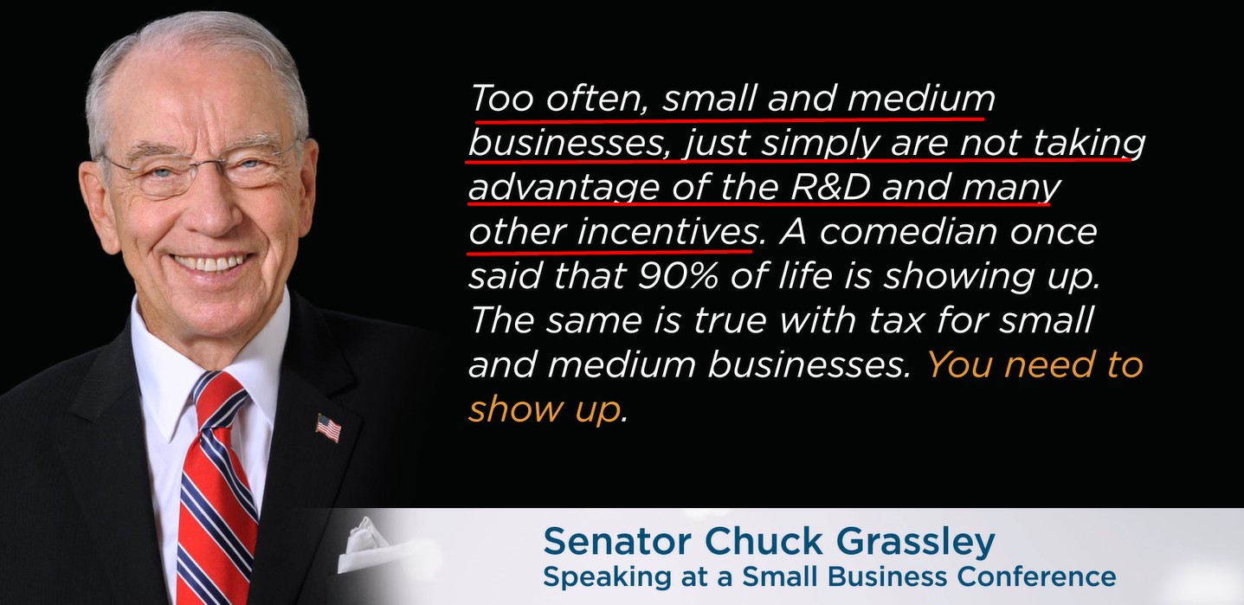

Slide 9
Understanding The Research & Development Tax Credit -
The R&D credit can be an excellent benefit for small companies, especially those who are developing new products or product lines. Nevertheless, the rules for claiming the credit are complex and nuanced.
Correctly claiming the credit may be beyond the skills of many tax professionals who serve small companies. If you think your company may qualify for the credit it can be a good idea to work with a company that specializes in qualifying companies and determining qualifying expenses.
Those companies should be willing to work with your tax professional (and vice versa).

Slide 10

POTENTIALLY QUALIFYING ACTIVITIES
WHAT WE ASK OUR CLIENTS
Are you developing new or improved
processes or products?
Are you developing new software platforms to
interface with your clients or customers?
Are you developing new designs,
formulations, or techniques?
Are you experimenting with new materials / coatings?
Are you developing prototypes or prototype machines?
Are you developing highly automated production lines with a combination of mechanical automation and computerized robotics?

Slide 11

THE 4-PART TEST QUALIFICATION CRITERIA
This was established by the IRS, is used to determine R&D tax credit eligibility by requiring that activities aim to improve a product or process, rely on hard sciences, involve technological uncertainty, and follow a process of experimentation.
PERMITTED PURPOSE
TECHNOLOGICAL IN NATURE
Intended to develop or improve a product, manufacturing process, Software, Technique, Formula or Invention for functionality, performance, reliability, or quality.
Must rely on principles of one of the following: physical sciences, computer sciences, chemistry, biological sciences, or engineering.
ELIMINATION OF UNCERTAINTY
PROCESS OF EXPERIMENTATION
Must be intended to discover information to eliminate technical uncertainty concerning the capability, or method for developing or improving a product or process, or design.
All of the activities must be elements of a process of experimentation via modeling, simulation, systematic trial and error testing, or other methods by evaluating one or more alternatives.

Slide 12
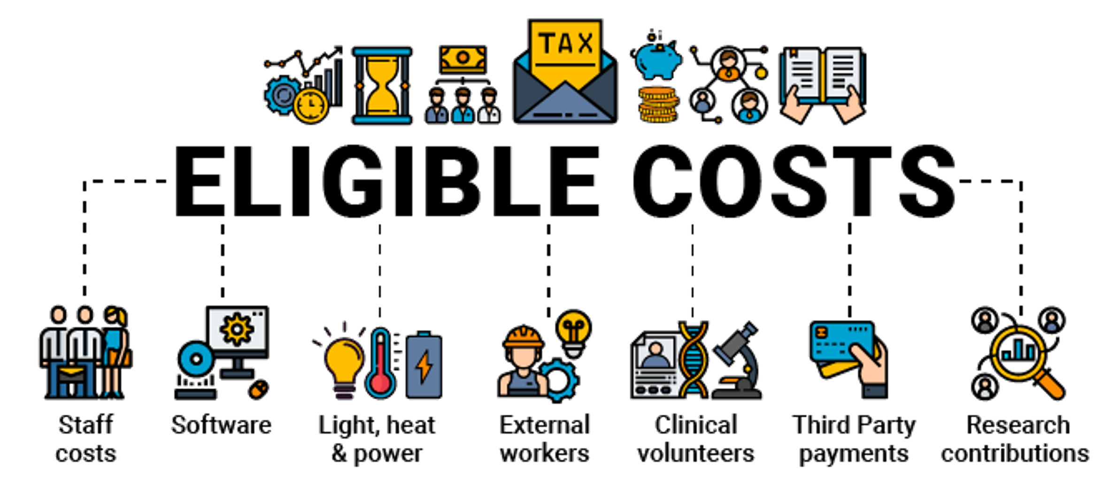
QRES QUALIFIED RESEARCH EXPENDITURES

Slide 13
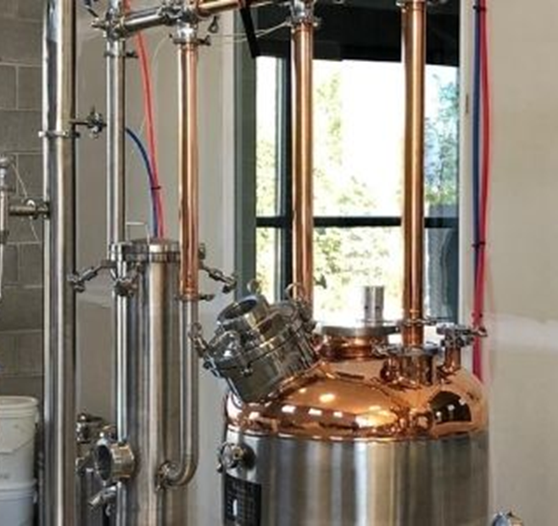
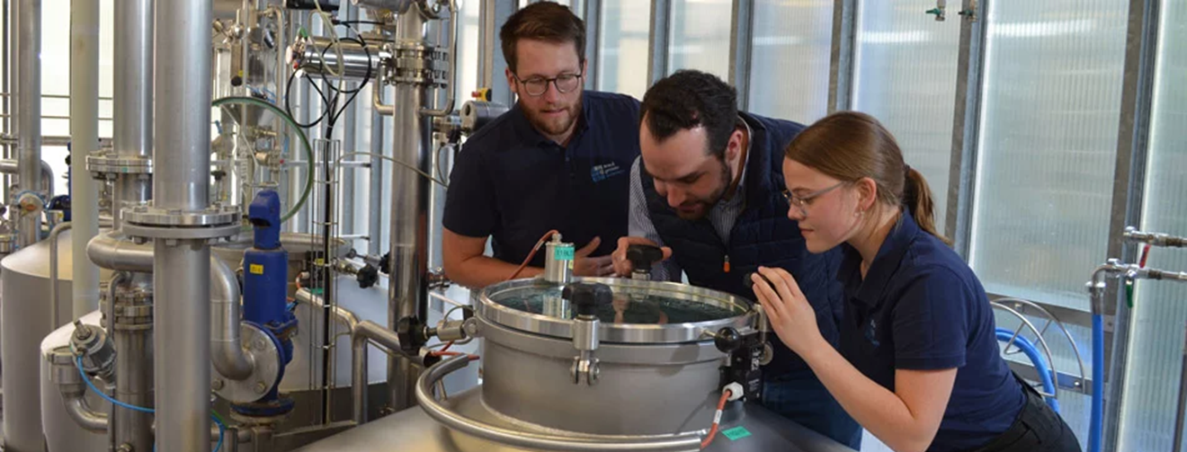




Slide 14





Software Development
Architecture
Design

Slide 15
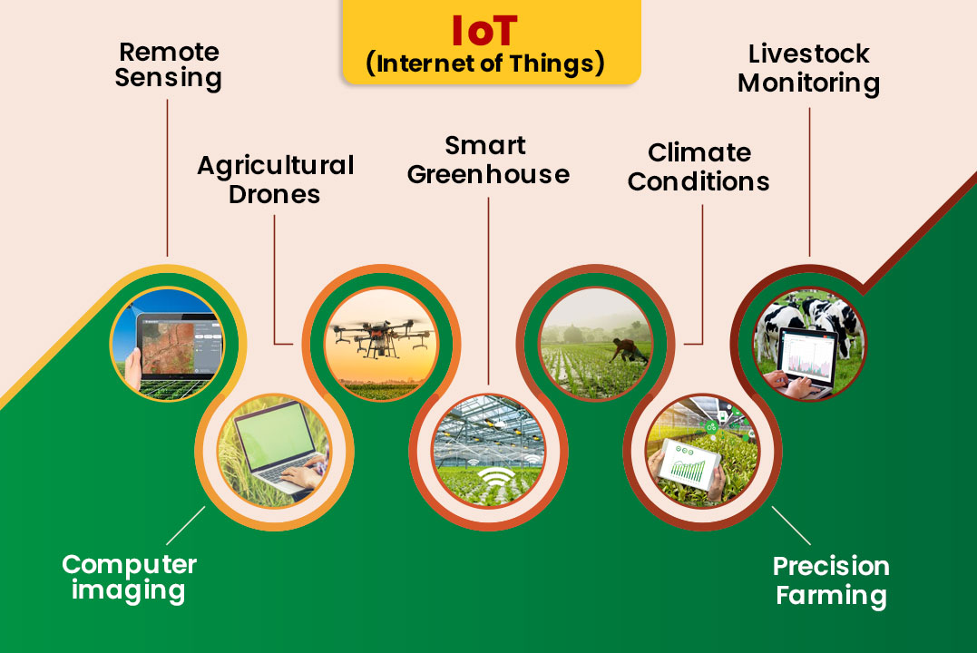

Slide 16
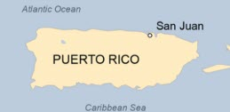
STATE R&D TAX CREDITS –
36 STATES & PUERTO RICO PARTICIPATE
THINGS TO REMEMBER ABOUT YOUR STATE’S R&D TAX CREDIT
01.
Each state has different rules; however, many follow the federal definition of qualified research (i.e., The Four-Part Test)
02.
Some state credits even exceed the federal benefit
03.
Documentation is also important for state computations
04.
Credit usability differs state-to-state and some states do not allow the pass-through of credits to individuals

Slide 17
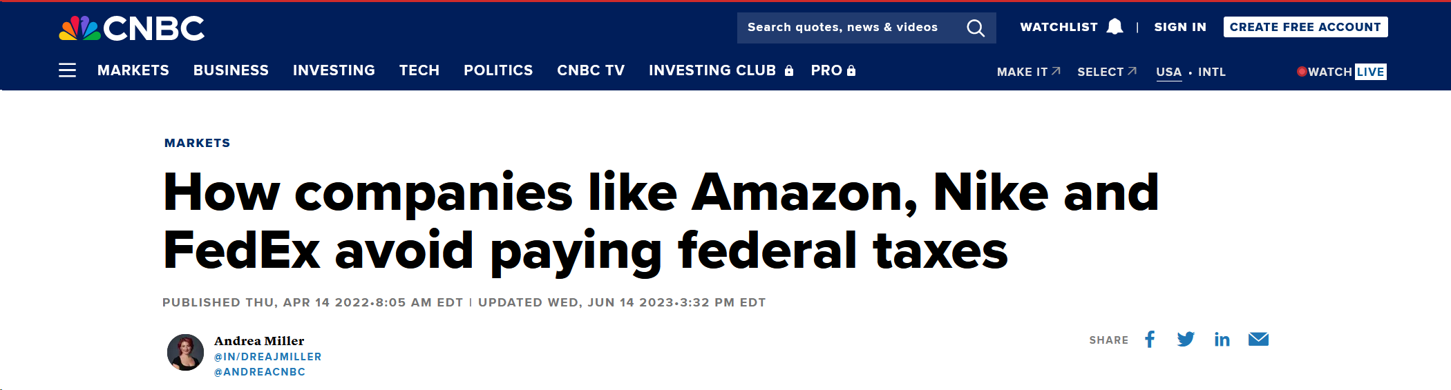
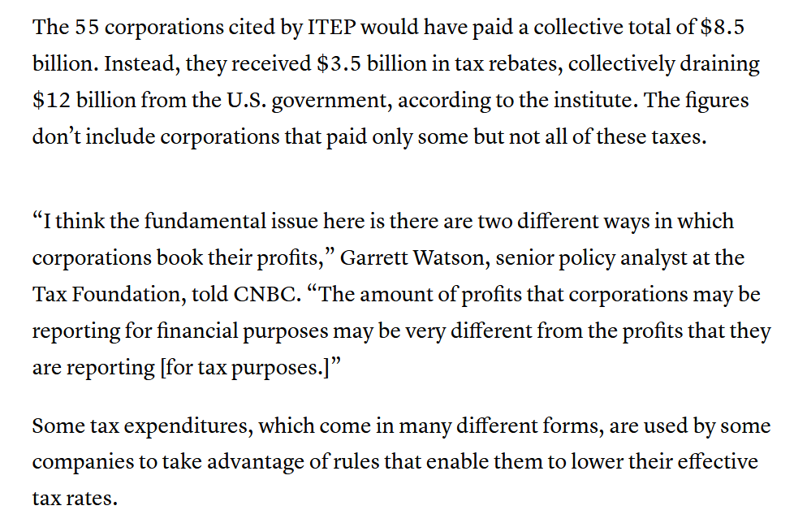


Why do you think these companies Pay ZERO Taxes and get $3.5 Billion in Tax Credits?

Slide 18

IDEAL CANDIDATES
FOR R&D STUDIES
IDEAL FOR COMPANIES
With Qualified Research Expenses between $0 to $Unlimited
DIY SELF-GUIDED EXPERIENCE
With unlimited R&D technical support
COMPREHENSIVE STUDY REPORT
With QRE allocations, breakdown, & activities
AUTOMATED TOOLS
Easy data input using our secure datatax hub platform
STUDY REPORT
Includes calculated workpapers with federal and state draft forms
FULL AUDIT DEFENCE INCLUDED
(Full representation)

Slide 19
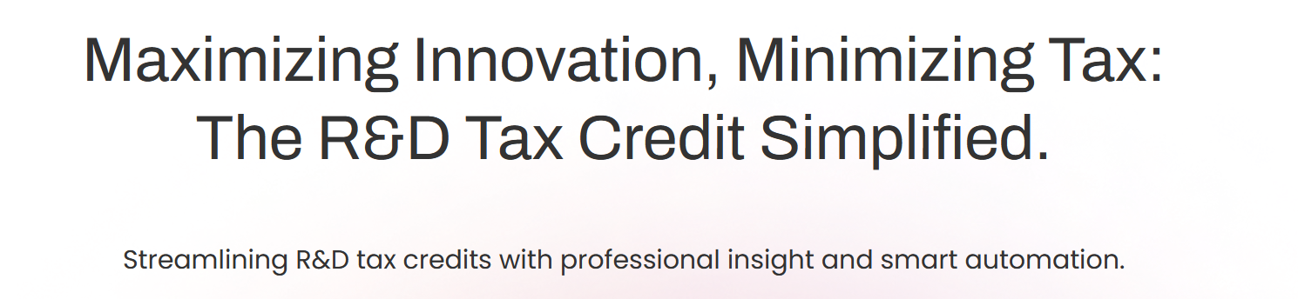
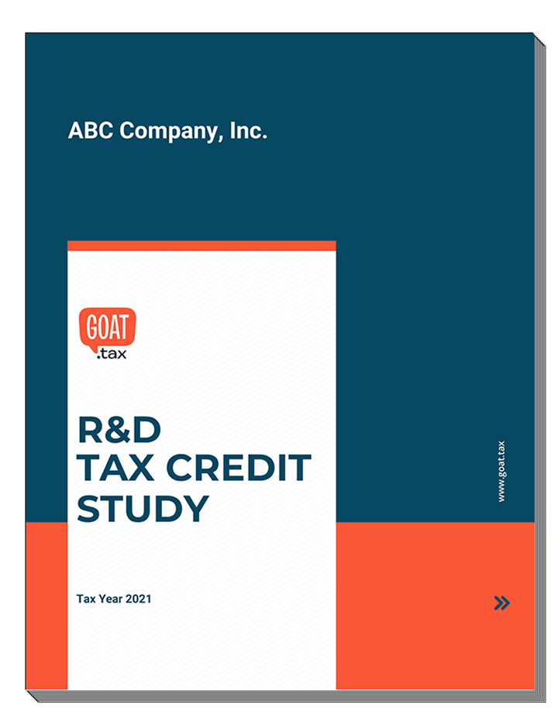

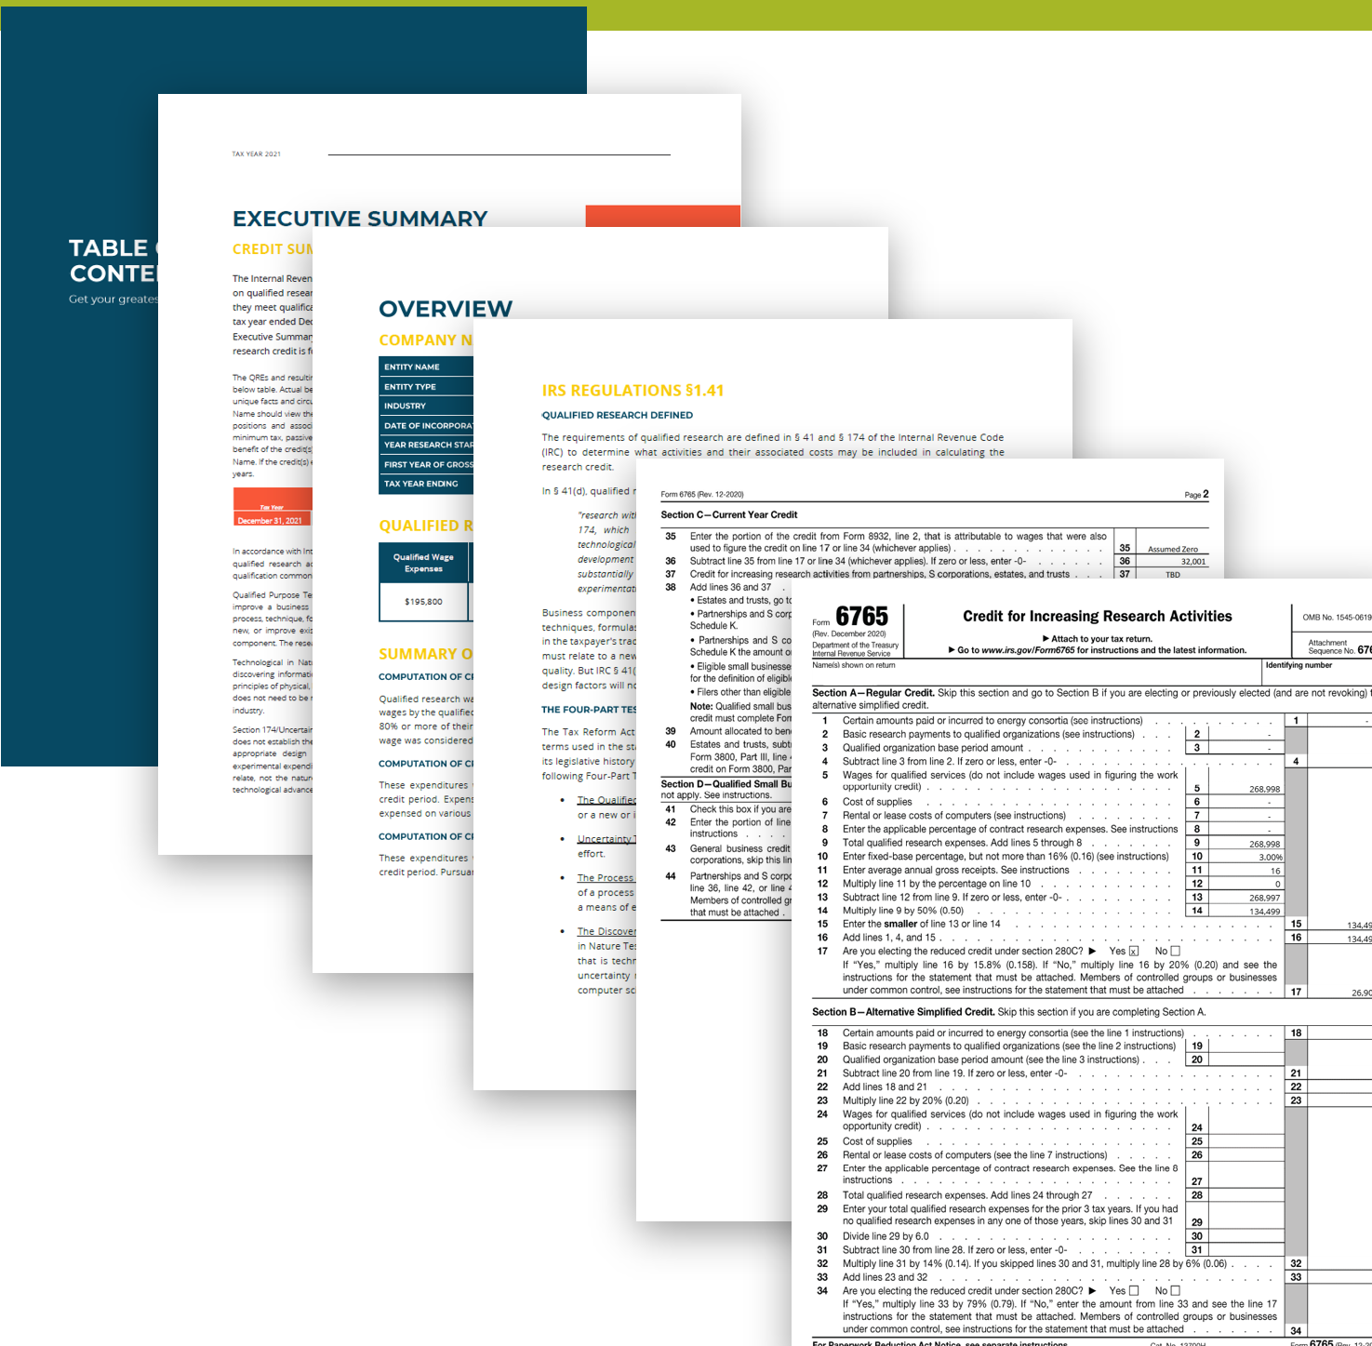
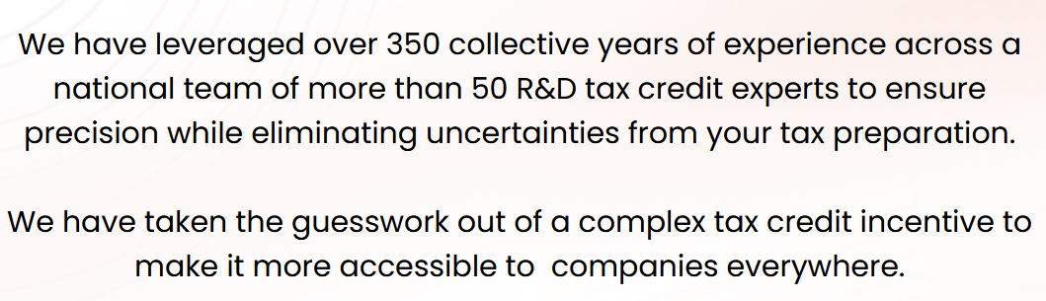
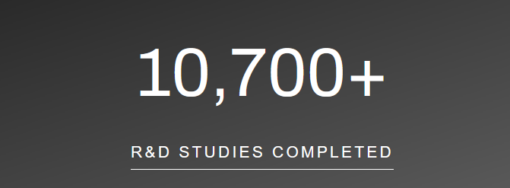
TPA deliverable
30-60 page detailed report

Slide 20

FERTILIZER COMPANY –
CASE STUDY
01.
This Missouri based company specialized in the development and manufacturing of Fertilizer.
02.
This taxpayer has never claimed the credit for all of there products in continuous development.
The credit was generated based on wages for over 45 employees; direct supplies and raw materials costs related to development of prototypes and validation samples; raw materials for production equipment and tooling development; and consumable supplies for 2023.
03.
04.
On average, this taxpayer has been able to generate over $500,000 in Federal and State credits on an annual basis.
INDUSTRY | TOTAL EMP | QREs | FED CREDIT | STATE CREDIT
Agriculture | 45 | $5.2M | $530,000 | $152,000

Slide 21
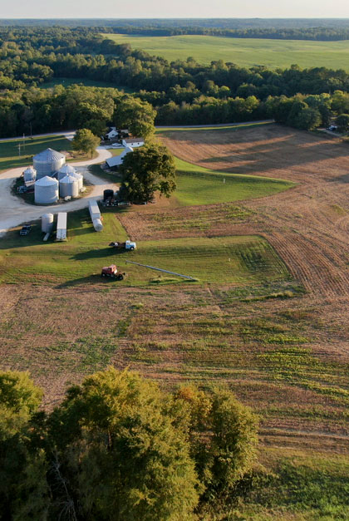
NEBRASKA FARM –
CASE STUDY
01.
Nebraska Farm with 3 sperate locations owned by family.
02.
Claimed the credit for each of there 3 Companies for 2023.
03.
2021, 2022, & 2024 are in process & should be complete within next 30 days.
04.
These taxpayers will be able to claim approximately $8M in Federal and State credits this year.
INDUSTRY | TOTAL EMP | TYOTAL QREs | FED CREDIT | STATE CREDIT
Agriculture | 3 | $6.2M | $1,753,000 | $232,000

Slide 22

SOFTWARE CASE STUDY –
PAYROLL TAX OFFSET
01.
This pre-revenue start up began its work in 2023 and has grown significantly since they started with their three-person team. Created an Ai Avatar for gaming, located in California.
02.
Creating a social app where people can capture non-fungible tokens (NFTs)
03.
On average, this taxpayer has been able to generate about $40,000 in annual Federal R&D tax credit against their payroll tax liability.
INDUSTRY | TOTAL EMP | QREs | FED CREDIT | STATE CREDIT
AR Platform | 12 | $460,000 | $45,000 | N/A

Slide 23
THE
APPROACH
CHECK ELIGIBILITY
INPUT YOUR DATA
STUDY DELIVERY
Answer basic questions to determine eligibility of the company and utilization options (regular tax offset vs payroll tax offset).
Utilize our tools to automate inputting your data into the calculation software. This effort is supported by an R&D tax credit Onboarder Expert. Preliminary estimated results discussed before continuing with final process.
Finalize and submit your study for full review. Your final deliverable will include complete report, draft tax forms. & instructions.
* Most Software Price Based On Net Credits Generated. You Are Always Guaranteed A Set ROI.

Slide 24
WHAT DOES IT COST?
NO UPFRONT PAYMENT
20% FEE AT COMPLETION
25% FEE WITH A PAYMENT PLAN
Full study completed & delivered to you along with proper IRS forms & instructions.
7 days after receiving your full study & forms we ask for our fee. (this also requires full participation to achieve data entry within 10 days)
12 monthly payments with 1% per month interest.

Slide 25
WHY MOVE FORWARD?
Potential thousands in savings
Zero risk — pay only if you benefit. And the fee is tax deductible.
Unlimited full protection through audit-ready report
1-million-dollar accurate calculation guarantee
Next Step: Complete onboarding to start!
LET'S BOOK YOUR NEXT 30 MIN APPOINTMENT WITH AN ONBOARDER!

