Slide 1
- Does drafting a QB high in the draft provide teams a better chance of success?
- How do stats compare amongst them and do they make a difference to success?
- What are the costs and what is the overall value?
- Is there a definitive draft strategy teams should utilitze?

Slide 2
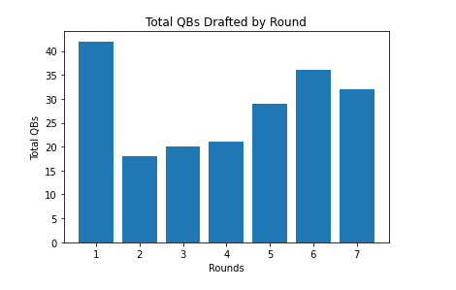
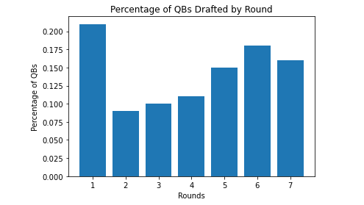
QBs Drafted from 2000 to 2015 Draft Classes

Slide 3
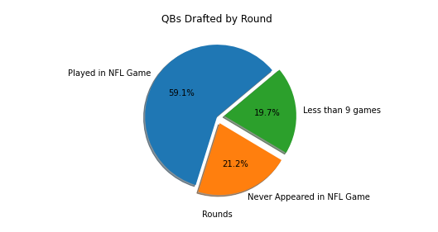
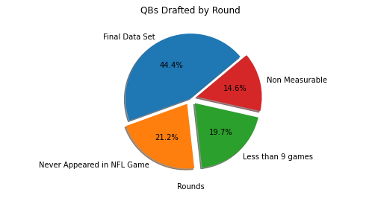
Data Cleanup – Elimination of Non Measurables or Insufficient Data

