Slide 1
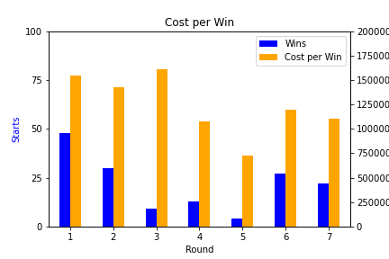
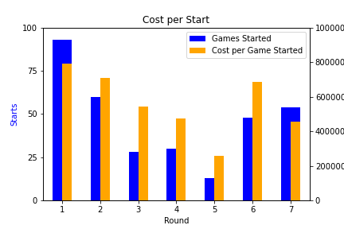

Slide 2
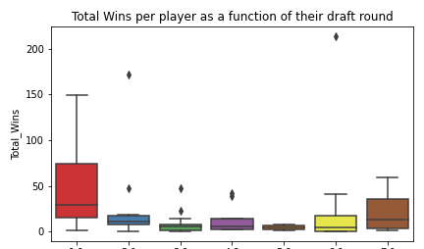

Slide 3
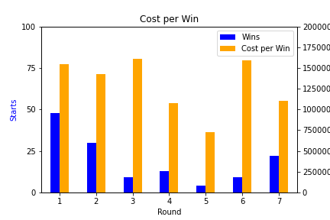
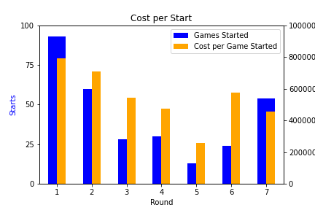

Slide 4
Conclusions
Can’t definitively say which round provides the absolute most value, but there is a clear talent gap drop after round 2.
Whether the motivation is Winning or simply Games Started, there is very little money saved by passing on a first rounder.
Rounds 3-5 provide extremely low value and should be avoided. The odds of finding a “Unicorn” in rounds 6 & 7 are just as likely.

