Slide 1
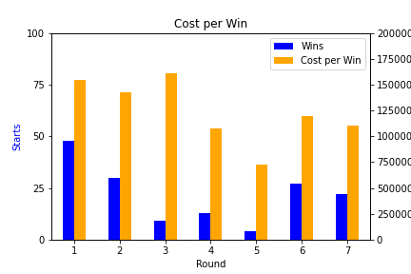
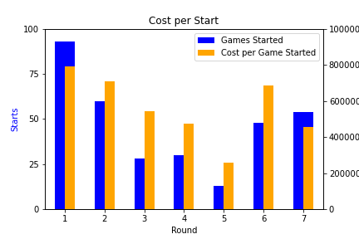
First rounders average 48 wins at a cost of $1.5M per “W”
…and approximately 88 games started at $800K/game

Slide 2
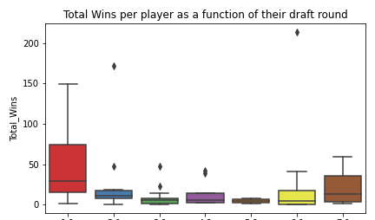
Do outliers make things more clear?

Slide 3
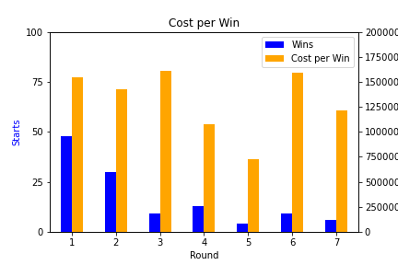
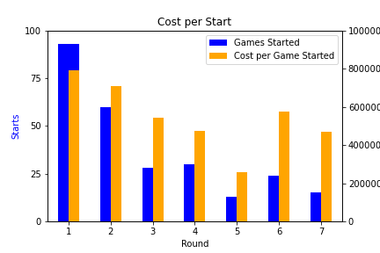
Without “The Goat”
(and his two outlier buddies)

Slide 4
Conclusions
Can’t definitively say which round provides the absolute most value, but there is a clear talent gap drop after round 2.
Whether the motivation is Winning or simply Games Started, there is very little money saved by passing on a first rounder.
Rounds 3-5 provide extremely low value and should be avoided. The odds of finding a “Unicorn” in rounds 6 & 7 are just as likely.

