Slide 1
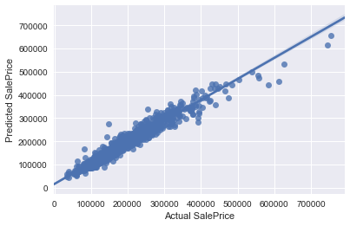
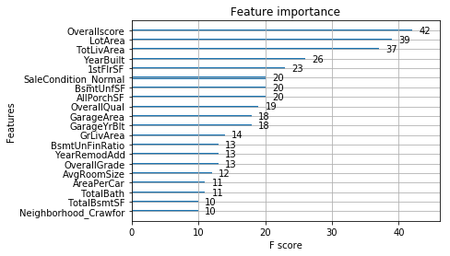
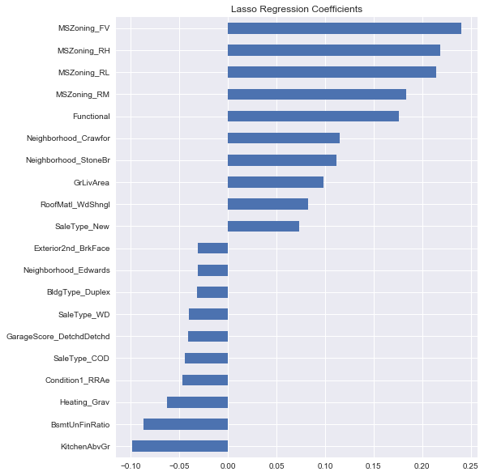
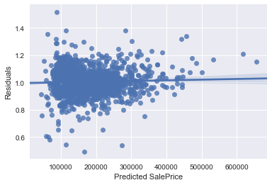
PICTURES TO USE
Linearity – Y_hat vs. actual SalePrice (lasso model)
Xgboost – most important features
Residual Plot (lasso) Y_hat vs. Residuals
Lasso Coefficients (most important variables)

Slide 2
ML Presentation

Slide 3
Summary:
EDA
Pre-processing
Imputing Missing Values
- Categorical
- Numeric
Encoding Categorical Features
Feature Engineering
- New Features
Model Training
Model Selection
Model Ensembling
Results
- RMSLE score using CV on training set
- Kaggle score

Slide 4
EDA:

Slide 5
Pre-Processing:

Slide 6
Model Training:

Slide 7
Results:

Slide 8

HELLO!
I am Jayden Smith
I am here because I love to give presentations.
You can find me at @username

Slide 9
1.
TRANSITION HEADLINE
Let’s start with the first set of slides

Slide 10
BIG CONCEPT
Bring the attention of your audience over a key concept using icons or illustrations

Slide 11
YOU CAN ALSO SPLIT YOUR CONTENT
White
Is the color of milk and fresh snow, the color produced by the combination of all the colors of the visible spectrum.
Black
Is the color of coal, ebony, and of outer space. It is the darkest color, the result of the absence of or complete absorption of light.

Slide 12
IN TWO OR THREE COLUMNS
Yellow
Is the color of gold, butter and ripe lemons. In the spectrum of visible light, yellow is found between green and orange.
Blue
Is the colour of the clear sky and the deep sea. It is located between violet and green on the optical spectrum.
Red
Is the color of blood, and because of this it has historically been associated with sacrifice, danger and courage.

Slide 13
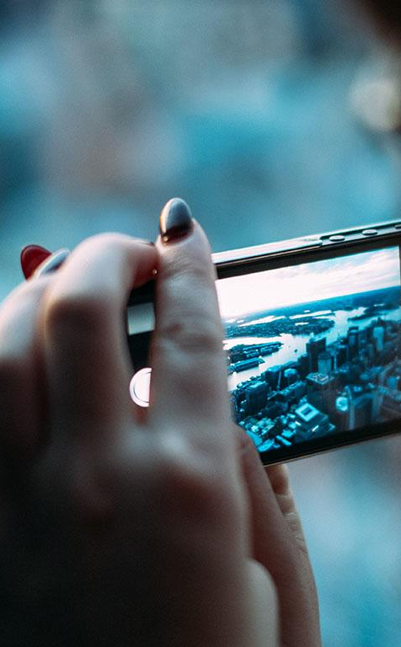
A PICTURE IS WORTH A THOUSAND WORDS
A complex idea can be conveyed with just a single still image, namely making it possible to absorb large amounts of data quickly.

Slide 14

Want big impact?
Use big image.

Slide 15
USE CHARTS TO EXPLAIN YOUR IDEAS
White
Gray
Black

Slide 16
AND TABLES TO COMPARE DATA
 | A | B | C
Yellow | 10 | 20 | 7
Blue | 30 | 15 | 10
Orange | 5 | 24 | 16

Slide 17
MAPS
our office

Slide 18
89,526,124
Whoa! That’s a big number, aren’t you proud?

Slide 19
89,526,124$
185,244 users
100%
That’s a lot of money
And a lot of users
Total success!

Slide 20
OUR PROCESS IS EASY
first
second
last

Slide 21
LET’S REVIEW SOME CONCEPTS
Yellow
Is the color of gold, butter and ripe lemons. In the spectrum of visible light, yellow is found between green and orange.
Blue
Is the colour of the clear sky and the deep sea. It is located between violet and green on the optical spectrum.
Red
Is the color of blood, and because of this it has historically been associated with sacrifice, danger and courage.
Yellow
Is the color of gold, butter and ripe lemons. In the spectrum of visible light, yellow is found between green and orange.
Blue
Is the colour of the clear sky and the deep sea. It is located between violet and green on the optical spectrum.
Red
Is the color of blood, and because of this it has historically been associated with sacrifice, danger and courage.

Slide 22
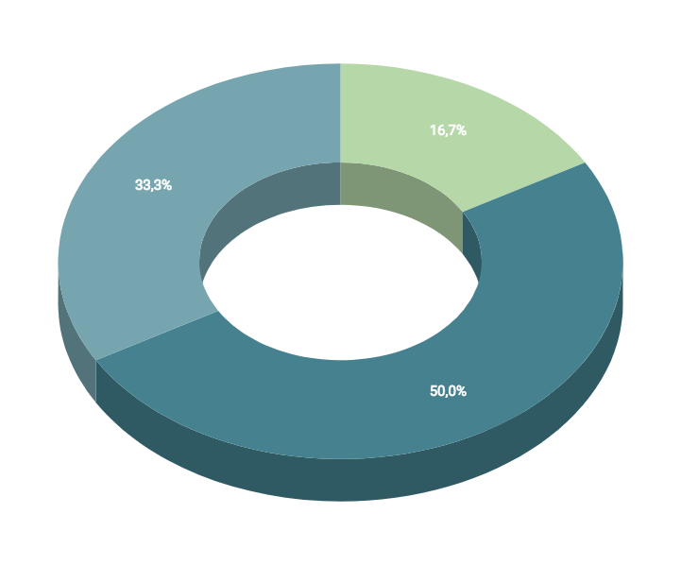
You can insert graphs from Google Sheets

Slide 23
ANDROID PROJECT
Show and explain your web, app or software projects using these gadget templates.
Place your screenshot here

Slide 24
iPHONE PROJECT
Show and explain your web, app or software projects using these gadget templates.
Place your screenshot here

Slide 25
TABLET PROJECT
Show and explain your web, app or software projects using these gadget templates.
Place your screenshot here

Slide 26
DESKTOP PROJECT
Show and explain your web, app or software projects using these gadget templates.
Place your screenshot here

Slide 27
THANKS!
Any questions?
You can find me at:
@username
user@mail.me

Slide 28
CREDITS
Special thanks to all the people who made and released these awesome resources for free:
Presentation template by SlidesCarnival
Photographs by Unsplash

Slide 29
PRESENTATION DESIGN
This presentation uses the following typographies and colors:
Titles: Dosis
Body copy: Titillium Web
You can download the fonts on these pages:
http://www.impallari.com/dosis
http://www.campivisivi.net/titillium/
Pastel green #d3ebd5 · Green #80bfb7 · Teal #0b87a1 · Navy #01597f · Dark navy #003b55
You don’t need to keep this slide in your presentation. It’s only here to serve you as a design guide if you need to create new slides or download the fonts to edit the presentation in PowerPoint®

Slide 30
SlidesCarnival icons are editable shapes.
This means that you can:
Resize them without losing quality.
Change fill color and opacity.
Change line color, width and style.
Isn’t that nice? :)
Examples:

Slide 31
😉
Now you can use any emoji as an icon!
And of course it resizes without losing quality and you can change the color.
How? Follow Google instructions https://twitter.com/googledocs/status/730087240156643328
✋👆👉👍👤👦👧👨👩👪💃🏃💑❤😂😉😋😒😭👶😸🐟🍒🍔💣📌📖🔨🎃🎈🎨🏈🏰🌏🔌🔑 and many more...

