Slide 1

GEOG 178/258
Week 8:
Model Viewer Controller: MVC
mike johnson

Slide 2
Model View Controller
Week
8
MVC

Slide 3
Model View Controller
Abstraction
of Reality
Week
8
EX1
How our model
is communicated
How our model is updated:
(timestep or user input)

Slide 4
Model View Controller
What are we trying to model? (Movement, physical process, behavior…?)
What is the abstraction we are interested in?
How will we represent the pieces in the most basic form (think back to the ‘essence’ of the object)
What classes can we inherit and which need to be built?
Week
8
MVC

Slide 5
Model View Controller
Week
8
MVC
How will results communicated? (Map, plot, text…)
What aspects of the model are we interested in as ‘results’

Slide 6
Model View Controller
Week
8
MVC
How will the model run? (timesteps, user input, single case…)

Slide 7
Model View Controller
Member Variables
Week
8
EX2
PaintComponent
Listeners

Slide 8
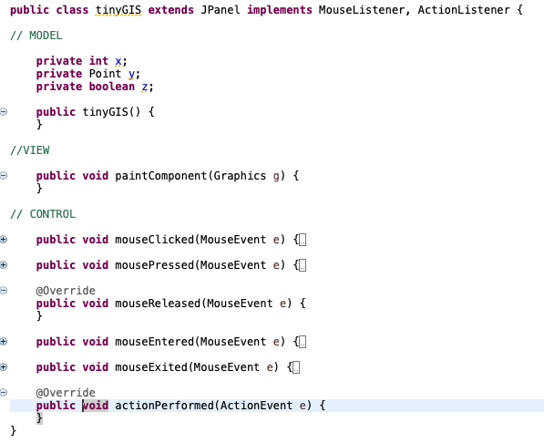
Model View Controller
Week
8
Model
View
Controller
EX3

Slide 9
Model View Controller
Week
8
Model
EX4
View
Controller

Slide 10
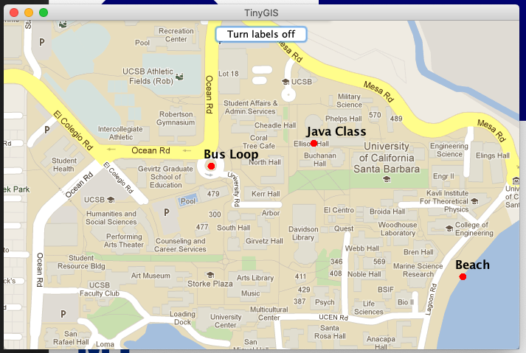
RUBRIC
Controller
Week
8
MVC
View
Model

Slide 11
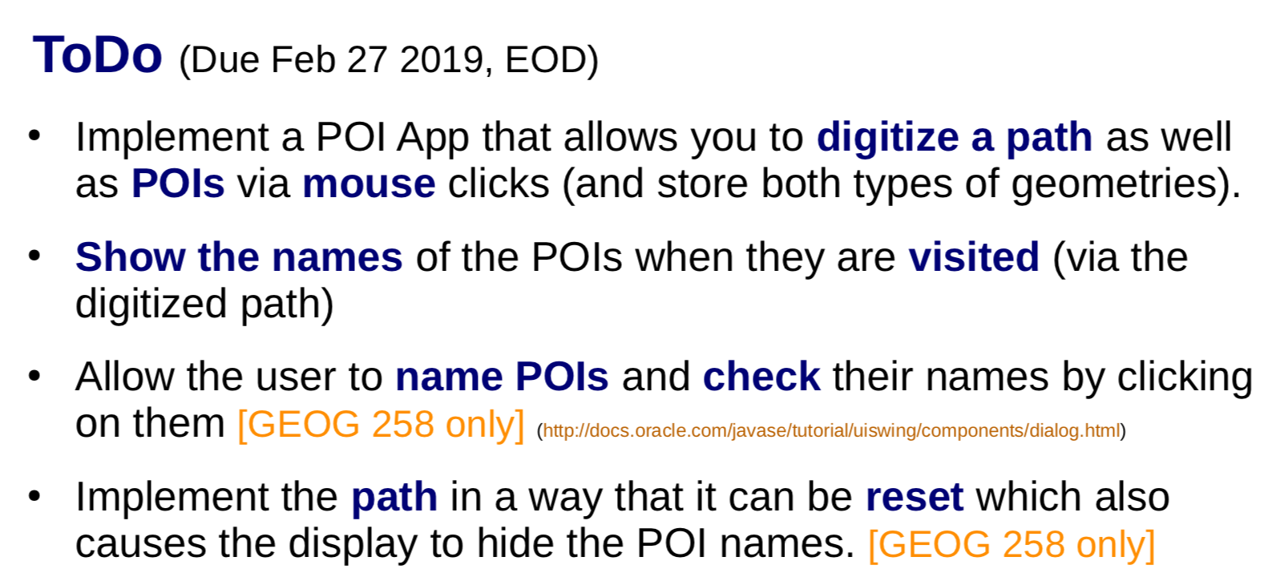
HW MVC
Model View Controller

Slide 12
HW MVC
Model:
POIs: Have names, and can be visited (Extend PointBuffer?)
Paths: Can visit POIs and be reset (PolyLine)
Viewer:
Map (campus.png; g.drawImage())
POI (w and w/o names) (g.fillOval(x,y))
Path (d.drawLine(x1,y1,x2,y2)
Controller:
Clicks let you draw new points, and name existing points (MouseListener)
Path can be reset (ActionListener?)
Week
8
MVC

Slide 13
In Class Example

Slide 14
HW Hints
Week
8
Can you change to ‘labels’ button and flag to change drawing mode?
Can you make use of POI.isInside() to change POI ‘visited’
3. Can you make use POI ‘visited’ to label features?
4. Can you make use of our temporary Point to population both paths and POIs?
MVC

Slide 15
RUBRIC
GEOG 178 | Points
Can I import your code w/o modification? | 2
Can I draw POIs | 2
Can I draw paths | 2
Can I switch between drawing modes | 2
Do names appear when visited | 2
Week
8
MVC
GEOG 278 | Points
Can I import your code w/o modification? | 2
Can I draw POIs | 1
Can I draw paths | 1
Can I switch between drawing modes | 1
Do names appear when visited | 1
Can I check/change a POIs name by clicking | 2
Can I reset the path in a way that hides POI names | 2

