Slide 1

GEOG 178/258
Week 9:
Serialization and Planar Graphs
mike johnson

Slide 2
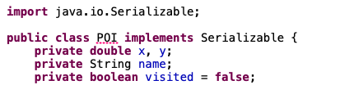
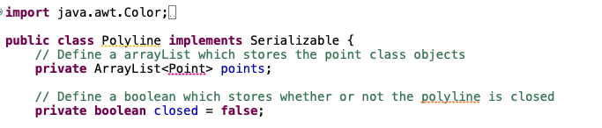
Telling Java an Object should be serializable
Week
9
Part 1

Slide 3
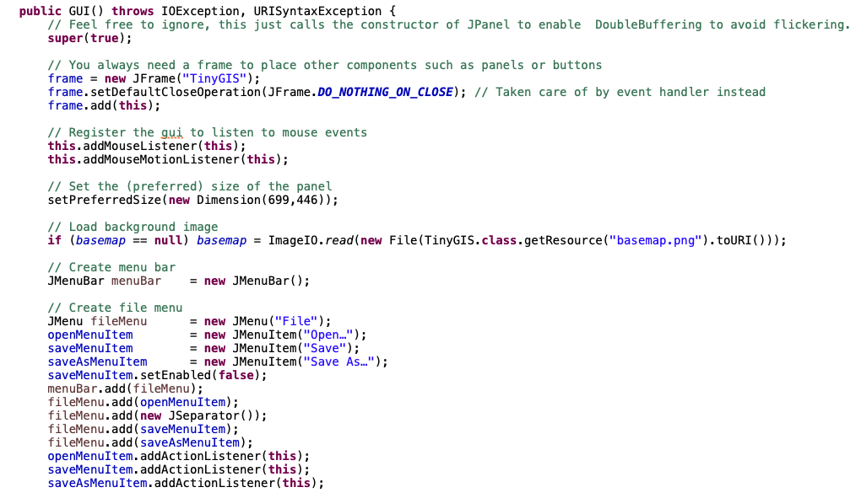
Initializing a Menu
Week
9
Part 1
Create a Menu bar
Add Options…
Enabled false
Add fileMenu to bar
Add options to fileMenu
Set actionListeners

Slide 4
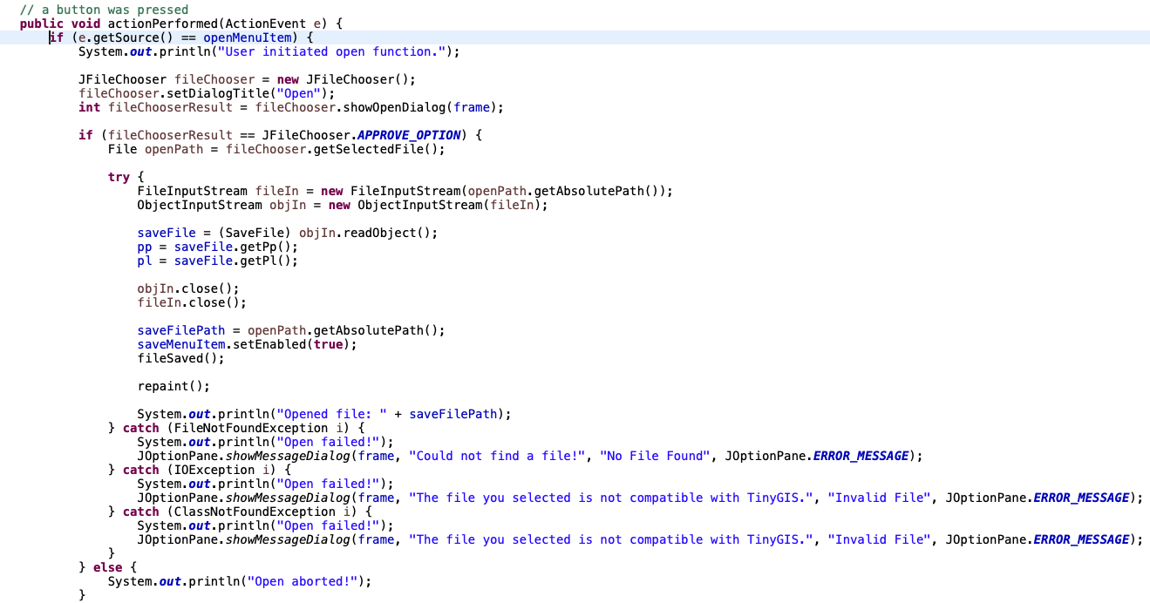
Defining File Open
Week
8
MVC

Slide 5
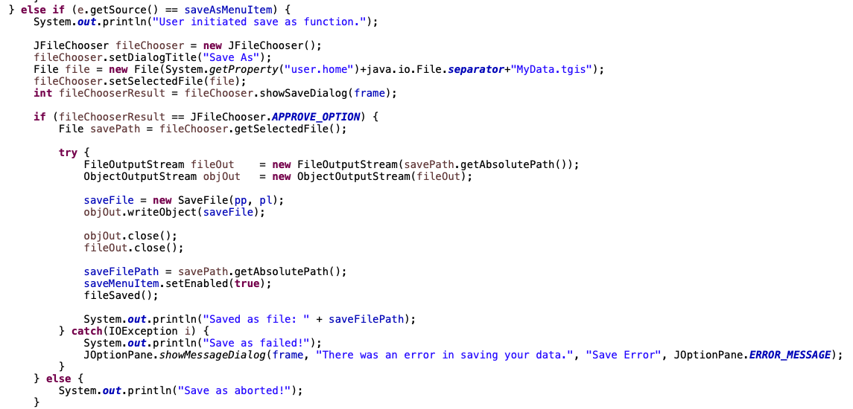
Saving a File
Week
8
MVC

Slide 6
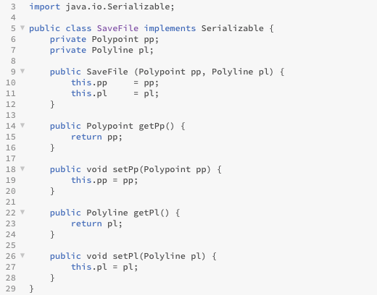
Sub-code (added here to save space)

Slide 7
Homework
Week
9
Part 2
POI!
PATH!

Slide 8
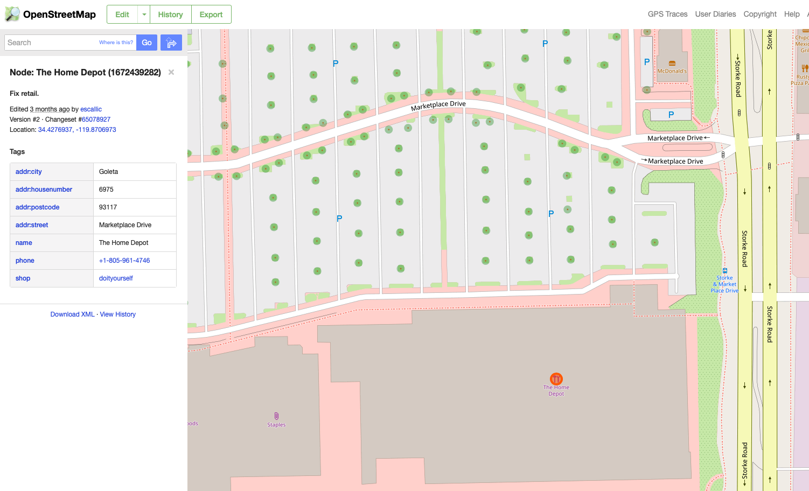
OSM (Nodes)
Week
9
Part 2

Slide 9
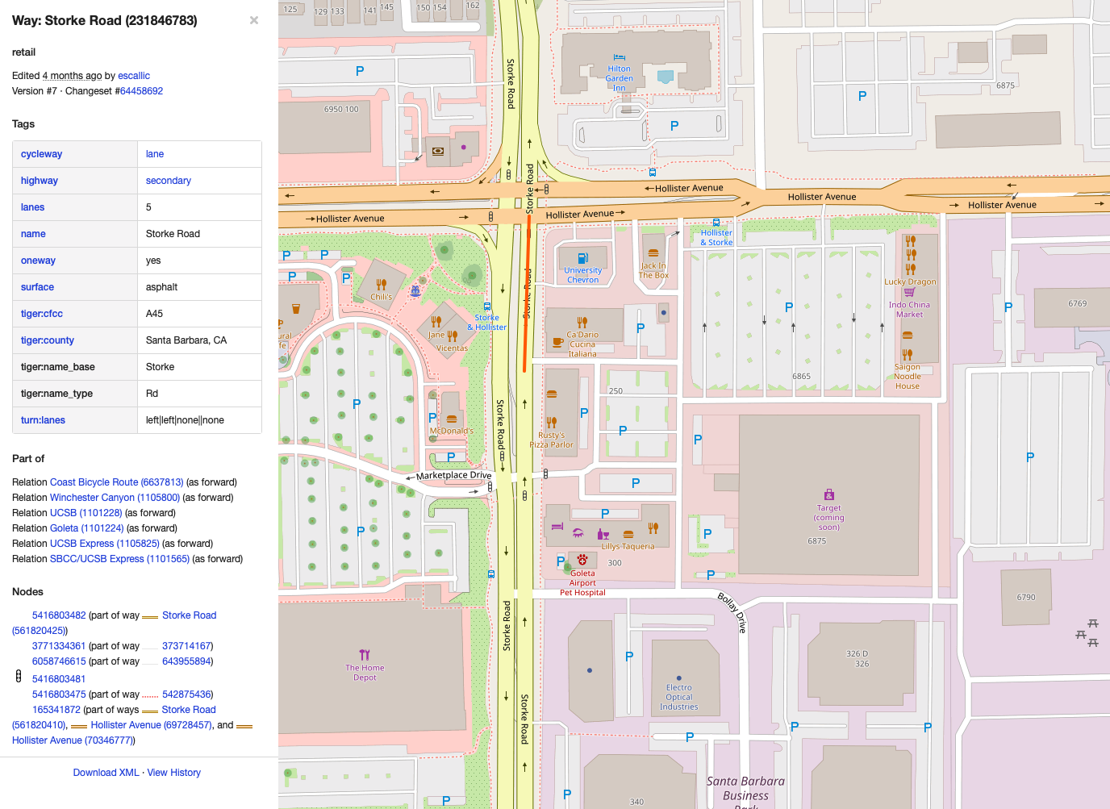
OSM (Ways)
Week
9
Part 2

Slide 10
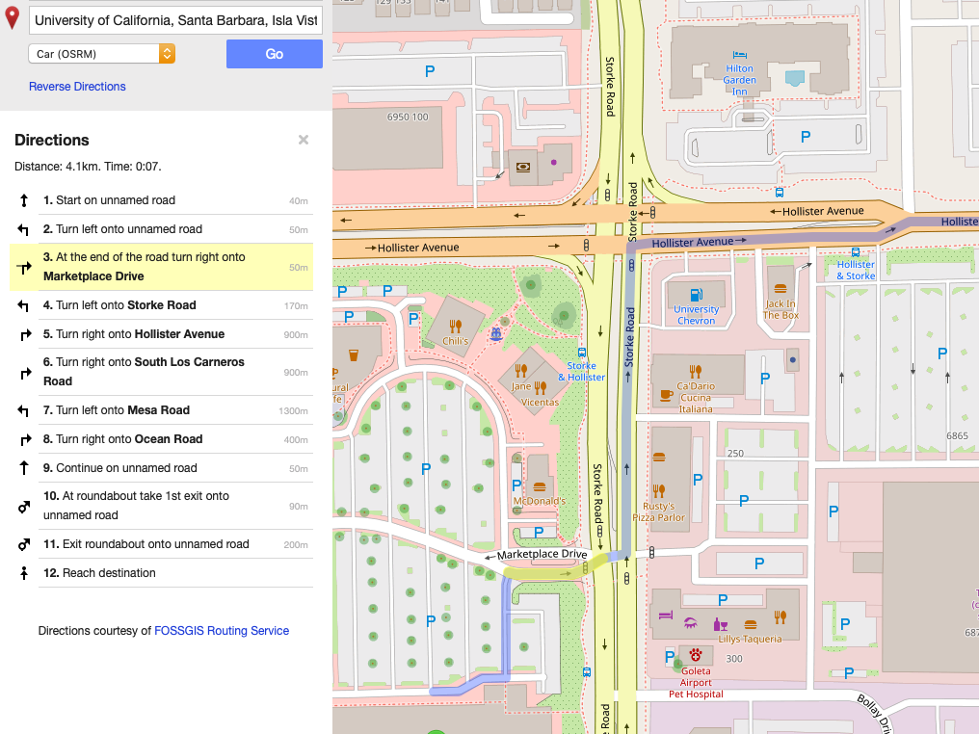
OSM Routing
Week
9
Part 2

Slide 11
Our Job: Build a Graph of ways and nodes
Week
9
Part 2
To go from D to F
DABF = 10
DCBF = 6
DCGEF = 6
DGF = 7
DGEF = 6

Slide 12
Minimum Example:
1A. Define line class (serialize?)
1. Draw a line with point buffers
1B. Add POI *258
find nearest node and generate line
2. If next click is within PB snap points,
otherwise don’t allow drawing
Home Depot
3. Allow process to repeat

Slide 13
More Difficult: Graph from lines
Currently: 4 line segments and 8 Points
Currently: One PolyLine (13 Points)
Should be: 17 nodes, 20 ways
Should be: 16 ways and 26 nodes

Slide 14
Finding Intersecting Nodes
Week
9
Part 2

Slide 15


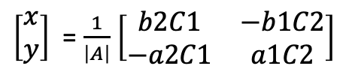
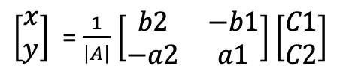
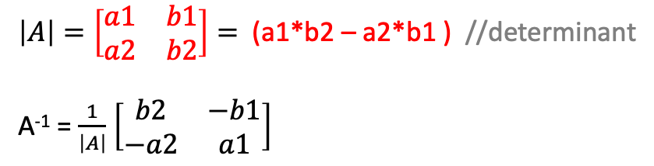
Finding the Intersection (Theory)
a1X + b1Y = C1
a2X + b2Y = C2
$$\left[\begin{matrix}a1X & b1Y \\ a2X & b2Y\end{matrix}\right]= \left[\begin{matrix}a1 & b1 \\ a2 & b2\end{matrix}\right]\left[\begin{aligned}x \\ y\end{aligned}\right]$$
$$\left[\begin{matrix}a1 & b1 \\ a2 & b2\end{matrix}\right]\left[\begin{aligned}x \\ y\end{aligned}\right]=\left[\begin{aligned}C1 \\ C2\end{aligned}\right]$$
Express 2 Lines:
$\left|A\right|=\left[\begin{matrix}a1 & b1 \\ a2 & b2\end{matrix}\right]=$ (a1*b2 – a2*b1 ) //determinant
A⁻¹ = $\frac{1}{\left|A\right|}$ $\left[\begin{matrix}b2 & −b1 \\ −a2 & a1\end{matrix}\right]$
Calculate
Determinant:
Re-order
Equations:
$\left[\begin{aligned}x \\ y\end{aligned}\right]$ = $\frac{1}{\left|A\right|}$ $\left[\begin{matrix}b2 & −b1 \\ −a2 & a1\end{matrix}\right]\left[\begin{aligned}C1 \\ C2\end{aligned}\right]$
$\left[\begin{aligned}x \\ y\end{aligned}\right]$ = $\frac{1}{\left|A\right|}$ $\left[\begin{matrix}b2C1 & −b1C2 \\ −a2C1 & a1C2\end{matrix}\right]$
Solve for X, Y:
X = (b2C1 – b1C2) / (a1*b2 – a2*b1 )
Y = (a1C2 – a2C1) / (a1*b2 – a2*b1 )
new Point (x, y)

Slide 16

Finding the Intersection (in Java)
Solve for X, Y:
X = (b2*C1 – b1*C2) / (a1*b2 – a2*b1 )
Y = (a1*C2 – a2*C1) / (a1*b2 – a2*b1 )
new Point (x, y)
Where a1 = $∆XLine1$
Where b1 = $∆YLine1$
Where C1 = $a1∗XLine1,Point1 +b1∗YLine1, Point1$
Where a2 = $∆XLine2$
Where b2 = $∆YLine2$
Where C2 =$a2∗XLine2, Point1+b2∗YXLine2, Point1$

Slide 17
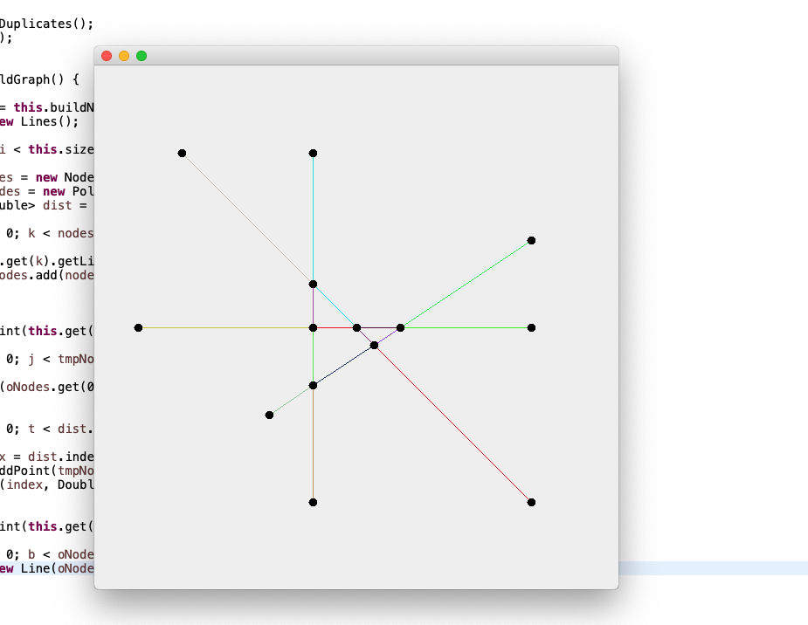
In Class Example

Slide 18
HW Hints
Can you turn your path (polyline) into type ‘Lines’
Should path be a class?
Can you create a class of ‘Paths’ to store multiple paths
3. Can you create buttons to execute ‘build nodes’ and ‘build graph’
Week
9
Homework Hints

Slide 19
Rubric
GEOG 178 | Points
Can I import your code w/o modification? | 2
Can I create a “planar” network (classes) | 2
Can I create a “planar” network (interface) | 2
Can I save a network? | 2
Can I read the network back in? | 2
Week
9
Rubric
GEOG 278 | Points
Can I import your code w/o modification? | 2
Can I create a “planar” network (classes) | 1
Can I create a “planar” network (interface) | 2
Can I save a network? | 1
Can I read the network back in? | 2
Can I connect a POI to the network? | 2

