Slide 1
About Michael
Graduated from the FSU MSAE program in 2018
Data Scientist for the Utah Department of Health
Recent Publications: Machine Learning with Regression in Python, Scaled Forecasting with Python and R, Reinforcement Learning Lock N’ Roll
Previously employed by Disney and Mather Economics
LinkedIn: https://www.linkedin.com/in/michaelwkeith/

Slide 2


Slide 3
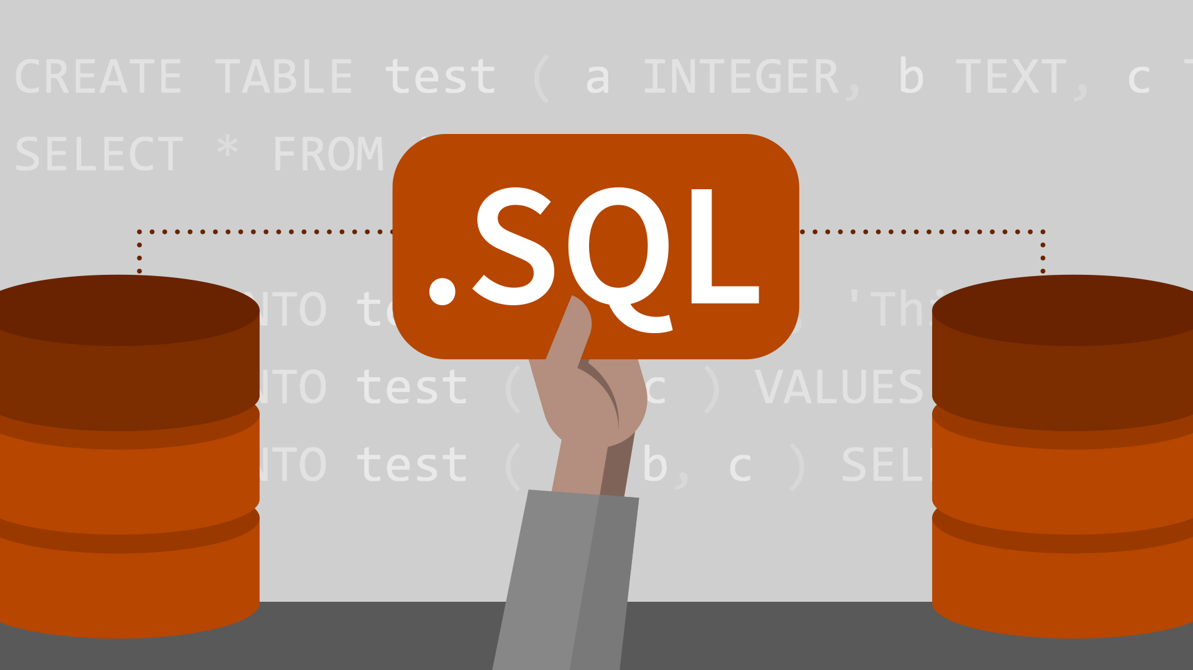
For Economists

Slide 4
Structured Query Language (SQL) is simple
Tool for slicing large datasets into smaller samples
Relatively easy to learn
Basic command set has vocabulary of less than 100 words
Nonprocedural language (code requires limited specification to work)

Slide 5
SQL is a tool for extracting data
STATA, SAS, R, and Python can be used for running economic models and doing statistics
Although some mathematical procedures are possible to perform, SQL is primarily for extracting different cuts of a larger pool of data (no regressions)

Slide 6




A business has many channels and components SQL relates them to each other

Slide 7

SQL facilitates data accessibility
Accesses and stores live datasets
Deciphers compressed data
Scales user logic

Slide 8
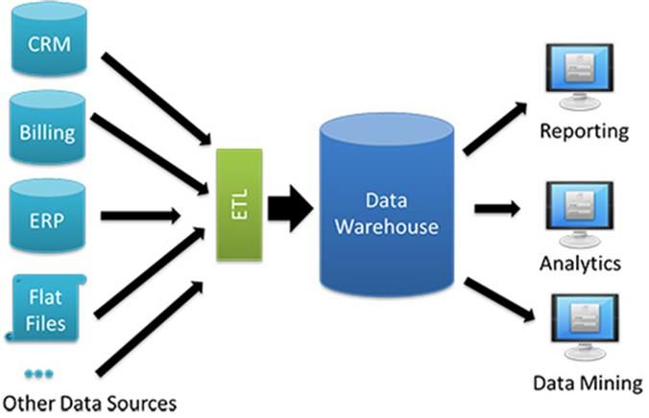
SQL

Slide 9
Let’s practice
SELECT
LEFT JOIN
CASE statements
GROUP BY
INNER JOIN

Slide 10
If you want to follow along:
1. Navigate to https://community.cloud.databricks.com
2. Sign up for an account
3. Upload data with UI
4. Create a cluster
5. Create a new notebook or import the one sent to you
6. Write SQL

Slide 11
Further study
Data Camp – Intro to SQL
Data Camp – Joining Data in SQL
LinkedIn Learning – SQL Essential Training

Slide 12

Appendix

Slide 13
Appendix
Add to Resume:
SQL
CASE, LEFT JOIN, INNER JOIN, AGGREGATION
Databricks
SPARK SQL

Slide 14

Advanced Excel

Slide 15
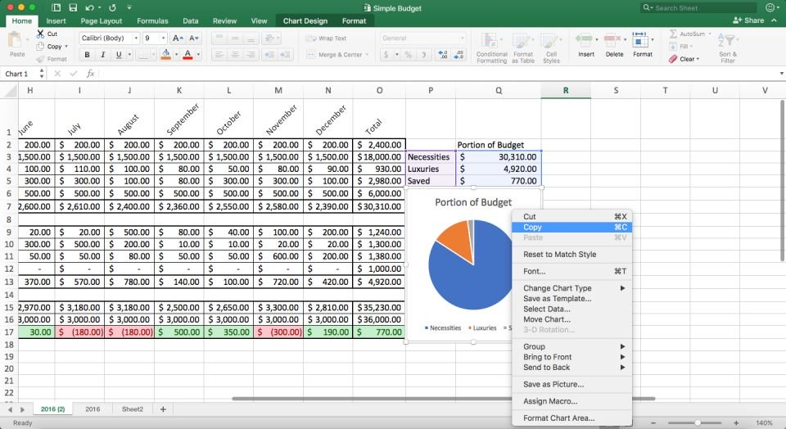
Excel is a tool for managing spreadsheets

Slide 16
Let’s Practice
Data Cleaning
Pivot Tables
VLOOKUP
SUMIFS
DATA VIS

Slide 17
Further Study
LinkedIn Learning – Excel 2016 Essential Training
Google

Slide 18
Appendix
VLOOKUP is like a LEFT JOIN
PIVOT TABLE is a must! Great tool for quickly exploring data

