Slide 1
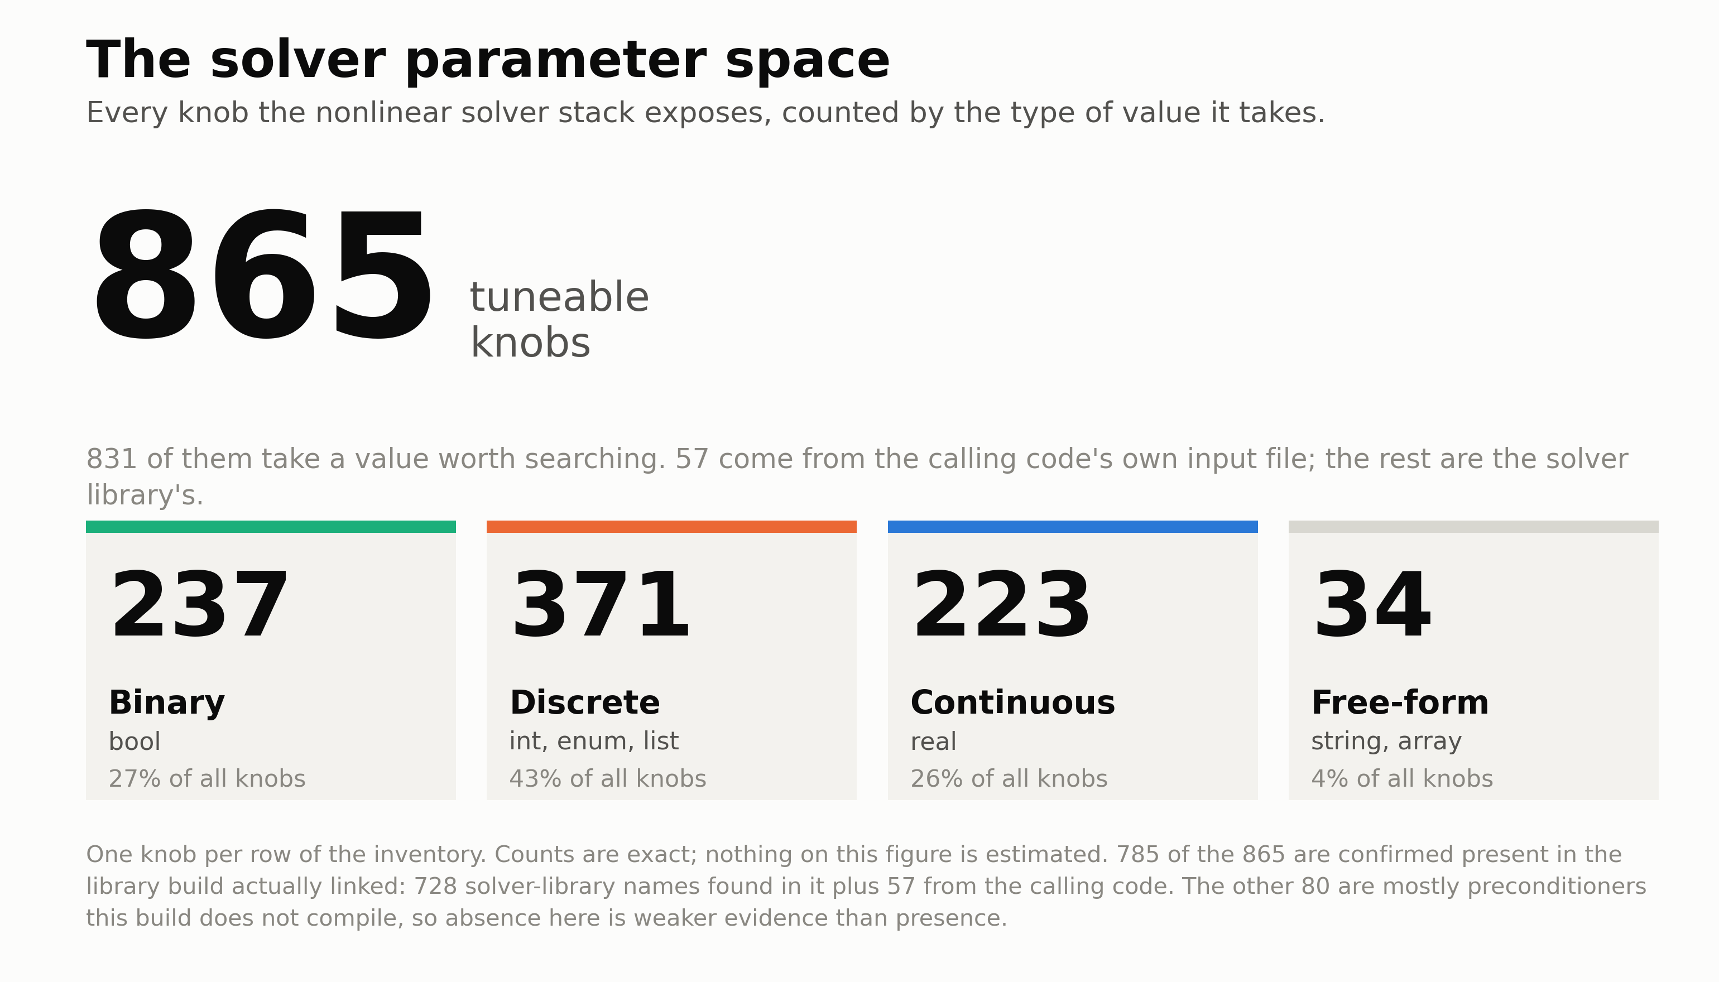
Notes:
Hermes-3 simulates plasma transport in the edge region of fusion reactors, modelling how hot exhaust gas is cooled before touching divertor walls.
The underlying PETSc nonlinear solver stack exposes 865 tunable parameters — comprising boolean flags, discrete choices, continuous tolerances, and algorithm selectors. 831 of these define a vast combinatorial space of potential solver configurations.
Historically, fusion simulations have relied on hand-tuned, conservative defaults dating back years. Manual tuning in an 865-dimensional space is impossible.
To systematically unlock simulation throughput without sacrificing physics accuracy, we designed an automated, evidence-based exploration framework.

Slide 2
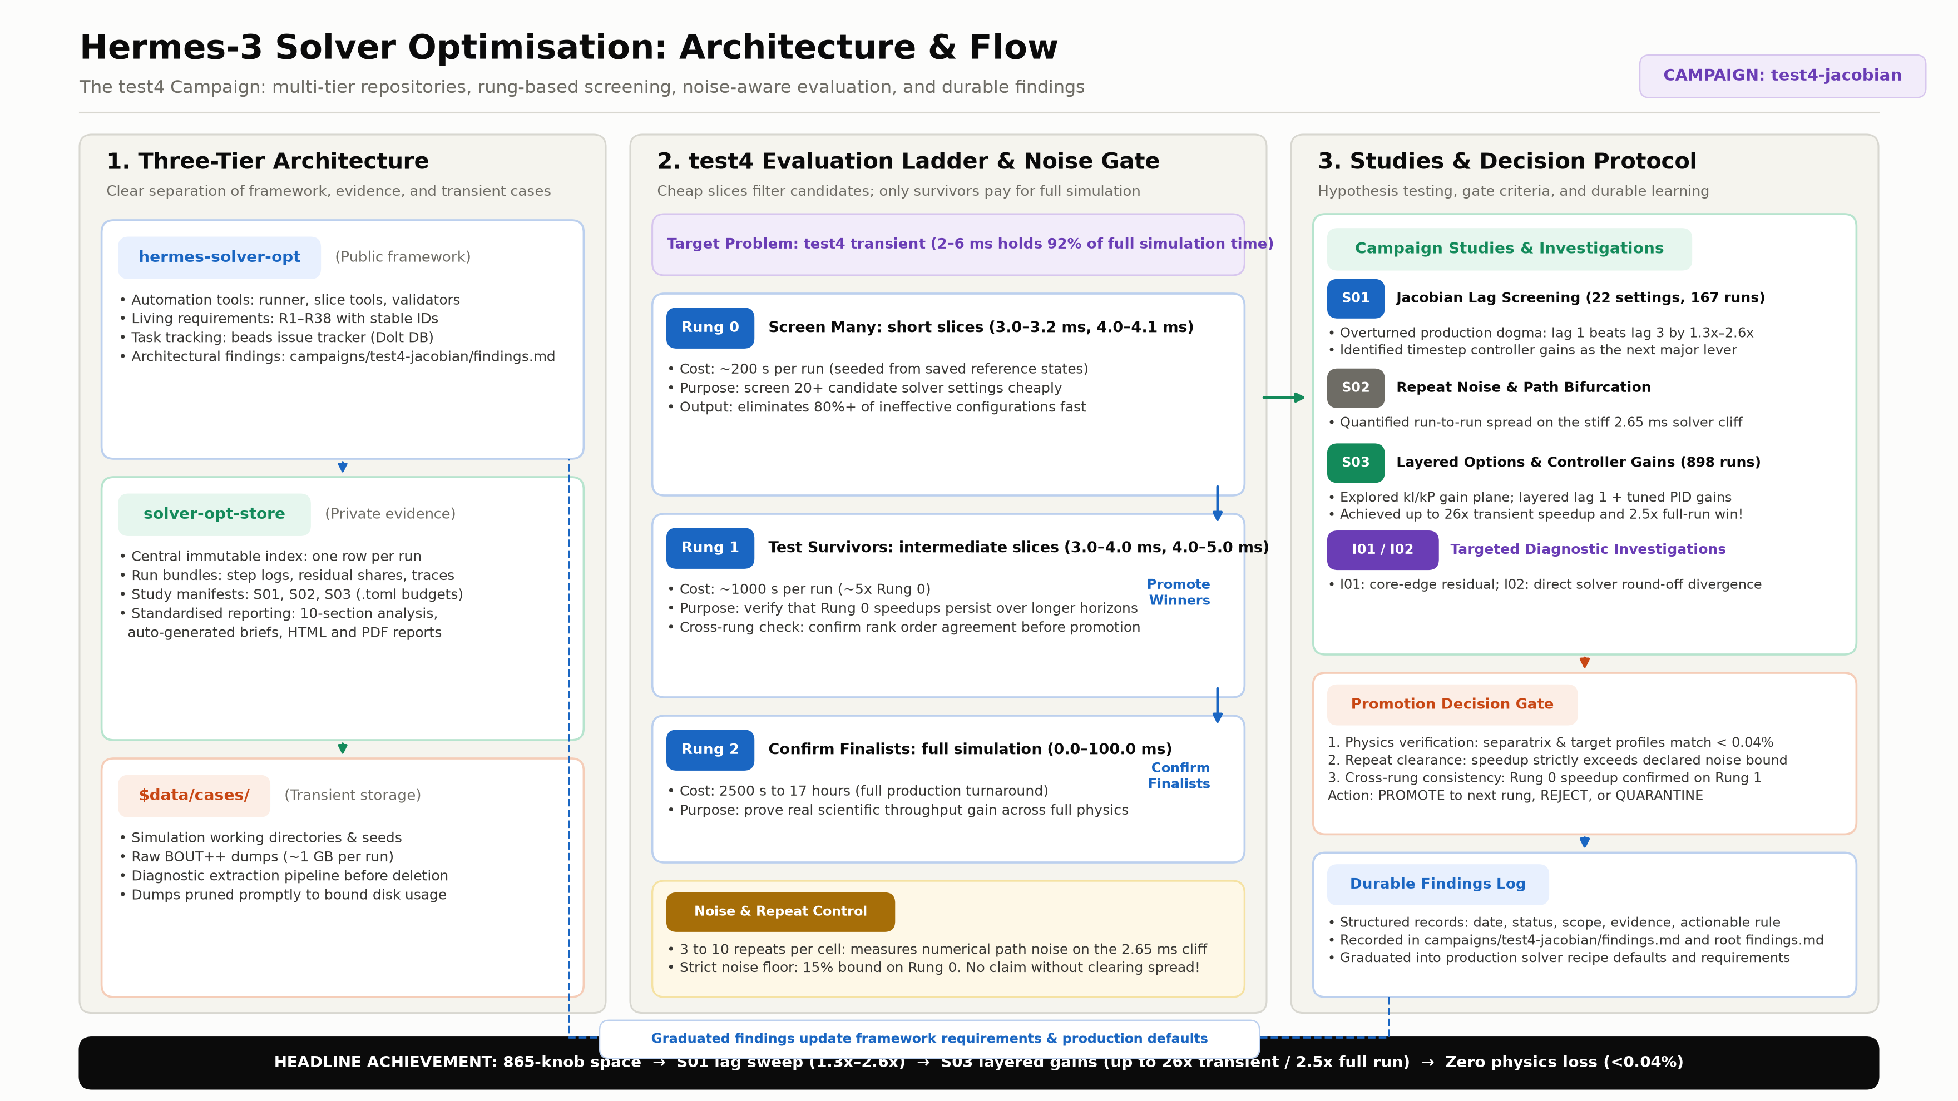
Notes:
This slide presents the core architecture and optimisation methodology developed during the hackathon, applied to the test4-jacobian campaign.
1. Three-Tier Storage: We cleanly decouple the public automation framework (hermes-solver-opt) from the immutable private evidence store (solver-opt-store) and the transient simulation working directories ($data/cases/). Raw simulation dumps (~1 GB each) are pruned promptly after diagnostic extraction.
2. Multi-Rung Evaluation Ladder: Full 100 ms simulations take up to 17 hours. We designed a multi-rung ladder where Rung 0 screens dozens of candidates on fast 200-second slices. Survivors advance to Rung 1 (1000-second intermediate windows) to test stability, and only top finalists run full 100 ms simulations on Rung 2.
3. Strict Noise & Repeat Control: On the stiff 2.65 ms transient cliff, numerical path bifurcations produce up to 15% run-to-run variation. Every cell is sampled across 3 to 10 repeats, and no speedup claim is accepted unless it strictly clears repeat noise.
4. Studies, Investigations & Promotion Gates: Hypotheses are structured into numbered studies (S01, S02, S03) and deep-dive investigations (I01, I02). Candidate settings must pass a 3-part gate: physics agreement (<0.04% profile deviation), noise clearance, and cross-rung consistency. Promoted findings are committed to durable findings logs and graduate back into default solver recipes.

Slide 3
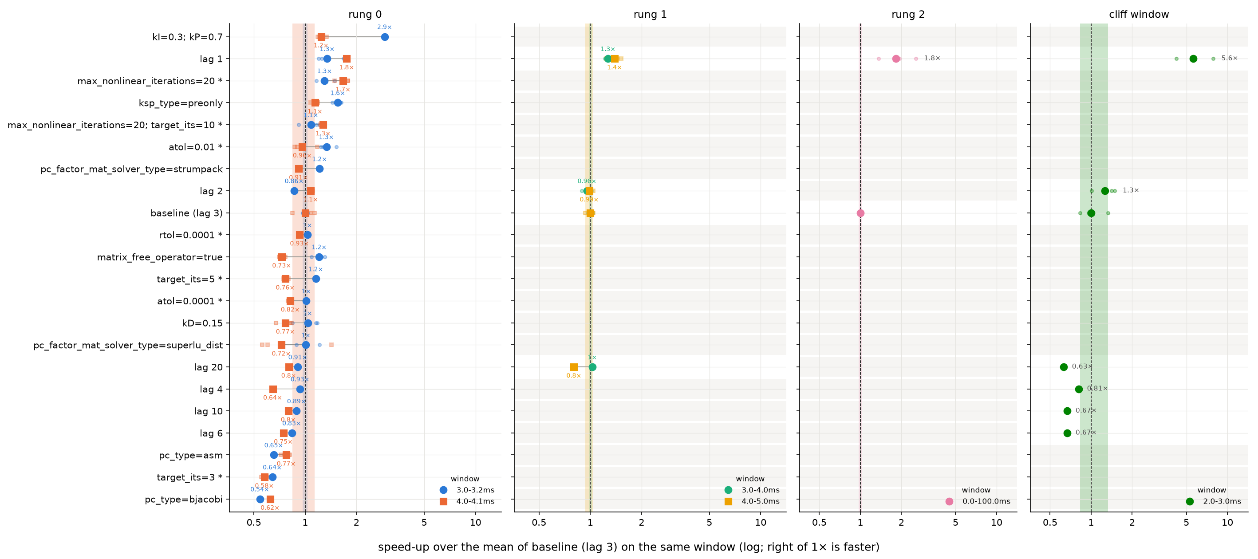
Study S01: Jacobian Lag Screening
Overturning production dogma: updating the Jacobian every step (lag 1) beats default lag 3 by 1.3x–2.6x with <0.04% physics error
Notes:
Study S01 screened 22 candidate solver configurations across 167 runs using our multi-rung ladder, focusing on the Jacobian lag parameter.
For years, standard practice assumed that lagging the Jacobian matrix — rebuilding it only every 3 nonlinear steps (lag 3) — saved time by amortising expensive numerical matrix assemblies.
Our data completely overturned this dogma: updating the Jacobian at every step (lag 1) converges significantly faster per Newton iteration, easily compensating for assembly cost.
Results: Lag 1 achieved 1.8x speedup on Rung 0, 1.3x–1.4x on Rung 1, and 1.8x on the full simulation (Rung 2). Crucially, during the stiff 2.0–3.0 ms cliff window, lag 1 was 5.6x faster.
Physics verification: Separatrix and divertor target profiles matched the baseline to within <0.04% relative error, confirming that this 1.8x speedup comes with zero loss of scientific fidelity.

Slide 4
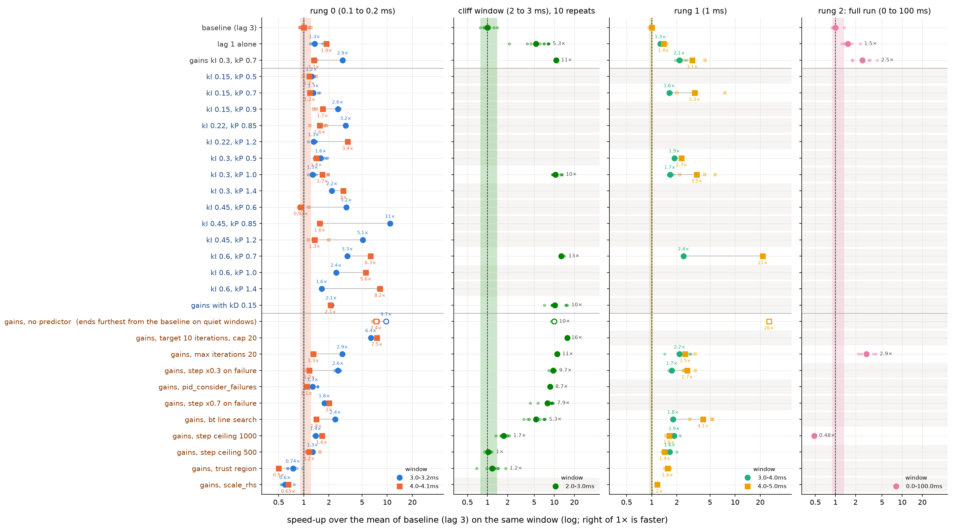
Study S03: Layered Options & Controller Gains
Compounding wins: pairing lag 1 with tuned PID controller gains yields up to 26x transient speedup and 2.5x full-run win
Notes:
Study S03 investigated whether we could compound our S01 gains by tuning the PETSc adaptive timestep controller across 898 runs.
We discovered that the default PI controller was excessively conservative following difficult nonlinear steps, needlessly throttling the timestep during the stiff 2–6 ms transient.
By pairing lag 1 with tuned controller gains (kI=0.3, kP=0.7) and modified failure backoff, the simulation accelerates dramatically across all rungs:
• On the 2–3 ms transient cliff (tested across 10 repeats), the tuned recipe delivered 10x to 16x speedup.
• On Rung 1 slices, speedup reached up to 26x over baseline.
• On the full 0–100 ms simulation (Rung 2), the compounded recipe delivered a 2.5x to 2.9x reduction in wall-clock time.
This translates directly to scientific productivity: multi-day production divertor simulations finish in a fraction of the time, while preserving exact profile agreement at divertor targets.

