Slide 1
Searching the settings of a slow simulation
A plan for automatic tuning, and where to take it next

Slide 2
What the code does, and what it costs
A fusion reactor holds plasma at over a hundred million degrees. The exhaust leaving that plasma has to be cooled on its way out, or it destroys the metal wall it lands on. This code predicts whether a given reactor design manages that.
Simulating a tenth of a second of plasma, on ten cores:
~1 hour
10s of hours
tens
a smaller production case
a large case at full resolution
cases in a single study
the cheapest thing worth running
the ones the science needs
multiply by the row above
The speed of the code decides which questions can be asked at all.

Slide 3
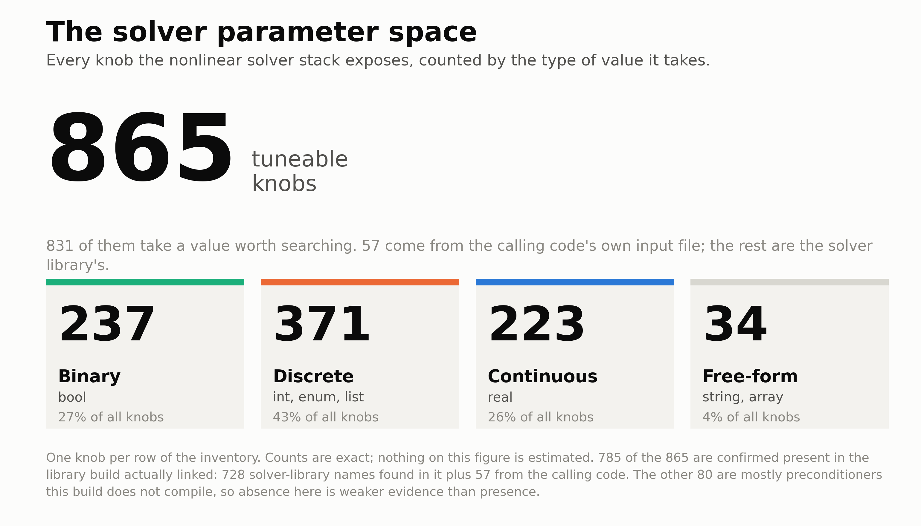
Notes:
865 tuning knobs across 850 distinct names, counted from the source that registers each option rather than from a manual. A further 66 options are monitors and views, which do not change the answer and are left out.

Slide 4
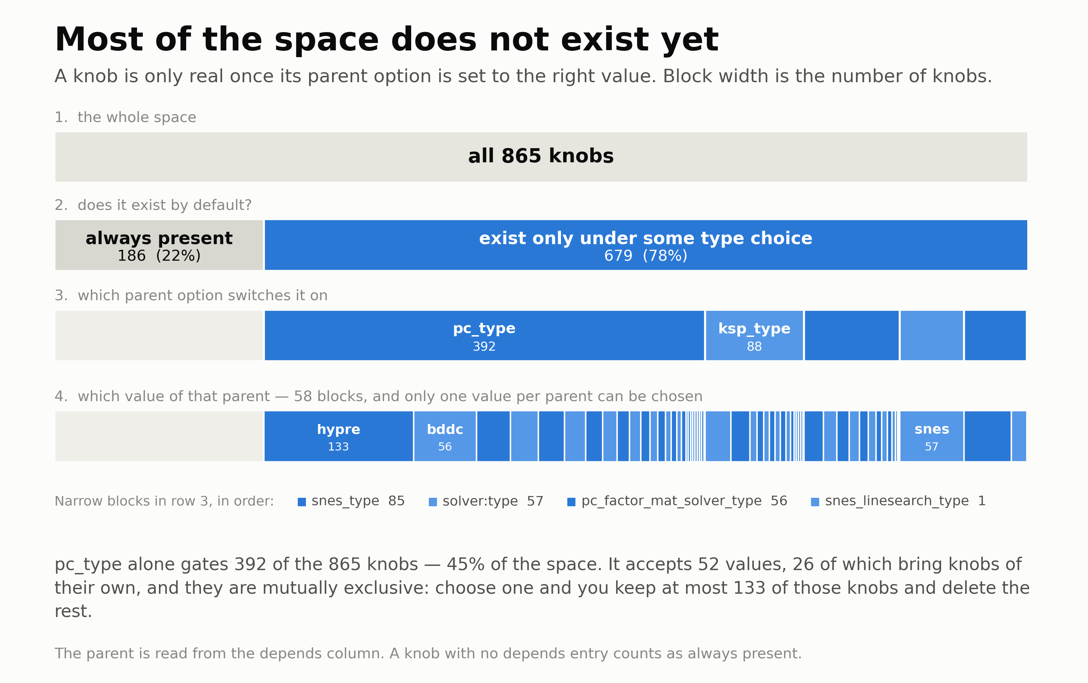
Notes:
Only 186 of the 865 exist unconditionally. One preconditioner choice decides whether 392 of them exist at all.

Slide 5
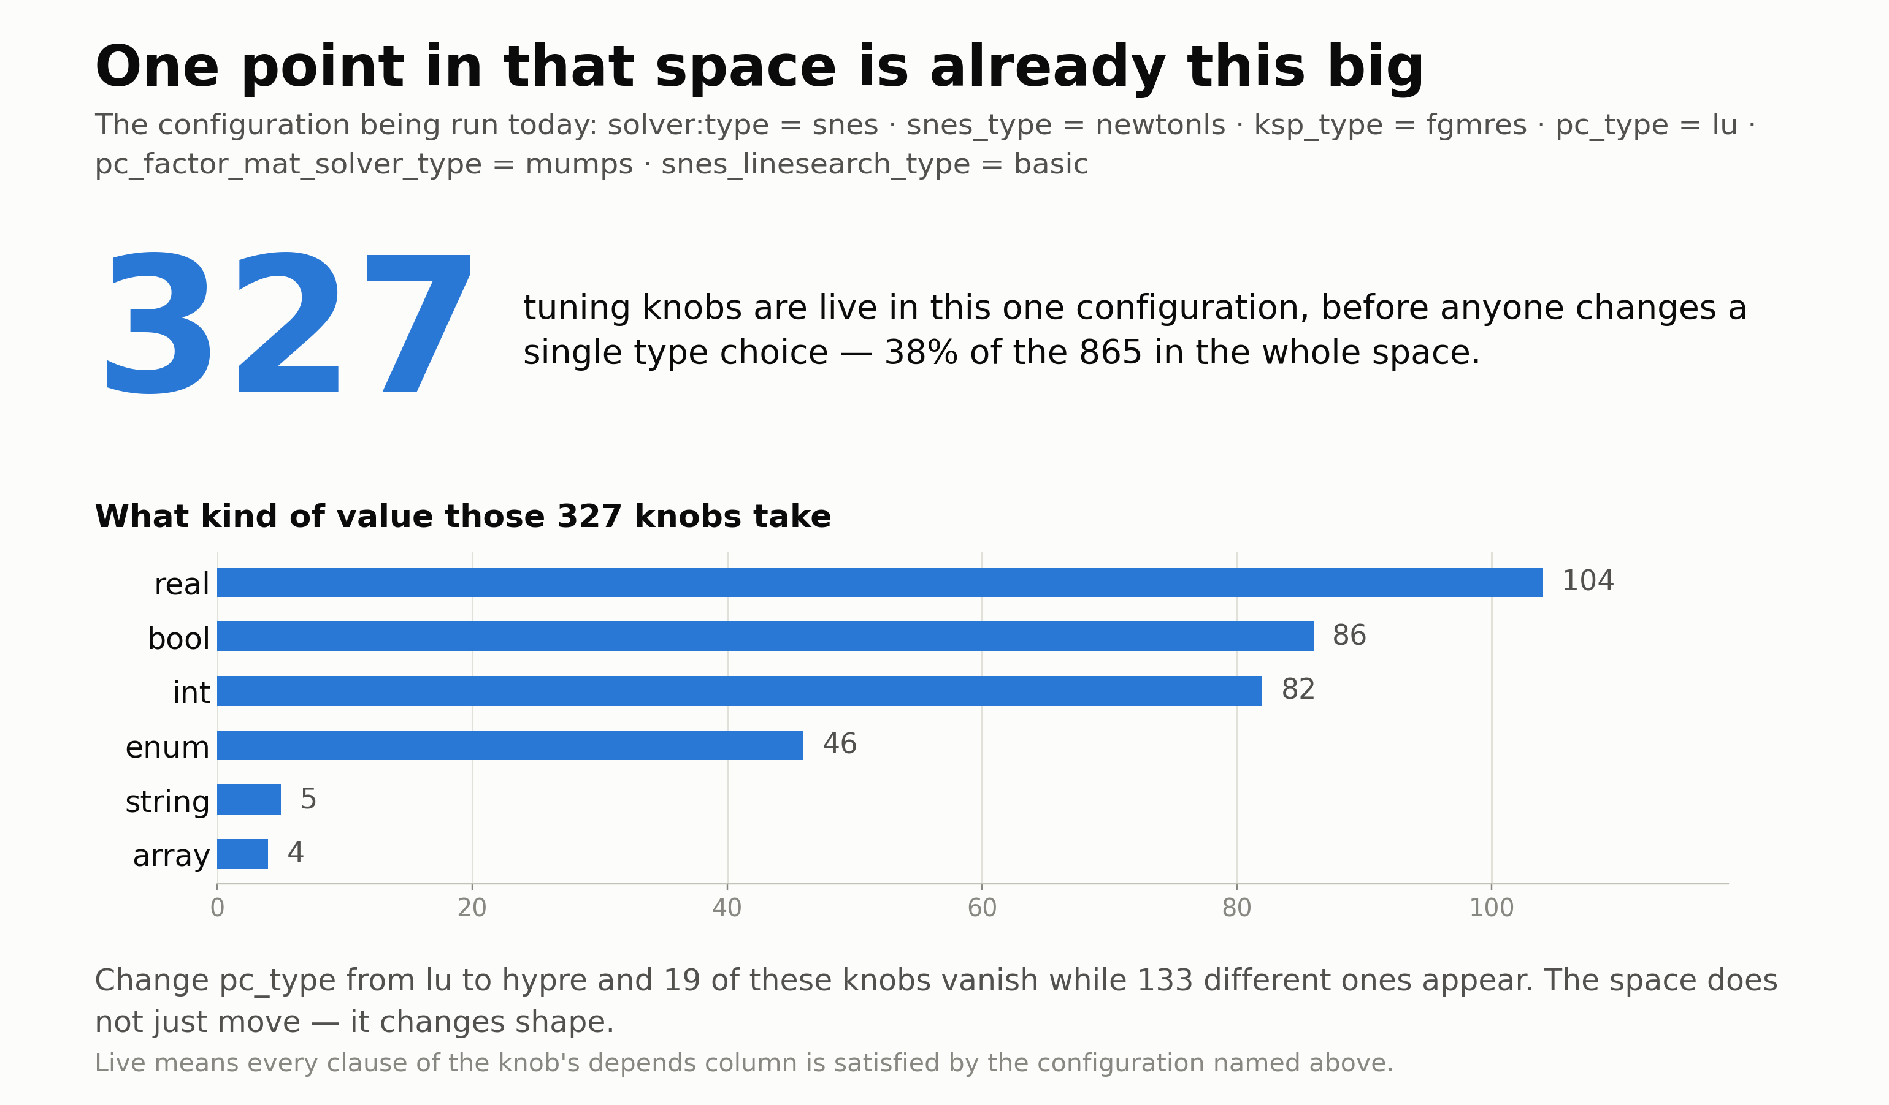
Notes:
The configuration in production today. 327 knobs are live in it, and the settings file we maintain describes 66 of those.

Slide 6
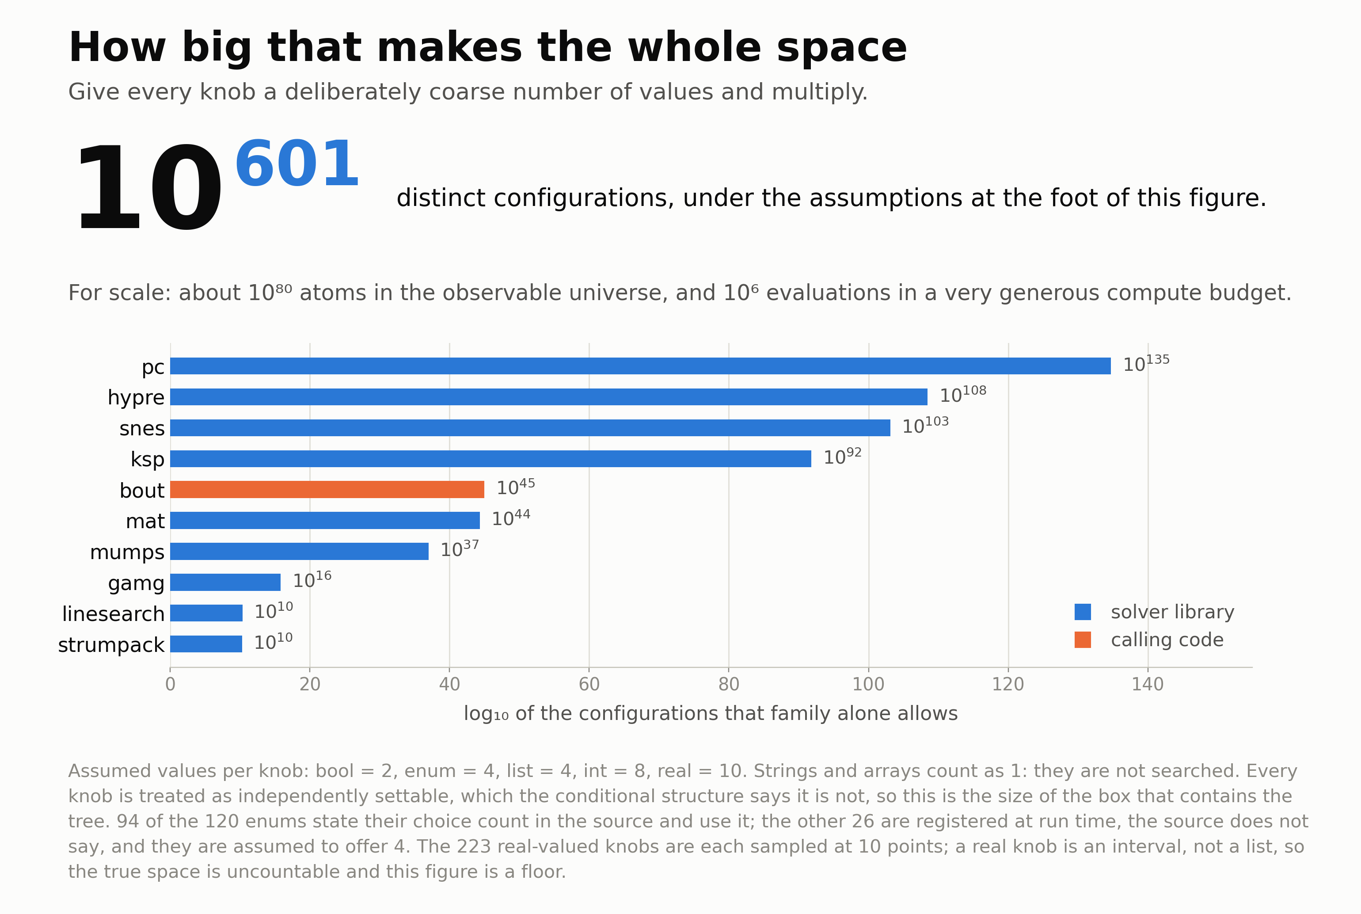
Notes:
A floor, not a size. A continuous knob is an interval rather than a list, and this treats every knob as independently settable, which the conditional structure says it is not.

Slide 7
Why this is not ordinary tuning
hours
One evaluation is expensive
so the number of trials will be small, and a method that needs thousands of them is out.
noisy
The same settings run twice do not agree
the measurement has spread, so a difference of a few per cent means nothing.
wrong
Fast can mean wrong
a setting can be quick because it is cutting corners. Speed alone cannot be the score.
failed
A failure is a result
some settings make a run die or never finish. That is information, not a missing number.

Slide 8
Testing on a slice, not a whole run
one long reference run, saving its state throughout
screen many
seconds
test survivors
minutes
confirm finalists
hours
A slice restarts from a saved state and runs a short way. Several positions, because the simulation is hard in different ways at different stages. Cheap slices screen many candidates; only the survivors pay for the longer ones.

Slide 9
The system
Optimiser
a list of trials
Runner
what happened
Record
decides what to try next
prepares, launches, watches, measures
one row per run, plus its evidence
past results, as a short table
The runner has no judgement in it, so it runs unattended, anywhere.
The optimiser can be an algorithm, a language model, or a person writing a list. The runner cannot tell the difference, so it can be swapped without touching anything else.
Speed and correctness are recorded side by side, never combined, so nothing can trade accuracy for time.

Slide 10
What exists, and what does not
Built and working
Not built
Measurement. A finished run turns automatically into one row of numbers and a bundle of evidence.
The record. One row per run, added to and never rewritten.
Reference runs for three cases, with their saved states.
The tool that cuts a slice and sets it up as a run.
The loop itself. A four-trial campaign has been generated, run, measured and recorded with nobody watching.
Any optimiser at all. Every trial so far was a list written by hand.
Any evidence that a slice predicts a full run.
A description of more than a fifth of the settings that are live.

Slide 11
What to work on together
1
Does a slice predict a full run, and how should that be checked before it is trusted?
2
What search method suits 865 mixed settings, most of which exist only when another setting has a particular value?
3
Where, if anywhere, does a language model belong in the loop?
4
How should a run that fails, or never finishes, be scored?

