Slide 1
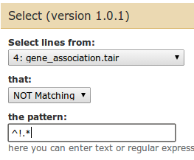
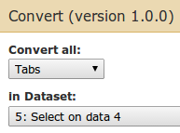
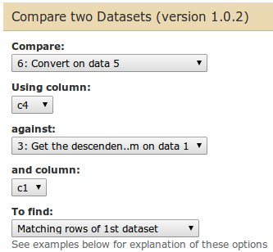
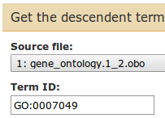
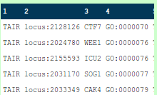
Filter and sort
Select lines that match an expresion
Text manipulation
Convert delimiters to TAB
Join, subtract and group
Compare two Datasets to find common or distinct rows
OBO ontology manipulation
Get the descendent terms of a given OBO term

