Slide 1
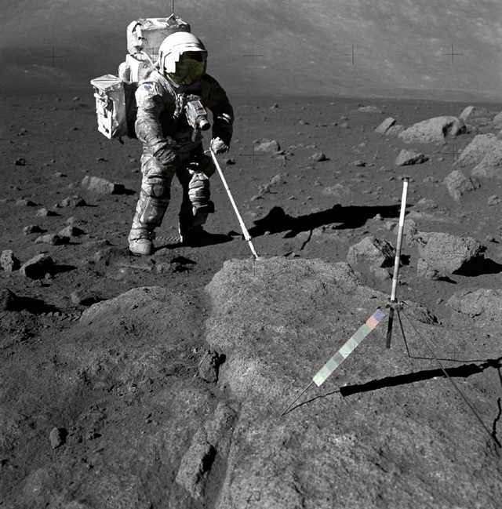
Data Extraction & Exploration with SPARQL & the Talis Platform

Slide 2
Agenda
Tutorial Schema
Graph Patterns
Simple SELECT queries
OPTIONAL patterns
UNION queries
Sorting & Limiting
Filtering & Restrictions
DISTINCT
SPARQL Query Forms
Useful Links

Slide 3
Tutorial Schema
  Based on NASA spaceflight data
  Available in:
  http://api.talis.com/stores/space

Slide 4
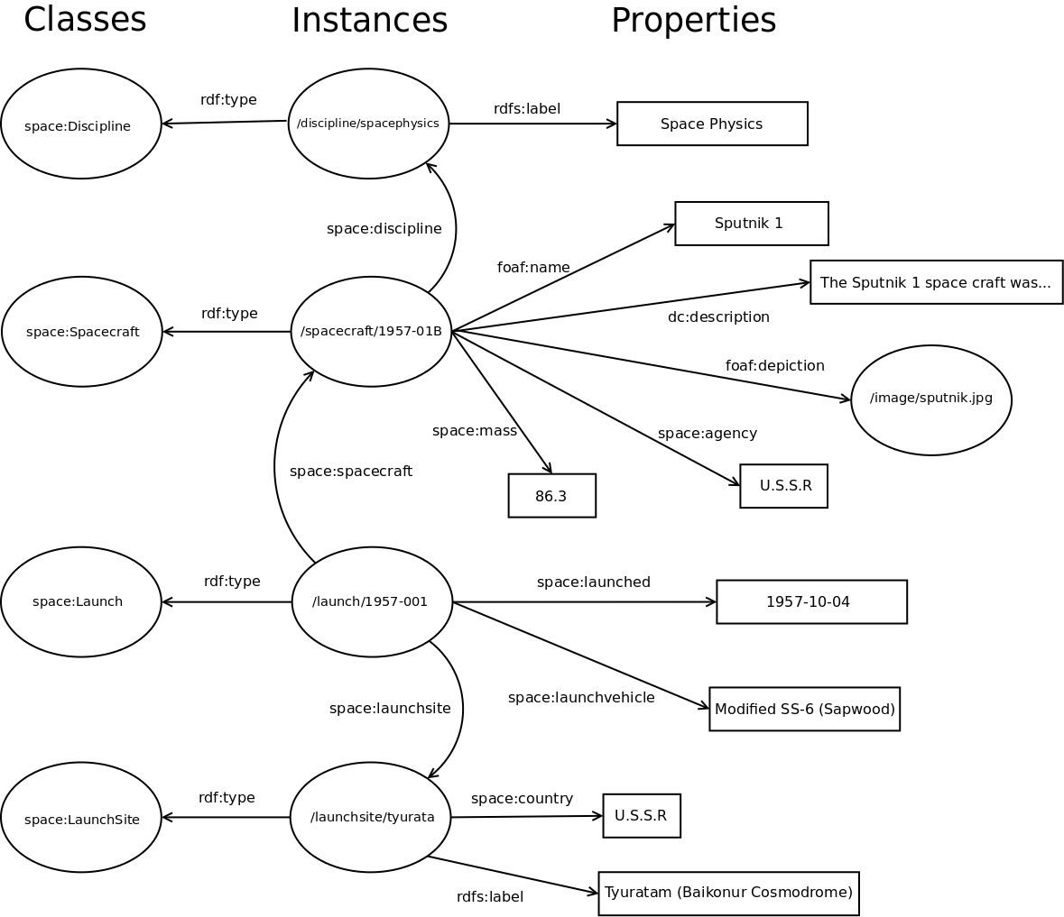

Slide 5
Triple and Graph Patterns
  How do we describe the structure of the RDF graph which we're interested in?

Slide 6
#An RDF triple in Turtle syntax
<http://purl.org/net/schemas/space/spacecraft/1957-001B>
foaf:name “Sputnik 1”.

Slide 7
#An SPARQL triple pattern, with a single variable
<http://purl.org/net/schemas/space/spacecraft/1957-001B>
foaf:name ?name.

Slide 8
#All parts of a triple pattern can be variables
?spacecraft foaf:name ?name.

Slide 9
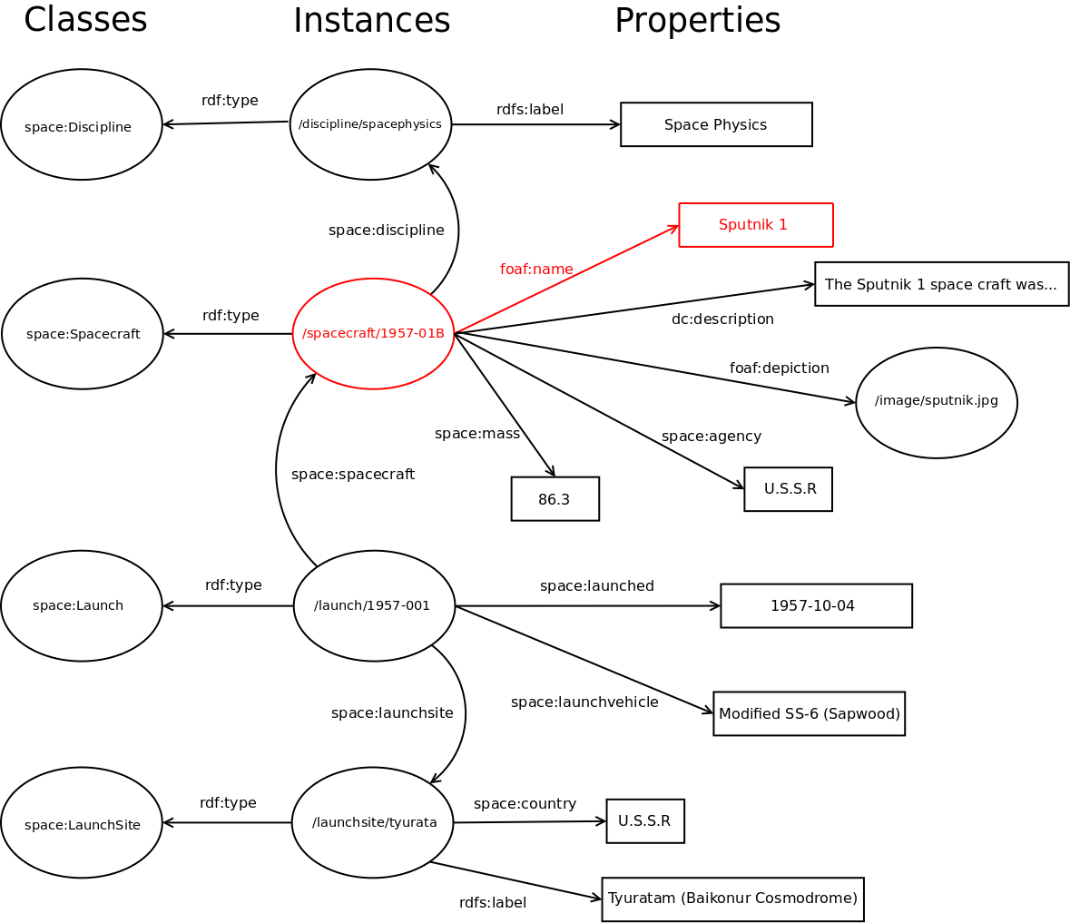

Slide 10
#Matching labels of resources
?subject rdfs:label ?label.

Slide 11
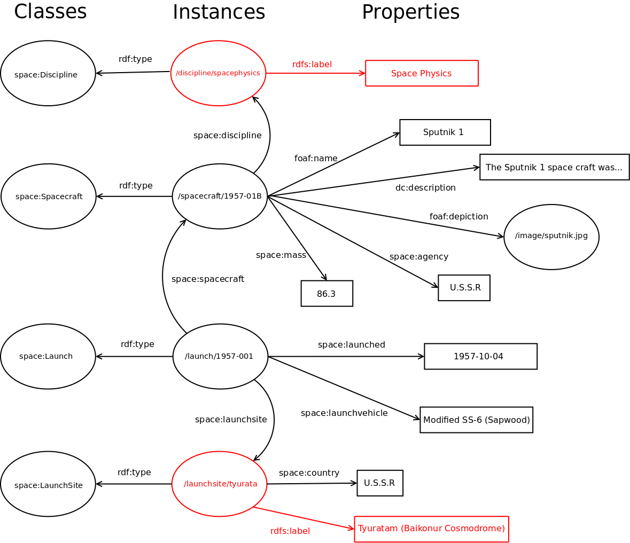

Slide 12
#Combine triples patterns to create a graph pattern
?subject rdfs:label ?label.
?subject rdf:type space:Discipline.

Slide 13
#SPARQL is based on Turtle, which allows abbreviations
#e.g. predicate-object lists:
?subject rdfs:label ?label;
rdf:type space:Discipline.

Slide 14
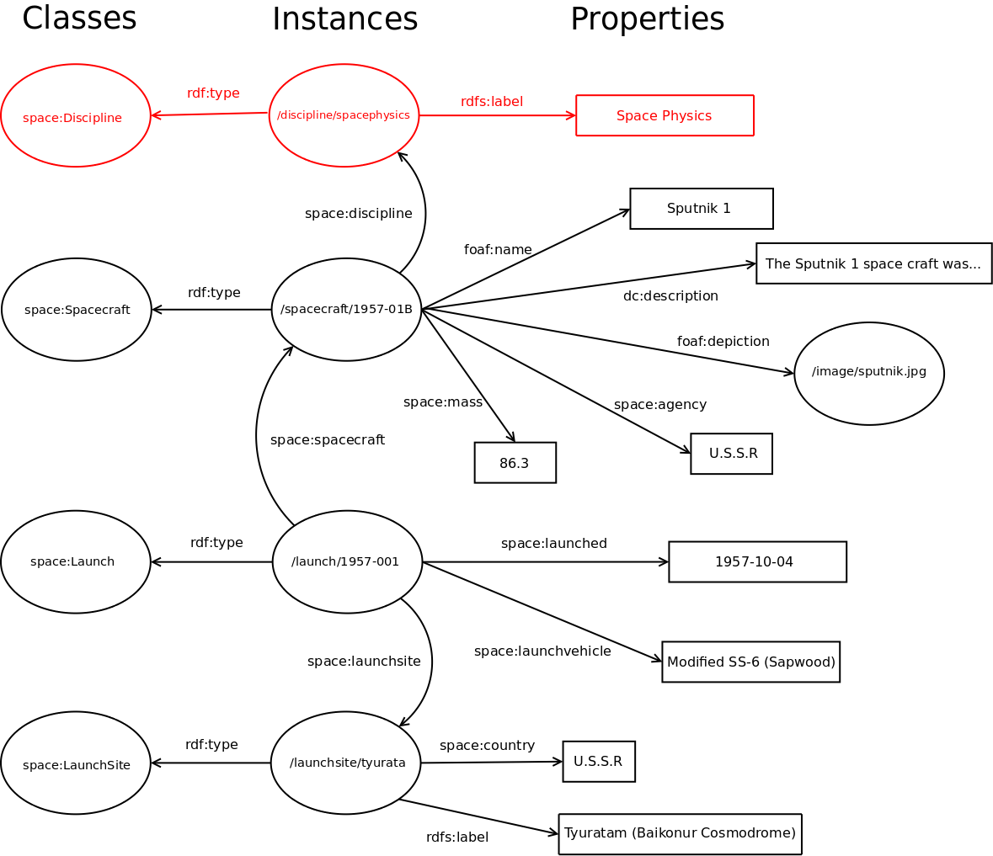

Slide 15
#Graph patterns allow us to traverse a graph
?spacecraft foaf:name “Sputnik 1”.
?launch space:spacecraft ?launch.
?launch space:launched ?launchdate.

Slide 16
#Graph patterns allow us to traverse a graph
?spacecraft foaf:name “Sputnik 1”.
?launch space:spacecraft ?launch.
?launch space:launched ?launchdate.

Slide 17
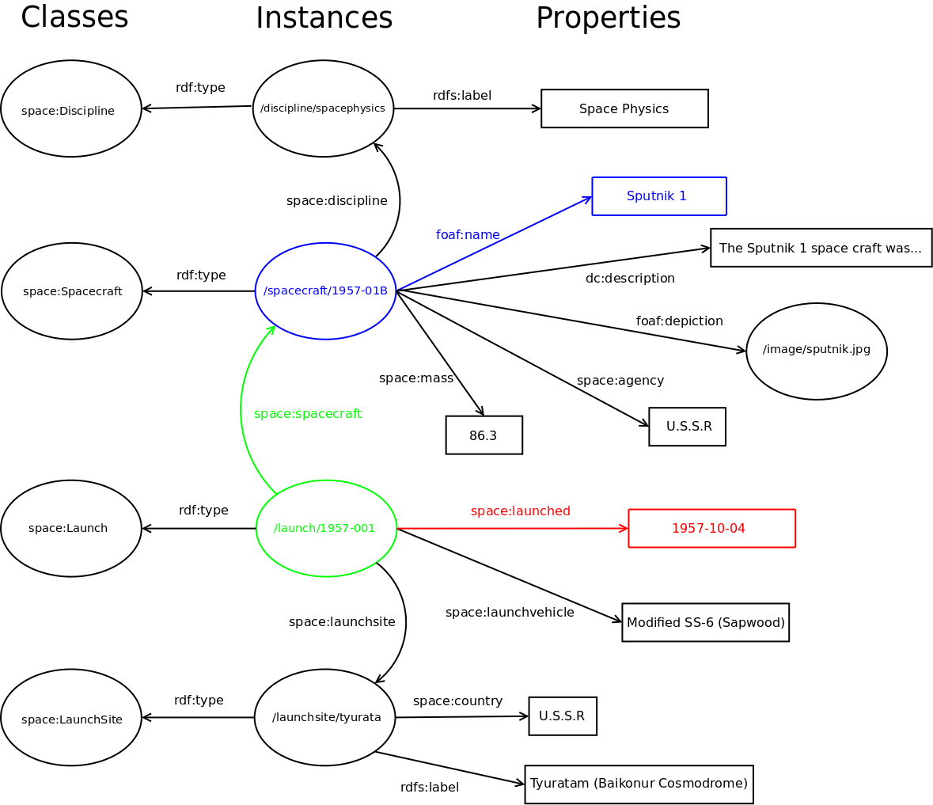

Slide 18
Structure of a Query
  What does a basic SPARQL query look like?

Slide 19
#Ex. 1
#Associate URIs with prefixes
PREFIX space: <http://purl.org/net/schemas/space/>
PREFIX rdf: <http://www.w3.org/1999/02/22-rdf-syntax-ns#>
PREFIX rdfs: <http://www.w3.org/2000/01/rdf-schema#>
#Example of a SELECT query, retrieving 2 variables
#Variables selected MUST be bound in graph pattern
SELECT ?subject ?label
WHERE {
#This is our graph pattern
?subject rdfs:label ?label;
rdf:type space:Discipline.
}

Slide 20
#Ex. 2
PREFIX space: <http://purl.org/net/schemas/space/>
PREFIX rdf: <http://www.w3.org/1999/02/22-rdf-syntax-ns#>
PREFIX rdfs: <http://www.w3.org/2000/01/rdf-schema#>
#Example of a SELECT query, retrieving all variables
SELECT *
WHERE {
?subject rdfs:label ?label;
rdf:type space:Discipline.
}

Slide 21
OPTIONAL bindings
  How do we allow for missing or unknown information?

Slide 22
#Ex. 3
PREFIX space: <http://purl.org/net/schemas/space/>
PREFIX foaf: <http://xmlns.com/foaf/0.1/>
SELECT ?name ?image
WHERE {
#This pattern must be bound
?spacecraft foaf:name ?name.
#Anything in this block doesn't have to be bound
OPTIONAL {
?spacecraft foaf:depiction ?image.
}
}

Slide 23
UNION queries
  How do we allow for alternatives or variations in the graph?

Slide 24
#Ex. 4
PREFIX space: <http://purl.org/net/schemas/space/>
PREFIX foaf: <http://xmlns.com/foaf/0.1/>
PREFIX rdfs: <http://www.w3.org/2000/01/rdf-schema#>
SELECT ?subject ?displayLabel
WHERE {
{
?subject foaf:name ?displayLabel.
}
UNION
{
?subject rdfs:label ?displayLabel.
}
}

Slide 25
Sorting & Restrictions
  How do we apply a sort order to the results?
  How can we restrict the number of results returned?

Slide 26
#Ex.5
#Select the uri and the mass of all the spacecraft
PREFIX space: <http://purl.org/net/schemas/space/>
PREFIX foaf: <http://xmlns.com/foaf/0.1/>
PREFIX rdfs: <http://www.w3.org/2000/01/rdf-schema#>
SELECT ?spacecraft ?mass
WHERE {
?spacecraft space:mass ?mass.
}

Slide 27
#Ex. 6
#Select the uri and the mass of all the spacecraft
#with highest first
PREFIX space: <http://purl.org/net/schemas/space/>
PREFIX foaf: <http://xmlns.com/foaf/0.1/>
PREFIX rdfs: <http://www.w3.org/2000/01/rdf-schema#>
SELECT ?spacecraft ?mass
WHERE {
?spacecraft space:mass ?mass.
}
#Use an ORDER BY clause to apply a sort. Can be ASC or DESC
ORDER BY DESC(?mass)‏

Slide 28
#Ex. 7
#Select the uri and the mass of the 10 heaviest spacecraft
PREFIX space: <http://purl.org/net/schemas/space/>
PREFIX foaf: <http://xmlns.com/foaf/0.1/>
PREFIX rdfs: <http://www.w3.org/2000/01/rdf-schema#>
SELECT ?spacecraft ?mass
WHERE {
?spacecraft space:mass ?mass.
}
#Order by weight descending
ORDER BY DESC(?mass)‏
#Limit to first ten results
LIMIT 10

Slide 29
#Ex. 8
#Select the uri and the mass of the 11-20th most
#heaviest spacecraft
PREFIX space: <http://purl.org/net/schemas/space/>
PREFIX foaf: <http://xmlns.com/foaf/0.1/>
PREFIX rdfs: <http://www.w3.org/2000/01/rdf-schema#>
SELECT ?spacecraft ?mass
WHERE {
?spacecraft space:mass ?mass.
}
ORDER BY DESC(?mass)‏
#Limit to ten results
LIMIT 10
#Apply an offset to get next “page”
OFFSET 10

Slide 30
Filtering
  How do we restrict results based on aspects of the data rather than the graph, e.g. string matching?

Slide 31
#Sample data for Sputnik launch
<http://purl.org/net/schemas/space/launch/1957-001>
rdf:type space:Launch;
#Assign a datatype to the literal, to indicate it is
#a date
space:launched "1957-10-04"^^xsd:date;
space:spacecraft <http://purl.org/net/schemas/space/spacecraft/1957-001B>
.

Slide 32
#Ex. 9
#Select name of spacecraft launched between
#1st Jan 1969 and 1st Jan 1970
PREFIX space: <http://purl.org/net/schemas/space/>
PREFIX foaf: <http://xmlns.com/foaf/0.1/>
PREFIX xsd: <http://www.w3.org/2001/XMLSchema#>
SELECT ?name
WHERE {
?launch space:launched ?date;
space:spacecraft ?spacecraft.
?spacecraft foaf:name ?name.
FILTER (?date > "1969-01-01"^^xsd:date &&
?date < "1970-01-01"^^xsd:date)‏
}

Slide 33
#Ex. 10
#Select spacecraft with a mass of less than 90kg
PREFIX space: <http://purl.org/net/schemas/space/>
PREFIX foaf: <http://xmlns.com/foaf/0.1/>
PREFIX xsd: <http://www.w3.org/2001/XMLSchema#>
SELECT ?spacecraft ?name
WHERE {
?spacecraft foaf:name ?name;
space:mass ?mass.
#Note that we have to cast the data to the right type
#As it is not declared in the data
FILTER( xsd:double(?mass) < 90.0 )‏
}

Slide 34
#Ex. 11
#Select spacecraft with a name like “ollo”
PREFIX space: <http://purl.org/net/schemas/space/>
PREFIX foaf: <http://xmlns.com/foaf/0.1/>
PREFIX xsd: <http://www.w3.org/2001/XMLSchema#>
SELECT ?name
WHERE {
?spacecraft foaf:name ?name.
FILTER( regex(?name, “ollo”, “i” ) )‏
}

Slide 35
Built-In Filters
Logical: !, &&, ||
Math: +, -, *, /
Comparison: =, !=, >, <, ...
SPARQL tests: isURI, isBlank, isLiteral, bound
SPARQL accessors: str, lang, datatype
Other: sameTerm, langMatches, regex

Slide 36
DISTINCT
  How do we remove duplicate results?

Slide 37
#Ex. 12
#Select list of agencies associated with spacecraft
PREFIX space: <http://purl.org/net/schemas/space/>
PREFIX foaf: <http://xmlns.com/foaf/0.1/>
PREFIX xsd: <http://www.w3.org/2001/XMLSchema#>
SELECT DISTINCT ?agency
WHERE {
?spacecraft space:agency ?agency.
}

Slide 38
SPARQL Query Forms
  Does SPARQL do more than just SELECT data?

Slide 39
ASK
  Test whether the graph contains some data of interest

Slide 40
#Ex. 13
#Was there a launch on 16th July 1969?
PREFIX space: <http://purl.org/net/schemas/space/>
PREFIX xsd: <http://www.w3.org/2001/XMLSchema#>
ASK WHERE {
?launch space:launched "1969-07-16"^^xsd:date.
}

Slide 41
DESCRIBE
Generate an RDF description of a resource(s)‏

Slide 42
#Ex. 14
#Describe launch(es) that occurred on 16th July 1969
PREFIX space: <http://purl.org/net/schemas/space/>
PREFIX xsd: <http://www.w3.org/2001/XMLSchema#>
DESCRIBE ?launch WHERE {
?launch space:launched "1969-07-16"^^xsd:date.
}

Slide 43
#Ex. 15
#Describe spacecraft launched on 16th July 1969
PREFIX space: <http://purl.org/net/schemas/space/>
PREFIX xsd: <http://www.w3.org/2001/XMLSchema#>
DESCRIBE ?spacecraft WHERE {
?launch space:launched "1969-07-16"^^xsd:date.
?spacecraft space:launch ?launch.
}

Slide 44
CONSTRUCT
Create a custom RDF graph based on query criteria
Can be used to transform RDF data

Slide 45
#Ex. 16
PREFIX space: <http://purl.org/net/schemas/space/>
PREFIX xsd: <http://www.w3.org/2001/XMLSchema#>
PREFIX foaf: <http://xmlns.com/foaf/0.1/>
CONSTRUCT {
?spacecraft foaf:name ?name;
space:agency ?agency;
space:mass ?mass.
}
WHERE {
?launch space:launched "1969-07-16"^^xsd:date.
?spacecraft space:launch ?launch;
foaf:name ?name;
space:agency ?agency;
space:mass ?mass.
}

Slide 46
SELECT
SQL style result set retrieval

Slide 47
#Ex. 17
PREFIX space: <http://purl.org/net/schemas/space/>
PREFIX xsd: <http://www.w3.org/2001/XMLSchema#>
PREFIX foaf: <http://xmlns.com/foaf/0.1/>
SELECT ?name ?agency ?mass
WHERE {
?launch space:launched "1969-07-16"^^xsd:date.
?spacecraft space:launch ?launch;
foaf:name ?name;
space:agency ?agency;
space:mass ?mass.
}

Slide 48
Useful Links
SPARQL FAQ
  http://www.thefigtrees.net/lee/sw/sparql-faq
SPARQL Recipes
  http://n2.talis.com/wiki/SPARQL_Recipes
SPARQL By Example Tutorial
  http://www.cambridgesemantics.com/2008/09/sparql-by-example
Twinkle, GUI SPARQL editor
  http://www.ldodds.com/projects/twinkle
  http://code.google.com/p/twinkle-sparql-tools

Slide 49
shared innovation

