Slide 1
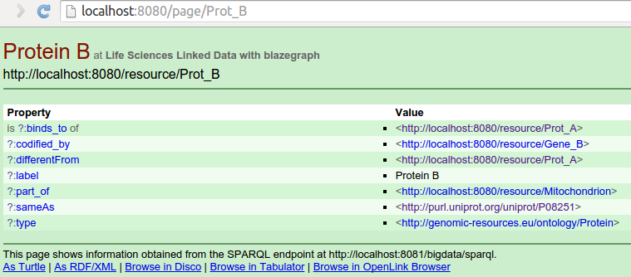
http://localhost:8080/resource/*
http://genomic-resources.eu/resource/*
http://localhost:8080/resource/Prot_B
PUBBY
303
http://localhost:8080/page/Prot_B
PUBBY
DESCRIBE <http://genomic_resources.eu/resource/Prot_B>
BLAZEGRAPH
Protein B
rdfs:label
PUBBY
<http://genomic_resources.eu/resource/Prot_B>
codified_by
<http://genomic_resources.eu/resource/Gene_B>
http://localhost:8080/resource/*
http://genomic-resources.eu/resource/*

Slide 2
http://localhost:8080/resource/*
http://genomic-resources.eu/resource/*
Accept: application/rdf+xml
http://localhost:8080/resource/Prot_B
PUBBY
303
http://localhost:8080/data/Prot_B
PUBBY
DESCRIBE <http://genomic_resources.eu/resource/Prot_B>
BLAZEGRAPH
Protein B
Protein B
rdfs:label
rdfs:label
<http://genomic_resources.eu/resource/Prot_B>
<http://genomic_resources.eu/resource/Prot_B>
PUBBY
codified_by
codified_by
<http://genomic_resources.eu/resource/Gene_B>
<http://genomic_resources.eu/resource/Gene_B>
http://localhost:8080/resource/*
http://genomic-resources.eu/resource/*

