Slide 1
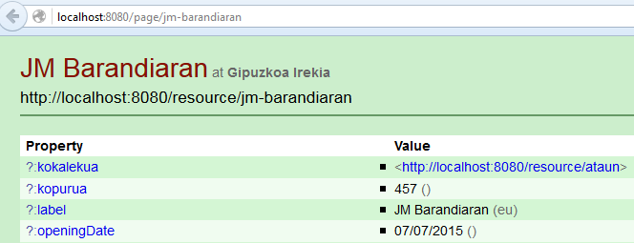
http://localhost:8080/resource/*
http://gipuzkoa.eus/resource/*
http://localhost:8080/resource/jm-barandiaran
PUBBY
303
http://localhost:8080/page/jm-barandiaran
PUBBY
DESCRIBE <http://gipuzkoa.eus/resource/jm-barandiaran>
BLAZEGRAPH
07/07/2015
openingDate
PUBBY
<http://gipuzkoa.eus/resource/jm-barandiaran>
kokalekua
<http://gipuzkoa.eus/resource/ataun>
http://localhost:8080/resource/*
http://gipuzkoa.eus/resource/*

Slide 2
http://localhost:8080/resource/*
http://gipuzkoa.eus/resource/*
Accept: application/rdf+xml
http://localhost:8080/resource/jm-barandiaran
PUBBY
303
http://localhost:8080/data/jm-barandiaran
PUBBY
DESCRIBE <http://gipuzkoa.eus/resource/jm-barandiaran>
BLAZEGRAPH
07/07/2015
07/07/2015
openingDate
openingDate
<http://localhost:8080/resource/jm-barandiaran>
PUBBY
<http://gipuzkoa.eus/resource/jm-barandiaran>
kokalekua
kokalekua
<http://localhost:8080/resource/ataun>
<http://gipuzkoa.eus/resource/ataun>
http://localhost:8080/resource/*
http://gipuzkoa.eus/resource/*

