Slide 1
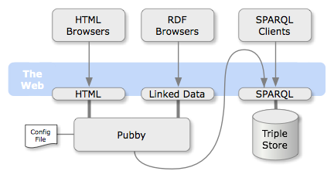
Jetty
Fuseki

