Slide 1



Web Ontology Language (OWL)
Máster Universitario en Inteligencia Artificial
Mikel Egaña Aranguren
3205 Facultad de Informática
Universidad Politécnica de Madrid (UPM)
Campus de Montegancedo
28660 Boadilla del Monte
Spain
http://www.oeg-upm.net
megana@fi.upm.es
http://mikeleganaaranguren.com
8/11/2011

Slide 2

Material
http://delicias.dia.fi.upm.es/wiki/index.php/MasterRD11-12
Week 9. 8/11/2011. OWL (Mikel Egaña Aranguren)
http://mikeleganaaranguren.wordpress.com/teaching/
Web Ontology Language

Slide 3
Index
Introduction to OWL
OWL syntaxes
OWL semantics
Reasoning
OWL tools
Assignment
(Comment on last assignment)
Web Ontology Language

Slide 4
Introduction to OWL
Introduction to OWL
Web Ontology Language

Slide 5
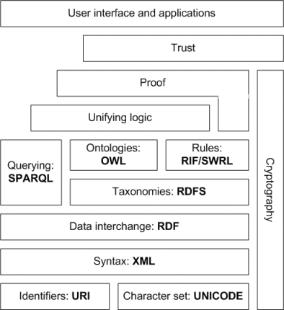
Introduction to OWL
OWL is a Knowledge Representation language proposed by the W3C as a standard to codify ontologies in a prospective Semantic Web
Web Ontology Language

Slide 6
Introduction to OWL
OWL is based in Description Logics
We can represent a knowledge domain computationally in an OWL ontology, in order to:
Apply automated reasoning: infer “new” knowledge, queries, consistency, classify entities against the ontology, …
Integrate knowledge from different resources
Web Ontology Language

Slide 7
Introduction to OWL
Everything about OWL 2: http://www.w3.org/standards/techs/owl
Document overview: http://www.w3.org/TR/2009/REC-owl2-overview-20091027/
Primer: http://www.w3.org/TR/2009/REC-owl2-primer-20091027/
Manchester OWL + Protégé tutorial (Copied some examples :-):
http://owl.cs.manchester.ac.uk/tutorials/protegeowltutorial/
Web Ontology Language

Slide 8
Introduction to OWL
OWL versions:
“OWL 1”: OWL lite, OWL DL, OWL Full
OWL 1.1
OWL 2 profiles: OWL EL, OWL QL, OWL RL
Web Ontology Language

Slide 9
OWL syntaxes
OWL syntaxes
Web Ontology Language

Slide 10
OWL syntaxes
For computers: RDF/XML, OWL/XML, …
RDF/XML:
<owl:Class rdf:about="#arm">
<rdfs:subClassOf>
<owl:Restriction>
<owl:onProperty rdf:resource="#part_of"/>
<owl:someValuesFrom rdf:resource="#body"/>
</owl:Restriction>
</rdfs:subClassOf>
</owl:Class>
For humans: Manchester OWL Syntax, functional, …
Manchester OWL Syntax: arm subClassOf art_of some body
http://www.co-ode.org/resources/reference/manchester_syntax/
Web Ontology Language

Slide 11
OWL semantics
OWL semantics
Web Ontology Language

Slide 12
OWL semantics
An OWL ontology comprises:
Entities: the named elements from the knowledge domain, created by the ontology creator. Entities are identified using URIs (To work in a web setting)
Axioms: axioms relate the entities to each other using the OWL logic vocabulary
An OWL ontology can import other ontologies (owl:import): the entities of the imported ontology can be referenced by axioms on our ontology
Web Ontology Language

Slide 13
OWL semantics
OWL is “Axiom-centric”
Entities only “exist” as part of axioms, and therefore the only way of creating an entity in an ontology is by adding an axiom that refers to it. We cannot create the class A, but we can state that A subClassOf owl:Thing
!!!
Web Ontology Language

Slide 14
OWL semantics
There are three types of entities in an OWL ontology:
Individuals
Properties
Classes
Web Ontology Language

Slide 15
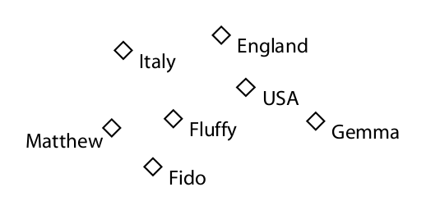
OWL semantics
Individuals: the objects of the knowledge domain
(Tutorial Manchester)
Web Ontology Language

Slide 16
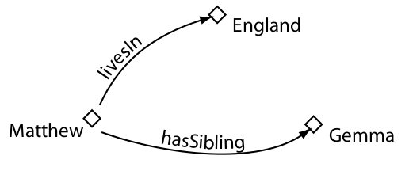
OWL semantics
Properties: they can be used to link individuals in binary relations
(Tutorial Manchester)
Web Ontology Language

Slide 17
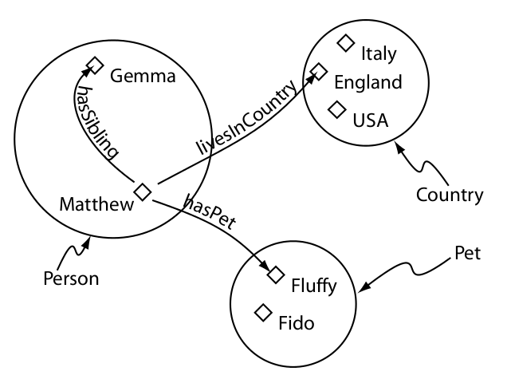
OWL semantics
Classes: sets of individuals with common characteristics
(Tutorial Manchester)
Web Ontology Language

Slide 18
OWL semantics
An OWL ontology with individuals and classes is a Knowledge Base
Knowledge Base (KB): Abox + Tbox
TBox (Terminological Box): ~schema (~ classes)
Abox (Assertional Box): ~data (~ individuals)
Web Ontology Language

Slide 19
OWL semantics
OWL works under the Open World Assumption (OWA)
Data Base (Closed World Assumption): the information not mentioned is false (Negation as Failure)
Knowledge Base (Open World Assumption): the information not mentioned is unknown (Can be true or false)
!!!
Web Ontology Language

Slide 20
OWL semantics
Pedro has spanish nationality
¿Does Pedro have british nationality?
CWA (DB): No
OWA (OWL KB): We don't know (Pedro can have double nationality). Till we assert that Pedro can only have one nationality, OWL will assume he can have more than one
OWA advantage: we can add new knowledge (e.g. New nationalities) easily, we don't have to “change the schema”
OWA is good for settings in which our knowledge will always be incomplete: open systems like the (Semantic) Web
Web Ontology Language

Slide 21
OWL semantics
In OWL there is no Unique Name Assumption (UNA)
The fact that two entities have different URIs does not imply that they are different entities
We have to explicitly assert, if we want to, that two entities are different from each other
In the (Semantic) Web, different resources talk about the same entity
!!!
Web Ontology Language

Slide 22
OWL semantics
No UNA + OWA:
Building an ontology in OWL is like pruning a space in which by default everything is possible (OWA) and all the entities are the same (!UNA)
Such prunning is performed by adding axioms that limit the possible facts and make entities different to each other
!!!
Web Ontology Language

Slide 23
OWL semantics
Classes
Web Ontology Language

Slide 24
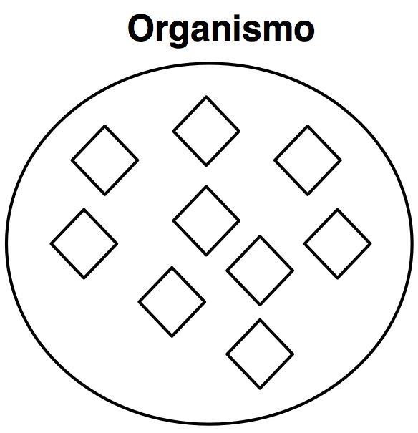
OWL semantics
Classes: Sets of individuals
Web Ontology Language

Slide 25
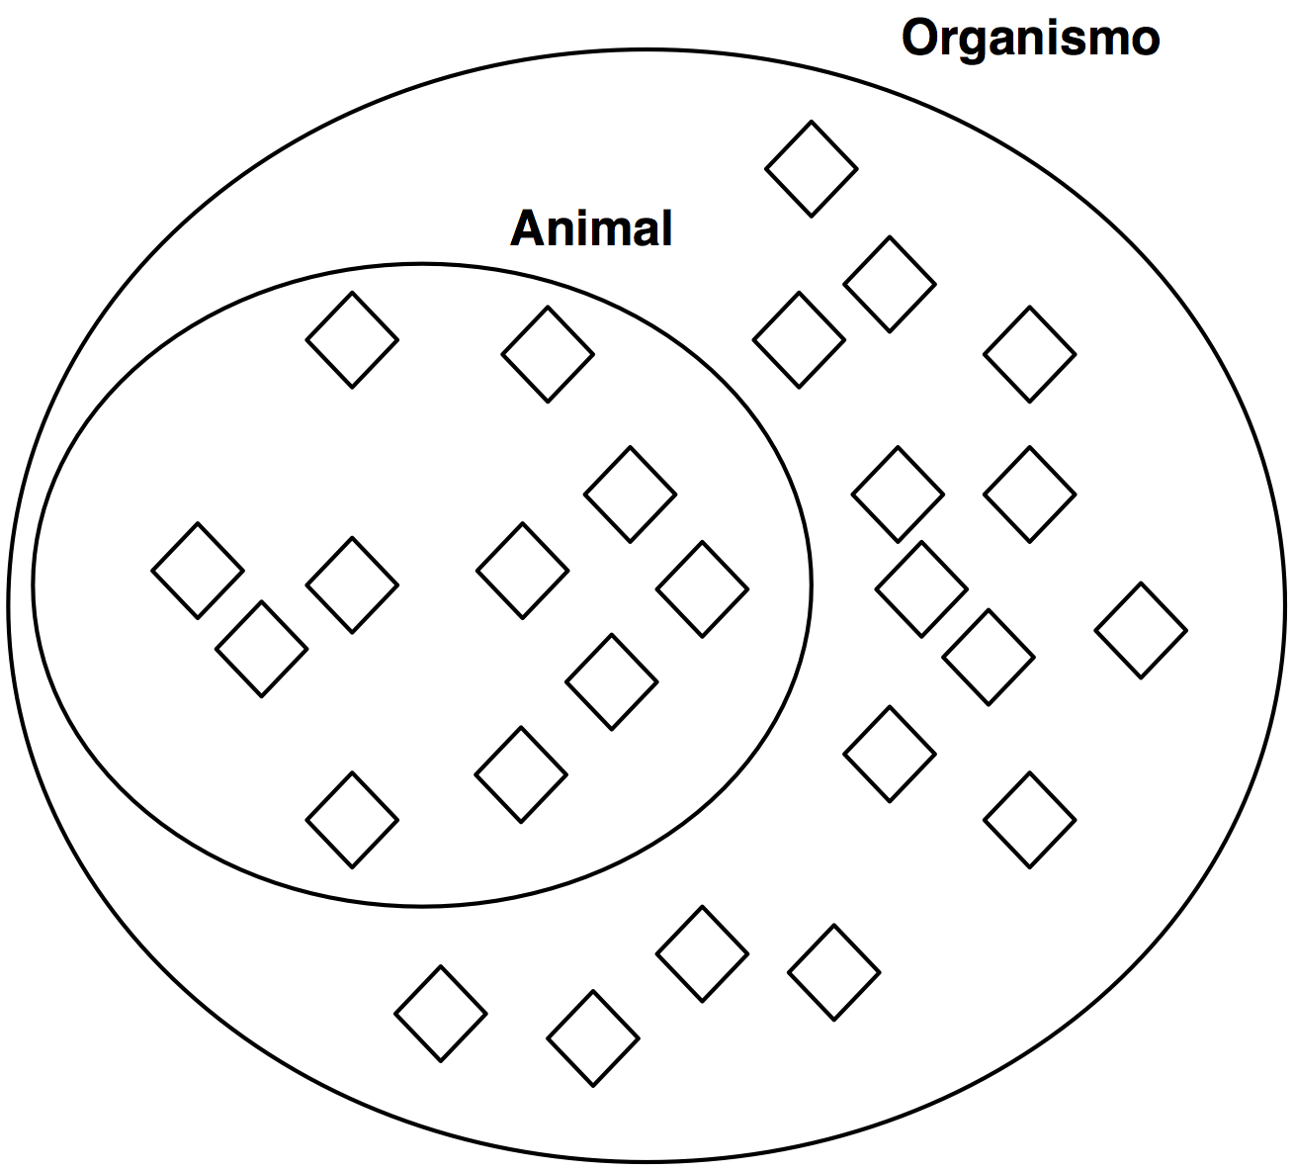
OWL semantics
Classes can be subclasses of other classes: all the instances of the subclass are also instances of the superclass (But no the other way around)
Web Ontology Language

Slide 26
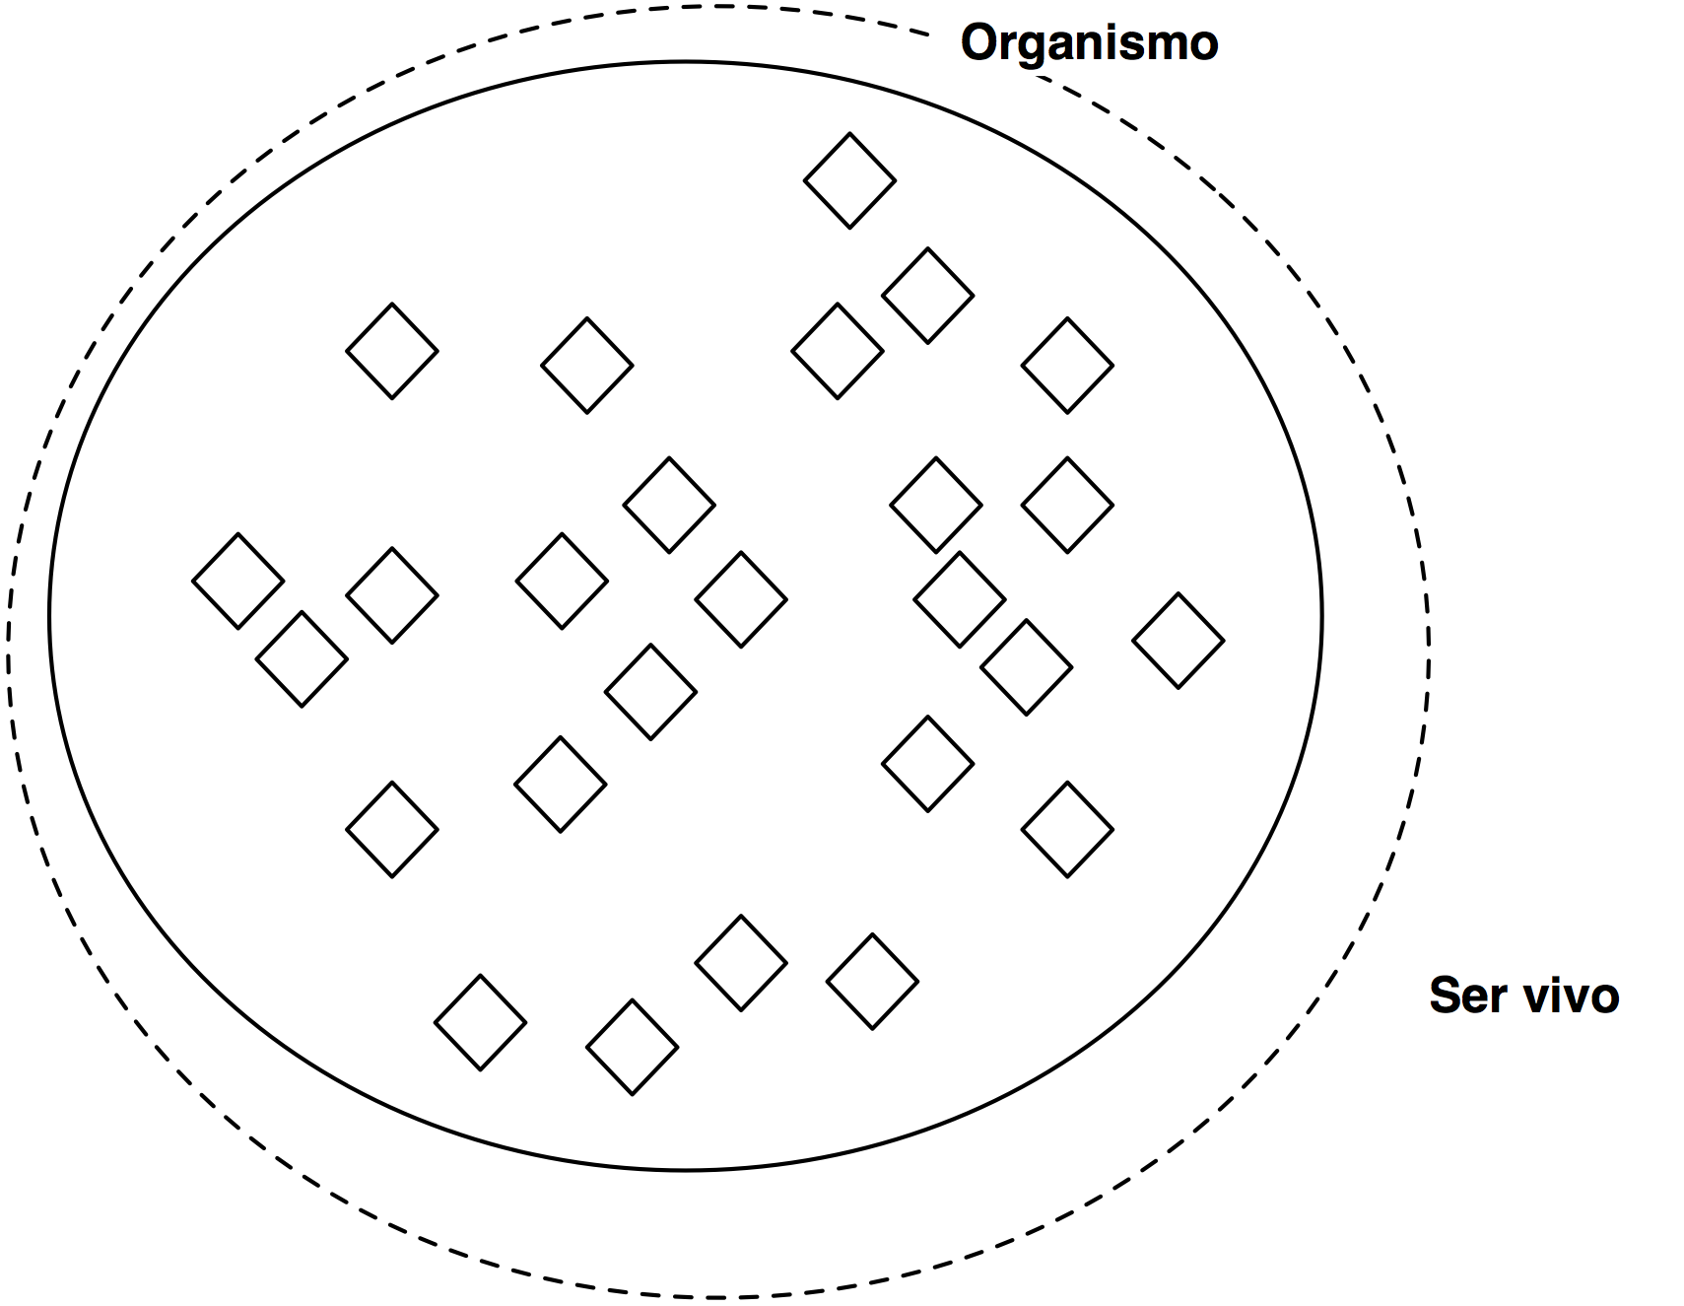
OWL semantics
Classes are equivalent if the extent of their sets is exactly the same: all the instances of A are also instances of B and the other way around
Web Ontology Language

Slide 27
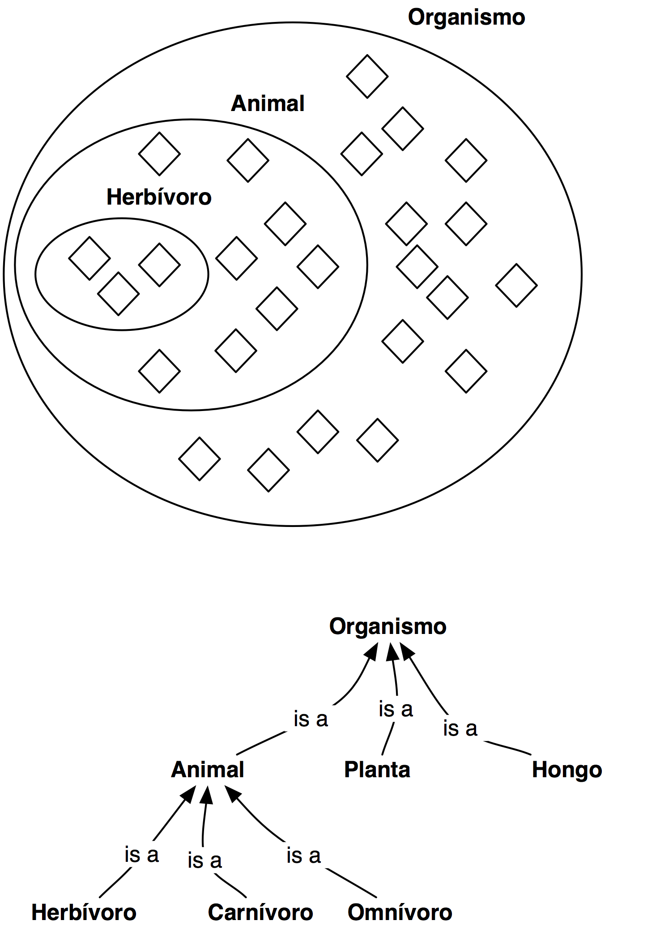
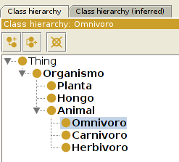
OWL semantics
A taxonomy can be built
combining different class-subclass
axioms
Web Ontology Language

Slide 28
OWL semantics
In order to define the qualities that the individuals of a class must hold to be members of that class, restrictions on the number and type of binary relations are used
Thus, the restrictions define the conditions that must be fulfilled to be a member of a given class
Web Ontology Language

Slide 29
OWL semantics
For example, we can state (In our ontology!) that in order to be human something must eat plants
Eating plants is a necessary condition to be human: all the humans eat plants, but there are other organisms that also eat plants that are not humans
We can also define a necessary and sufficient condition: producing language is a unique quality of humans: if we find an individual (Organism) capable of producing language we can infer that is human, since no other organism does it
Web Ontology Language

Slide 30
OWL semantics
Conditions are anonymous classes: the named class we are defining with such conditions can be a subclass (Necessary) or equivalent class (Necessary and sufficient) to the anonymous class
Web Ontology Language

Slide 31
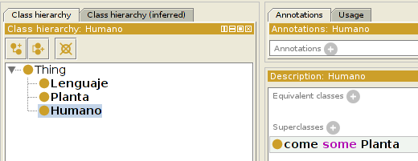
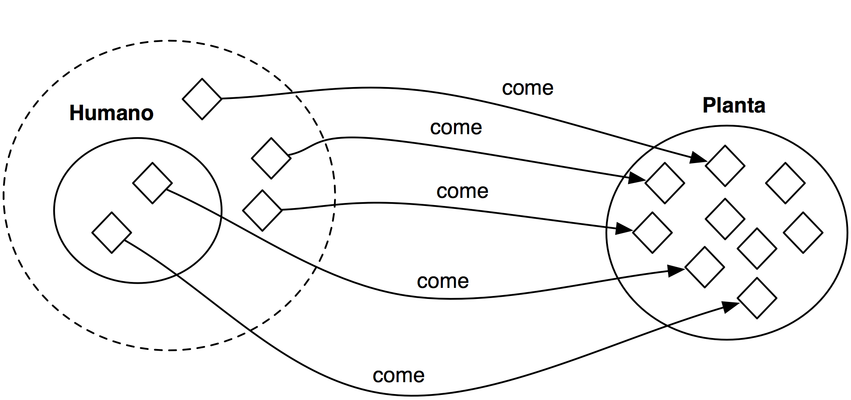
OWL semantics
The class Humano is a subclass (N) of the anonymous class comprised of the individuals that have at least one come binary relation with an individual of the class Planta
Web Ontology Language

Slide 32
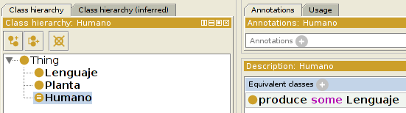
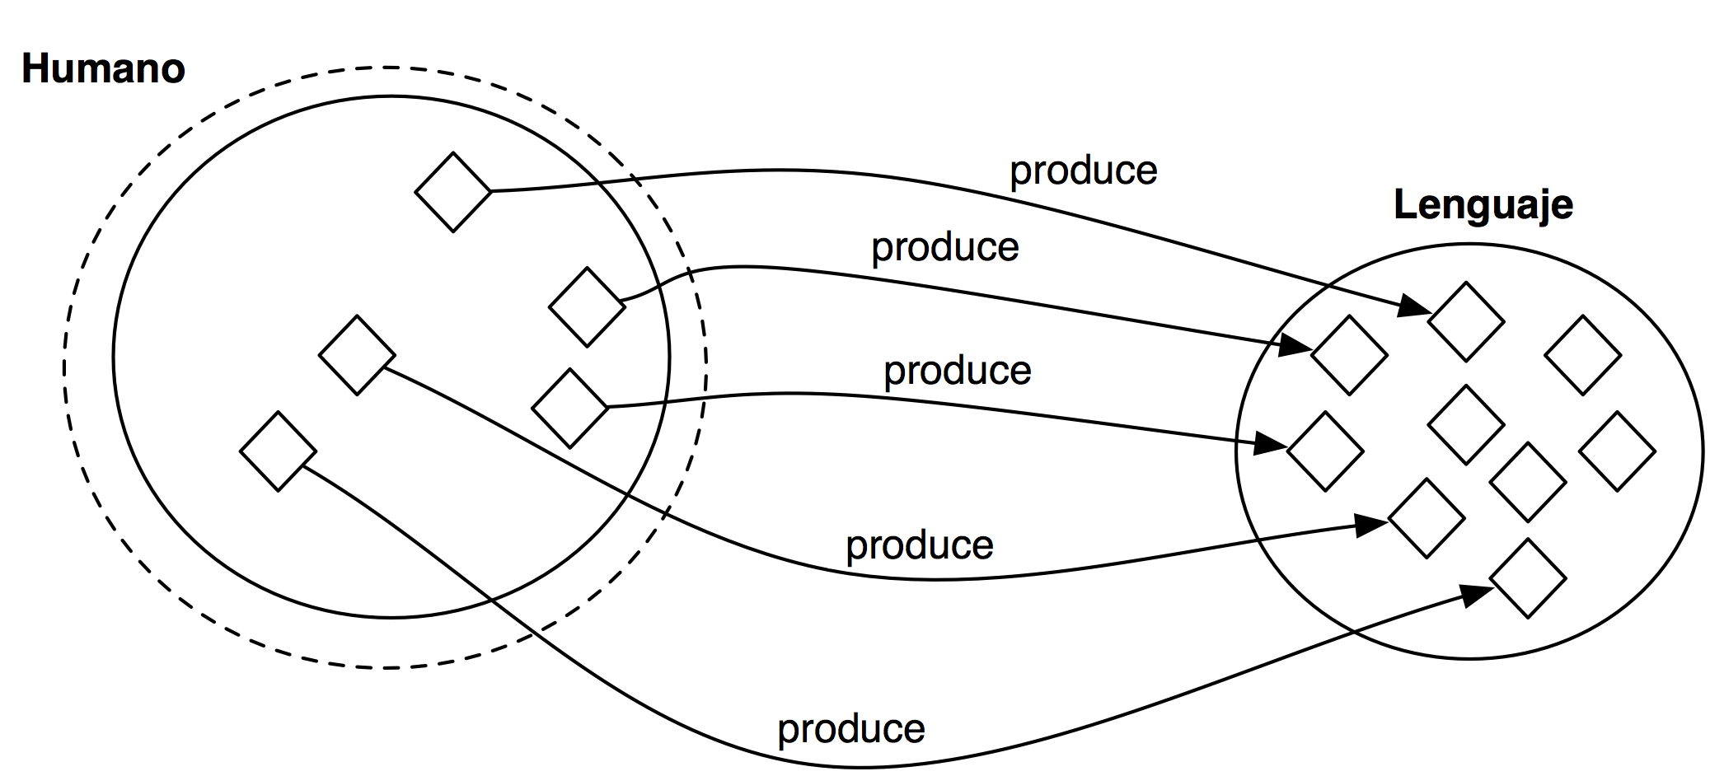
OWL semantics
The class Humano is equivalent (N+S) to the anonymous class comprised of the individuals that have at least on relation with the property produce with and individual of the class Lenguaje
Web Ontology Language

Slide 33
OWL semantics
The classes with necessary and sufficient conditions are defined classes, and they are exploited for automated reasoning
The classes with only necessary conditions are primitive classes
Web Ontology Language

Slide 34
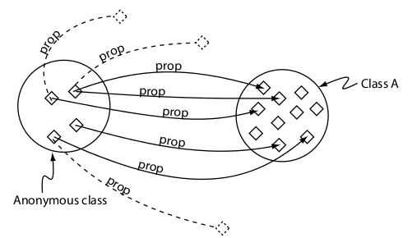
OWL semantics
Existential restrictions
owl:someValuesFrom: the anonymous class comprised of the individuals that, ammongst other things, have at least one relation to an individual of a given class with a given property: humano subClassOf come some Planta
(Tutorial Manchester)
Web Ontology Language

Slide 35
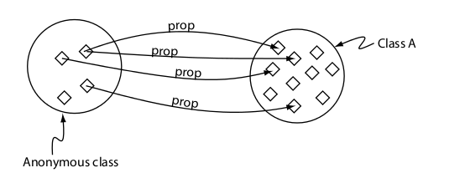
OWL semantics
Universal restriction
owl:allValuesFrom: the anonymous class comprised of the individuals that, if having a relation with a given property, must be to an individual of a concrete class or none: humano subClassOf come only Organismo
(Tutorial Manchester)
Web Ontology Language

Slide 36
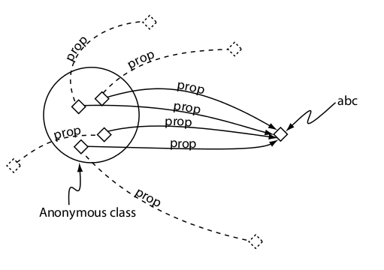
OWL semantics
hasValue
the anonymous class comprised of the individuals that have a relation to a concrete individual humano subClassOf come value este_tomate
(Tutorial Manchester)
Web Ontology Language

Slide 37
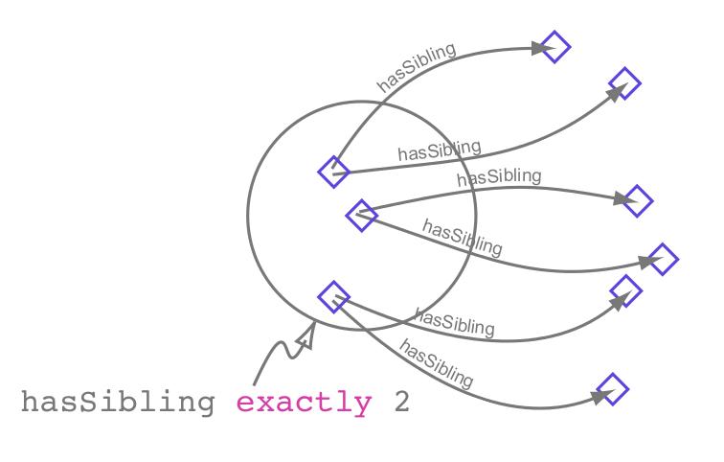
OWL semantics
Cardinal restrictions:
Min: humano subClassOf come min 1
Max: humano subClassOf come max 5
Exactly: humano subClassOf come exactly 3
(Tutorial Manchester)
Web Ontology Language

Slide 38
OWL semantics
QCR (Qualified Cardinality Constraint):
Min: humano subClassOf come min 1 Planta
Max: humano subClassOf come max 5 Planta
Exactly: humano subClassOf come exactly 3 Planta
Web Ontology Language

Slide 39
OWL semantics
We can state that a class is different to other class (They don't have any individual in common) using disjointFrom: humano disjointFrom planta
We can state that two classes are the same (They have the same extent of individuals) using equivalentTo: humano equivalentTo persona
Web Ontology Language

Slide 40
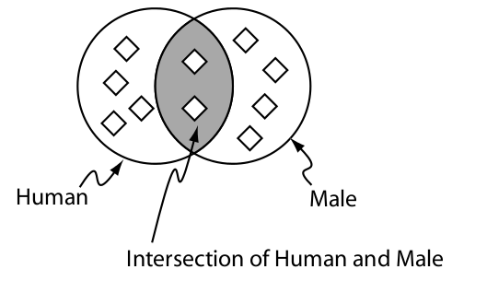
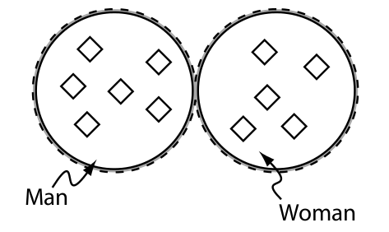
OWL semantics
Booleans
Not: humano subClassOf not (come some electrodomestico)
And (Intersection):
man equivalentTo human and male
Or (Union):
human equivalentTo woman or man
!!!
Web Ontology Language

Slide 41
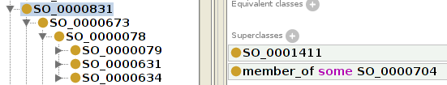
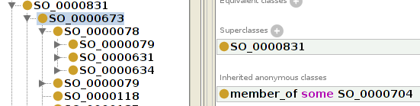
OWL semantics
In a class hierarchy, the subclass “inherits” the conditions of the superclass: it can have further conditions but not a condition that conflicts with the conditions of the superclass
Web Ontology Language

Slide 42
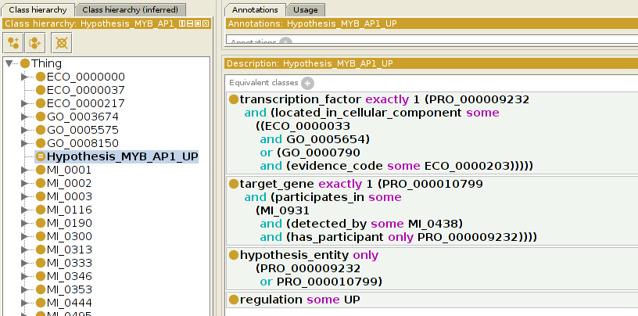
OWL semantics
Conditions can be very complex, combining different OWL elements
Web Ontology Language

Slide 43
OWL semantics
Properties
Web Ontology Language

Slide 44
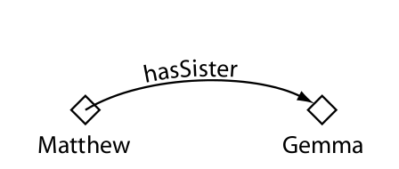
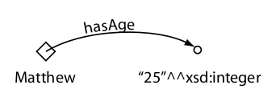
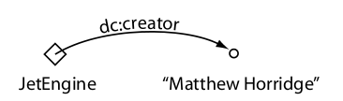
OWL semantics
Object Properties
DataType Properties
Annotation Properties*
(Tutorial Manchester)
Web Ontology Language

Slide 45
OWL semantics
Object Properties
Web Ontology Language

Slide 46
OWL semantics
Property hierarchy:
Sub/SuperProperties
p SubPropertyOf q
If A p B, A q B
But if D q F, not D p F
Equivalent Properties
Disjoint Properties
Web Ontology Language

Slide 47
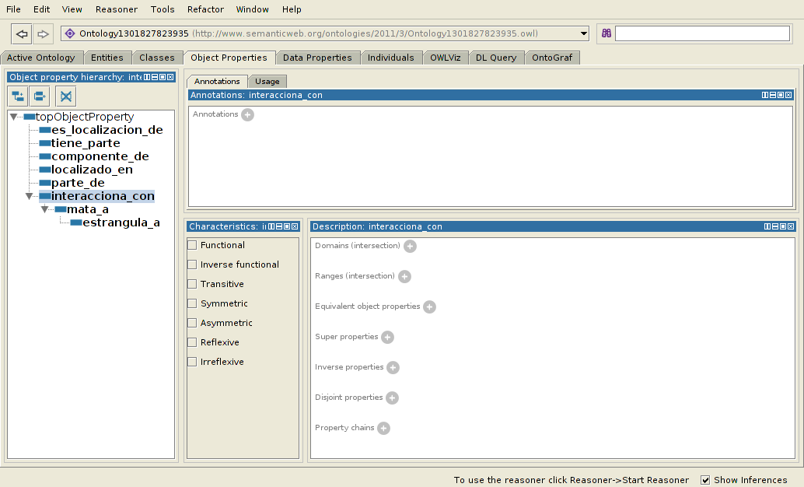
OWL semantics
Web Ontology Language

Slide 48
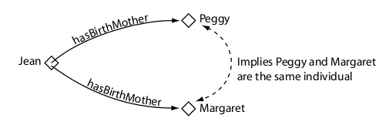
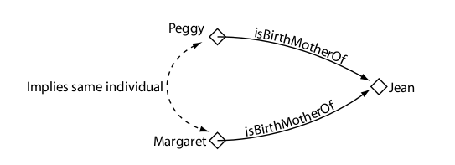
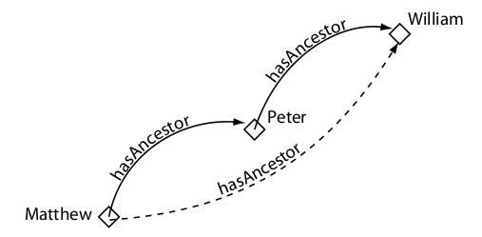
OWL semantics
Functional
Inverse functional
Transitive
(Tutorial Manchester)
Web Ontology Language

Slide 49
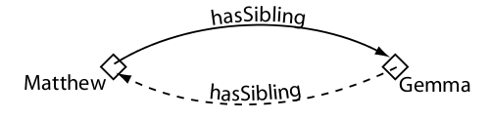
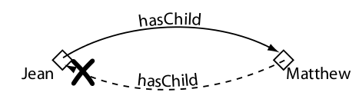
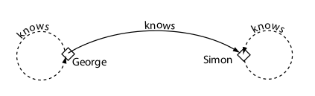
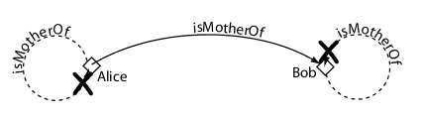
OWL semantics
Symmetric
Antisymmetric*
Reflexive
Irreflexive*
(Tutorial Manchester)
Web Ontology Language

Slide 50
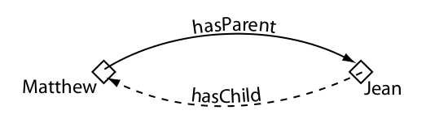
OWL semantics
Inverse properties
(Tutorial Manchester)
Web Ontology Language

Slide 51
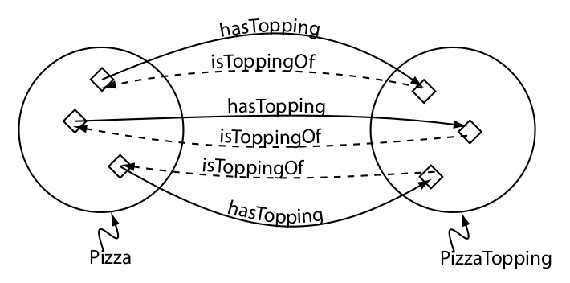
OWL semantics
Domain and Range:
Usually classes or class unions
But any anonymous expression class can be used
They are not constraints, they are axioms
!!!
Web Ontology Language

Slide 52
OWL semantics
Data Type Properties
Web Ontology Language

Slide 53
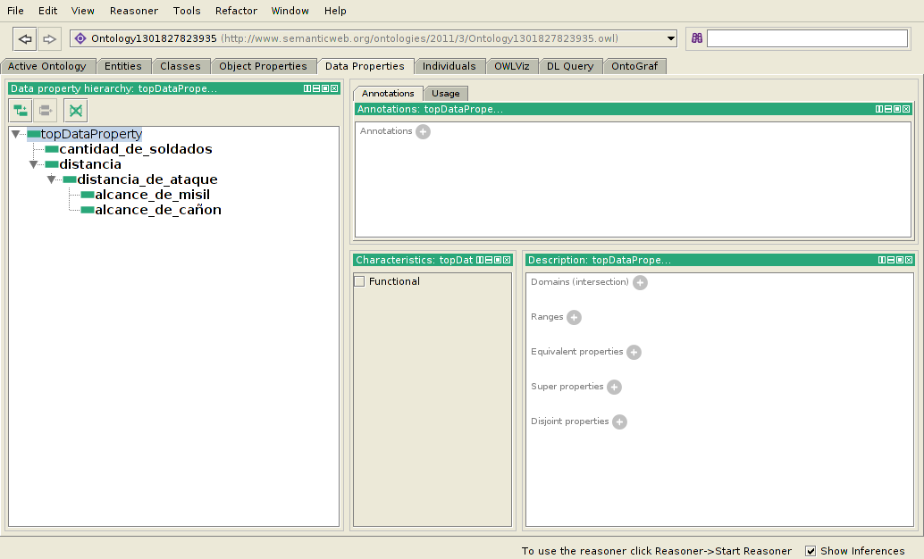
OWL semantics
Web Ontology Language

Slide 54
OWL semantics
Equivalent / sub-super / disjoint
Only Functional (No transitive, inverse functional, … )
Domain: ~ Object Properties
Range:
Built-in datatypes
Data range expression
Web Ontology Language

Slide 55
OWL (semantics)
Annotation Properties
Web Ontology Language

Slide 56
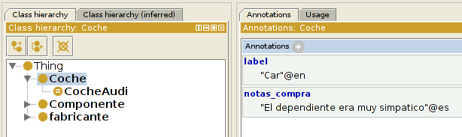
OWL (semantics)
Add non-semantic annotations in natural language to entities, axioms or the ontology
rdfs:label, rdfs:comment, …
Dublin Core (http://dublincore.org/)
Custom annotation properties
Language (en, es, ...) and type (xsd:string, …)
Web Ontology Language

Slide 57
OWL semantics
Individuals
Web Ontology Language

Slide 58
OWL semantics
An individual can be a member of one or more anonymous or named classes (Types)
An individual can be the same as other individual (SameAs)
An individual can be different from another individual (DifferentFrom)
Individuals can be related in binary relations (Object Properties):
my_wheel part_of my_car
my_wheel not part_of your_car
Individuals can be related with data (Data Type properties):
my_car has_power "90"^^xsd:positiveInteger
my_car not has_power "90"^^xsd:positiveInteger
Web Ontology Language

Slide 59
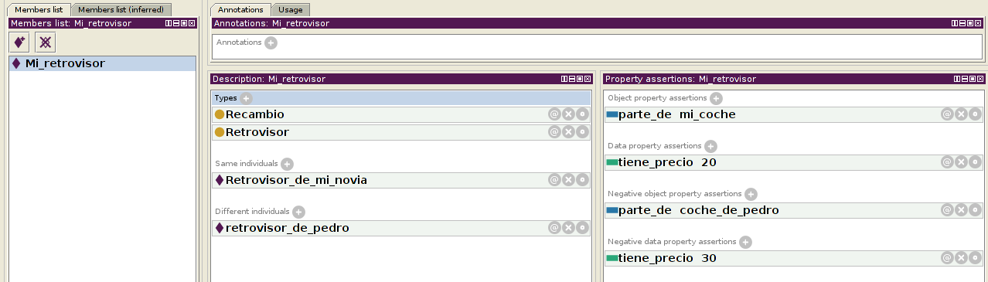
OWL semantics
Web Ontology Language

Slide 60
OWL semantics
Some extra constructs
Web Ontology Language

Slide 61
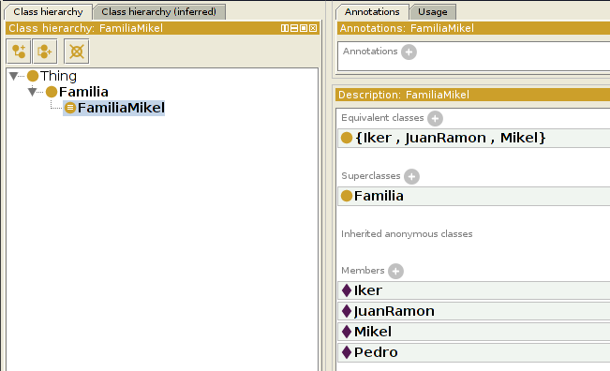
OWL semantics
OWL oneOf
Web Ontology Language

Slide 62
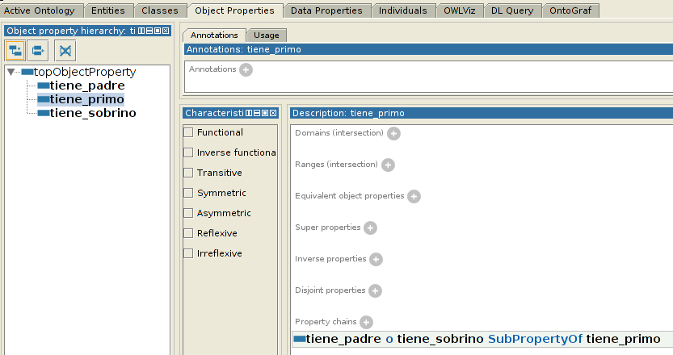
OWL semantics
Role chains
Web Ontology Language

Slide 63
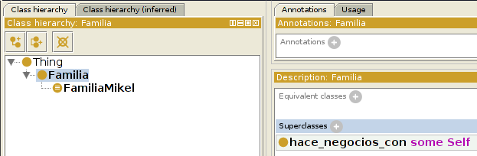
OWL semantics
OWL Self
Web Ontology Language

Slide 64
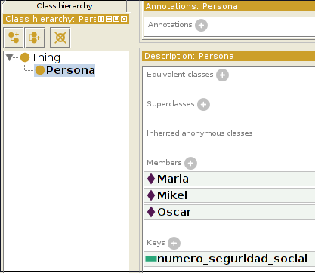
OWL semantics
OWL keys
http://www.w3.org/TR/2009/REC-owl2-primer-20091027/#Keys
~ “datatype inverse functional”
numero_seguridad_social “7”^^xsd:integer
numero_seguridad_social “8”^^xsd:integer
numero_seguridad_social “7”^^xsd:integer
Web Ontology Language

Slide 65
Reasoning
Reasoning
Web Ontology Language

Slide 66
Reasoning
Reasoning is performed by using a reasoner: a reasoner infers the axioms implied by the axioms we have stated in the ontology
Thus, ther reasoner generates the inferred axioms from the asserted axioms
The reasoner makes all the implied axioms explicit, including the ones that would be missed by a human because of the complexity/size of the ontology
Therefore, a reasoner helps us deal with complex knowledge
OWL offers sound and complete reasoning if we don't use OWL full constructs (e.g. make an object property functional and transitive, … )
That is the theory. In practice there can be efficiency problems. Reasoners are improving fast and OWL 2 offers different profiles optimized for different kinds of reassoning
Web Ontology Language

Slide 67
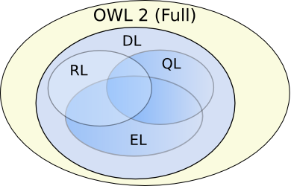
Reasoning
OWL profiles
http://www.w3.org/TR/owl2-profiles/
Web Ontology Language

Slide 68
Reasoning
Reasoning can be used to:
Maintain a class hierarchy
Check consistency of the ontology
Clasify an entity against the ontology
Make queries against the ontology
Web Ontology Language

Slide 69
Reasoning
Use reasoning every time you change your ontology
Be aware of OWA and lack of UNA
!!!
Web Ontology Language

Slide 70
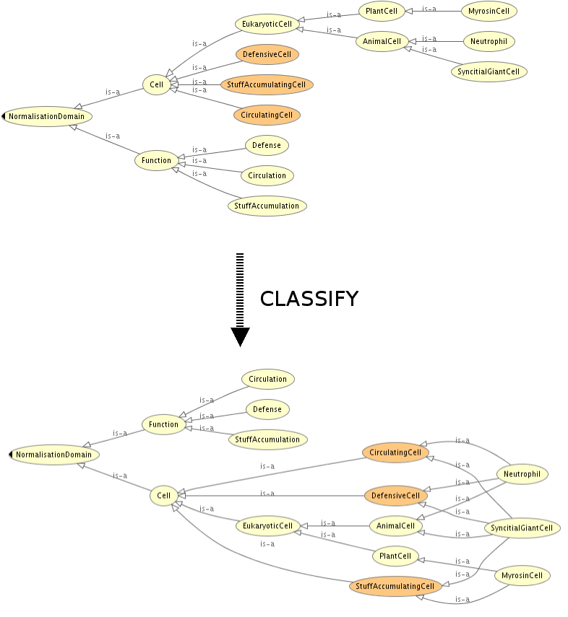
Reasoning
Maintain a class hierarchy
http://www.gong.manchester.ac.uk/odp/html/Normalisation.html
Web Ontology Language

Slide 71
Reasoning
Check consistency of an ontology
Not satisfiable classes cannot have any individual (There is no individual that can satisfy the axioms)
An ontology becomes inconsistent if we state that a not satisfiable class has an individual
In an inconsistent ontology, not satisfiable classes are subclasses of owl:Nothing
Automated reasoning cannot be performed in an inconsistent ontology
An inconsistent ontology usually means that we have modelled something wrong
Web Ontology Language

Slide 72
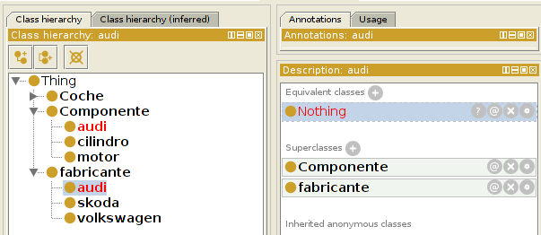
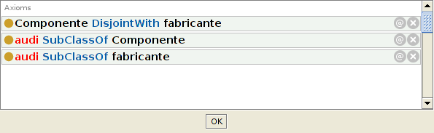
Reasoning
Check consistency of an ontology
Web Ontology Language

Slide 73
Reasoning
Classify new entities against the ontology
Individuals: types
Classes: subClassOf, equivalentTo
Web Ontology Language

Slide 74
Reasoning
Queries against the ontology
A query is an anonymous class
We ask the reasoner how the entities of the ontology relate to such class (type, subclass, … )
Defined classes can also be regarded as queries
Web Ontology Language

Slide 75
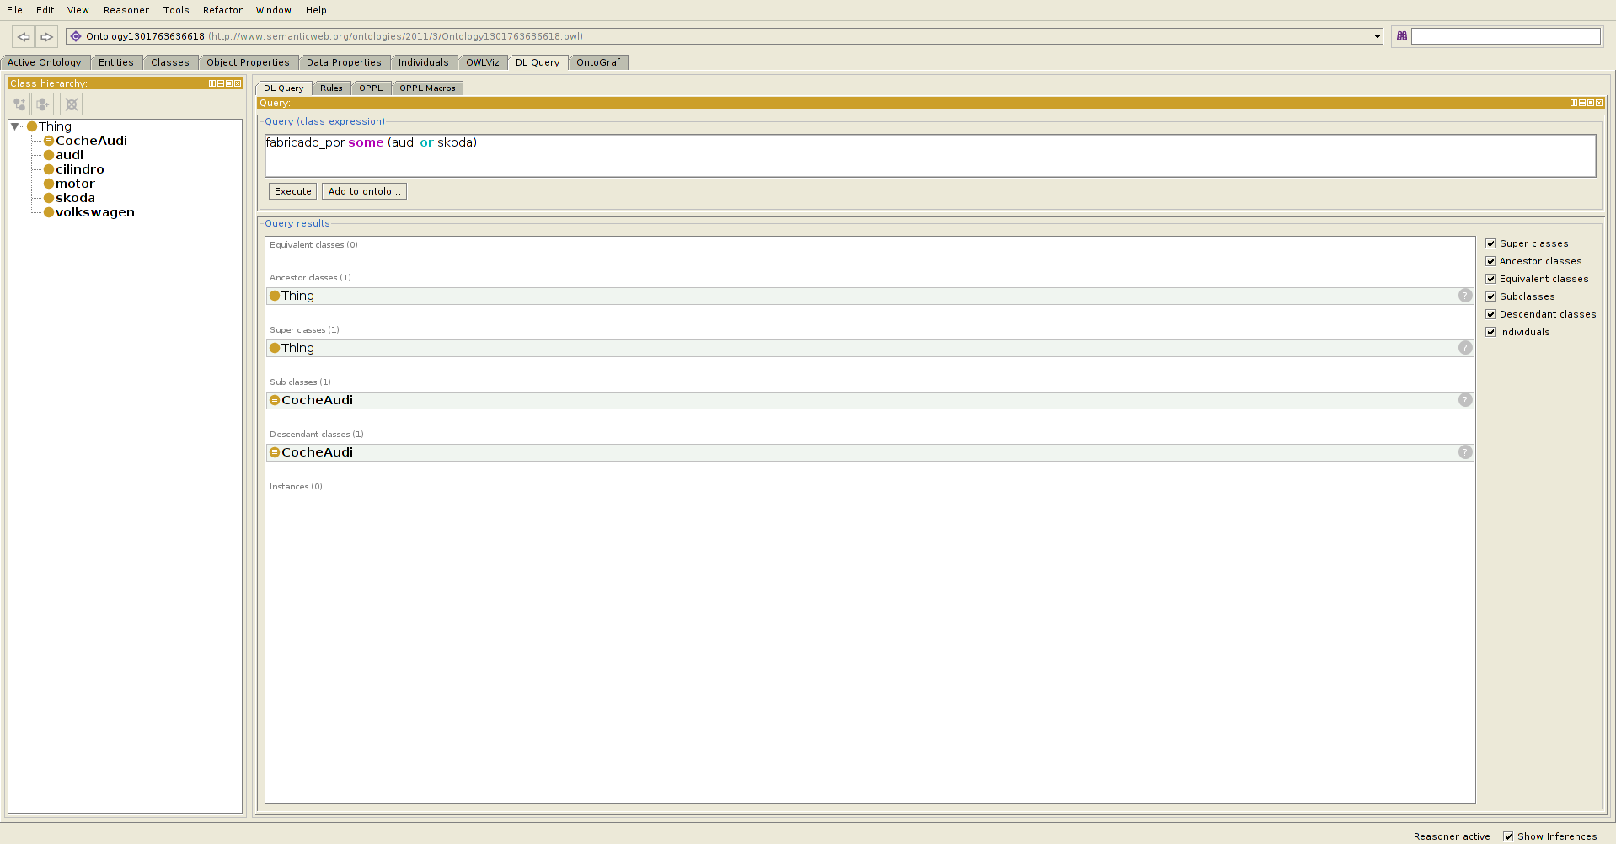
Reasoning
Web Ontology Language

Slide 76
OWL tools
OWL tools
Web Ontology Language

Slide 77
OWL tools
Ontology editors:
Protégé: http://protege.stanford.edu/
TopBraid composer: http://www.topquadrant.com/products/TB_Composer.html
NeOn toolkit: http://neon-toolkit.org
APIs:
OWL API: http://owlapi.sourceforge.net/
Reasoners:
Pellet: http://clarkparsia.com/pellet/
HermiT: http://hermit-reasoner.com/
FaCT++: http://code.google.com/p/factplusplus/
Racer: http://www.racer-systems.com/
Web Ontology Language

