Slide 1
A semantic query interface for the OGO platform
  José Antonio Miñarro-Giménez (jose.minyarro@um.es)
  Mikel Egaña Aranguren, Ph.D. (mikel.egana.aranguren@gmail.com)
  Francisco García-Sánchez, Ph.D. (frgarcia@um.es)
  Jesualdo Tomás Fernández-Breis, Ph.D. (jfernand@um.es)
  Faculty of Computer Science
  University of Murcia
  Spain
  ITBAM (DEXA)
  Bilbo 2010
http://tinyurl.com/35amhn6
Notes:
The OGO system ...
Presentation URL
Creative commons attribution non commercial share alike

Slide 2
Overview
Orthologs
Information about orthologs and diseases
OGO system
A semantic query interface for the OGO system
Sample query

Slide 3
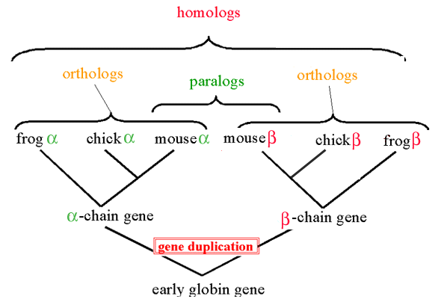
Ortholog sequences
  http://www.stanford.edu/group/pandegroup/folding/education/h.htm
Notes:
Orthologs are homolog sequences (they share a common ancestor) that diverged by an speciation event

Slide 4
Ortholog sequences
Trait
Trait
Notes:
Orthologs can be used to generate hypotheses. For example, if frog alpha and chicken alpha are ortholog genes, and it is known that frog alpha is involved in a certain trait (e.g. a disease), then it is likely that chicken alpha is also involved in or related to such trait, in chicken
Therefore, the information about orthologs is very important in biomedical research, since they show new research paths for human diseases with a genetic cause

Slide 5
Orthologs and genetic diseases
Online Mendelian Inheritance in Man (OMIM)
Gene 1
Disease
Homologene
KOG
Inparanoid
OrthoMCL
Orthologs
Gene 2
Notes:
Unfortunately, information about orthologs and diseases is scattered and it is difficult to combine

Slide 6
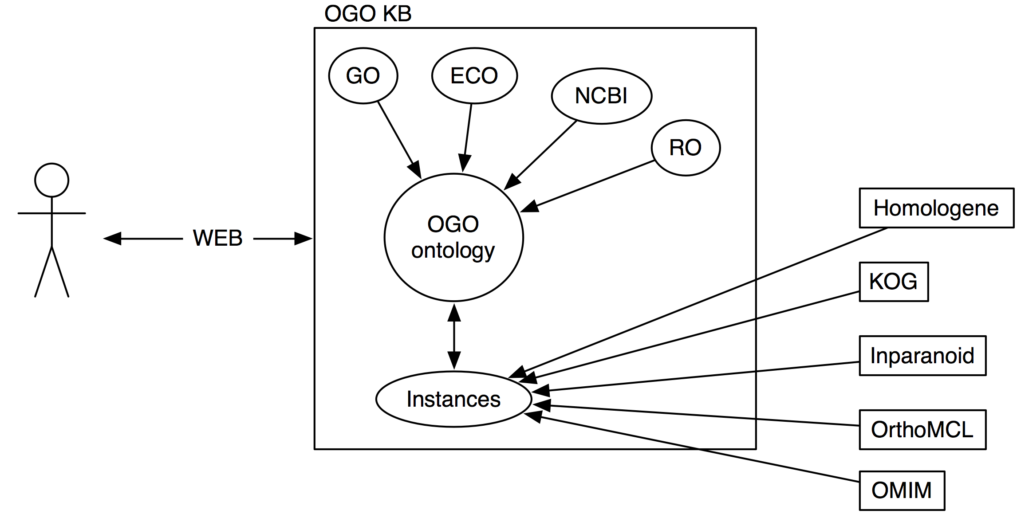
OGO system
Notes:
The OGO system provides a resource for accesing the ortholog/diseases combined information in a precise way.
The OGO system is an OWL KB, in which the OGO ontology provides the schema and the information regarding orthologs and diseases is stored in instances, with relationships between them
The OGO ontology is also used as a guide for the user to build queries
The system is accessed with keywords or SPARQL
The pipeline is executed periodically (Mappings, information checking)

Slide 7
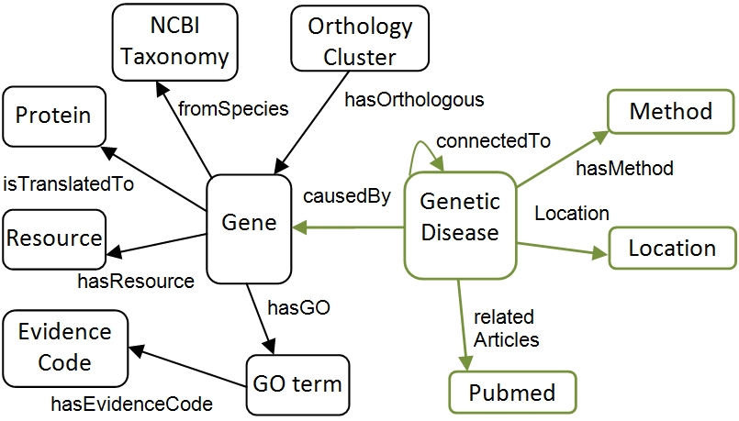
OGO ontology
Notes:
OGO ontology (KB schema and querying)

Slide 8
OGO ontology: imported ontologies
Gene Ontology (OBOF): molecular function, biological process and cellular component of gene products
Evidence Codes Ontology (Candidate OBOF): GO annotations evidence codes
OBO Relationship Types (Candidate OBOF):
  Gene product participates in some (molecular function or biological process)
  Gene product located in some cellular component
NCBI taxonomy: organisms classification
Notes:
Imported ontologies (GO, ECO, RO) reuse existing semantics for querying, as we will see when I describe the queries
OBOF: Wealth of quality reusable semantics of the biodomain
GO: Member
ECO, RO: Candidates

Slide 9
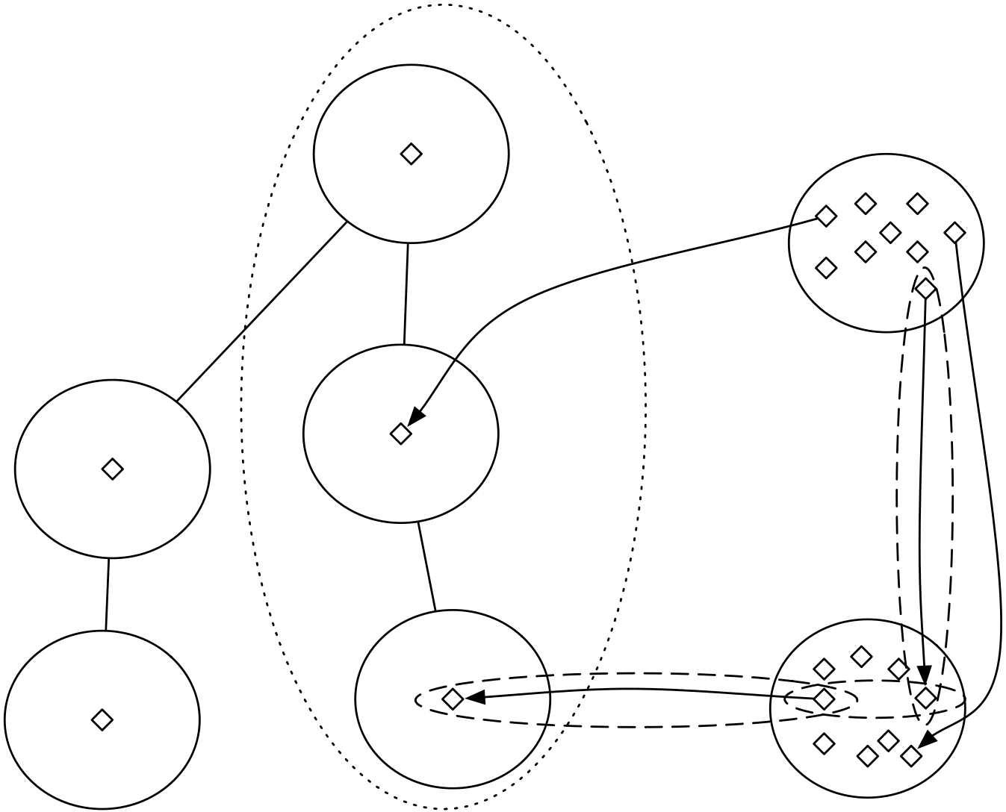
Imported ontologies: OWL punning
Notes:
Not detailed
Classes as values (OBO format)
Future DL

Slide 10
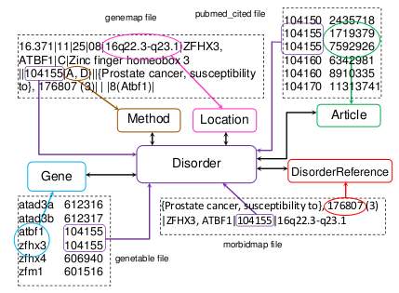
OGO ontology: mappings to OMIM
Notes:
Pipeline

Slide 11
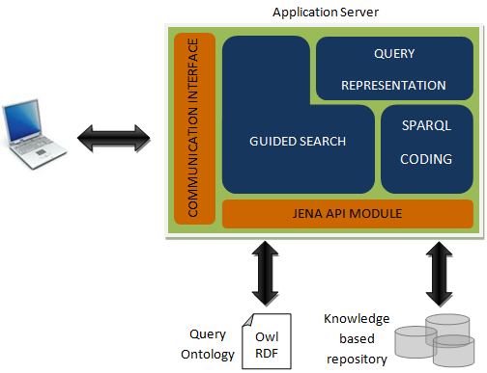
Implementation of the OGO system
Notes:
JENA allows to store OWL in a MySQL database, and to access it with SPARQL

Slide 12
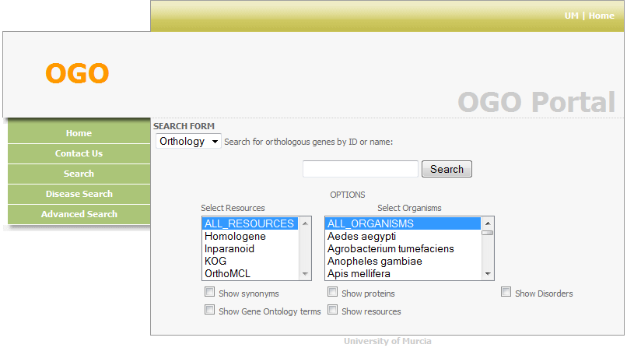
Interfaces of the OGO system
Keyword based querying
Semantic querying
Notes:
The OGO system has two interfaces:
Keyword based interface (by disease/by orthologs): not very expressive but fast
Semantic interface (next)

Slide 13
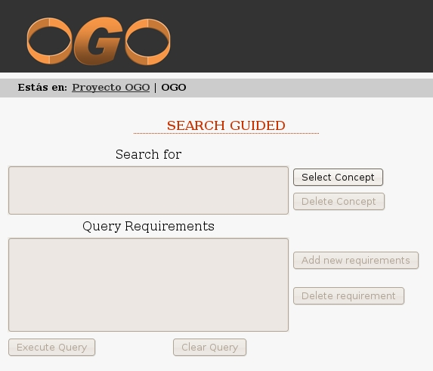
Semantic interface
Notes:
The semantic interface is more expressive than the keyword based interface. However, as SPARQL is difficult to use by biologists, the semantic interface provides a graphical interface for creating queries, that, later, are translated into SPARQL
It should be noted that this does not allow to use the whole expressivity of SPARQL, but a considerable part of it (see grammar)

Slide 14
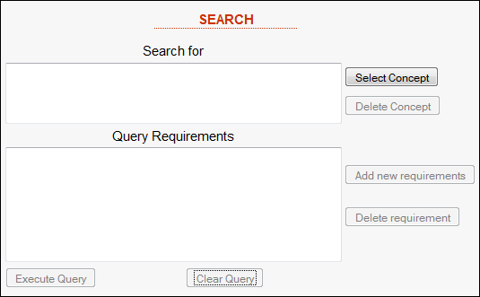
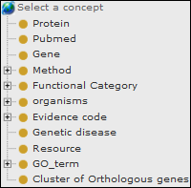
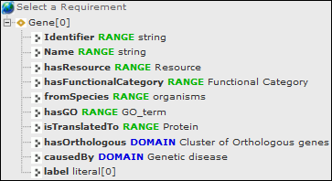
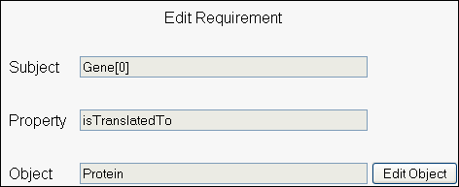
Semantic interface
Notes:
In order to define the query, we can select concepts from the OGO ontology, and add any requirements, also using the OGO ontology
We can exploit the imported ontologies for querying: GO, ECO, NCBI
The defined query is translated into SPARQL and executed against the KB

Slide 15
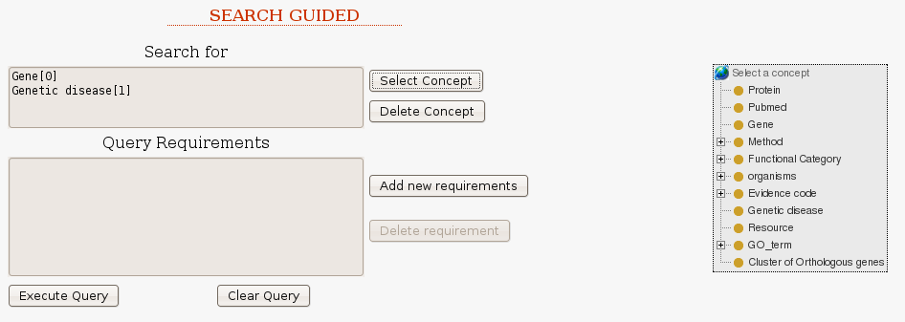
Sample query
Ortholog genes of the gene that causes prostate cancer on Rattus norvegicus?
Notes:
Whole process
First we select the variables that we are interested in from the OGO ontology. In this case, Gene and Genetic disease (i.e, we want to retrieve Genes and Genetic diseases)
The imported ontologies can be exploited (GO, ECO, NCBI) for querying

Slide 16
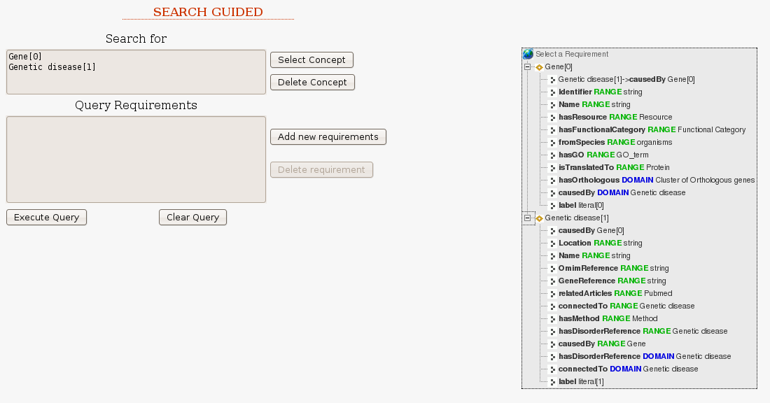
Sample query
Ortholog genes of the gene that causes prostate cancer on Rattus norvegicus?
Notes:
Then we add requirements, also using the OGO ontology (And Imported ontologies).
We can use the selected variables or new ones.
We can delete/edit requirements

Slide 17
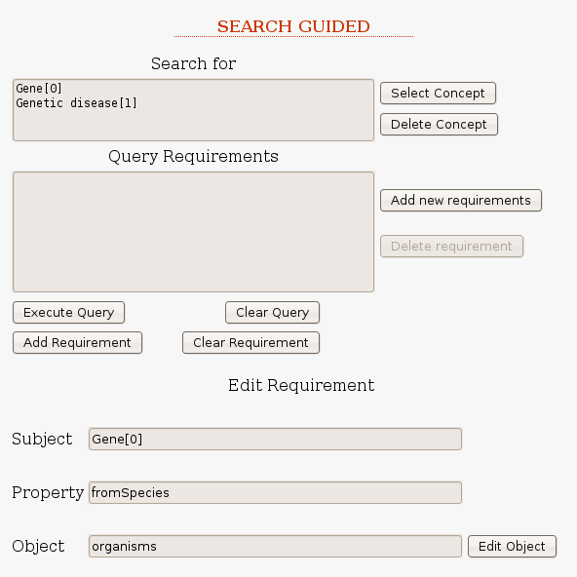
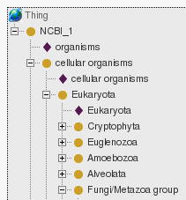

Sample query
Ortholog genes of the gene that causes prostate cancer on Rattus norvegicus?
Notes:
We edit a requirement by using the OGO ontology (to add new variables and values) or by using the already defined variables
NCBI (imported, like GO, and ECO) for providing values for the requirement

Slide 18
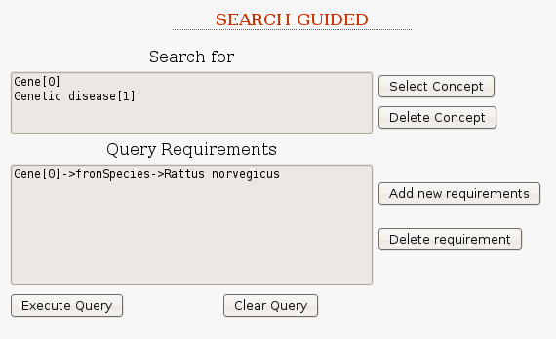
Sample query
Ortholog genes of the gene that causes prostate cancer on Rattus norvegicus?
Notes:
We add the finished requirement to the the query

Slide 19
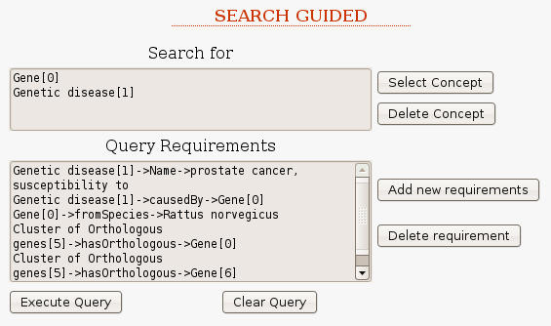
Sample query
Ortholog genes of the gene that causes prostate cancer on Rattus norvegicus?
Notes:
We can add as many requirements as we want

Slide 20
Sample query
Ortholog genes of the gene that causes prostate cancer on Rattus norvegicus?
@prefix ncbi: <http://um.es/ncbi.owl>.
@prefix ogo: <http://miuras.inf.um.es/ontologies/OGO.owl>.
SELECT
?Gene_0
?Genetic_disease_1
WHERE {
?Gene_0 ogo:fromSpecies ncbi:NCBI_10116
?Genetic_disease_1 ogo:Name ?literal_4 .
FILTER (regex(?literal_4,"Prostate cancer, susceptibility to")) .
?Genetic_disease_1 ogo:causedBy ?Gene_2 .
?Cluster_of_Orthologous_genes_3 ogo:hasOrthologous ?Gene_2 .
?Cluster_of_Orthologous_genes_3 ogo:hasOrthologous ?Gene_0 .
}
Notes:
Finally, the query is translated into SPARQL and executed against the KB

Slide 21
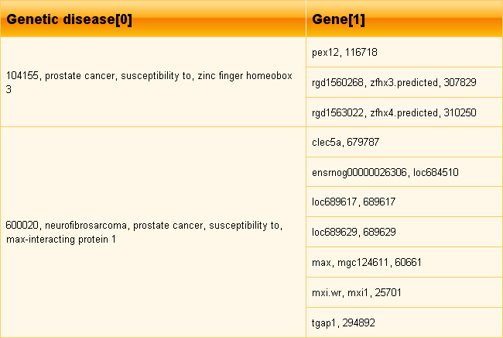
Sample query
Ortholog genes of the gene that causes prostate cancer on Rattus norvegicus?
Notes:
Results

Slide 22
Query grammar
Query::="SELECT" ListVar (WhereClause)?
ListVar::=Var (Var)*
WhereClause::="WHERE {" ConditionClause (ConditionClause)* "}"
ConditionClause::=[VarCondition | LiteralCondition] "."
VarCondition::=[Var | Individual] Property [Var | Individual]
LiteralCondition::=[Var | Individual] Property [Var | Individual] "."
"FILTER (regex (" Var "," Literal "))"
Var -> This term represents a variable in the query which can be matched to any concept or individual in the ontology.
Individual -> This term represents a concept or individual identied by an URI in the ontology.
Property -> This term represents a relationship or property identied by an URI in the ontology.
Literal -> This term represents any data value dened by the user.
Notes:
The expressivity of the query is limited by the grammar

Slide 23
Future plans
OWL reasoning for querying (OWL 2 QL?)
Pellet Integrity Constraint Validator (Pellet ICV):
  OWL as schema language for RDF (CWA)
  Check the gathered information
More bio-ontologies
Clinical archetypes for querying (ISO 13606): exchange of ortholog/disease information in a standard biomedical research setting

Slide 24
Conclusions
Orthologs and diseases: new hypotheses
OGO provides a resource for exploiting such combined information
Semantic query interface: “Complex” queries easily (No SPARQL syntax)
http://miuras.inf.um.es/~ogo/

Slide 25
Acknowledgements
Spanish Ministry for Science and Education (grant TSI2007-66575-C02-02)
Comunidad Autónoma de la Región de Murcia (grant BIO-TEC 06/01-0005)
Fundación Séneca, Servicio de Empleo y Formación (grant 07836/BPS/07)
Notes:
YOGY already does this, however, redundant results by resource, instead of gene centric, i.e.same gene in different resources
OGO ontology is used to check the consistency of the info
Less expressivity in SPARQL: no OPTIONAL

