Slide 1





Spreadsheets to OWL
with Populous
Mikel Egaña Aranguren
3205 School of Computer Science
Universidad Politécnica de Madrid (UPM)
28660 Boadilla del Monte
Spain
Ontology Engineering Group (OEG)
http://www.oeg-upm.net
megana@fi.upm.es
http://mikeleganaaranguren.com
Robert Stevens
Biohealth Informatics Group
School of Computer Science
University of Manchester
Manchester
UK
Robert.steven@manchester.ac.uk
Simon Jupp
Functional Genomic Group
European Bioinfomatics Institute
Wellcome Trust Genome Campus
Hinxton
UK
jupp@ebi.ac.uk
8/12/2011

Slide 2
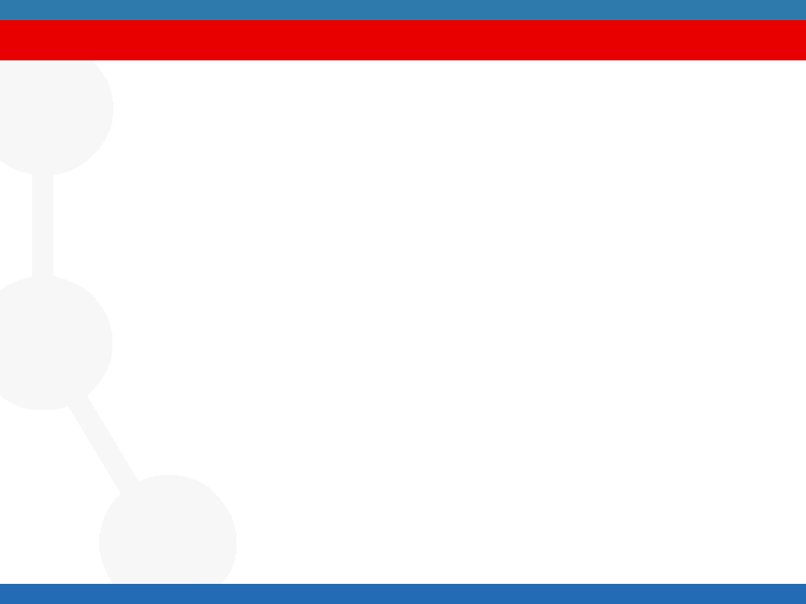
Motivation
Engaging life scientists in data annotation and ontology
population
Protégé and OWL are scary..
Need for simple “form filling” style of knowledge gathering and
describing data - so we use spreadsheets.
Q1 How do we get people to annotate data in spreadhseets accoridng to ontologies?
Q2 How do we transform those spreadsheets into sets of axioms?
Populous

Slide 3
Writing ontologies in OWL is hard
Especially if one doesn’t know OWL;
Hard to do complex patterns of axioms;
Hard to be consistent and conform to a style;
Hard to re-factor an ontology’s content
Doing all this in bulk is tedious and error prone
Populous

Slide 4
Separation of concerns
Knowledge
All Eukaryotic Cells are either nucleated or anucleate, some cells are multinucleate
‘Eukaryotic Cells’ has_nucleation some ‘Nucleation’
‘Nucleation’ subClassOf {mononucleate , binucleate , polynucleate , anucleate}
Ontologically
‘Eukaryotic Cells’ has_nucleation some ‘Nucleation’
‘Nucleation’ subClassOf {mononucleate , binucleate , polynucleate , anucleate}
Differentia
‘Eukaryotic Cells’ ‘Nucleation’
Mononuclear phagocyte mononucleate
Flight Muscle cell multinucleate
Red Blood cell anucleate
Real Examples
Populous
Notes:
This slide shows a piece of knowledge in free text about cells, then we show how this could be represented ontologically. Then we highlight the differentia in the pattern. Finally show some real examples of values that could fit the pattern

Slide 5
Ontology patterns
Repetative pattern
‘Protein’
has_molecular_function some ‘Molecular Function’
is_capable_of some ‘Biological Process’
located_in some ‘Cellualr component’
Axioms often added in regular ways
There are often patterns of axioms for a particular way of representation
There are also design patterns – standard well recognised solutions
Analogous to software patterns
Doing the same thing in the same way… it’s a good thing
Populous

Slide 6
Some requirements
Want consistent axiom generation
Want to write axioms according to patterns
Separate knowledge gathering from axiom generation
Engage domain experts not experts in OWL and/or ontologies
Validate content to go into the ontology
Do all of this in a familiar environment i.e. spreadsheets
Populous

Slide 7
Using spreadsheets
Spreadsheets are often used simply to organise data
Basic tabulation
Saying the same kinds of things repeatedly
A very familiar environment
Want to capitalise on this…
Populous

Slide 8

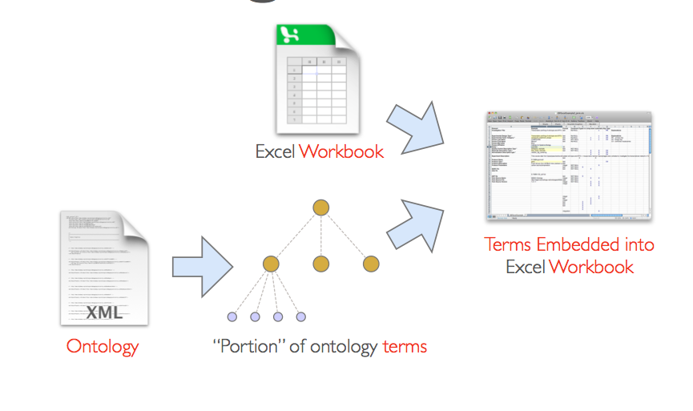
RightField
http://www.rightfield.org.uk
Semantic Annotation by Stealth
Populous

Slide 9
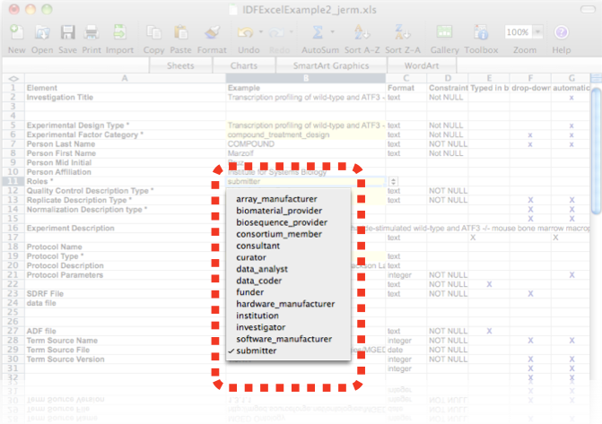
Excel validations
Populous
Notes:
Screenshot of drop down validation list from excel

Slide 10
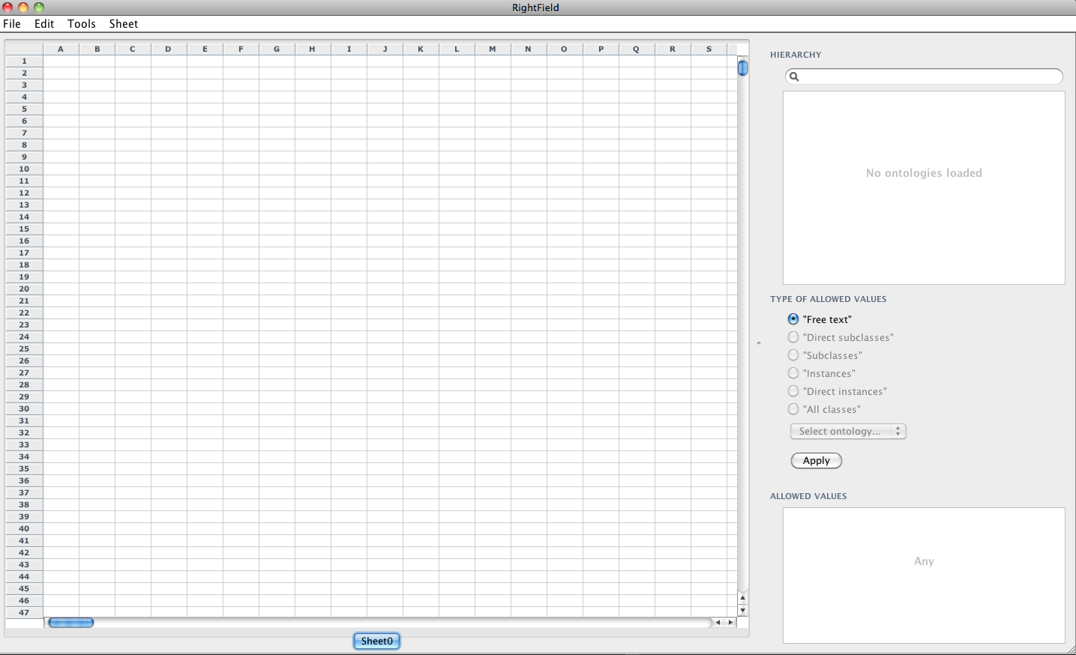
Populous workflow
Populous
Notes:
Empty populous spreadsheet

Slide 11
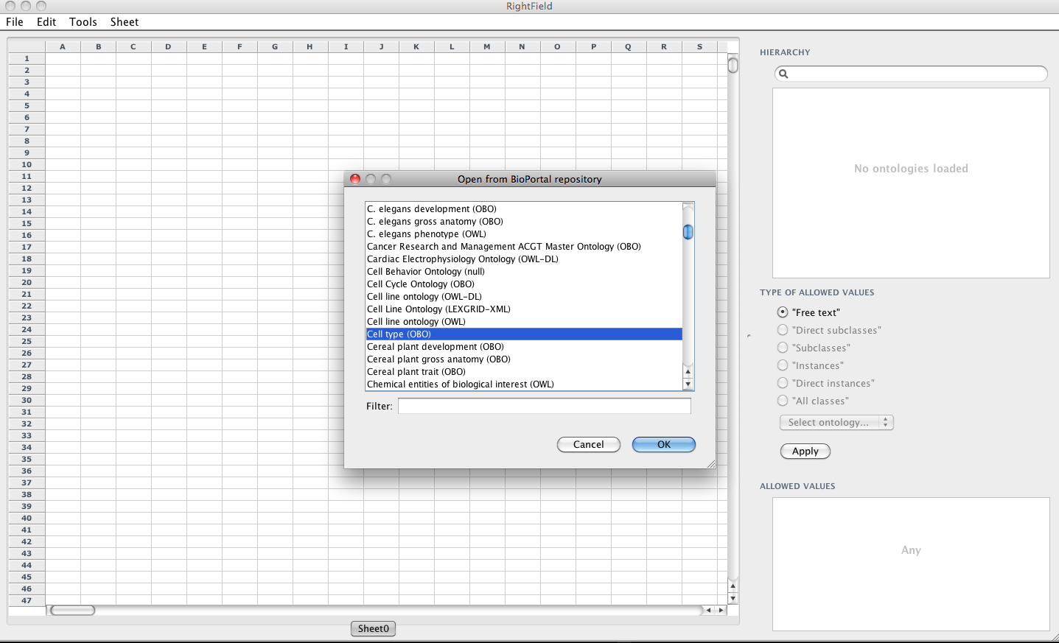
Populous workflow
Load from file or directly
from BioPortal
Populous
Notes:
Loading ontologies form BioPortal

Slide 12
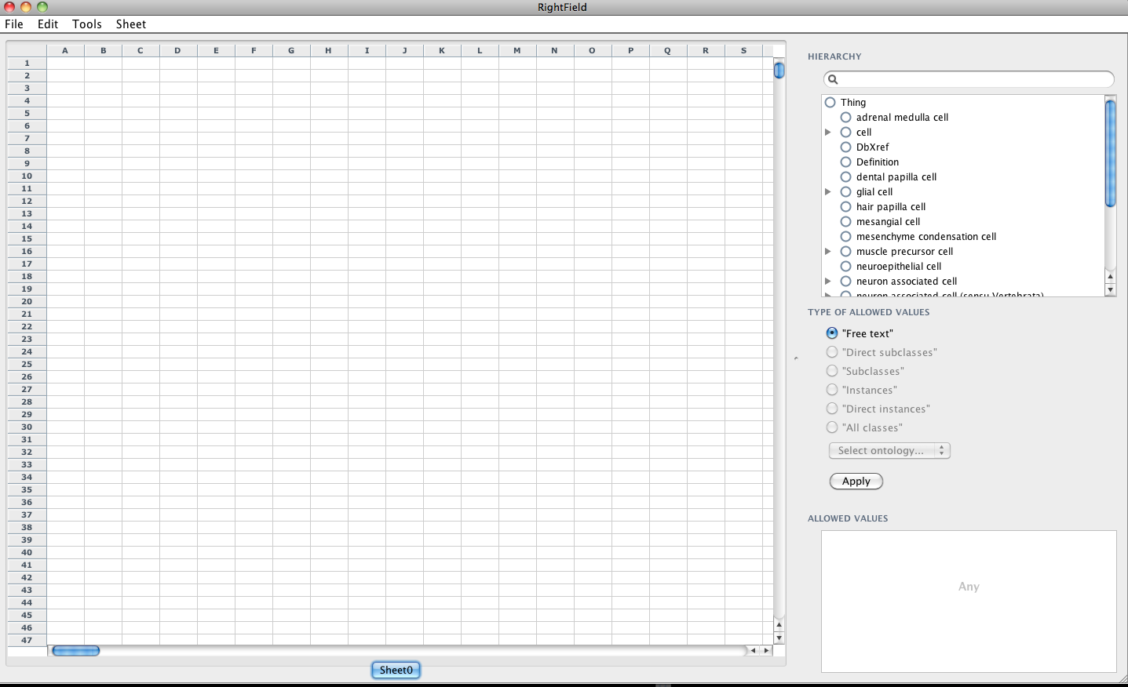
Populous workflow
Ontology browser
Populous
Notes:
Loading ontologies form BioPortal

Slide 13
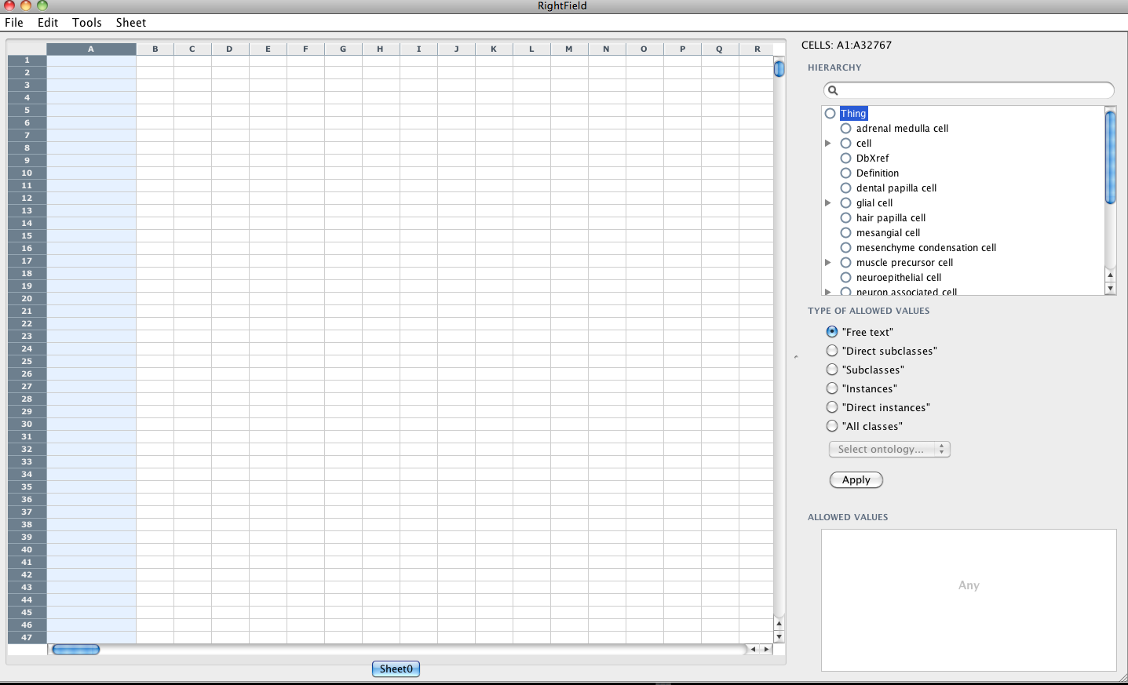
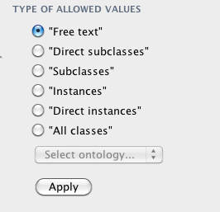
Populous workflow
1. Select column
2. Select Class in Ontology
3. Select allowed values
Populous
Notes:
Loading ontologies form BioPortal

Slide 14
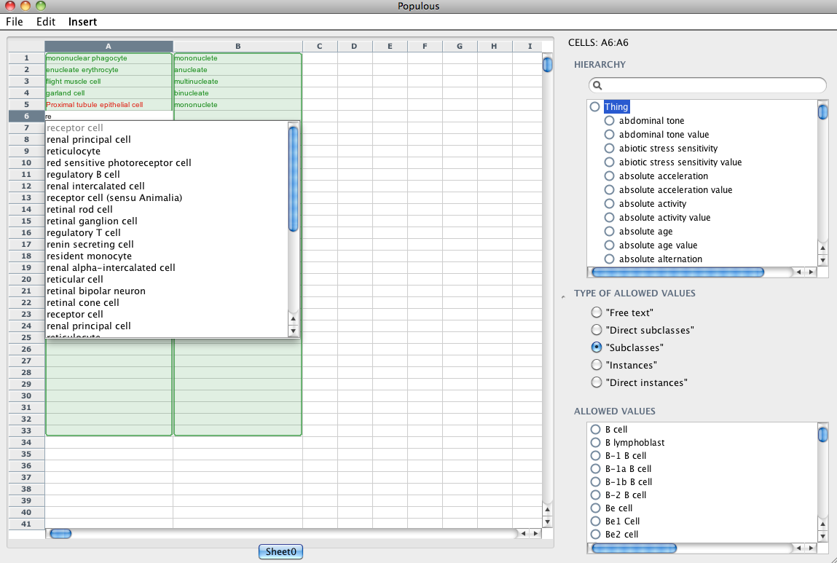
Populous workflow
Label rendering
Tab completion
Syntax Highlighting
Multi-value cells
Populous
Notes:
Loading ontologies form BioPortal

Slide 15
Demo 1
Demo of Populous in action.
Populous

Slide 16
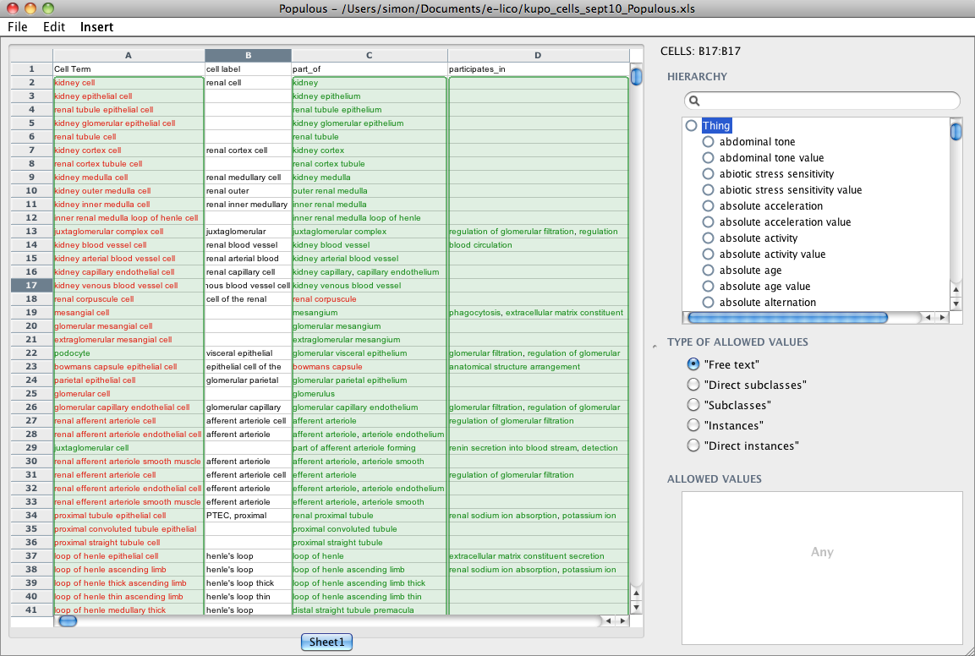
OWL generation
Manchester OWL syntax
Class: CL:0003523
Annotation:
rdfs:label ‘Kidney Cell’
EquivalentTo:
CL:0000000 and OBO_REL:part_of some MAO_000629
Populous

Slide 17
Introduction to OPPL
Ontology Pre Processor Language (oppl.sf.net)
Scripting language to automate the manipulation of OWL ontologies
Apply pre-defined very complex OWL modelling automatically
Based in Manchester OWL Syntax
Populous

Slide 18
OPPL script anatomy
OPPL script
Variable declaration,
Variable declaration,
...
SELECT
Query,
Query,
...
WHERE
Constraint,
Constraint,
...
BEGIN
ADD/REMOVE Axiom,
ADD/REMOVE Axiom,
...
END;
OPPL for Populous

Slide 19
OPPL script anatomy
OPPL script Populous OPPL script
Variable declaration,
Variable declaration,
...
SELECT
Query,
Query,
...
WHERE
Constraint,
Constraint,
...
BEGIN
ADD/REMOVE Axiom,
ADD/REMOVE Axiom,
...
END;
Variable declaration,
Variable declaration,
...
SELECT
Query,
Query,
...
WHERE
Constraint,
Constraint,
...
BEGIN
ADD/REMOVE Axiom,
ADD/REMOVE Axiom,
...
END;
Variable declaration,
Variable declaration,
...
SELECT
Query,
Query,
...
WHERE
Constraint,
Constraint,
...
BEGIN
ADD/REMOVE Axiom,
ADD/REMOVE Axiom,
...
END;
OPPL for Populous

Slide 20
OPPL script anatomy
OPPL script Populous OPPL script
Variable declaration,
Variable declaration,
...
SELECT
Query,
Query,
...
WHERE
Constraint,
Constraint,
...
BEGIN
ADD/REMOVE Axiom,
ADD/REMOVE Axiom,
...
END;
Variable declaration,
Variable declaration,
...
SELECT
Query,
Query,
...
WHERE
Constraint,
Constraint,
...
BEGIN
ADD/REMOVE Axiom,
ADD/REMOVE Axiom,
...
END;
?cell:CLASS,
?parent:CLASS
BEGIN
ADD ?cell subClassOf ?parent
END;
Variable declaration,
Variable declaration,
...
SELECT
Query,
Query,
...
WHERE
Constraint,
Constraint,
...
BEGIN
ADD/REMOVE Axiom,
ADD/REMOVE Axiom,
...
END;
OPPL for Populous

Slide 21
OPPL script anatomy
CLASS
CONSTANT
OBJECTPROPERTY
DATAPROPERTY
ANNOTATIONPROPERTY
INDIVIDUAL
Variable
Variable type
?cell:CLASS,
?parent:CLASS
BEGIN
ADD ?cell subClassOf ?parent
END;
OWL expression: Manchester OWL syntax + variables
OPPL for Populous

Slide 22
OPPL script anatomy
OWL expression
=
createIntersection
createUnion
(?var.VALUES)
?cell:CLASS,
?anatomyPart:CLASS,
?partOfRestriction:CLASS = part_of some ?anatomyPart,
?anatomyIntersection:CLASS = createIntersection(?partOfRestriction.VALUES)
BEGIN
ADD ?cell equivalentTo CL_0000000 and
?anatomyIntersection
END;
OPPL for Populous

Slide 23
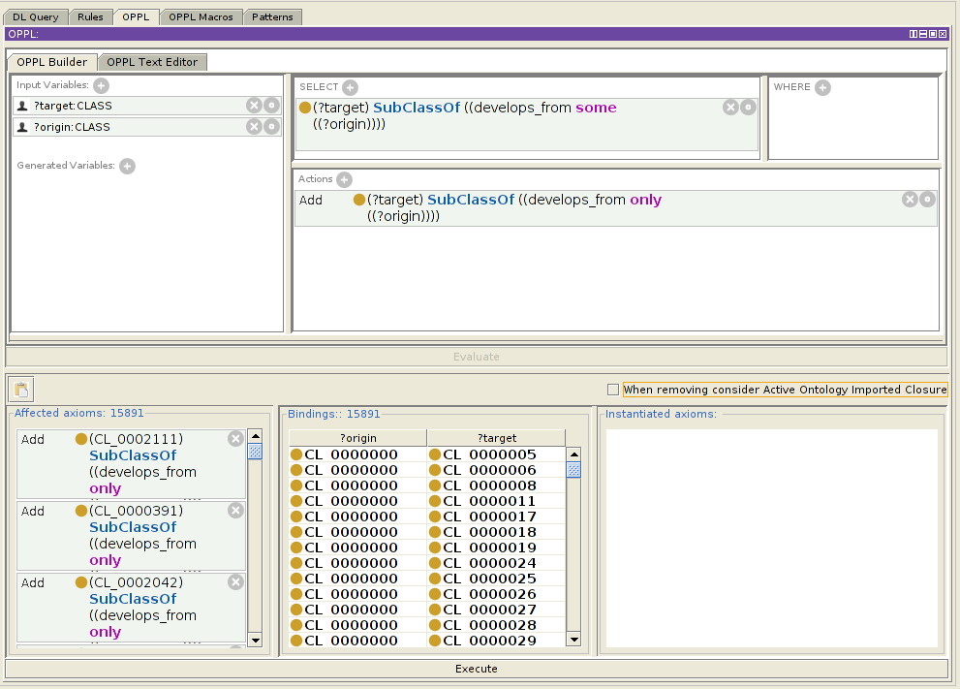
Creating OPPL script
OPPL builder
OPPL for Populous

Slide 24
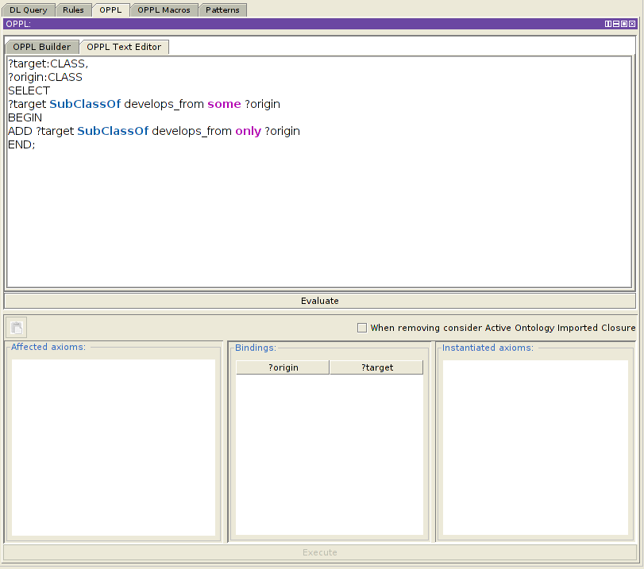
Creating OPPL script
OPPL text editor
OPPL for Populous

Slide 25
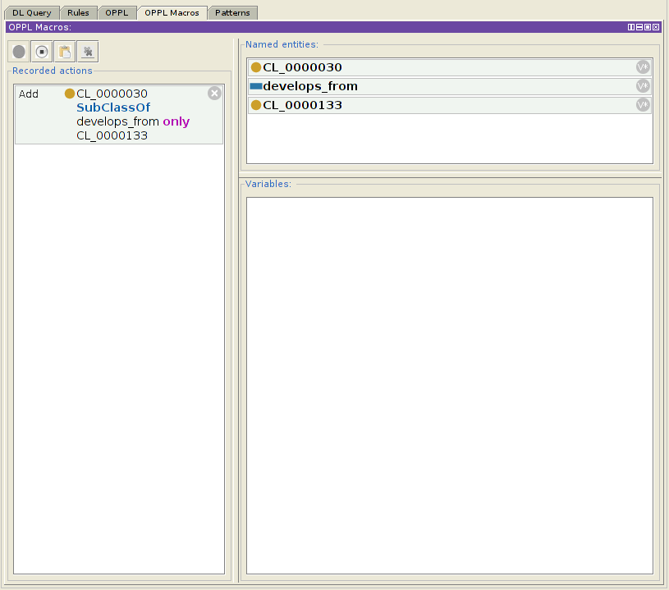
Creating OPPL script
OPPL macros
OPPL for Populous

Slide 26
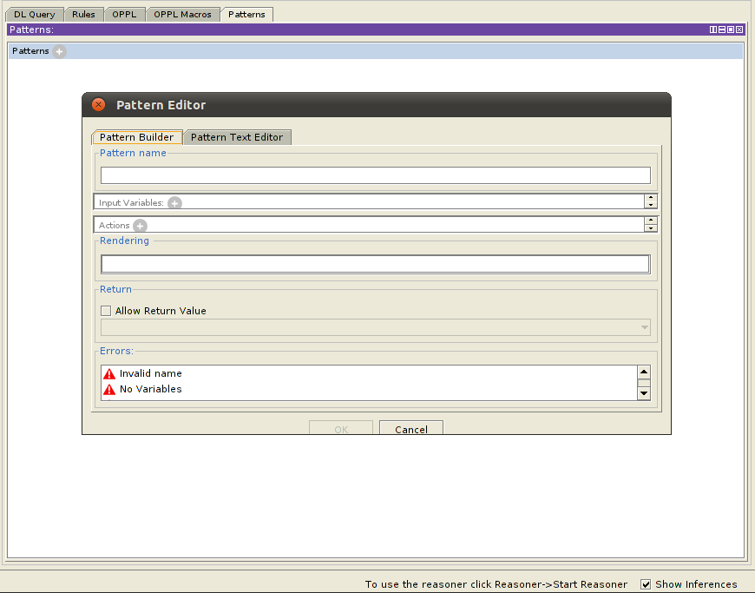
Creating OPPL script
OPPL patterns
OPPL for Populous

Slide 27
More information
OPPL publications: http://oppl2.sourceforge.net/documentation.html
OPPL documentation: http://oppl2.sourceforge.net/oppl_documentation.html
OPPL patterns: http://oppl2.sourceforge.net/patterns_documentation.html
OPPL Manual: http://oppl2.sourceforge.net/manual.pdf
OPPL sample scripts: http://oppl2.sourceforge.net/taggedexamples/
OPPL for Populous

Slide 28
Demo 2
Demo 2 -converting spreadsheets to OWL using OPPL
Populous

Slide 29
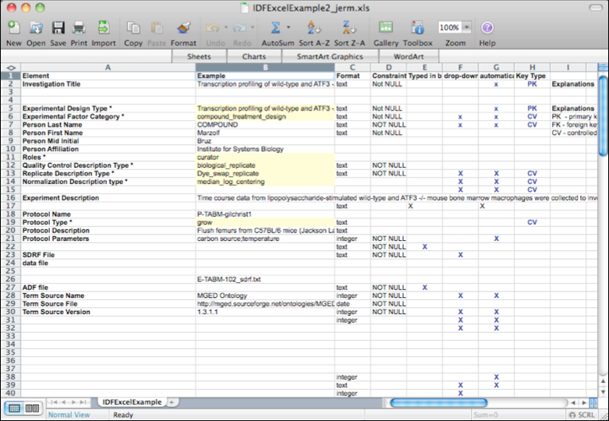
Populous and RightField
Ontological annotation by stealth
Real biological data + high quality meta-data
Development of a Kidney and Urinary Pathway Knowledge Base
Populous

Slide 30
Demo 3
Demo 3 - Experiment template for data annotation
Populous

Slide 31
Acknowledgements
RightField
  Matthew Horridge, Katy Wolstencroft, Stuart Owen,
  Carole Goble
Populous
Simon Jupp, Robert Stevens funded by e-LICO
  EU-FP7 Collaborative Project (2009-2012) Theme ICT-4.4: Intelligent Content and Semantics
  and NIH funded NCBO driving biological project program
Mikel Egaña Aranguren is funded by the Marie Curie Cofund programme (FP7)
OPPL 2 is maintained by Luigi Iannone
Populous

