Slide 1
Modeling Mortgage Defaults with Machine Learning
Mike Labadie

Slide 2
Overview
Topic: Mortgage Lending
Washington D.C. is at the center of mortgage lending analysis
Fannie and Freddie; bank regulators; treasury
Capital 1=consumer credit
Goal: identify individual loans that will default
Regression models typically used to identify % of loans in a portfolio that will default
Financial crisis was precipitated in large part due to bad mortgage lending analysis
Want to look at risk from time of origination; not just 3-12 months out

Slide 3
Dataset
Fannie Mae
Purchases and securitizes mortgage loans
Publish data to increase transparency
Loan Performance Data
Single Family Fixed Rate Mortgage Loans
Data back to 2000; history on over 35 million loans; 50 different attributes
Grouped by quarter in which the loan was purchased by Fannie
Two Files
Origination Data (Doesn’t change):
Property information; Loan terms; Borrower information
Monthly Data (Builds monthly):
Current Balance; Current delinquency status; Paid Off flag
Clean data (dropped 500 loans out of 637K)
Highly used in academia, financial markets, etc.

Slide 4
Process
Build a dataset
Merge the Origination and Monthly files
34 million records in the monthly file
2012 Q1 for training and 2012 Q2 for validation
EDA: 2012 Q1
Modeling
Different sampling techniques
Hyper-parameter tuning
Validation: 2012 Q2 dataset
Analysis
Feature importance modeling + Predicted probability analysis

Slide 5
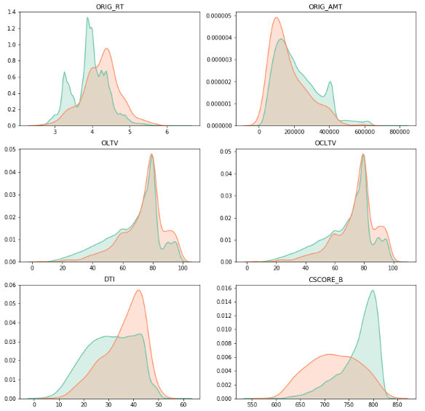
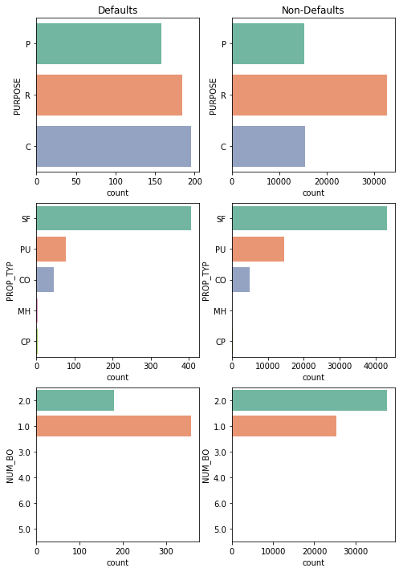
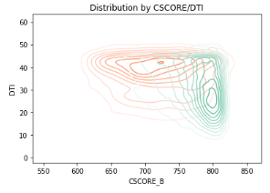
EDA – Feature Distributions

Slide 6
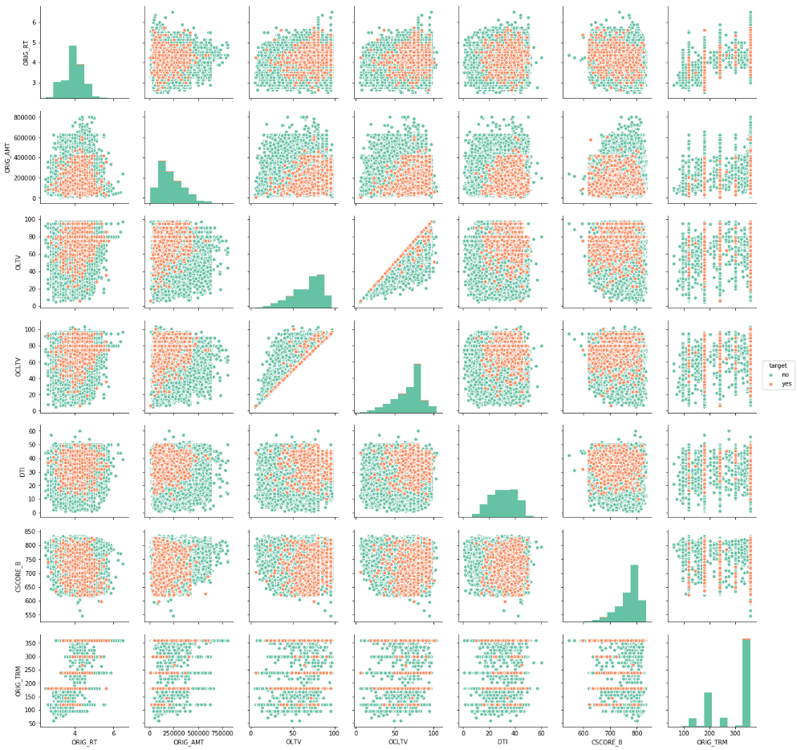
EDA - Correlation Matrix

Slide 7
Modeling - Challenges
Imbalanced Classes
0.88% default rate
Imbalanced vs Under-sampling vs Class Weights
What is the Correct Metric?
Accuracy versus Recall
Models all fall back to virtually no defaults when scored on accuracy
Large Sample Size
637K samples in 2012 Q1 dataset

Slide 8
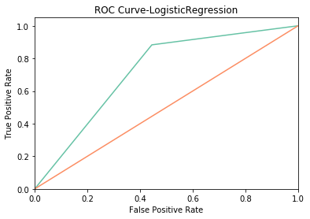
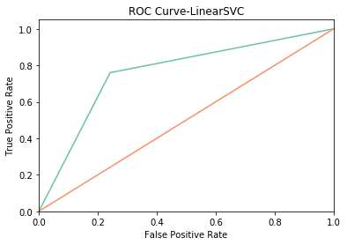
Modeling - Results
Models: Decision Tree, Random Forest, MLP, Logistic Regression, LinearSVC
Variety of parameters for each model (i.e. class_weight, regularization, etc.)
Sampling Techniques: Random Sample (1%, 10%, 25%), Under-Sampling, Entire Dataset
Results on the Validation Set:
Highest overall recall (training and validation) was Logistic Regression
Identified nearly 90% of the defaults in the validation; though predicted that 46% of loans would default
LinearSVC and MLP presented a nice balance identifying nearly 80-85% of defaults while predicting that only 25-35% of loans would default
Result was a higher F1-Score

Slide 9
Modeling - Observations
Across the board, training and validation results were very similar
Training Sampling
Best model was trained using just a 1% random sample
No tangible improvement with larger sample sizes
Decision Tree, Random Forest, and MLP only worked with under-sampling
Worked=predicted any defaults
Decision Tree selected a reasonable percentage of defaults; just not the right loans!
With under-sampling, default class_weight=None was optimal parameter (vice versa for random sampling)
Processing time considerations:
LinearSVC versus SVC (linear was always optimal kernel for SVC)
Lengthy processing time for Random Forest with large n (also longest prediction time)
Performed little feature selection
Removed interest rate as it is often linked to borrower’s credit score

Slide 10
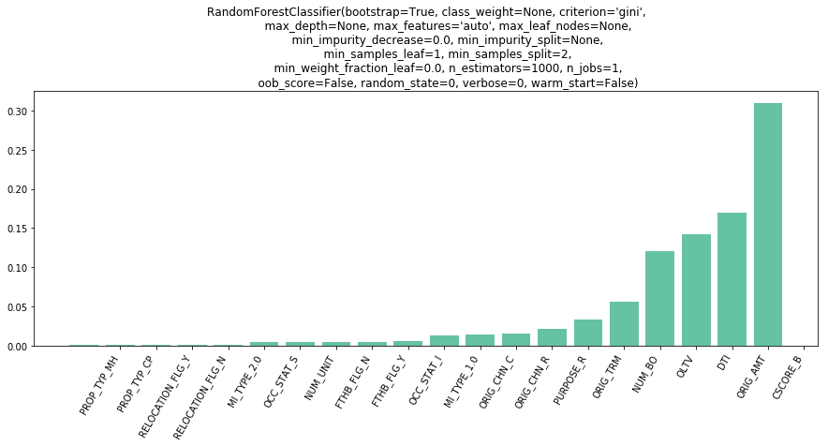
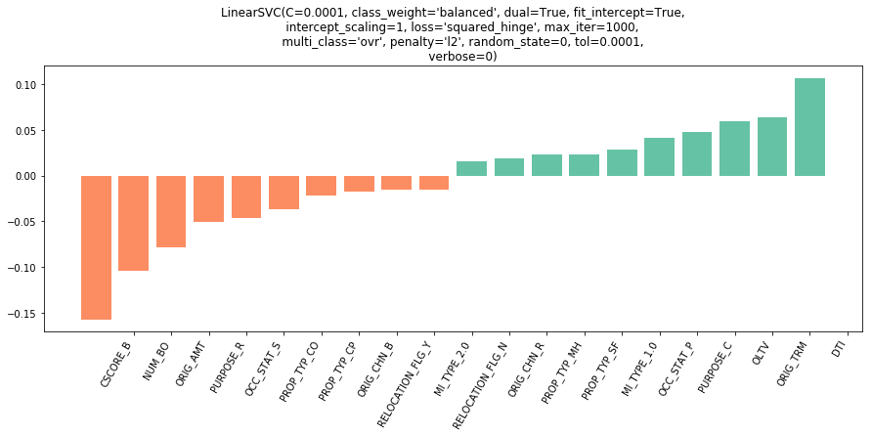
Feature Importance
Findings from Random Forest:
Credit Score, Loan Amount, DTI, LTV, Number of Borrowers (Lesser extent)
Random Forest achieved 79% recall
Findings from LinearSVC:
Defaults Hyperplane:
Credit Score, Number of Borrowers, Second Home, Condos
Non-defaults Hyperplane:
DTI, Term, LTV, Primary Residence, Cash-Out Refi

Slide 11
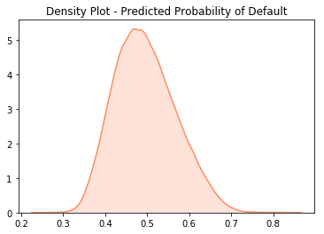
Predicted Probabilities
Precision on defaults is very low for all models
Many predicted defaults were not
More useful to think of these as scores
May want to adjust thresholds
“Worst” Loan (However, has not defaulted): 85% probability of default
Credit Score=678, LTV=85%, DTI=21%, Single Borrower, First Time Buyer, Purchase, $32K, Mobile Home
“Best” Loan (Also, no default): 24% probability of default
Credit Score=805, LTV=24%, DTI=26%, Six Borrowers, Not First Time Buyer, Refi, $325K

Slide 12
Conclusion
As predicted probabilities highlight, these aren’t great models
Better feature/parameter selection
Not enough information about the mortgage to make informed predictions
What are the borrower’s assets?
Human behavior is not always rational or predictable

