Slide 1
CSCI-680 JAVA Stacks and Heaps
Spoorthi Gujjula
Sampath Kumar Das

Slide 2
Introduction
Stack
What are stacks?
How does stacks work in Java?

Slide 3
Stack Illustration
Stack is a section of computer memory used to store temporary information.
Example: Variable created inside a method.
Information ceases to exist after method finishes execution.

Slide 4
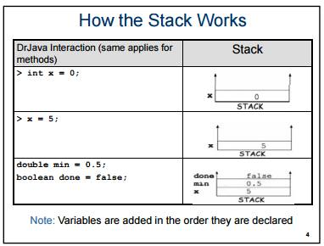

Slide 5
Heaps
What is Heap?
How does heaps work in Java?

Slide 6
Heap Illustration
Objects are stored in a section of memory called “Heap”.
Information exists as long as the program has not finished.

Slide 7
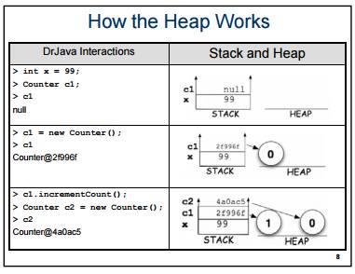

Slide 8
Differences between Stacks and Heaps
Heap memory is used by all the parts of the application whereas stack memory is used only by one thread of execution.
Whenever an object is created, it’s always stored in the Heap space and stack memory contains the reference to it. Stack memory only contains local primitive variables and reference variables to objects in heap space.
Objects stored in the heap are globally accessible whereas stack memory can’t be accessed by other threads.

Slide 9
Continued…
Memory management in stack is done in LIFO manner whereas it’s more complex in Heap memory because it’s used globally.
Stack memory is short-lived whereas heap memory lives from the start till the end of application execution.
Stack memory size is very less when compared to Heap memory. Because of simplicity in memory allocation (LIFO), stack memory is very fast when compared to heap memory.

Slide 10
Example
Public void m1()
{
int x=10;
m2(10); m3 ref
}
Public void m2(int b) m2 b c
{
boolean c; m1
m3();
}
Public void m3() STACK
{
account ref= new account();
}
Class account()
{ p=0
int p; q=0
int q;
} HEAP

Slide 11
How is memory deallocated on the stack and heap?
The data on the stack is automatically deallocated when variables or methods go out of scope.
In the heap for the memory to be deallocated it uses the concept of Garbage collection, with out the programmer have to do anything.

Slide 12
Garbage collector
Garbage collector is an application program which runs inside the JVM.
The garbage collector collects the objects that go out of scope. The garbage collector runs in the low memory situation, you can even ask it to collect the garbage by calling “System.gc()”
It uses the concept of mark and sweep methodology. According to this methodology the garbage collector goes through the entire heap and check which addresses are referenced, those addresses which are referenced as marked and left alone while those which are unmarked are collected by the garbage collector.

Slide 13
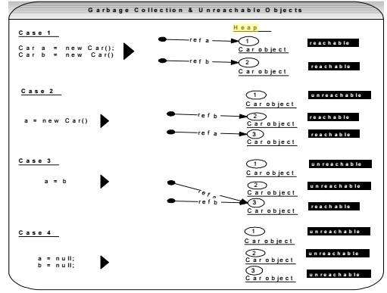
Unreferenced and Referenced objects

Slide 14
THANKS

