Slide 1
Design and Deploy Forecasting Model using MS Azure ML and R
Module Project
Module: NICF Basic R Programming
Course: NICF Diploma in Business Analytics
Start Date :
End Date :
Submission Date :
Learner Name :
Enrollment ID :
Presentation Date :

Slide 2
Contents
Document History
Version Number | Effective Date of release | Summary of Included Changes | Author
1 | 13th July 2016 | First Edition | Satya CVS

Slide 3
Contents
Contents
S. No. | Description
01 | Project Outcomes
02 | AML Architecture
03 | Forecasting Model
04 | Setting up the Forecasting Model
05 | R Programs
06 | Data transformation process
07 | Correlation Analysis Process and Output
08 | Implementing Seasonal Forecasting Model
09 | Refine Model
10 | Forecast Output after Model Adjustment

Slide 4
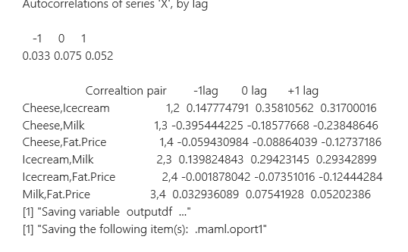
1. Project Outcomes
List the outcomes of the project
Some weak correlations observed.

Slide 5
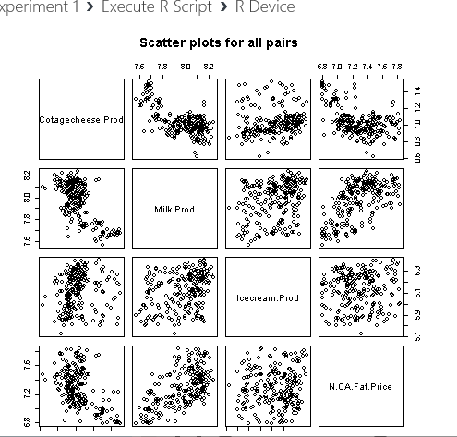
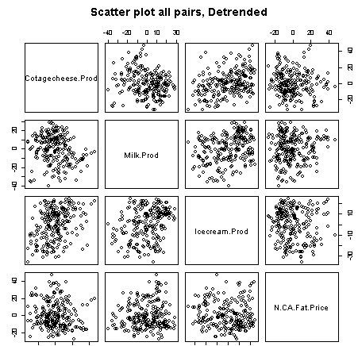
Scatter Plots

Slide 6
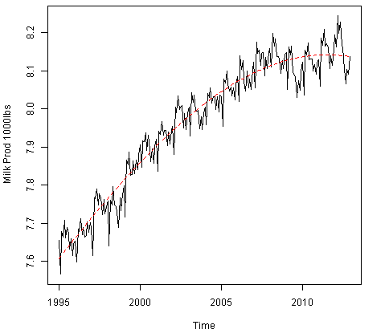
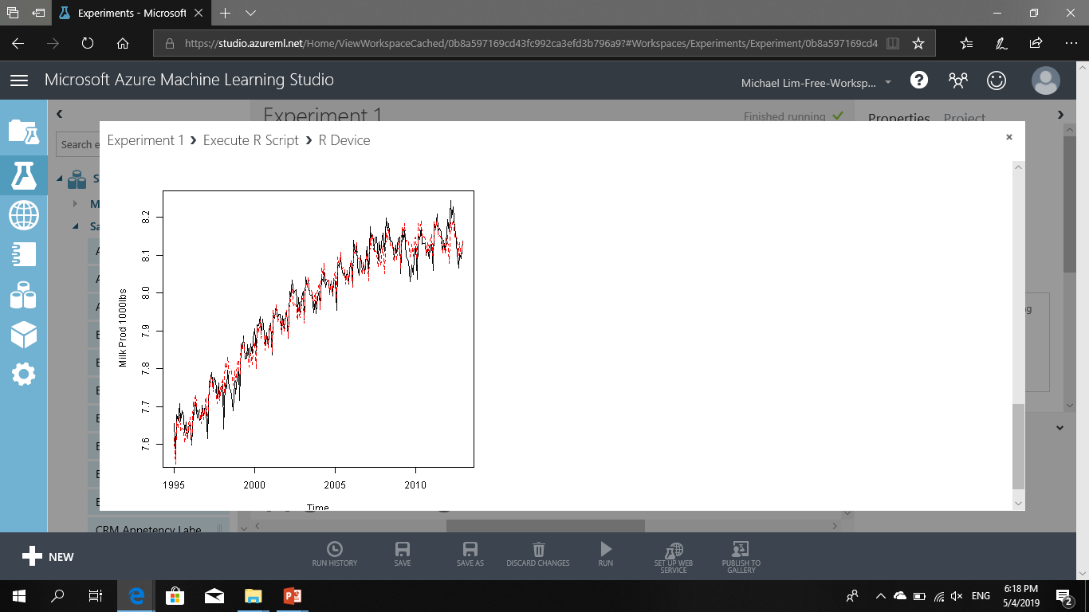
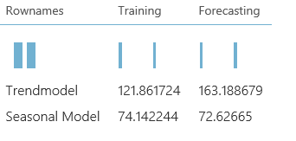
Trend, Seasonal Models and RMS error

Slide 7
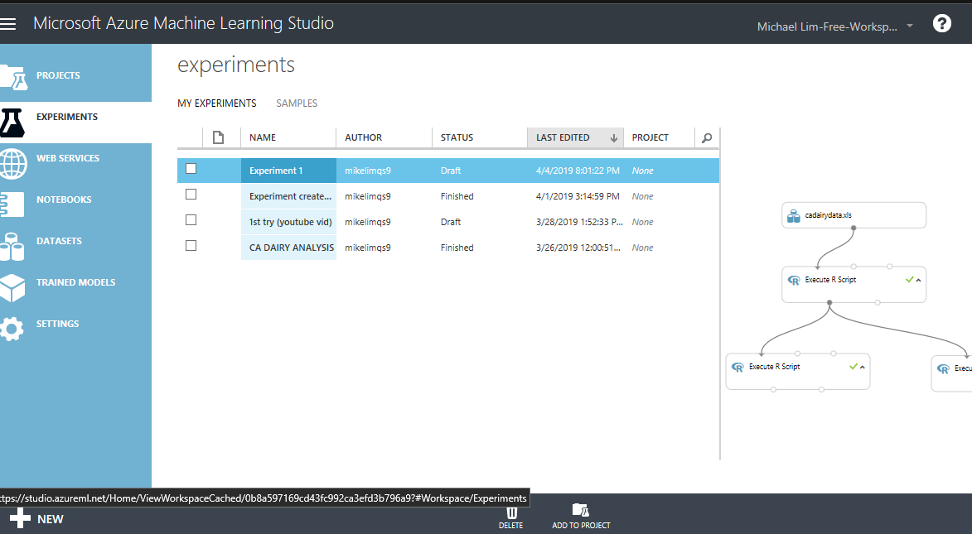
2. AML Architecture
List the MS AML Architecture with Tools used
The New button on the bottom left can create new experiments or upload new datasets

Slide 8
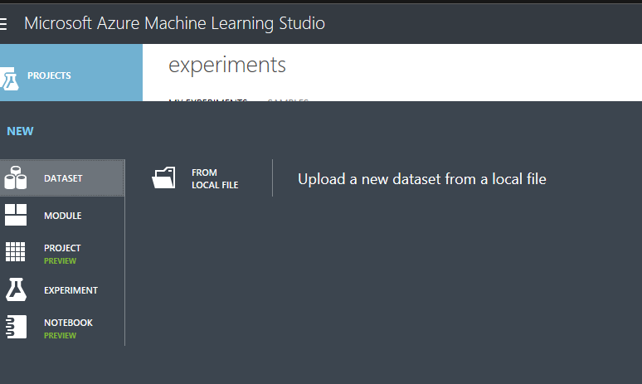
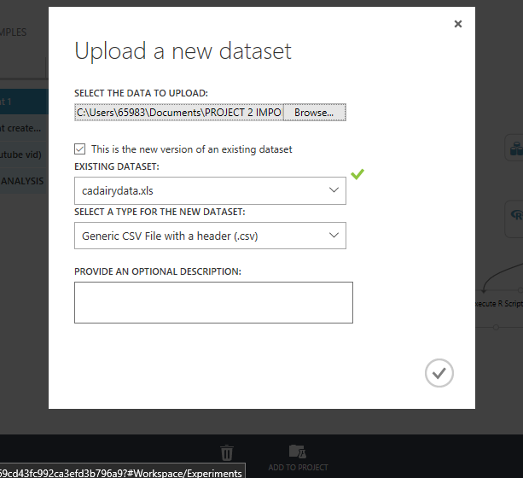
AML Architecture
New > Dataset > Upload dataset

Slide 9
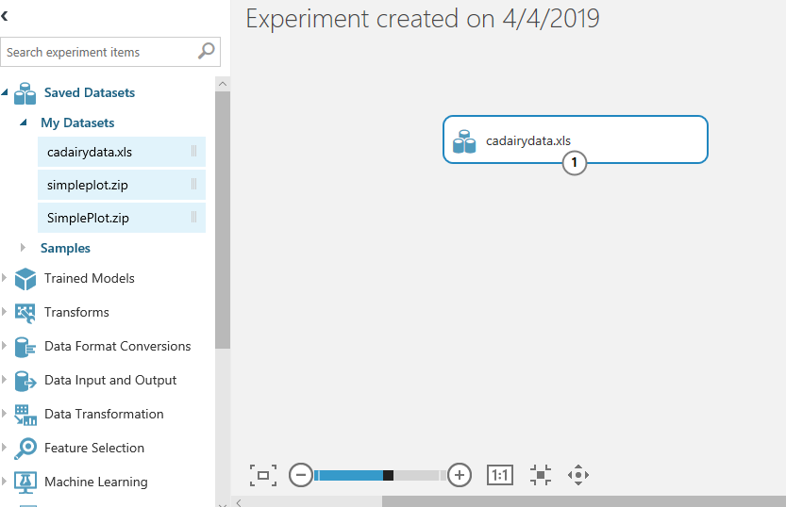
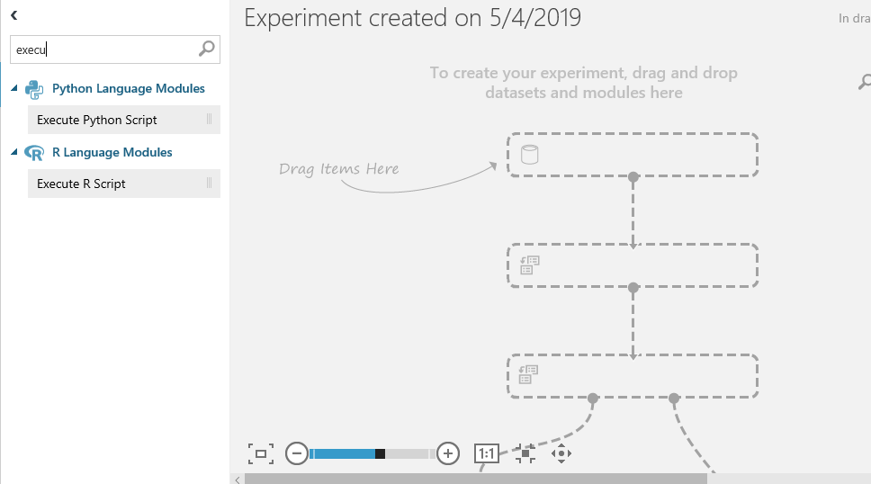
Drag cadairydata.xls into workspace < Drag Execute R Script into model

Slide 10
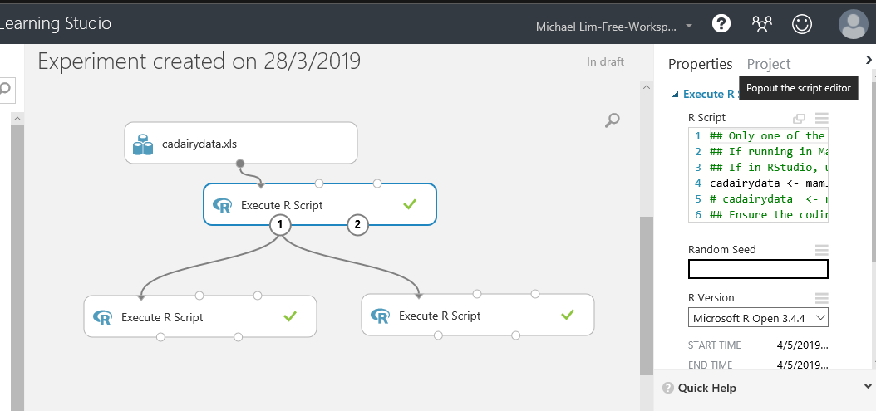
AML Architecture
Script editor is on the right.

Slide 11
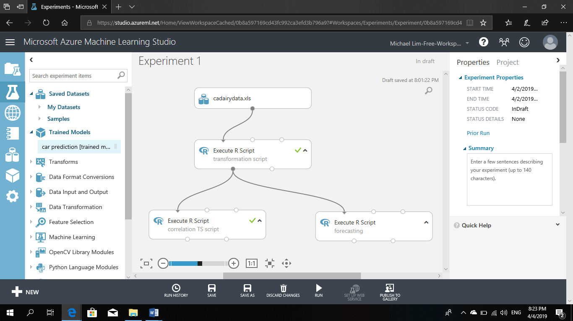
AML Architecture

Slide 12
3. Forecasting Model
List the details of Forecasting model which you are designing and deploying on Azure AML
  Load the Dataset
  Prepare the Data
  Define the timeseries and perform correlation analysis
  Create Trend and Seasonal Models
  Score the Model
  Forecasting

Slide 13
4. Setting up the Forecasting Model
List the Process for setting up Forecasting Model using AML Studio
  Steps :
  Load the Dataset
  Prepare the Data
  Define the timeseries
  and perform correlation analysis
  Create Trend and Seasonal Models
  Score the Model
  Forecasting
1
2
3
4,5,6

Slide 14
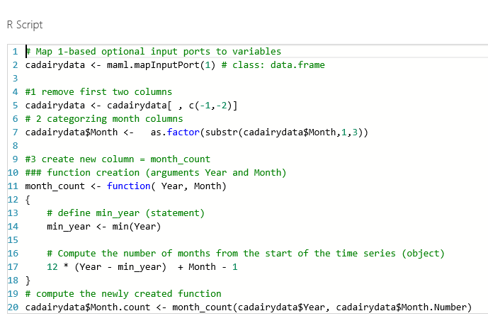
5. R Program Code For Transformation
List the R Code and its purpose for using in the Project for Data Transformation

Slide 15
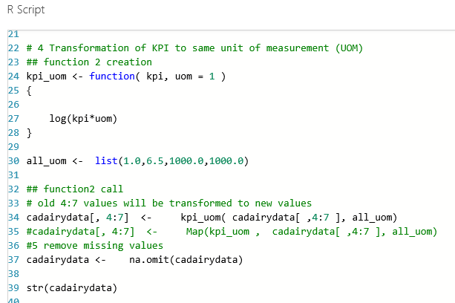
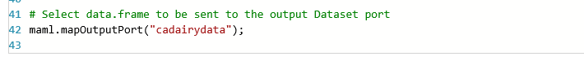
R Program Code For Transformation

Slide 16
6. Data Transformation Process
List the Data Transformation Process
Remove unwanted columns
Change month to factor
Using function(), Create month count for use in Timeseries
Compute $Month.Count by passing $Year, $Month.Number into the function
Transform the 4 KPI into same unit of measurement
Remove rows with missing values with na.omit
Send dataframe to output port.

Slide 17
7. Correlation Analysis Process and Output
List the Correlation Analysis Process and Output
Create $Time as POSIXct object
Use pairs() function to generate scatterplot for our 4 KPIs
Create function for time series
Use lapply detrend the values of the KPIs and save in df.allcolumns
Use pairs() function to create scatterplot using cadairydata df
Use pairs to create detrended scatterplot using df.allcolumns
Create pairwise correlation index and output as a list
Use cbind to output df.correlations with lag -1, 0, +1 as header

Slide 18
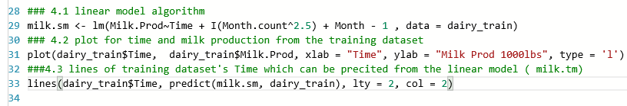
8. Implementing Seasonal Forecasting Model
List the Process for implementing Seasonal Forecasting Model

Slide 19

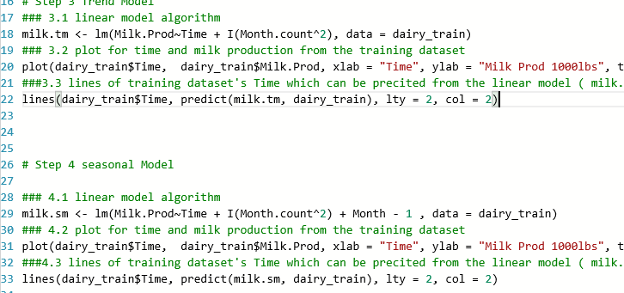
9. Refine Model

Slide 20
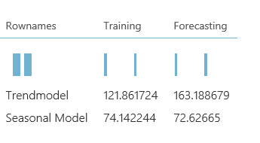

10. Forecast Output after Model Adjustment
List the Forecast Output after model adjustment based on actual production data

