Slide 1
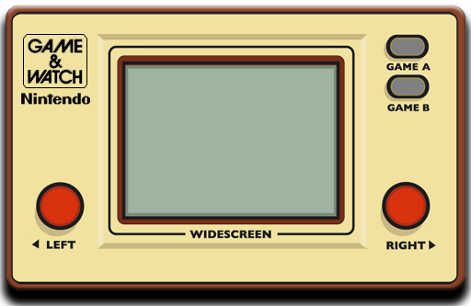

o
Michael Lim
1.27.2020

Slide 2


Video Games are played by millions of people worldwide & some regions in the world have different videogame tastes which is reflected by historical sales number.
The data gathered is from 2006 – 2018 from www.vgchartz.com.
4 different samples set: USA, Europe, Japan and Global.
Assume that there are1300 video games per region: USA, Europe, Japan.
Based on high-performing console video games excluding PC & Mobile games.
Notes:
The data gathered from the websites ranged from yearly sales per video game to other metrics such as its genre.

Slide 3
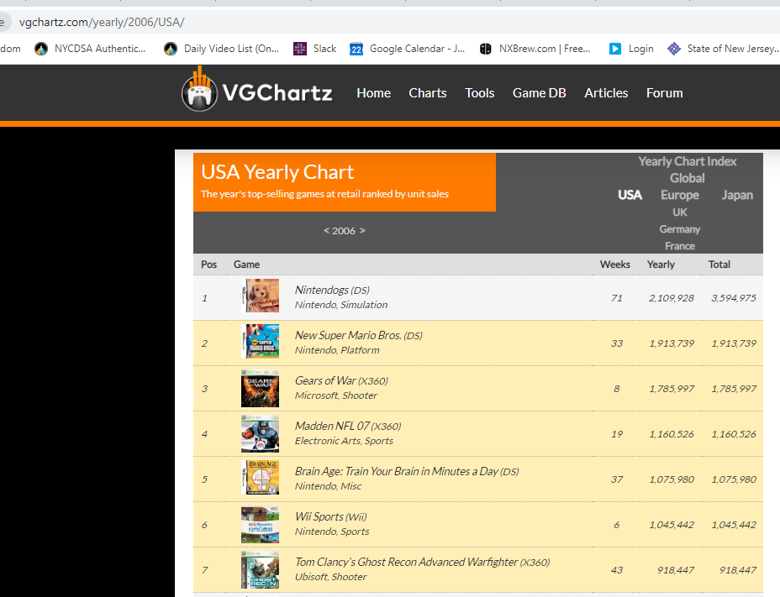
Video Games are played by millions of people worldwide & some regions in the world ha
The data gathered is from 2006 – 2018.
Global data includes USA, Europe, Japan and rest of the world.
1300 Video Games per region: USA, Europe, Japan.
Based on high-performing console video games excluding PC & Mobile games.

Slide 4

Video Game Genres
Global | Japan | Europe | USA
Notes:
There are 4 bars each representing a group (global, us, eu, japan) and one could assume that the global population would heavily influence which genre is most popular.

Slide 5
Video Game Genres
Global | Japan | Europe | USA
Notes:
However, in some instances Japan

Slide 7
Video Game Genre
Japan | Europe | USA
Notes:
This clustered bar graph represents the popularity for each genre based on region and for the genre to be popular it must be on the yearly top 100 list for units sold.
Some of the top performing genres in the US are RPG and Adventure games, and for Europe is sports, platform, shooter, action and fighting games
USA: Sports, Platform, Shooter, Action, Fighting
Japan: Simulation, Misc, Action, Adventure, Party, Puzzle, Strategy , fighting, role-playing
Europe: RPG, Action-Adventure, racing

Slide 9


Slide 10
Global Genres All Time
Genre | # | %
Action | 263 | 20%
Shooter | 222 | 17%
Sports | 178 | 14%
Role-Playing | 167 | 13%
Misc | 119 | 9%
Platform | 87 | 7%
Racing | 80 | 6%
Adventure | 49 | 4%
Simulation | 48 | 4%
Fighting | 47 | 4%
Action-Adventure | 14 | 1%
Puzzle | 12 | 1%
Strategy | 9 | 1%
Party | 3 | 0%
Sandbox | 1 | 0%
Music | 1
Sum: | 1300 | 100%

Slide 11


Slide 12
USA Genres All Time
Genre | # | %
Action | 272 | 21%
Shooter | 243 | 19%
Sports | 217 | 17%
Role-Playing | 132 | 10%
Misc | 107 | 8%
Platform | 89 | 7%
Racing | 71 | 5%
Fighting | 51 | 4%
Adventure | 43 | 3%
Simulation | 35 | 3%
Action-Adventure | 14 | 1%
Puzzle | 12 | 1%
Strategy | 9 | 1%
Party | 3 | 0%
Music | 2 | 0%
Sum: | 1300 | 100%

Slide 13


Slide 14
European Top 100 Genres All Time
Genre | # | %
Action | 251 | 20%
Shooter | 215 | 17%
Sports | 171 | 13%
Racing | 124 | 10%
Misc | 121 | 9%
Role-Playing | 118 | 9%
Platform | 82 | 6%
Simulation | 69 | 5%
Adventure | 45 | 4%
Fighting | 35 | 3%
Action-Adventure | 15 | 1%
Puzzle | 14 | 1%
Strategy | 12 | 1%
Party | 5 | 0%
Music | 2 | 0%
Sum: | 1279 | 100%

Slide 15


Slide 16
Japanese Top 100 Genres All Time
Genre | # | %
Role-Playing | 343 | 26%
Action | 278 | 22%
Misc | 145 | 11%
Sports | 123 | 10%
Adventure | 73 | 6%
Platform | 65 | 5%
Fighting | 61 | 5%
Shooter | 48 | 4%
Simulation | 46 | 4%
Strategy | 36 | 3%
Racing | 33 | 3%
Puzzle | 27 | 2%
Action-Adventure | 13 | 1%
Party | 6 | 0%
Inc, Action | 2 | 0%
Music | 1
Sum: | 1300 | 101%

Slide 17
 | Global | USA | Europe | Japan | Which country more popular?
Action | 263 | 272 | 251 | 278 | Japan
Action-Adventure | 14 | 14 | 15 | 13 | Europe
Adventure | 49 | 43 | 45 | 73 | Global
Fighting | 47 | 51 | 35 | 61 | Japan
Inc, Action | 0 | 0 | 0 | 2 | Japan
Misc | 119 | 107 | 121 | 145 | Japan
Music | 1 | 2 | 2 | 1 | USA,EU
Party | 3 | 3 | 5 | 6 | Japan
Platform | 87 | 89 | 82 | 65 | USA
Puzzle | 12 | 12 | 14 | 27 | Japan
Racing | 80 | 71 | 124 | 33 | Europe
Role-Playing | 167 | 132 | 118 | 343 | Japan
Sandbox | 1 | 0 | 0 | 0 | Global
Shooter | 222 | 243 | 215 | 48 | USA
Simulation | 48 | 35 | 69 | 46 | Europe
Sports | 178 | 217 | 171 | 123 | USA
Strategy | 9 | 9 | 12 | 36 | Japan
Which genre more popular? | Action | Action | Action | Role-playing
Notes:
Japan : Action, Fighting, Misc, Role-playing, Strategy
Europe: Action-adventure, racing
USA: Platform, Shooter, Sports
Global: Adventure
Popular genre based on region
Global
Action Shooter Sports
USA
Action Shooter Sports
Europe
Action Shooter Sports
Japan
Role-playing Action Misc

Slide 18

Although Global, USA, and Europe share the same top three video game genres - action, shooter, sports - Japan’s top three video game genres are role-playing, action, and miscellaneous genres. This disparity is most likely influenced by culture or other multi-variate factors.
Notes:
Global
Action Shooter Sports
USA
Action Shooter Sports
Europe
Action Shooter Sports
Japan
Role-playing Action Misc

