Slide 1





Slide 2

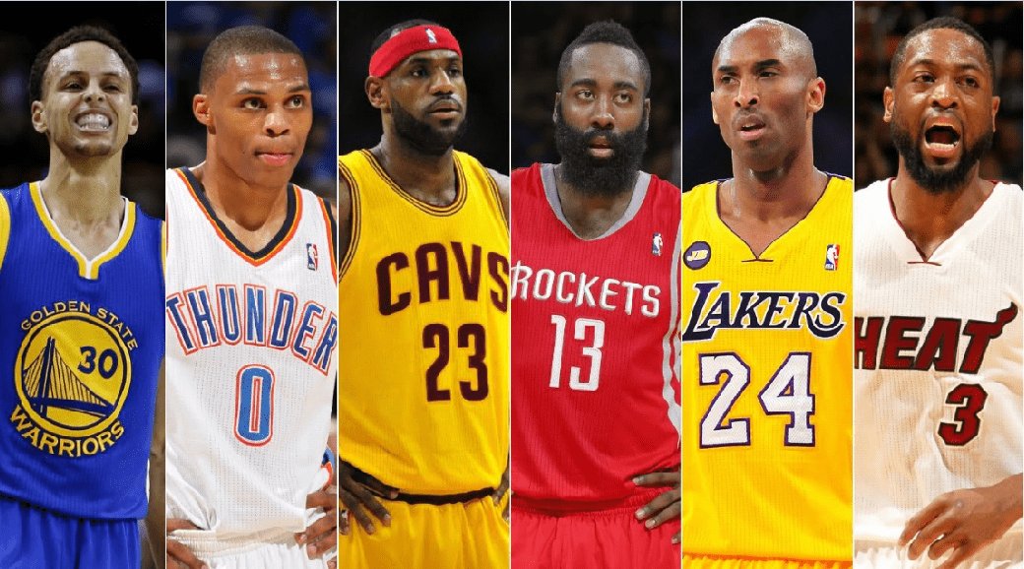

Slide 3

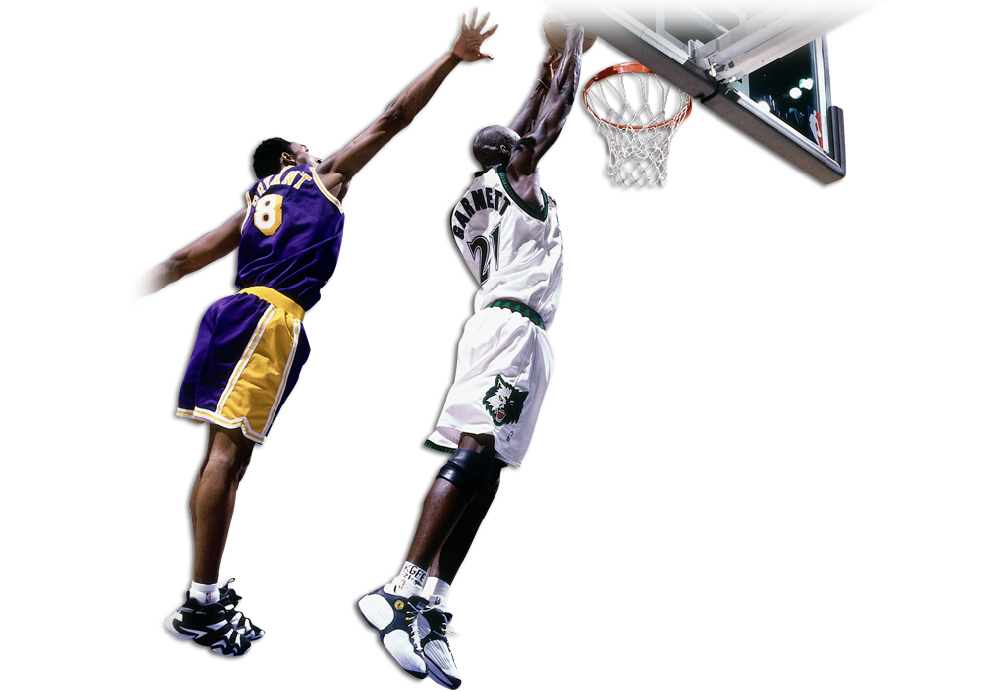
Introduction
Objective
Application
Who’s it for?
How to use
Insights
Future Goals
Challenges

Slide 4

Insights
App
Intro

Slide 5

National Basketball Association formed in 1949.
30 teams divided into two major conferences: Eastern & Western conference.
Each team plays 82 games – 41 at home, 41 at away
30 Teams each generate $1.9 BN yearly (three times the valuation 5 years ago).
NBA Franchise generated $ 8 BN in revenue in 2019 across various platforms

Slide 6

Provide Insight into various shooting statistics to fans and coaches for better decision-making purposes.
Made Vs. Miss shots
Away vs. Home
Best & Worst Defenders
Optimal Shot Distance
Top 3 Point Shooters
Metrics:
Player
Defender Name
Shot Distance
Distance from defender
Missed vs. Made Shots
Type of shots
Location: Away or Home Game

Slide 7
Insights
App
Intro

Slide 8

Who’s it for?
Fantasy basketball
Coaches?
What insights can you gain from the features?
Made vs. Miss Shots
Away vs. Home Games
Best & Worst Defenders
Optimal Shot Distance 5-30 ft+
Top 100 3 Point Shooters in the league

Slide 9
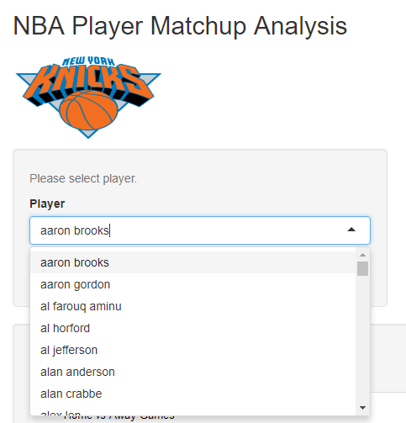
How to use the app?
Select player from drop down menu

Slide 10
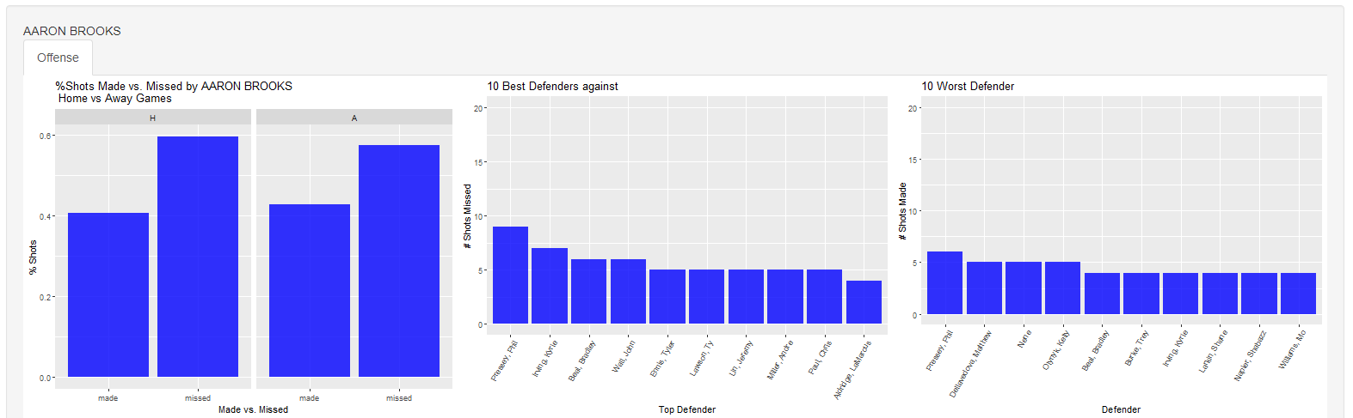
How to use the app?
2. Three charts populate
- % Shots Made vs. Missed (Home vs. Away Games)
- 10 Best and wort defenders based on made vs missed shots

Slide 11
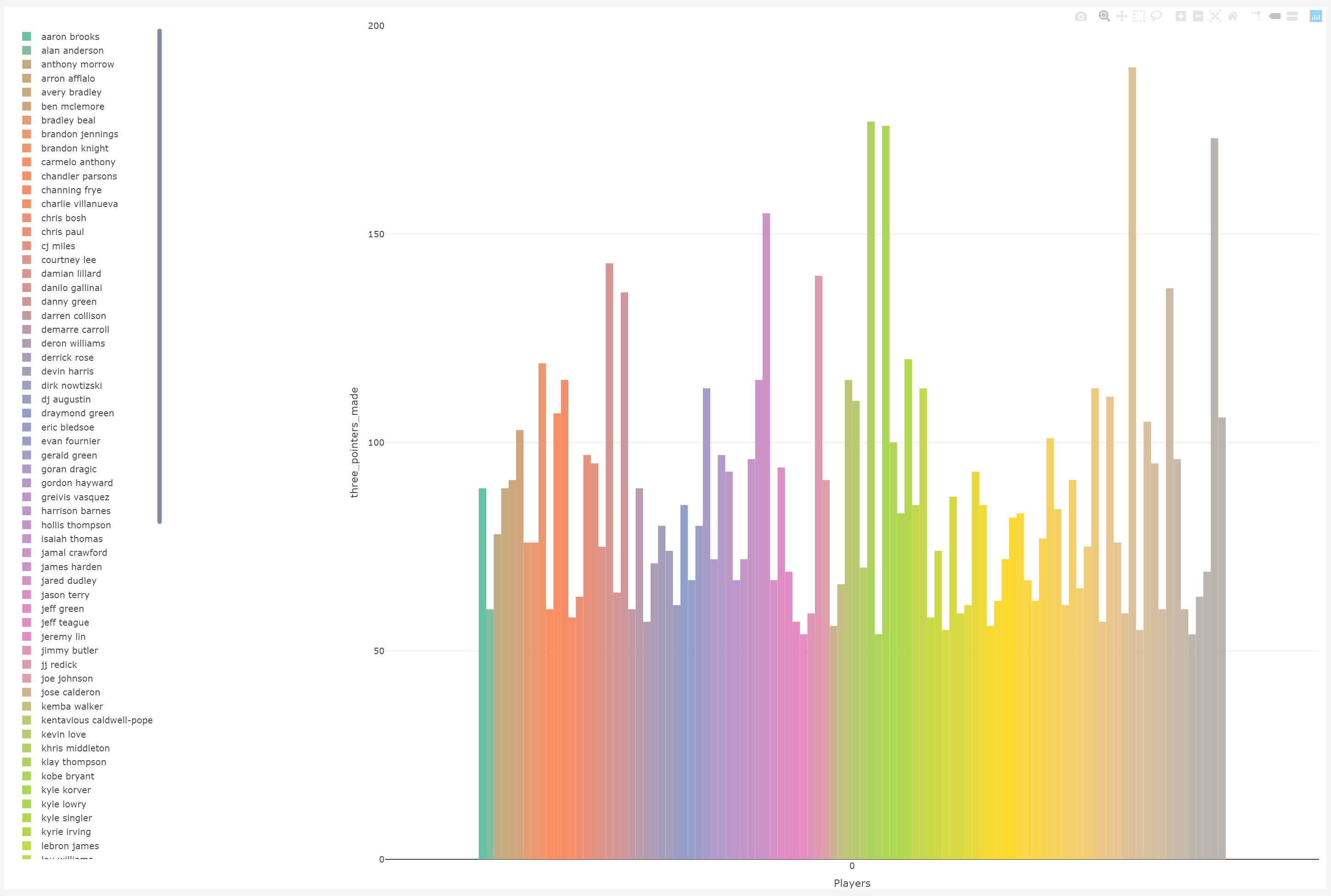
How to use the app?
3. Top 100 3 point-shooters
- Click players of interest to compare 3 pts made

Slide 12
Insights
App
Intro

Slide 13

Create a shot location map for every player
Analyze other metrics such as:
Touch time
Turnover
Quarterly performance : 1st quarter vs 4th quarter
Number of dribbles
Feature Engineering
Correlation Heatmap of different features

Slide 14
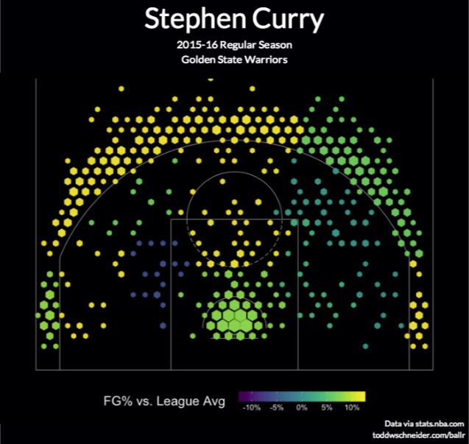
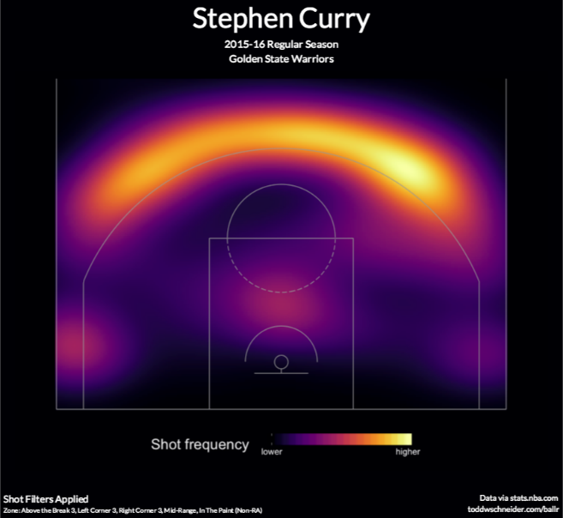
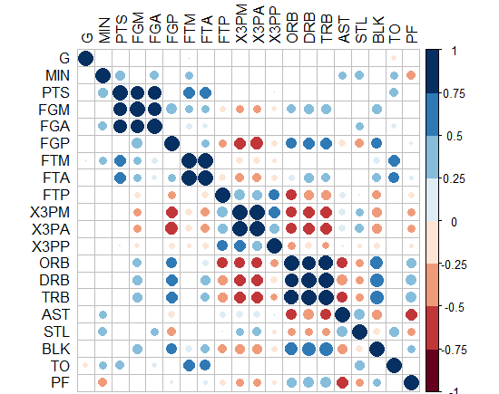

Slide 15

Determining project based on no dataset
Lack of (x,y) coordinates of shot taken

Slide 16


