Slide 1
gstack Tutorial #5
From YouTube analytics to a re-engineered Short
CSR-RAP agent × Claude Opus 5.5 × HyperFrames — how the AGI Race V2 was made
Scope: V2 of the published AGI Race Short. Episode 2 (Mission: Impossible) is still in production and is not taught here.
September 2026

Slide 2
EXECUTIVE SUMMARY
V2 raised structural quality by 27.9 %; whether viewers agree is still an open test
0.602 → 0.770
4.15 s
1.67 → ?
CSR-RAP B score
Hook complete
Comments per 1,000 views
V1 proved the topic (R × A). V2 adds the production system (R × P = 0.865).
Punchline first, title second: the premise lands in 8.9 % of the Short.
Target > 2.5. Nothing is proven until 72 h of real V2 analytics return.
Source: docs/SOURCES.md
2

Slide 3
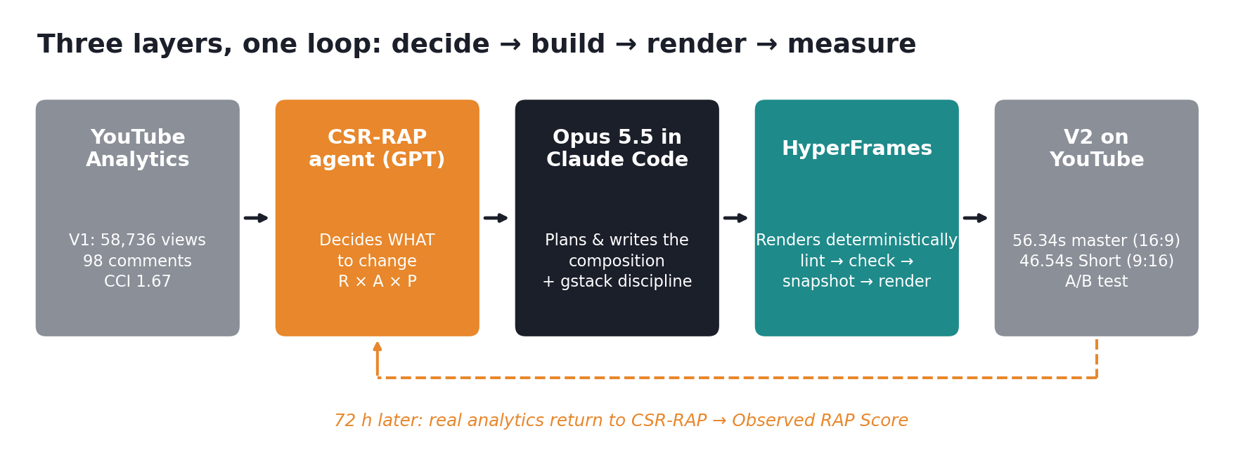
THE SYSTEM
The leverage came from splitting the work across three systems with different jobs
Decide (CSR-RAP) → build (Opus 5.5 + gstack) → render (HyperFrames) → measure, then loop.
Source: docs/SOURCES.md
3

Slide 4
PART 0 · MENTAL MODEL
Generative AI creates uncertain pixels; HyperFrames controls certain information
Must be exactly right → HyperFrames
May vary → generative model / source footage
Timing of every beat, to the frame
All on-screen text, captions, role tags
9:16 reframing per shot
Freeze, black cut, end-card
Audio cue placement
Photoreal characters and environments
Motion inside a shot
Texture and lighting detail
Seek-safe test: if the renderer jumps straight to t = 4.312 s, is the frame still correct?
V2 needed almost nothing from the right column: its pixels already existed in V1.
Source: docs/SOURCES.md
4

Slide 5
PART 1 · SETUP
The whole toolchain installs on Windows 11 in about 10 minutes; gstack takes one
1
Prerequisites
2
gstack (~1 min)
3
HyperFrames
4
Doctor first
Git · Node.js ≥ 22 · FFmpeg · Bun ≥ 1.0 · Claude Code
Paste the README one-liner into Claude Code; test with /office-hours
Install the Claude Code plugin; restart; /hyperframes routes the job
Check the machine before designing anything; pin the CLI version
winget install --id OpenJS.NodeJS -e
git clone … garrytan/gstack.git ~/.claude/skills/gstack && ./setup
claude plugin install hyperframes@hyperframes
npx hyperframes doctor
Pitfall we hit: 'claude' is not recognized → add %LOCALAPPDATA%\Microsoft\WinGet\Links to PATH and open a new PowerShell.
Source: docs/SOURCES.md
5

Slide 6
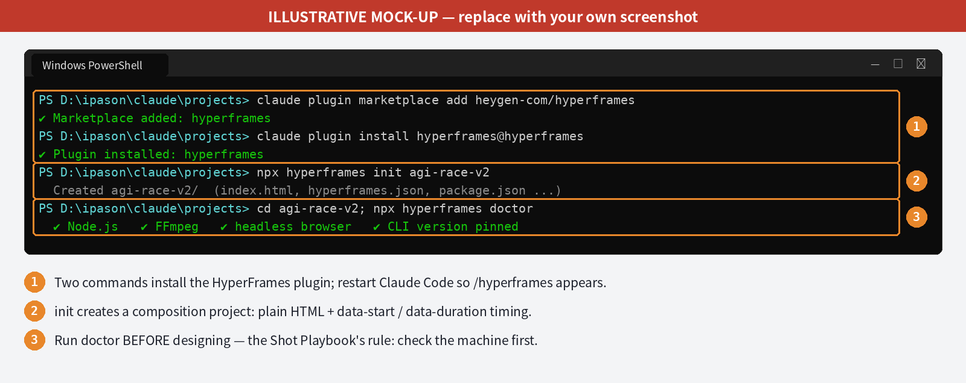
PART 1 · SETUP
Two commands install HyperFrames; the doctor check runs before any design work
Illustrative mock-up with annotations. Replace with your own screenshot.
Source: docs/SOURCES.md
6

Slide 7
PART 2 · CSR-RAP DIAGNOSIS
V1 proved the topic works, but conversion did not follow the views
58,736
Layer | Score | Diagnosis
R Rules of Business | 88 | Cognitive compression: an AI race became a desert race
A Attributes of Industry | 90 | Hot topic, recognisable figures, strong Shorts fit
P Production capability | 76 | Weak causality; fails in 9:16
B = R × A × P | 0.602 | One weak layer caps the whole result
views (channel's first breakout)
98
comments
1.67
CCI = comments per 1,000 views
Source: docs/SOURCES.md
7

Slide 8
PART 3 · VISUAL DNA
Measuring V1 first showed what to keep and exactly what broke on mobile
62.49 s
47
1.08 s
runtime
shots (46 hard cuts)
median shot; 20 of 46 under 1 s
0.95 s
1.5 s + 0.84 s
4
mean shot in the fastest block, just before the climax
near-freeze, then black
elements cut by a 9:16 crop: title, ensemble, final freeze, every subtitle
All values FFmpeg-measured by Opus 5.5 in Claude Code (Episode1_Visual_DNA.md).
Source: docs/SOURCES.md
8

Slide 9
PART 4 · THE DETOUR
An agent that only writes prompts for another generator is still gambling
1
The gate worked
“Entry gate: FAIL. Nothing has been generated yet… Numbers for frames nobody has generated would be invented.”
Opus refused to score footage that did not exist.
2
The dependency was wrong
The pipeline waited on the least controllable step: generated faces.
3
The pivot proved the control layer
C24 pilot: countdown correct at any seek time; black cut on frame 139; lint 0 errors; contrast 13/13.
4
…and showed its limit
— Opus 5.5, text-to-video route, home PC
C24 scored R 0.82, A 0.75: held back by placeholder characters, not structure.
Source: docs/SOURCES.md
9

Slide 10
PART 5 · SHOT PLAYBOOK
Seven Shot Playbook rules turned one day's mistakes into permanent constraints
1
Route through /hyperframes; multi-scene → /general-video
5
Holds over ≈4 s get one monotonic micro-motion, never a loop
2
Run doctor and read the timeline before designing
6
Critical text in the centre third, so it survives 9:16
3
Search the catalog before building; reuse components
7
lint → check → snapshot → render → ffprobe, then human eyes
4
Seek-safe: no wall-clock logic, no Web Audio graphs, no conflicting fromTo
Renders are visually, not bit-for-bit, deterministic: 61 of 144 frames identical, the rest ≥ 50 dB PSNR.
Source: docs/SOURCES.md
10

Slide 11
PART 6 · THE V2 BRIEF
The V2 brief pairs a change list from CSR-RAP with a keep list from the Visual DNA
Change (from CSR-RAP)
Keep (from Visual DNA)
Cold open on the strongest punchline
Title slam; hook complete by ≈4 s
Role tags replace name recognition
Delete unintelligible lines
9:16 as its own composition
End-card bridge to Episode 2
Fast grammar (median shot ≈1.08 s)
Acceleration before the climax
"Slow down" as the biggest close-up
Unresolved jump
Near-freeze → black ending
Muted grade
Before the build: /office-hours → /plan-ceo-review (scope: HOLD, re-edit only) → /plan-eng-review. After it: /review.
Source: docs/SOURCES.md
11

Slide 12
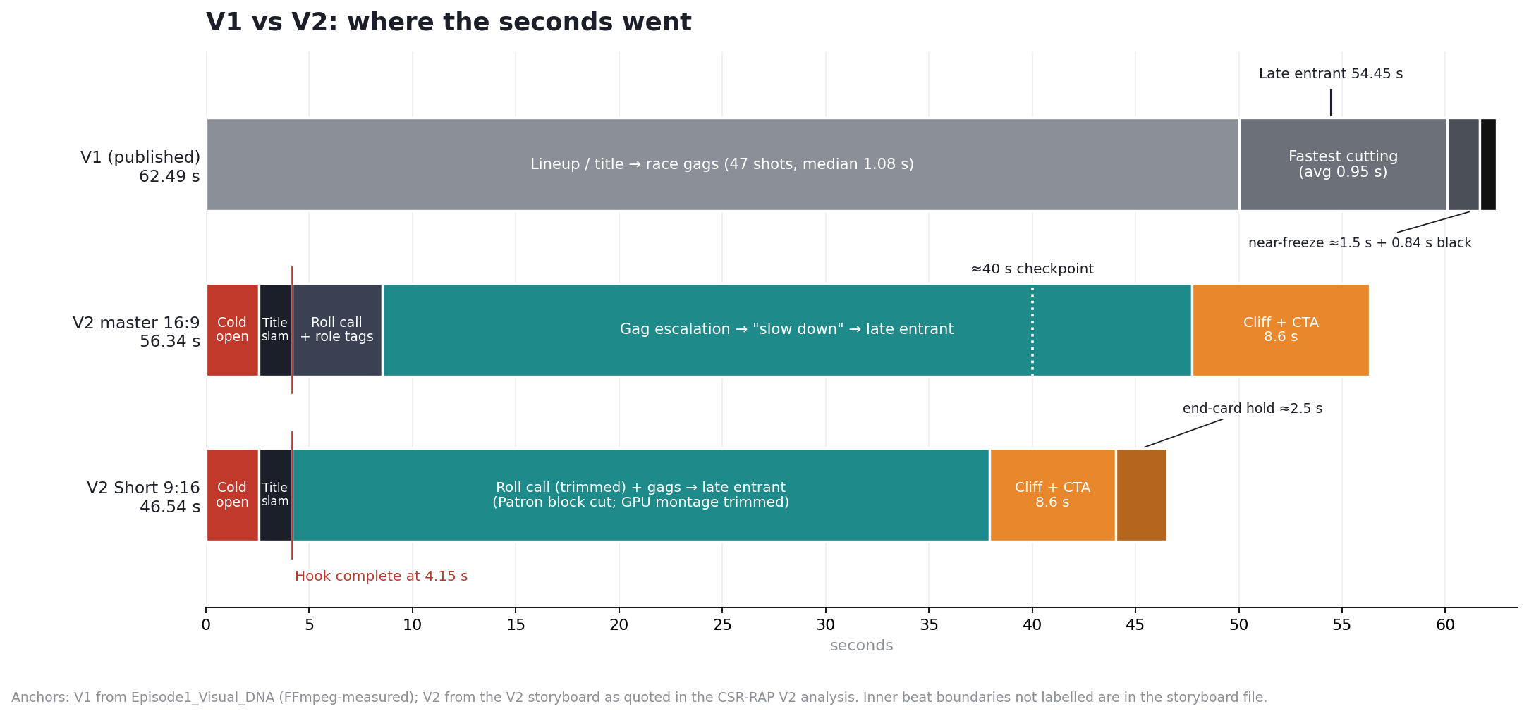
PART 7 · V2 ANATOMY
V2 delivers spectacle, punchline and premise in the first 4.15 seconds
Source: docs/SOURCES.md
12

Slide 13
PART 7 · V2 ANATOMY
Every V1 weakness the diagnosis named has a specific V2 answer
Metric | V1 | V2 | Assessment
Main runtime | 62.49 s | 56.34 s | −9.8 %
Short runtime | — | 46.54 s | −25.5 % vs V1
Opening | Lineup / title | Strongest gag first | Clear upgrade
Hook complete | Slower | 4.15 s | Stronger
Role comprehension | Relies on recognition | Explicit role tags | Major upgrade
9:16 | Fails in several places | Shot-by-shot reframing | Major upgrade
Ending | Unresolved jump | Jump + Episode 2 bridge | Commercial upgrade
CTA system | Weak / generic | TO BE CONTINUED → EP 2 → SUBSCRIBE | Clear upgrade
Production | Video generation | Programmable HyperFrames re-edit | P upgrade
Source: docs/SOURCES.md
13

Slide 14
PART 8 · RE-SCORE
The strongest pair of layers moved from topic choice (R × A) to production system (R × P)
+27.9 %
structural quality, B 0.602 → 0.770
0.865
R × P, now the strongest coupling, and it compounds across episodes
≠ views
a design score, not a forecast; A stays provisional until real data arrives
Source: docs/SOURCES.md
14

Slide 15
PART 9 · CLOSE THE LOOP
Freeze both uploads for 72 hours and read three windows on the retention curve
The one question: does HyperFrames packaging turn the same content into better audience behaviour?
Window | Question | If it fails
0–4.15 s | Does the cold open stop the swipe? | Test another opening punchline
≈40 s | Does "slow down → late entrant" lift attention? | Tighten the escalation before it
Last 8.6 s | Does the end-card add subscribers or cause exits? | Cliff + no subscriber lift → hold 2.5 s → 1–1.5 s
Observed RAP Score (proposed): hook = stayed-to-watch % · retention = APV · engagement = CCI (target > 2.5) · subscribers per 1,000 views · vertical advantage = Short APV ÷ master APV
Source: docs/SOURCES.md
15

Slide 16
PART 10 · LIMITS
Four limits stand between this result and a proven one
1
No V2 analytics yet
2
Scores are judgements
Every V2 claim is structural until the 72-hour pull.
CSR-RAP rates design quality; it does not measure behaviour.
3
Generative layer untested
4
Real people, satirised
Episode 2's faces, hands and keys remain the open risk.
Role tags reduce reliance on likeness; review platform policy each release.
Source: docs/SOURCES.md
16

Slide 17
PART 11 · OPERATING SYSTEM
The same nine steps re-engineer any Short, not just this one
Export analytics; compute CCI
Diagnose with CSR-RAP
Measure: Visual DNA
1
2
3
Challenge: /office-hours
Brief Opus 5.5
Build + verify in HyperFrames
4
5
6
Re-score (design)
Upload, freeze, measure 72 h
Feed back into the next brief
7
8
9
Source: docs/SOURCES.md
17

Slide 18
Measure, don't re-edit
The next decision belongs to the viewers' data, not to another render.
Repo: TUTORIAL.md · TUTORIAL.zh.md · starter/prompts · docs/SOURCES.md
gstack: github.com/garrytan/gstack
HyperFrames: github.com/heygen-com/hyperframes

