Slide 1
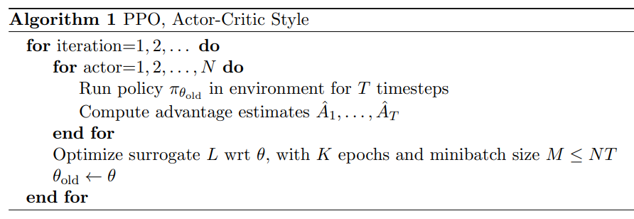
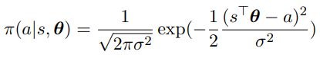
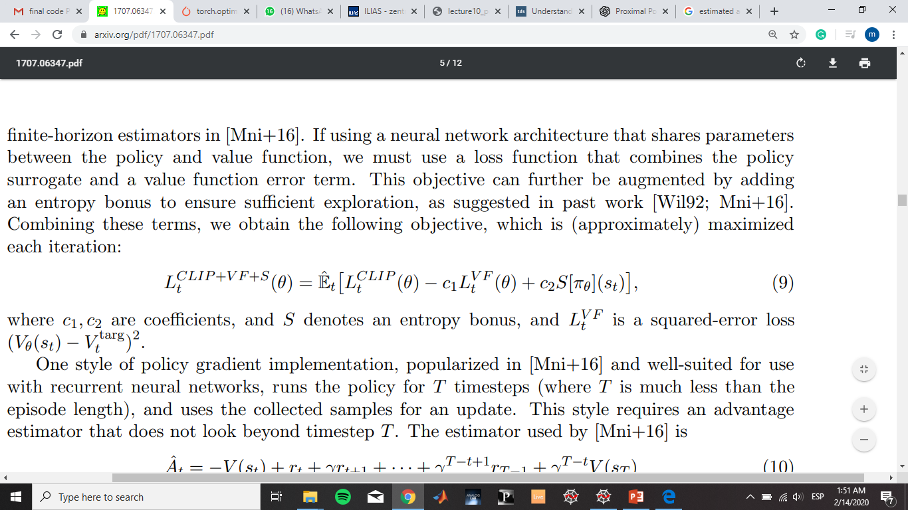
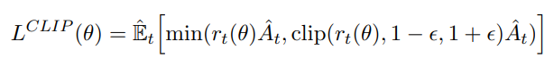
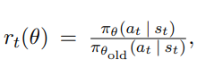
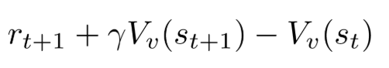
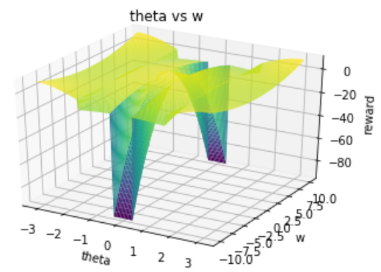
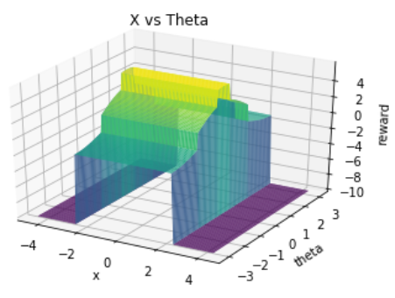
Swing-up Pendulum Cart Pole
Enviroment
Proximal Policy Optimization(PPO)
State space
State-of-the-art algorithm
Policy gradient method
Reliable and clear explanation[1]
Continuous
Action space
Algorithm
Loss Function
Reward Function
Notes:
Tuning for optimal performance
To have a clear Idea about the motivation of this paper, it starts like this: Suppose that you have a model like a NN, you have a data set! So you want to make the best Hyperparameters of the NN that fit this dataset. Using the same model on different datasets , we will need new hyperparameters that goes well with the model and the dataset.

Slide 2
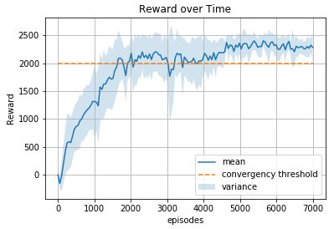
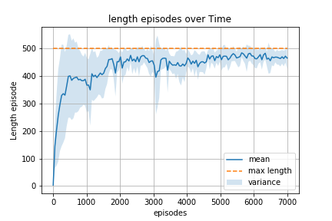
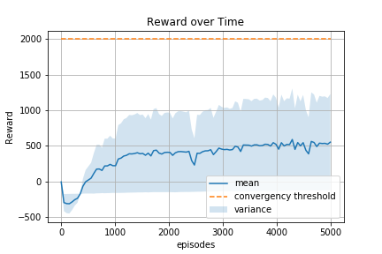
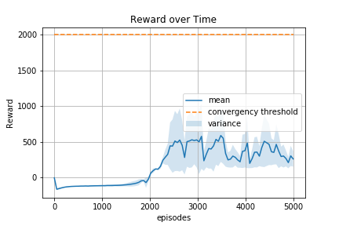
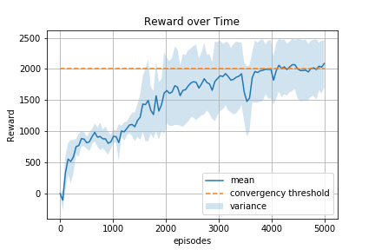
Swing-up Pendulum Cart Pole
Hyperparameters
Std = 0.7
Clipping_eps = 0.4
Update = 4096
Episode_length = 500
C1 = 0.7
C2 = 0.01
Epochs = 64
No MiniBatch training
Std = 0.25
Annealing
1000 Tsteps
CosinAnnealing(std)
Notes:
Tuning for optimal performance
To have a clear Idea about the motivation of this paper, it starts like this: Suppose that you have a model like a NN, you have a data set! So you want to make the best Hyperparameters of the NN that fit this dataset. Using the same model on different datasets , we will need new hyperparameters that goes well with the model and the dataset.

