Slide 1
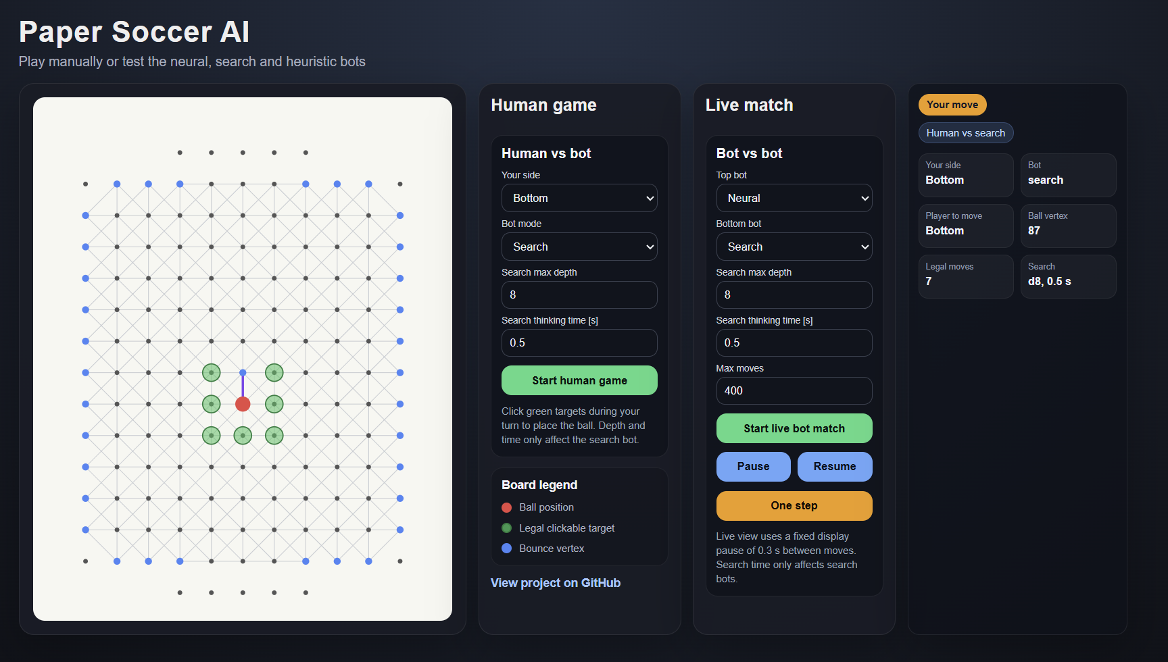
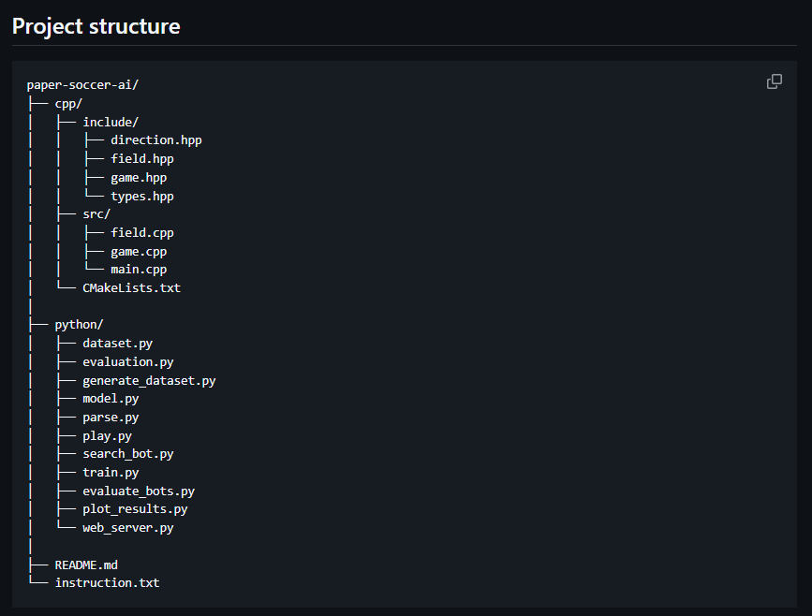
Paper Soccer AI
C++ game engine + search expert + neural trained bot
• Playable Paper Soccer game
• C++ rule engine saves GameState
• Python bots use this state for search, training and web play
Applied Machine Learning
PyTorch
C++
Notes:
Opening: explain the project in one sentence. Show that it is a game first, then an ML project.

Slide 2
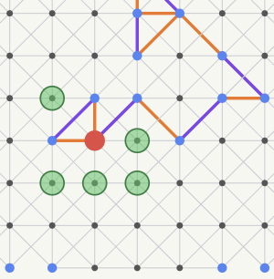
1. Game rules
Paper Soccer is a graph game with blocking edges and extra moves.
Core rules
• Ball starts in the center
• Move to one of 8 neighboring points
• Used edge cannot be used again
• Goal = move into opponent’s goal
• No legal moves = loss
Bounce rule
If the ball lands on a visited point or border, the same player moves again. One turn can become a chain of moves.
Each move draws a line between two neighboring points. After that, this edge becomes blocked and cannot be used again, so the graph changes after every move.
Because of the bounce rule, a single turn can become a longer chain of moves. The player keeps moving if the ball lands on a visited point or on the border.
This means the state is not only the ball position. We also need to remember used edges and visited vertices, which makes the game interesting for search algorithms and neural-network training.
Notes:
Explain the bounce rule carefully. It motivates why the state and search are interesting.

Slide 3
2. From game to software
We split the project into a rule engine, Python bots, and a browser visualization
C++ Engine
gamestate.txt
Python Parser
ML
Web UI
rules, legal moves, winner
serialized board state
tensors + GameState
heuristic, search, neural
play + watch matches
• C++ is the source of truth for rules.
• After each move it saves the board into gamestate.txt.
• Python reads this file, reconstructs GameState and creates tensors.
• The same state format is used by bots, training and the web UI.
Notes:
Tell the story: not one monolithic program, but a bridge between engine and ML.

Slide 4
3. C++ engine: board as a graph
The engine run the rules and produces a deterministic GameState
C++ responsibilities
State is compact
• build board graph
• store neighbours in 8 directions
• check legal moves
• remove used edges
• detect goals and dead ends
• handle bounce turns
• save deterministic GameState
current_player
current_vertex
allowed[vertex][direction]
extra_turn[vertex]
neighbours[vertex][direction]
• The state is compact but contains all information about the state of game.
• allowed[v][d] stores open edges.
• extra_turn[v] marks visited / bounce vertices.
• Bots only choose directions - legal moves are still checked by the engine.
Notes:
Keep it brief: the engine is the authority. Mention that bots never break the rules because legal moves are checked.

Slide 5
4. Bot modes
We implemented a baseline, a search expert and a neural bot
Heuristic
Search
Neural
one-step score
negamax + pruning
trained policy
progress to goal
mobility bonus
trap penalty
simulates future moves
alpha-beta pruning
heuristic at leaf nodes
input vector → 8 scores
illegal move masking
learns from search expert
score = 3.0 * progress + 1.0 * mobility + 0.8 * extra - trap_penalty
progress = how much the move goes toward the opponent’s goal
mobility = number of available moves from the next vertex / 8
extra = bonus if the move lands on a bounce / visited vertex
trap_penalty = 5.0 if mobility == 0, 1.5 if mobility <= 0.125, 0.0 otherwise
Notes:
Show that the bots are not just variants. Each one has a role: baseline, teacher, learner.

Slide 6
5. Dataset generation
The neural bot learns from search-generated expert labels
Initial GameState
Simulated games
Search expert
Tensors saved
Training set
Generation settings
Epsilon exploration
Saved tensors
games_count = 10000
max_moves = 400
epsilon = 0.30
expert_depth = 5
70% best expert move
30% random legal move
states.pt → board vectors
targets.pt → scores for 8 moves
legal_masks.pt → legal move mask
best_moves.pt → best search move
• For each generated state, the search bot evaluates all legal moves. Then we save: state vector + expert scores + legal mask + best move.
• epsilon = 0.30 gives exploration: 70% expert move, 30% random legal move. The random move only changes the path - labels still come from search.
• Expert scores are clamped to [-20, 20] and normalized before training. Duplicate states are skipped.
Notes:
This is the core ML slide. Explain that epsilon is exploration, not noisy labels.

Slide 7
6. Neural network
The model predicts a score for every direction, then masks illegal moves
Input state
MLP policy
8 move scores
current player
ball position
allowed edges
bounce vertices
Linear layers
activation
AdamW training
up
up-right
right
...
up-left
→ Linear(input, 512) + ReLU
→ Linear(512, 256) + ReLU
→ Linear(256, 128) + ReLU
→ Linear(128, 8)
≈ 1531 features
illegal moves are masked
Loss combines two signals:
• soft target loss - it learns full expert score distribution
• hard CE loss - learns exact best move
Illegal moves are masked.
Loss = 0.8 soft target loss + 0.2 hard CE loss
train_size = int(0.9 * len(dataset))
test_size = len(dataset) - train_size
Optimizer: AdamW, lr = 0.0002
Scheduler: ReduceLROnPlateau
lr = lr × 0.5, patience = 35
Notes:
Do not go into too much math. Say it is not predicting winner, it is choosing moves.

Slide 8
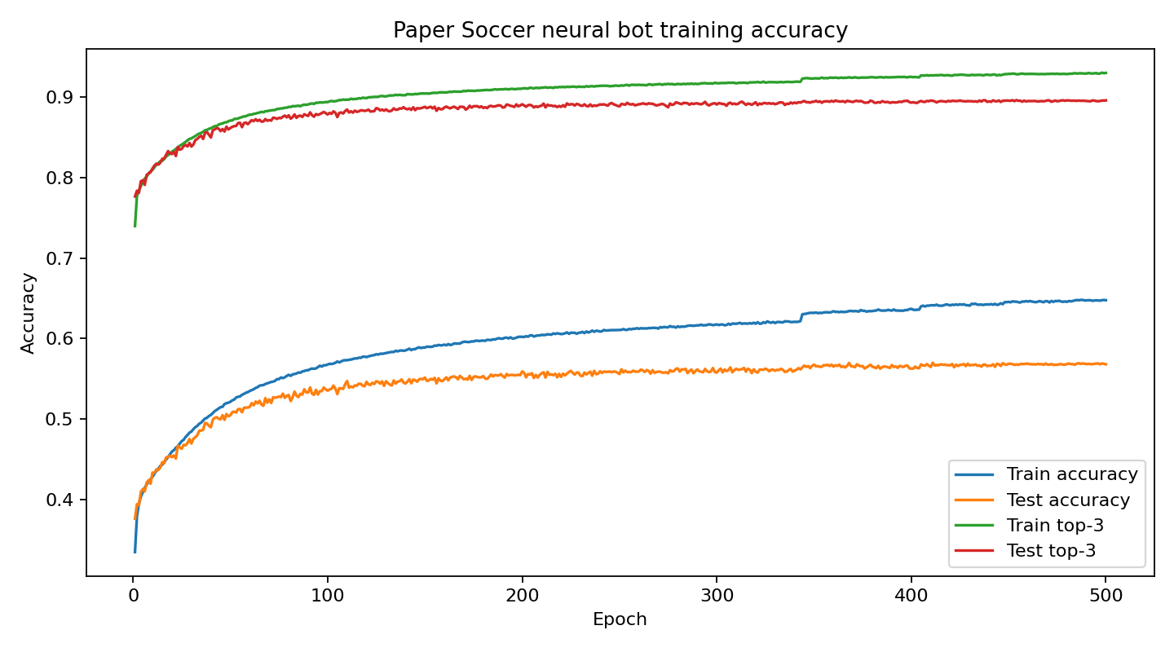
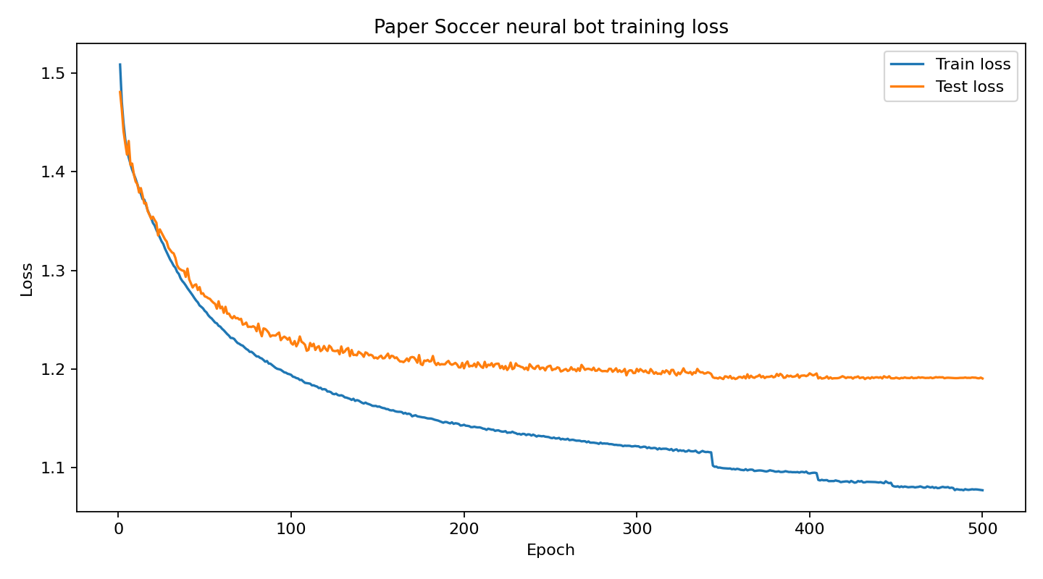
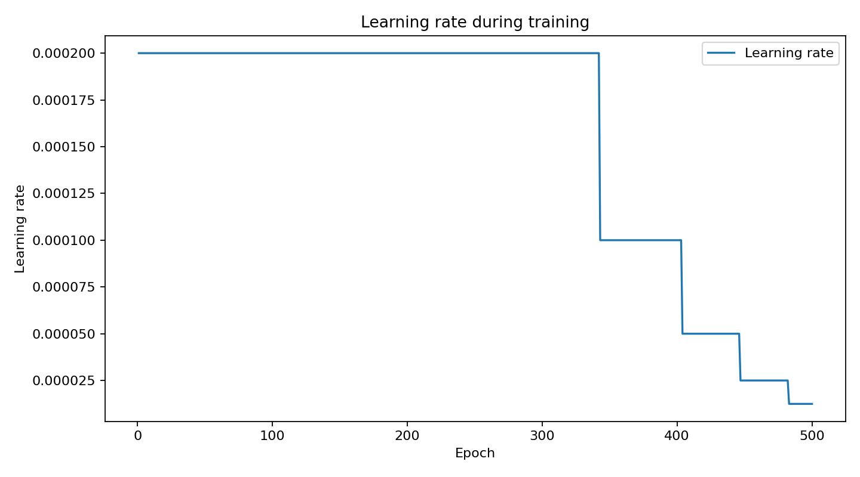
7. Training results
The model learned useful move preferences
• Accuracy plot: exact accuracy improves steadily, while top-3 reaches almost 90%.
• Loss plot: training loss keeps decreasing, test loss stabilizes.
• Learning rate plot: scheduler lowers LR after plateaus, allowing finer updates.
Best test accuracy: 0.5698
Best test top-3 accuracy: 0.8955
Notes:
Explain that top-3 matters because several moves can be almost equally good in Paper Soccer.

Slide 9
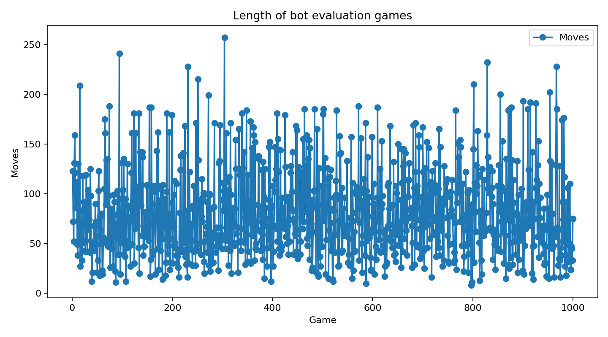
8. Evaluation
The neural bot became competitive with a hand-written heuristic approach
Final match result
1000 games · neural vs heuristic
Neural
448 wins
Heuristic
552 wins
We tested bots in automatic bot-vs-bot matches with random openings.
• neural bot is much faster than search during gameplay
• it uses one forward pass + legal move masking
• it learned useful move preferences from search-generated states
• it became competitive without hand-written strategy rules
Final results:
1000 games, neural vs heuristic
448 neural wins, 552 heuristic wins
Notes:
End with a short live demo if time allows. Mention that the goal was not a perfect bot, but a full ML pipeline.

