Slide 1
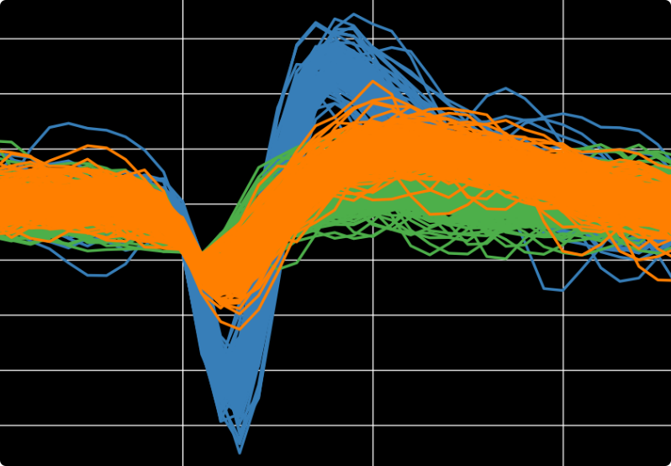
NeuroSorter
Biomedical Neuroengineering Research Group at UMH

Slide 2
How to install
A - Requisites:
1- git and pip installed
2- python >= 3.7
B - Open a terminal and type:
1- git clone https://github.com/mikelval82/NeuroSorter-Interface.git
2- cd NeuroSorter-Interface
3- pip install -r requirements.txt

Slide 3
How to run
A - Open a terminal and type:
1- cd NeuroSorter-Interface/AUTO_SPIKE_SORTING_GUI
2- python3 AUTO_SPIKE_SORTING_GUI.py

Slide 4
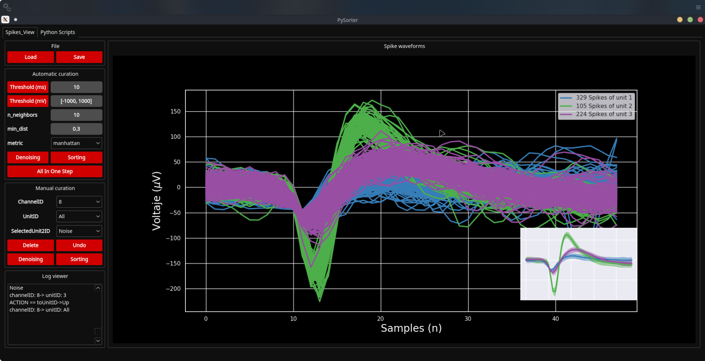
GUI description

Slide 5

GUI description
1-Load: Loads nev and custom mat or npy file types. Several files can be loaded together.
2-Save: Saves in custom npy file type. Save the same numbers of files that are loaded and with the same name + ‘_processed’.
Data is structured as a python dictionary both during data management and in custom npy files:
spike_dict = {‘FileName’:[corresponding ExperimentID],
’ExperimentID’:[expID per waveform],
‘ChannelID’:[channelID per waveform],
’UnitID’:[unitID per waveform],
’OldID’:[an index for undo action],
’TimeStamps’:[time stamp per waveform],
’Waveforms’:[list of waveforms]
}

Slide 6
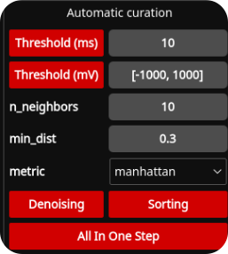
GUI description
1- CrossTalk (ms): A sliding window of 10 ms is applied over the temporal information. If spike events happen in more than 10 channels at the same bin they are removed. This is only valid for Berna’s experiments!!
2- Threshold (mv): Every waveform out of the specified range is removed.
3- Denoising: Template and clustering based spikes detection.
4- Sorting: UMAP clustering followed by similarity measures to merge similar clusters.
5- All In One Step: Push this button and take a coffe, everything is done after a while!!!

Slide 7
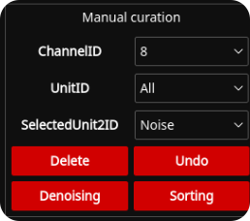
GUI description
1- ChannelID combobox: Allows to visualize spikes waveforms for each channel.
2- UnitID combobox: Allows to visulize spikes waveforms for the selected unit ID regarding the selected channel in the ChannelID combobox.
3- SelectedUnit2ID: [Alt+Num] Selected waveforms are sent to the selected unit in the combobox widget.
4- Delete: [Ctrl+d] Selected waveforms are sent to Noise unit.
5- Undo: [Ctrl+z] Undoes the last action performed.
6- Denoising: [Ctrl+c] Same as in automatic but for the selected [channelID].
7- Sorting: [Ctrl+s] Same as in automatic but for the selected [channelID/UnitID].

Slide 8
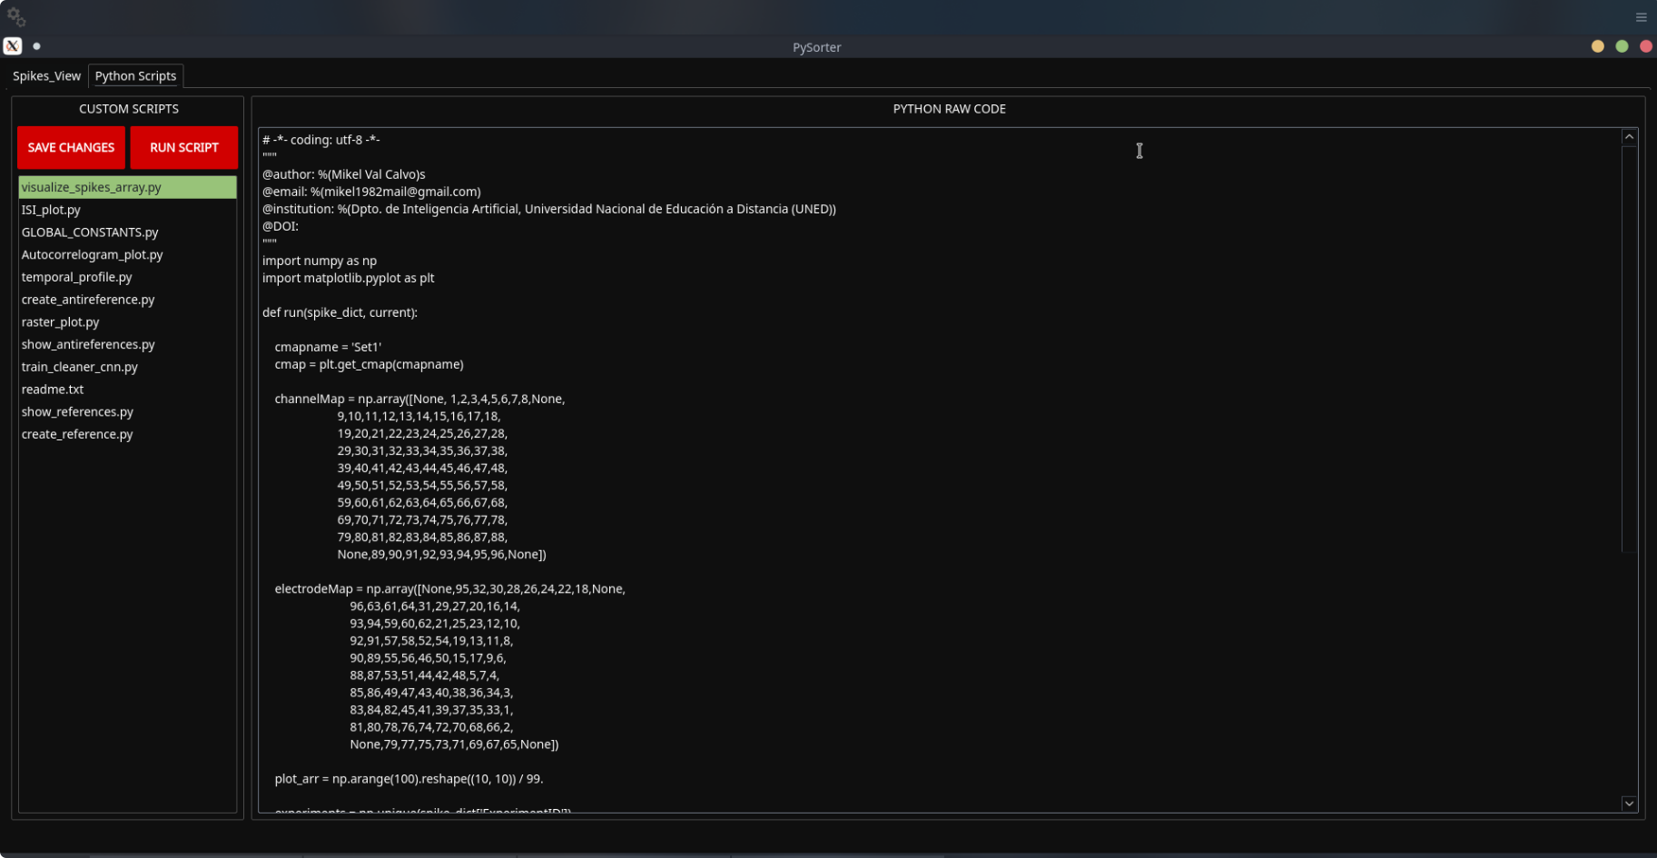
GUI description

Slide 9
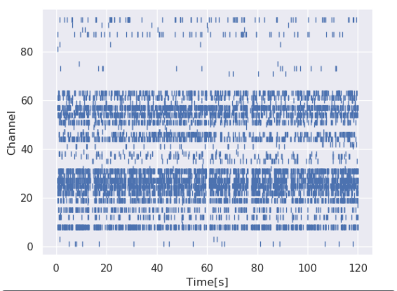
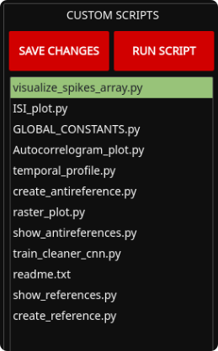
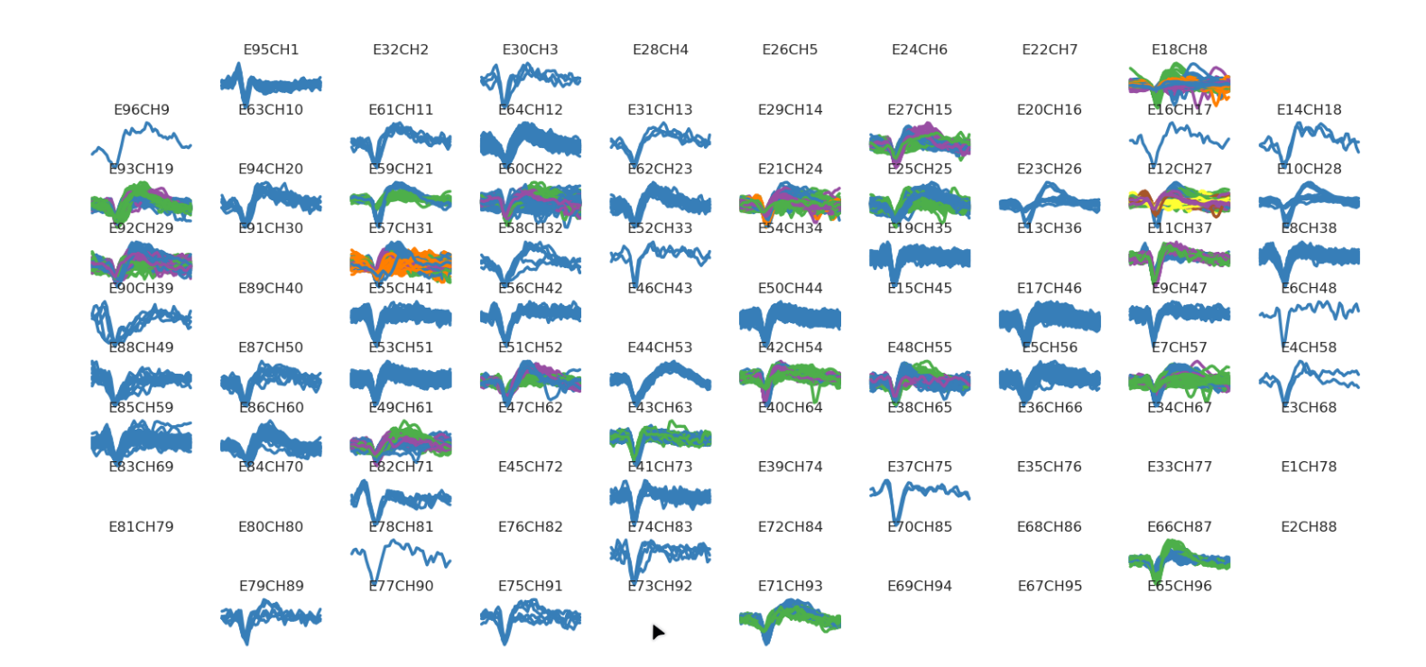
GUI description
1- visualize_spikes_array
2- raster_plot
3- show_references
4- show_antireferences
5- create_reference
6- create_antireference

Slide 10
Still under development so feedback is mandatory!!!
THANKS!!

