Slide 1
Virtual Environments for Communicating Changing Forests
Michael J Mahoney Colin M Beier Aidan C Ackerman

Slide 2
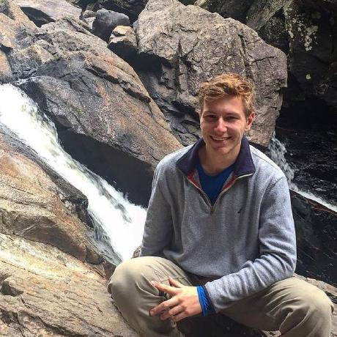
About Me
Mike Mahoney
3rd Year PhD Student (GPES)
Based in Cambridge, MA
Focusing on visualization, VR and ML as ways to think about large-scale systems
These slides: mm218.dev/lab2022

