Slide 1
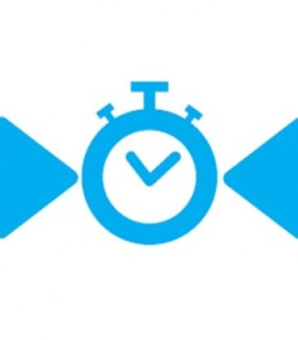
ASP.NET SignalR
Presented by Mike

Slide 2
Content
Quick Refresh
Hub And Persistent Connection
SignalR Definition
WebSocket, SSE, Forever Frame & Long Polling
Conclusion
Question Time

Slide 3
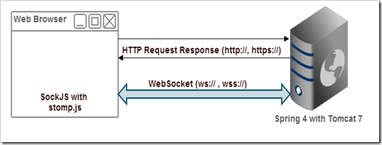
Quick Refresh
How Does Http Request and WebSocket Work ?

Slide 4
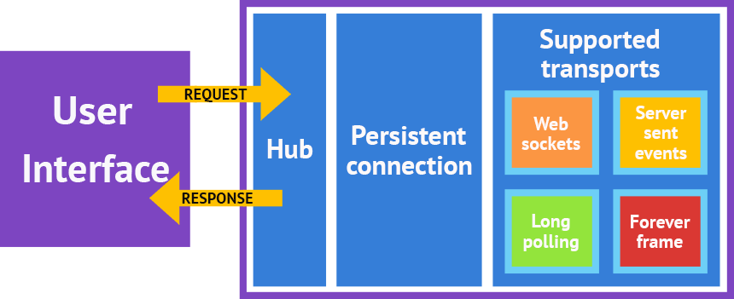
Hub And Persistent Connection

Slide 5
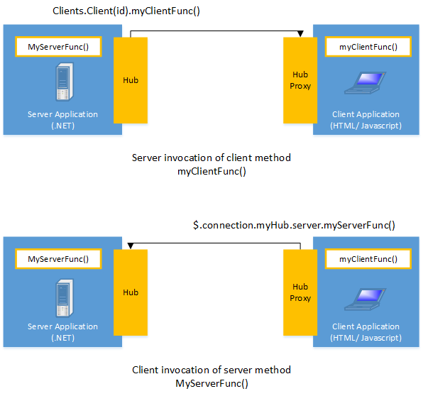
SignalR Definition
Library
Realtime application
Bi-directional communication
Support WebSocket and other techniques
APIs (management, grouping and authorization)

Slide 6
WebSocket, Event Source, Forever Frame and Long Polling
Transport Protocol | WebSocket | SSE (Server Sent Event) | Forever Frame | Long Polling
Connection | Always Open | Always Open | Always Open | Open / Close
Browsers | Firefox, Chrome and Safari | All Browsers except Internet Explorer | Internet Explorer | Old Browsers
How does it work ? | HTTP Handshake Process (agreement) | Object Event Source | Hidden Iframe | Opening pipe (AJAX)
Difference (S: Server / C: Client) | Asynchronous S/C Push and Receive data from browser (Full-duplex) | Event-stream Simplex Asynchronous S Push Only | Separate channel Support Iframe S Push Only | By Default Old technique Expensive Costs: CPU/Memory/ban-dwidth C Pull

Slide 7
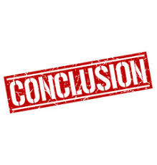
SignalR
Build Realtime application
Different Transports
No worries about WebSocket details - low level
Enjoy and Love !

Slide 8

Time For Questions

