Slide 1
J2K Library Overview
Background
Driven by GGEO-0068M3-PR-FINAL
RAD_0181: The Radar Application shall produce numerically lossless JPEG2000 (J2K) compressed WBID products in accordance with the NSG Product Compression Methods (NSGPCM)
RAD_0191: The Radar Application shall produce visually lossless JPEG2000 (J2K) compressed WBID products in accordance with the NSG Product Compression Methods (NSGPCM)
RAD_0192: The Radar Application shall produce numerically lossless reconstruction of uncompressed JPEG2000 (J2K) compressed WBID products from numerically lossless J2K compressed WBID products
Direction given by Mike Barth
Support WBID App
Provide flexibility to support non-WBID imagery as well as WBID imagery
Features of the J2K Library
Uses the FOSS OpenJPEG library at the heart of the algorithm
Provides both numerically and visually lossless compression
Provides decompression of both numerically and visually lossless compressed images
Provides support for mono-chromatic (single-component) and poly-chromatic (multi-component) images
Provides support for images of arbitrary precision (bits per pixel) as well as both signed and unsigned pixel values
Provides support for tiled images (this is at the heart of the J2K library algorithms)
Provides support for use of Spark for parallel compression of tiles
Uncompressed image tiles are input in an RDD
Compressed J2K images (codestreams) are returned in an RDD

Slide 2
J2K Library Architecture
CPA J2K Library
cpaj2k.j2klib (python)
clibj2k.py
libj2k.so
C - CPA
Client App
j2k_compress.py
j2k_decompress.py
libopenjp2.so
C - FOSS
J2kCompressRDD

Slide 3
Memory Management
Python
C
…
cpaj2k.j2klib.ctypes
libj2k.so
create_ image(…):
id = libj2k.create_image(…)
data id
ptr
Conceptual Demo Only
Not actual code.
…
13
0x12345678
14
NULL
15
NULL
free_ image(id):
libj2k.free_image(id)
16
0x12348765
…
int create_ image(…)
{
p = opj_create_image(…)
id = next_id++
id_map[id] = p
return id
}
libopenjp2.so
DataId
opj_create_image(…)
self.data_id
self.data_type
free_ image_id(int id)
{
p = id_map[data_id]
if( p != NULL) {
opj_free_image(p)
id_map[data_id] = NULL
}
}
opj_free_ image(ptr)
__del__():

Slide 4
J2K Library Modules
cpaj2k.j2klib
API
internal
j2k_compress.py
j2k_version.py
codestream.py
j2k_decompress.py
util
markers
combine_tiles.py
factory.py
const.py
spark
compress_single_tile.py
find.py
com.py
siz.py
compress_j2k_rdd.py
separate_tiles.py
marker.py
ppm.py
sot.py
j2k_rdd_codestream.py
validate_tiles.py
segment.py
qcc.py
tlm.py
S3.py
transform
error.py
tile_info.py
update_tile.py
clibj2k.py

Slide 5
J2K Compression (non-Spark)
Package: cpj2k.j2klib.j2k_compress
Function: compress
Invocation Parameters
Uncompressed Image
tiles | required | list of pixel data in numpy arrays, one per tile
num_rows | required | number of rows of tiles in image
bpp | 8 | significant number of bits per pixel
sgnd | False | flag set if pixel values are signed
Compression Parameters
compression_type | NL | NL (numerically) or VL (visually) lossless
profile | optional | NPJE or EPJE (not currently supported)
levels | optional | number of decomposition levels
layers | optional | number bit encoding layers
alloc_type | optional | BPP (bits per pixel) or PSNR (peak signal to noise ratio)
alloc_values | optional | list of desired BPP or PSNR achieved with each added layer
prog_order | optional | LRCP or RLCP – bit ordering within encoded layer
Additional Parameters
timeout | 900 | time before compression times out (0=no timeout)
Output Results
Compressed Image
codestream | bytes | J2K codestream for image
J2KLRA TRE Data
nlevels | integer | number of decomposition levels
nlayers | integer | number of bit encoding layer
bitrates | list of float | target BPP achieved with each layer
Notes:
Specifying a profile overrides levels, layers, alloc_type, alloc_values, and prog_order
If not otherwise specified, levels, layers, alloc_type, alloc_values, and prog_order default to their NPJE values

Slide 6
J2K Compression (Spark)
Package: cpj2k.j2klib.spark.compress_j2k_rdd
Class: J2kCompressRDD
J2kCompressRDD Attributes
Compression Parameters
compression_type | NL | NL (numerically) or VL (visually) lossless
profile | optional | NPJE or EPJE (not currently supported)
levels | optional | number of decomposition levels
layers | optional | number bit encoding layers
alloc_type | optional | BPP (bits per pixel) or PSNR (peak signal to noise ratio)
alloc_values | optional | list of desired BPP or PSNR achieved with each added layer
prog_order | optional | LRCP or RLCP – bit ordering within encoded layer
Additional Parameters
timeout | 900 | time before compression times out (0=no timeout)
Output Results
Compressed Image
codestream | RDD | J2K codestreams, one for each tile in the image
J2KLRA TRE Data
nlevels | integer | number of decomposition levels
nlayers | integer | number of bit encoding layer
bitrates | list of float | target BPP achieved with each layer
Notes:
Only difference between Spark and non-Spark versions of compress is the use of RDDs to pass uncompressed pixel data on input and compressed codestreams on output
First tile in output RDD has image main header prepended to it
Last tile in output RDD has EOC marker appended to it
Invocation Parameters
Uncompressed Image
tiles | required | RDD of pixel data in numpy arrays, one per tile
num_rows | required | number of rows of tiles in image
bpp | 8 | significant number of bits per pixel
sgnd | False | flag set if pixel values are signed

Slide 7
J2K Decompression (non-Spark)
Package: cpj2k.j2klib.j2k_decompress
Function: decompress
Invocation Parameters
Compressed Image
codestream | required | J2K codestream for entire image
resolution | 0 | image size downsampling factor (0=full size)
layers | 0 | decompressed image quality factor (0=fullest quality)
Additional Parameters
timeout | 900 | time before decompression times out (0=no timeout)
Output Results
Uncompressed Image
pixels | numpy array | Single array for entire image

Slide 8
Numerically vs. Visually Lossless Compression
Numerically Lossless | Visually Lossless
Uses perfectly invertible wavelet transform of image | Uses nearly invertible wavelet transform of image
Retains all bits in encoding of the transform coefficients | Retains only most important bits in encoding of the transform coefficients
Able to perfectly reconstruct the original image from the compressed data | Able to reconstruct a reasonably good facsimile of the original image from the compressed data… as far as can be perceived by visual inspection
 | Able to achieve higher compression ratio
Supports decompression at lower resolution than original image | Supports decompression at lower resolution than original image
Supports decompression at lower image quality than original image | Supports decompression at lower image quality than original image

Slide 9
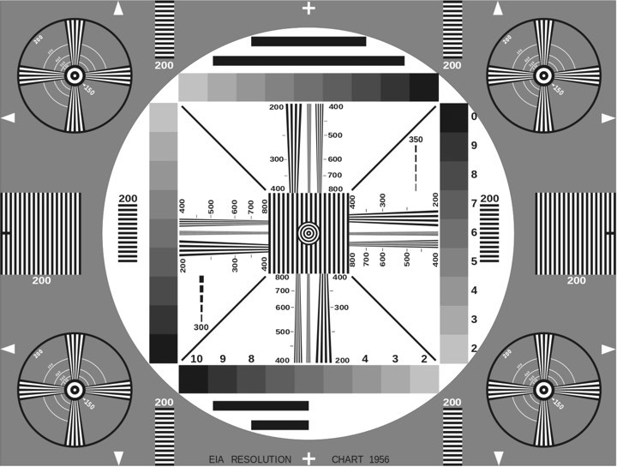
Original Image

Slide 10
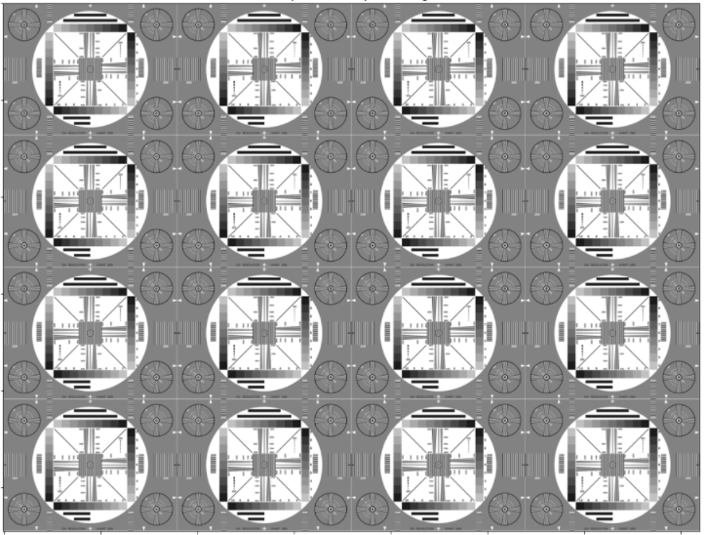
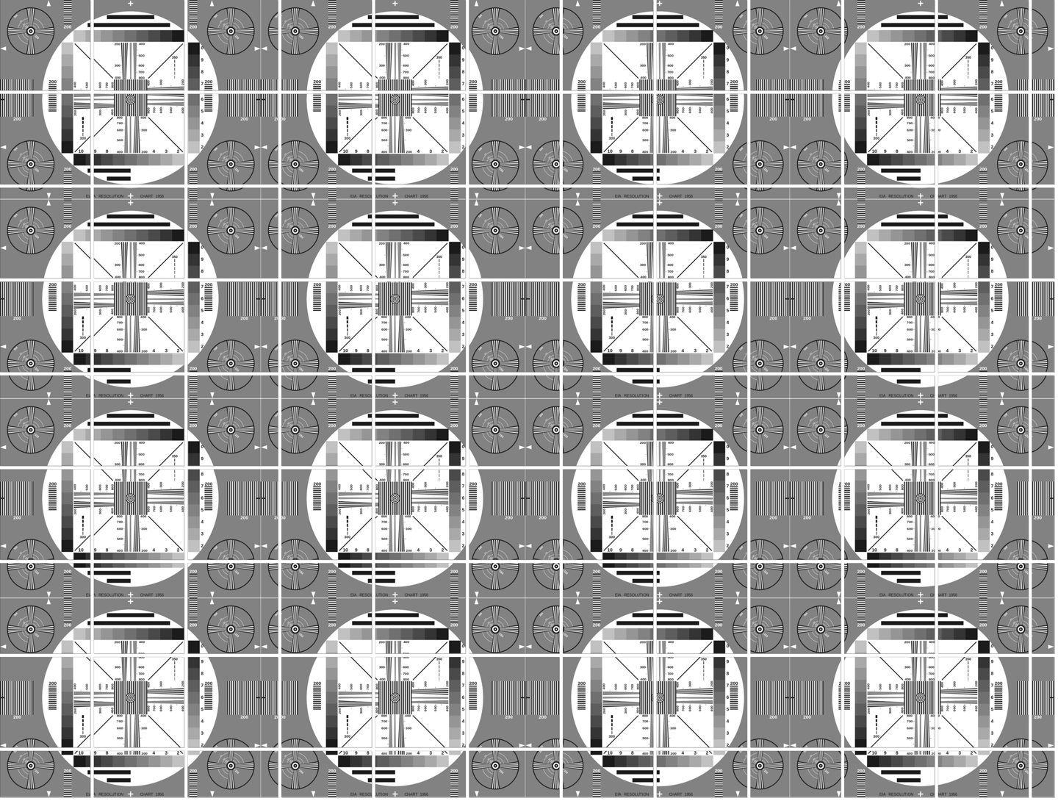
Tiling of Large (8720x11520) Image
All tiles except those in last row and last column must be same shape (width and height)
All tiles in last row must have same height and must have same width as all other tiles in their column
All tiles in last column must have same width and must have same height as all other tiles in their row

Slide 11

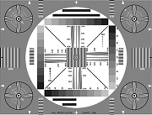



Reduced Number of Decompression Levels

Slide 12
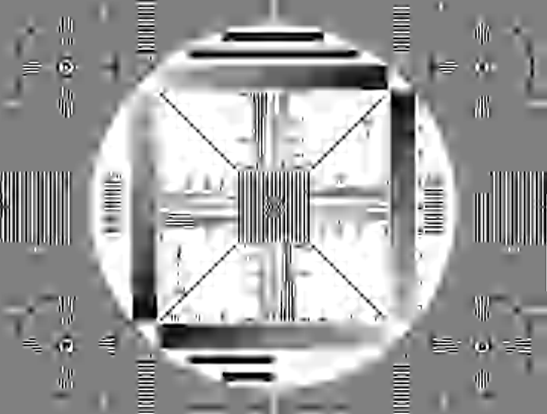



Reduced Number of Decoded Layers
1 Layer Decoded (PSNR=17dB)
3 Layers Decoded (PSNR=22dB)
All 20 Layers Decoded
5 Layers Decoded (PSNR=32dB)
15 Layers Decoded (PSNR=48dB)

