Slide 1
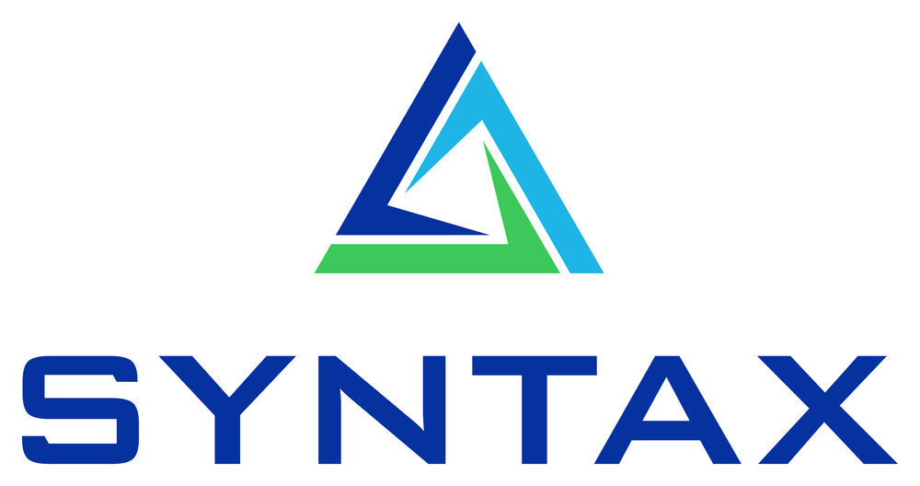
Automating EBS Contract Renewals
An AI agent for Blanket Purchase Agreement renewals — built with the Oracle Private Agent Factory
Syntax Corporation · Private Agent Factory series

Slide 2
THE PROBLEM
Renewals are a slow, error-prone bottleneck
Manual & tedious
Escalation creep
Coverage gaps
No audit trail
Buyers re-key supplier price lists into EBS interface tables, agreement by agreement.
Above-market price increases slip through; no consistent tolerance is applied.
Agreements lapse or overlap; renewals miss the contiguous term.
Hard to show why a renewal was accepted or held.
Syntax Corporation · Confidential
2

Slide 3
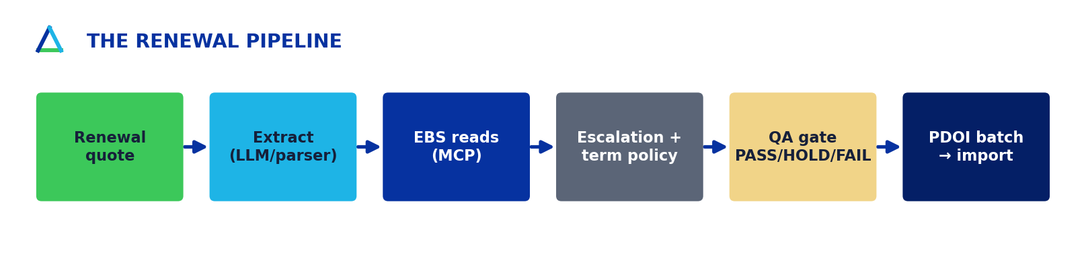
THE SOLUTION
One agent, end-to-end — read-only by default
Ingest a supplier renewal quote → pull current prices from EBS via a governed MCP → apply deterministic renewal policy → stage a balanced PDOI batch for Import Price Catalogs. The buyer approves the renewed agreement in EBS — the agent never auto-approves a contract.
Syntax Corporation · Confidential
3

Slide 4
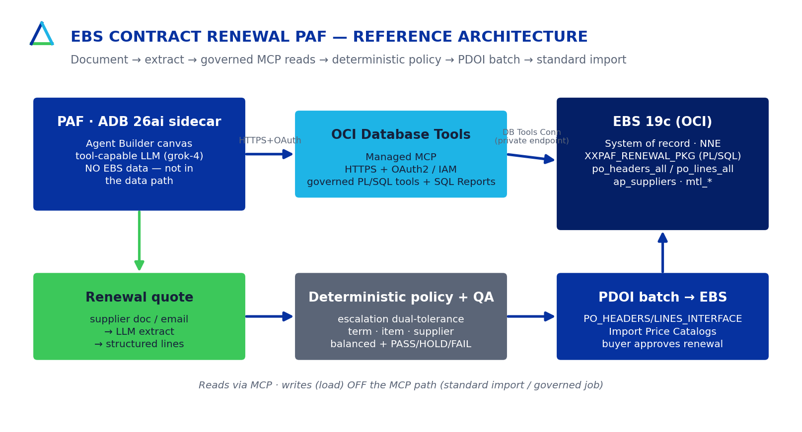
ARCHITECTURE
EBS 19c · PAF sidecar · managed MCP
Syntax Corporation · Confidential
4

Slide 5
DETERMINISTIC POLICY
Auditable rules — outside the LLM
Price escalation
Hold only when the increase breaches BOTH a 7% cap AND a $250 annual-impact floor — real over-charges caught, trivial ones ignored.
Term
Contiguous with the expiring agreement; length ≤ 36 months.
Validity
Item still active/orderable; supplier site active.
Balance & QA
Header AMOUNT_AGREED = Σ(price×qty); PASS / HOLD / FAIL gate before any load.
Syntax Corporation · Confidential
5

Slide 6
PROOF
Verified live against EBS Vision
51
BPA 4467
$17,920
100%
tests green
(43 hermetic + 8 live)
golden record
HVAC Express, 5 lines
balanced renewal
batch (Σ price×qty)
SQL + write contract
verified on the real DB
Python↔PL/SQL parity validated live; PDOI batch round-tripped through the real PO_HEADERS_INTERFACE / PO_LINES_INTERFACE and rolled back clean.
Syntax Corporation · Confidential
6

Slide 7
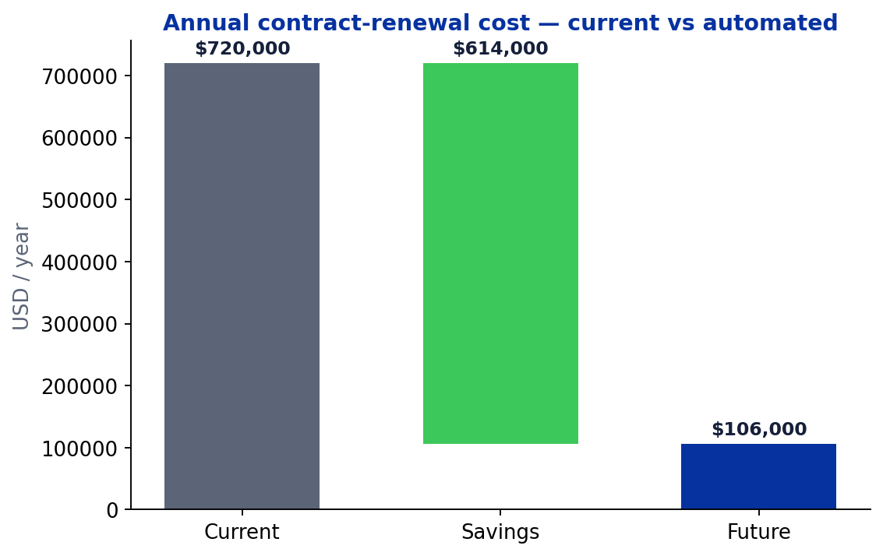
BUSINESS CASE
Payback in weeks, not years
$614,000
net annual savings
1.4 mo
payback
466%
3-year ROI
Syntax Corporation · Confidential
7

Slide 8
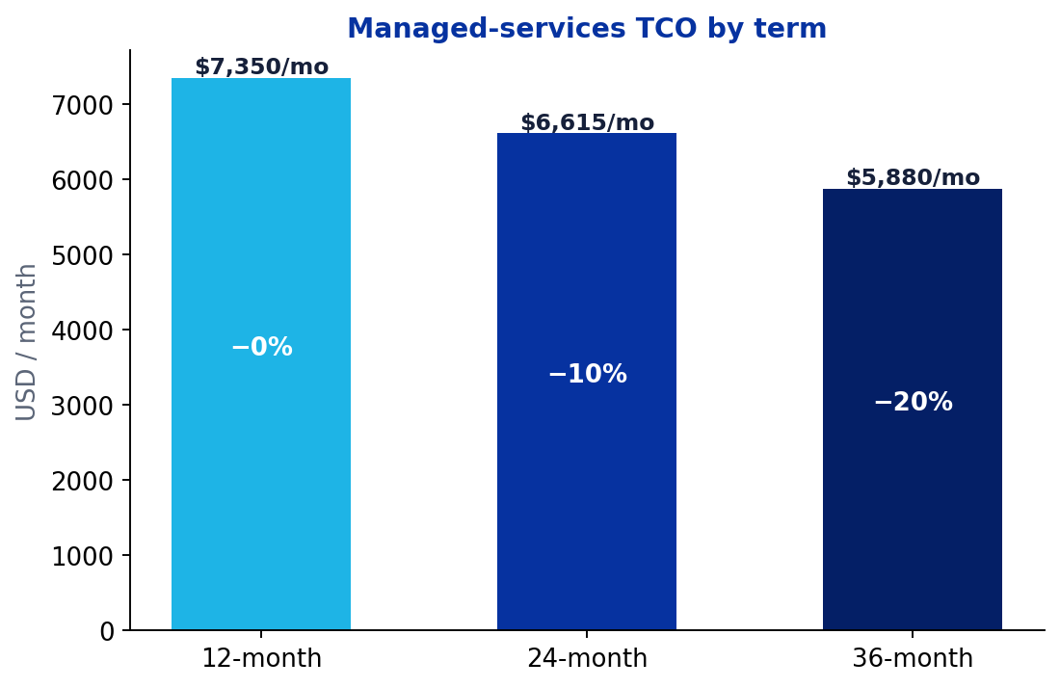
COMMERCIALS
Transparent, fixed-fee + managed services
Fixed-fee implementation: $60,800 · 8 weeks · $95/hr blended
Managed services / month
12-month
$7,350/mo
−0%
24-month
$6,615/mo
−10%
36-month
$5,880/mo
−20%
Syntax Corporation · Confidential
8

Slide 9
Renew every agreement — accurately, on time, on policy.
Start with a read-only value assessment against your EBS data.
Syntax Corporation © 2026 · Confidential

