Slide 1
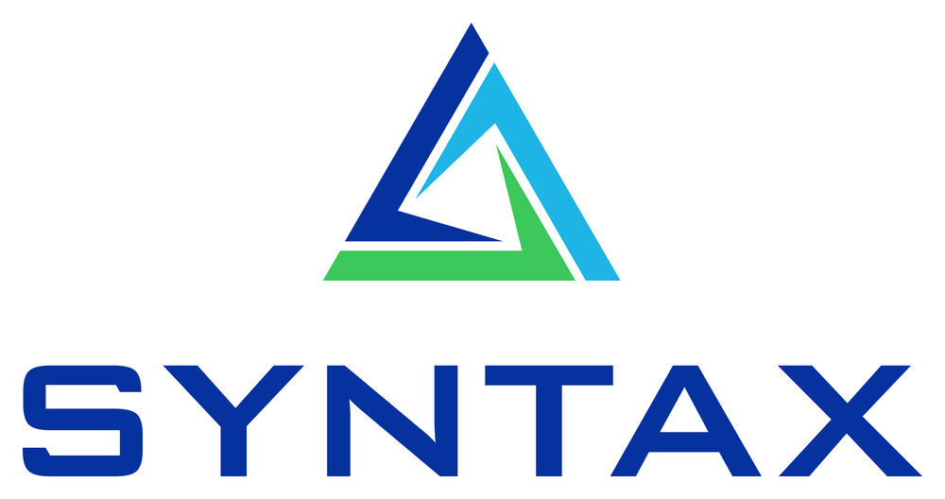
PAF Agent Factory
Deliverables Catalog
Everything every engagement ships — one branded, QA-gated, no-drift set.
Oracle Private Agent Factory 26.4 · domain-neutral core

Slide 2
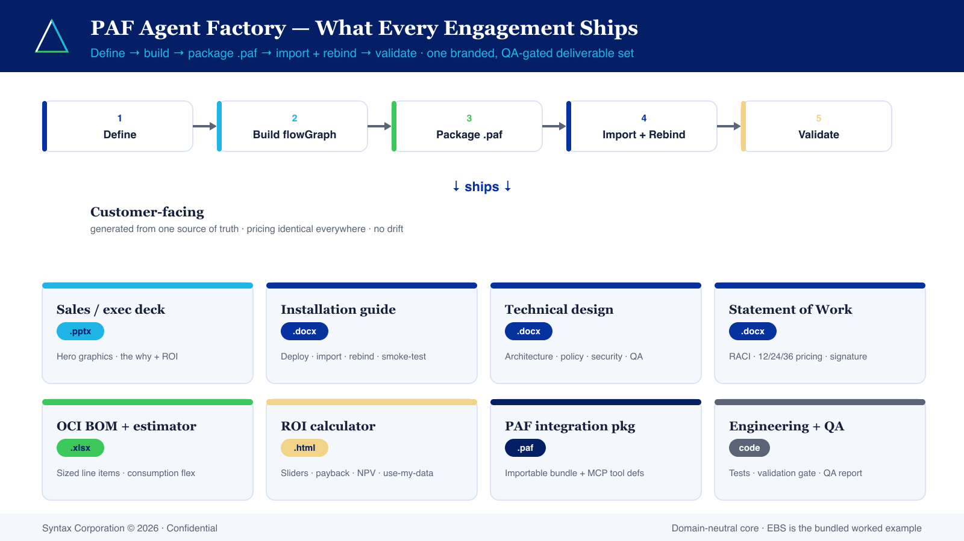
What every engagement ships
Define → build → package .paf → import + rebind → validate
Syntax Corporation © 2026 · Confidential
2

Slide 3
Customer-facing deliverables
Generated from one source of truth — pricing identical everywhere
Sales / exec deck
Installation guide
Technical design
Statement of Work
.pptx
.docx
.docx
.docx
The why: problem, agentic solution, architecture, ROI headline. Hero graphics.
Prereqs, deploy, register MCP, import .paf, rebind, smoke-test.
Architecture, policy, interface contract, security, QA strategy + diagram.
Scope, RACI, milestones, 12/24/36-mo pricing, signature. Generic legal shell.
OCI BOM + estimator
ROI calculator
PAF integration pkg
Monitoring & obs TDD
.xlsx
.html
.paf
.docx
Sized line items (ADB/PAF, managed MCP, GenAI) + consumption flex.
Interactive payback / NPV; 'use my data' mode. Same pricing inputs.
Importable bundle (password simple4u) + MCP tool defs + canvas recipe.
Two-plane supervision design (Plane A traces + Plane B availability) + CxHub data contract. Per-tenancy.
Syntax Corporation © 2026 · Confidential
3

Slide 4
Engineering & governance deliverables
Proof the agent is correct — not just plausible
The agent
Reference engine
Domain logic
bundle
code
PL/SQL
.paf bundle(s) + Agent Spec content + clone-able flowGraph templates.
Typed pipeline — reference impl + mock + test oracle.
System-of-record runs the logic (e.g. EBS XX… package) + MCP tool defs.
Test suite
Validation gate
QA report
pytest
gate
report
Hermetic + live golden + parity + packager round-trip tests.
Ground-truth scenarios + HITL + guardrails. Zero unsafe actions = PASS.
Bug-hunt-to-zero record + honesty register.
Syntax Corporation © 2026 · Confidential
4

Slide 5
Adult supervision
Two-plane monitoring — platform availability + agent observability, one pane
Plane A · Agent observability
Plane B · Platform availability
THE DIFFERENTIATOR
TABLE STAKES
Every run traced — step, tool call, LLM call; latency and cost attributed per run, agent and time window
Tool-call success rate flags a degraded MCP server or ERP backend before users feel it
Automated evaluators score groundedness and tool-call validity — quality without storing payloads
Synthetic probes replicate every PAF connection — DB 26ai, model endpoint, MCP, egress
Credential-expiry calendar and config-drift watch catch silent outages before they fire
SLA-backed: PAF/UI 99.5%, DB reachability 99.9%, MCP tool-call success ≥ 98%
Ships as: Monitoring & observability TDD (.docx) · CxHub data contract (.json) · Plane B probe set · per-agent OAuth audit chain
Generation is the giveaway; supervision is the product — the recurring value the foundation fee funds.
Syntax Corporation © 2026 · Confidential
5

Slide 6
Built right
Why the deliverables are trustworthy
1
2
3
Single source of truth
QA-gated
One brand, hero graphics
Customer files are generated from in-repo markdown + one pricing model. Edit the source, regenerate — deck, SOW, and ROI never disagree.
Nothing is generated until the QA gate is green: hermetic + live + parity tests pass, and the validation gate shows zero unsafe actions.
Every artifact reads from one brand source (palette, fonts, logo, tri-color motif); hero diagrams render once and are reused across deck / design / SOW.
Syntax Corporation © 2026 · Confidential
6

Slide 7
Where deliverables are created
Reusable catalog + per-engagement artifacts
The factory (reusable)
The engagement (the actual files)
paf_claud_skill
references/deliverables.md — the recipe
deliverables/ — this catalog doc + showcase deck
templates/deliverables/ — the generators
core/ — the importable .paf + validation gate
the agent's own git repo
deliverables/ — the .docx / .xlsx / .html / .pptx
slides/ — the deck + hero-diagram generators
e.g. EBS-Contract-Renewal-PAF (the EBS AP agent)
Syntax Corporation © 2026 · Confidential
7

Slide 8
One factory. Every deliverable.
Domain-neutral core · EBS bundled · branded, QA-gated, reproducible.
Syntax Corporation © 2026 · Confidential

