Slide 1
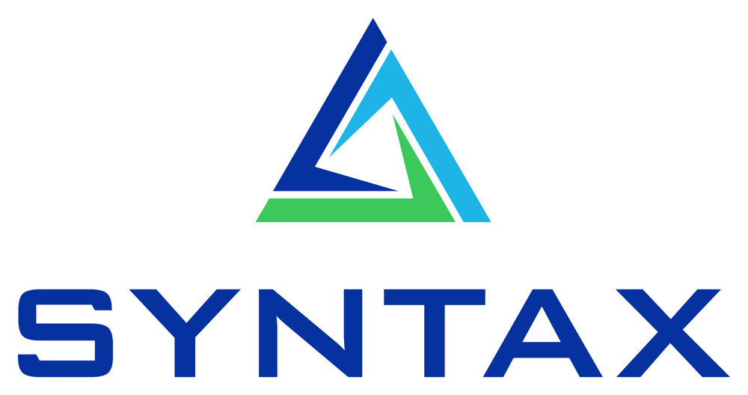
PRIVATE AGENT FACTORY · ORACLE E-BUSINESS SUITE
AP Invoice Automation Agent
Invoice-to-Match for EBS — extract, 3-way match, and code supplier invoices straight into the Payables Open Interface, validated against your live EBS data.
$2–3
~$930K
100%
cost / invoice, automated
annual value (50K invoices)
audit trail preserved
Syntax Corporation © 2026

Slide 2



THE PROBLEM
Manual AP is slow, costly, and error-prone
$12–15
8–10 days
1–3%
fully-loaded cost to process one invoice by hand
typical cycle time — late payments, missed discounts
of spend lost to duplicate and over-billed invoices
AP automation is a $3B+ category with multiple unicorns. Every EBS shop runs tens of thousands to millions of invoices a year — and pays incumbents $3–8 each.
Syntax Corporation · Confidential
2

Slide 3




THE SOLUTION
An EBS-native agent that does the AP grunt work
Reads any invoice
Checks live EBS
PDF, email or text — a deterministic parser (zero external deps) with an optional LLM for messy/scanned docs.
Supplier, PO, receipts, tax and GL — read-only, org-scoped lookups against the real E-Business Suite.
Matches & codes
Validates & delivers
Deterministic 3-way match with price/qty tolerances, GL distribution inheritance and tax classification.
A QA gate proves every invoice balances before it writes balanced AP Open Interface files.
Same agentic pattern as Oracle's Private Agent Factory contract-renewal blog — pointed at the far larger AP revenue pool.
Syntax Corporation · Confidential
3

Slide 4
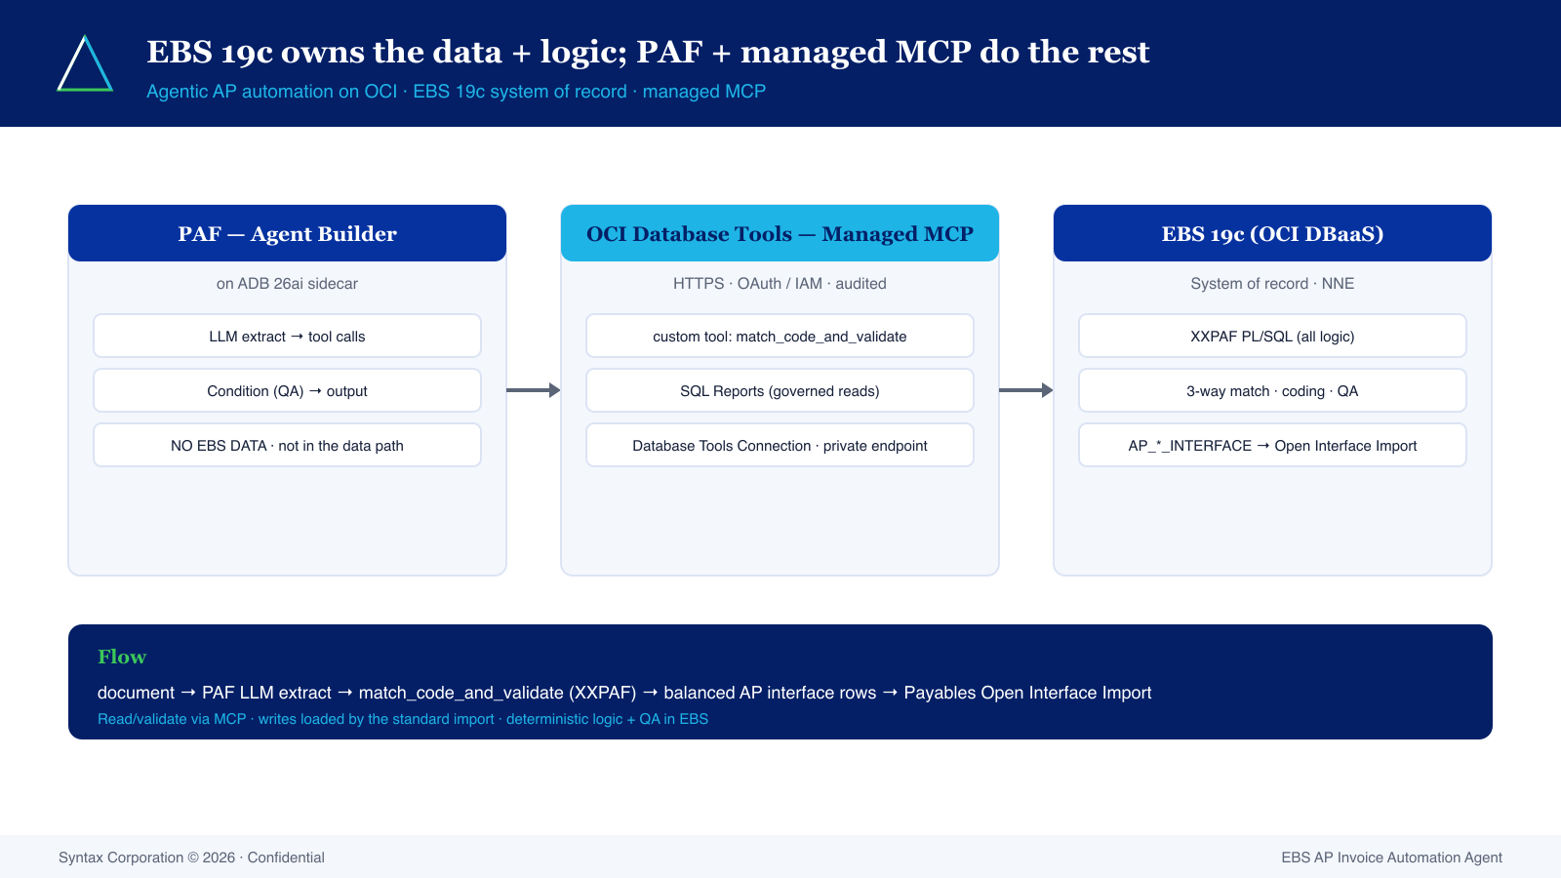
ARCHITECTURE
EBS 19c owns the data + logic; PAF + managed MCP do the rest
Syntax Corporation · Confidential
4

Slide 5


TRUST & CONTROL
Built for auditors, not just speed
Read-only by design
Multi-org safe
Only SELECTs against EBS; the single write path is off by default and touches interface tables only.
Org-scoped queries + FND_GLOBAL.APPS_INITIALIZE context; bind variables everywhere — no injection surface.
Deterministic policy
QA gate before load
Match, tolerance and coding rules live outside the LLM — reproducible and explainable for SOX.
Every invoice is checked to balance, reconcile and resolve all FKs; failures are held, never imported.
Every interface row is stamped with the agent run-id and a confidence score — traceable end to end.
Syntax Corporation · Confidential
5

Slide 6
PROVEN ON LIVE EBS VISION DATA
Real invoice. Real PO. Clean match.
Purchase Order 3495
Advanced Network Devices · Org 204 · Oracle EBS 19c Vision
4 lines
monitors, RAM, hard drives
QA STATUS
PASS
500 / 500
invoiced vs received on every line
01-520-7530-0000-000
All 4 lines auto-approved · 0 errors · loadable
GL distribution inherited from the PO
Verified against the live database during the build — not a mock.
$632,500.00
invoice total — header balances to lines
Syntax Corporation · Confidential

Slide 7
BUSINESS CASE
~$930K of annual value at 50K invoices/yr
Agent list price
$25K–$50K
per year, priced per invoice
20–40×
return on the agent fee — with margin to share with partners.
Net ~$822,520/yr · payback ~1.4 mo · implementation $30,400 (fixed)
Syntax Corporation · Confidential
7

Slide 8


WHY SYNTAX
The partner to put this into production
Deep EBS expertise
Reference build in hand
OCI + PAF aligned
Decades running Oracle E-Business Suite for enterprise customers — we know your AP, PO and GL setup.
A working, QA'd agent proven against live Vision data — not slideware. Ready to point at your instance.
Positioned for the Private Agent Factory motion on AI Database 26ai, with TCO and licensing mapped.
Syntax Corporation · Confidential
8

Slide 9
NEXT STEPS
Let's run it on your EBS instance
1
Discovery
2
Proof of value
3
Productionize
Confirm AP volumes, invoice mix and target operating unit.
Point the agent at a read-only EBS copy; demo a live 3-way match.
Deploy on PAF / 26ai with AME approvals and scheduled import.
Syntax Corporation © 2026 · EBS AP Invoice Automation Agent

