Slide 1
Webdam Interview
Home Test Assignment
Michael Menezes
May 31, 2017

Slide 2
Agenda
Objective
Design
Demo
Q&A

Slide 3
Objective
Test Interview APIs
GET
HEAD
Find Bugs
Automate the testing

Slide 4
Design
Build a Framework
Design Should be Extensible
Easy to Add Test Cases
Easy to test additional functions
Use BDD, Ruby
Have Built in reporting

Slide 5
Feature File
Scenario Outline: Validate the Retrieve asset GET API Given I have a validation token And the asset parameter is <asset_id> And the function is GET When I call the asset API Then I get the asset return code <code> and <assets> Examples: |code|asset_id|assets| |200 ||5| |200 |12342|1| |404 |1234567|0| |404 |-1|0| |404 |hello|0|

Slide 6
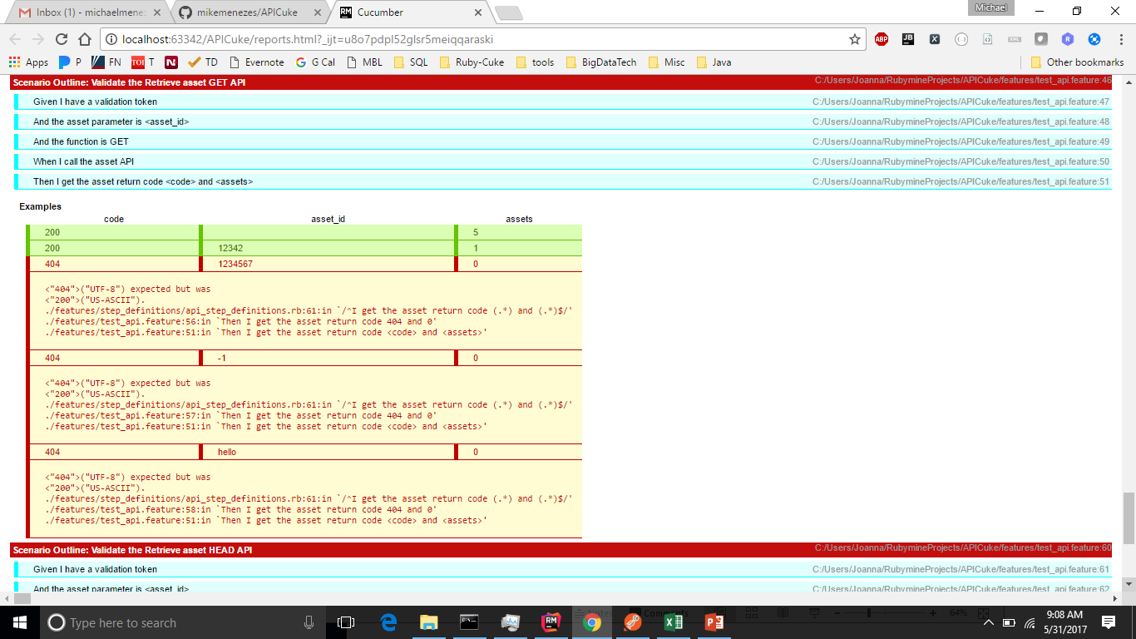
BDD Report

Slide 7
Demo

