Slide 1
Thermodynamic measurements of lithiation in graphite
-galvanostatic, GITT, entropy, enthalpy

Slide 2
Motivation
Need good quality data for model validation: several gaps in the literature:
  Half cell Li/graphite (OCV) measurements at variable T, conducted at sufficiently slow C-rate to extract meaningful thermodynamic parameters. Last systematic variable T experiments done by Aurbach circa 2000:
    Slow rate CV and PITT (3 electrode cell): but no data below 25 degrees C.
    Data from Argentina group: all done at room T.
  Apparent hysteresis between charge and discharge profiles – why?
  Role of surface versus bulk in low SOC features, and effect of T – more data needed to validate hypotheses.
  Entropy information:
    Existing data from Yazami – missing data at high SOC, experiments conducted with only one central temperature. Possible issues with experimental protocols.
    Very little analysis done to interpret the profiles – no modelling.
    Enthalpy profiles (from same experiments): could shed insight into the nature of the transitions between different stages (two phase versus solid solution) and low SOC transitions.
    Parameters from inelastic neutron scattering experiments (Debye temperatures) exist already: possibility to get quantitative information on vibrational as well as configurational entropy and their T dependence.
Controlled temperature Li/graphite coin cell experiments, in combination with atomistic-based models, have the potential to address all or most of the above!

Slide 3
Experimental plan
We have a starting sample with a mean CHECK 20 micron particle size (from Sigma-Aldrich).
  Conveniently, same graphite used by Manuel Otero in Cordoba.
  Synthetic graphite sample – and readily available!
Richard Fields (Manchester) has agreed to perform molecular sieving to control the particle size distribution (more small particles) and to perform BET analysis on these distributions:
  Change the mean surface/area to volume ratio.
  Experiments in Cordoba showed ball milling introduces extra oxygenated defects in between graphene planes.
Meanwhile, Miriam and Cindy made coins cells here with the raw 20 micron sample, with intentionally low mass loading.
So far experiments have been conducted at 25 degrees, or a central T = 25 degrees, but evental aim is to examine high and low T to provide maximum data to validate the models.

Slide 4
Structure (20 microns, 25 degree central T)
Part 1: preformation cycles (C/10).
Part 2: slower (C/50) galvanostatic profiles.
Part 3: dQ/dV and dV/dQ from C/50.
Part 4: high resolution GITT (charge and discharge)
Part 5: IN PROGRESS high resolution entropy profiling (charge and discharge)
(Note all C rates are based on the theoretical capacity of 372 mAh/g)

Slide 5
Part 1: preformation cycles
These are standard protocols that we adopted after consulting with Manuel Otero (Cordoba) and Konstantinos Antonopoulos (TUM).
Was done as first thing on each cell:
  to ensure stable SEI formation
  To check the general electrochemistry and feaures of graphite before moving on to the much slower measurements.
  All preformation done at 25 degrees C.
  A 20 min rest period was performed between each charge and discharge.

Slide 6
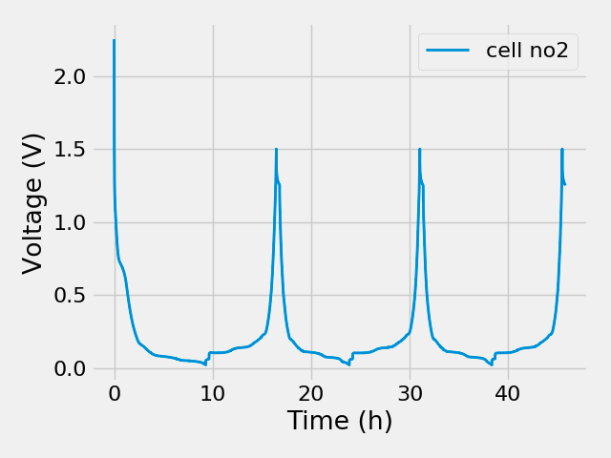
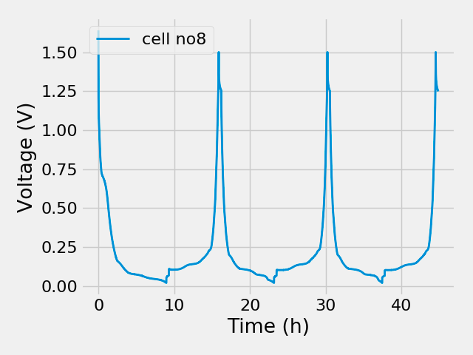
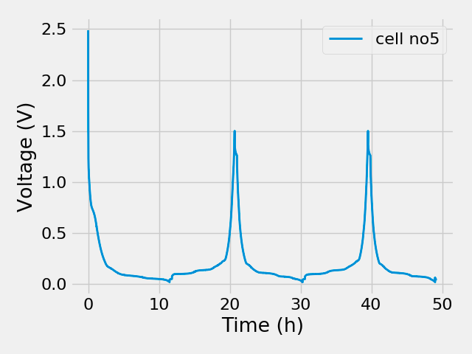
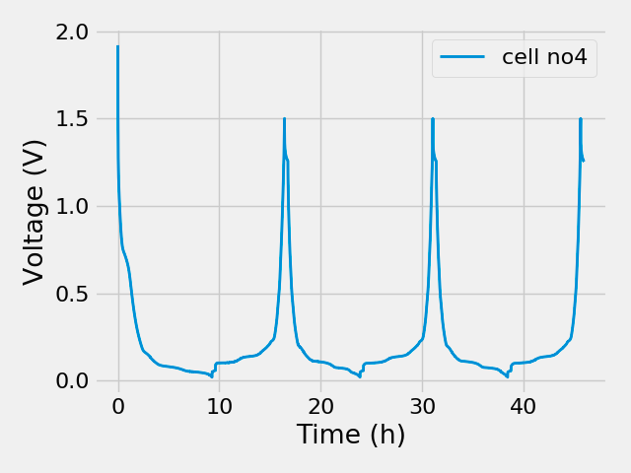
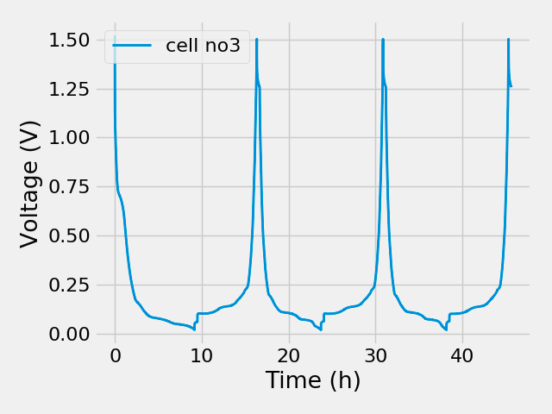
Results: preformation (C/10)
T = 25 degrees

Slide 7
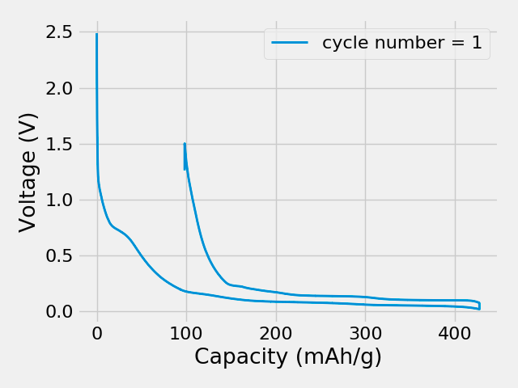
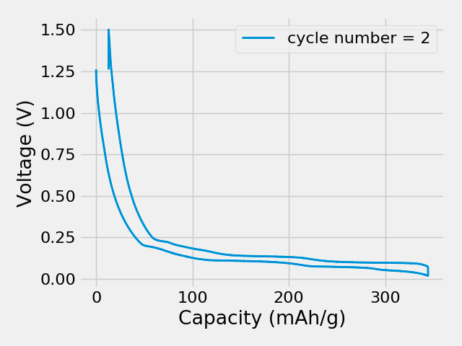
Capacity 1st and 2nd cycles (C/10)
Discharge
Charge
Cell 5
T = 25 degrees
All cells showed an irreversible loss of capacity after first discharge: SEI formation

Slide 8
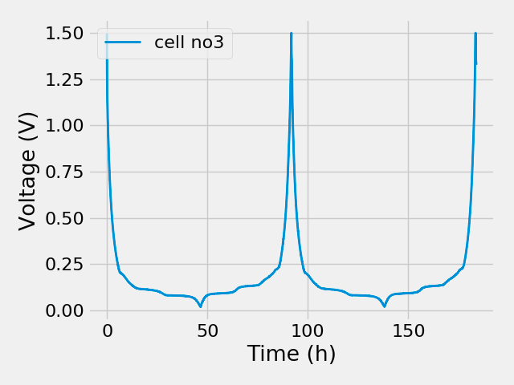
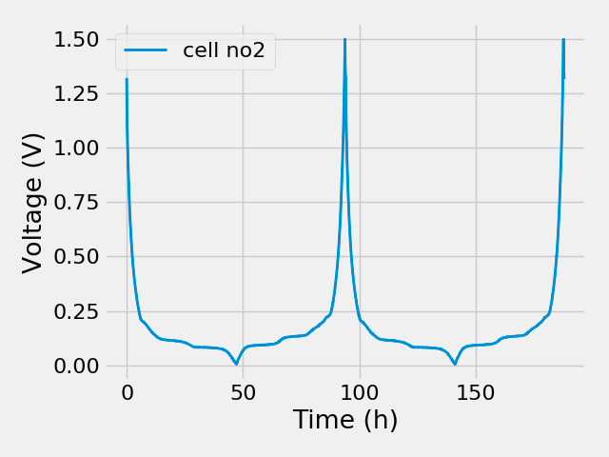
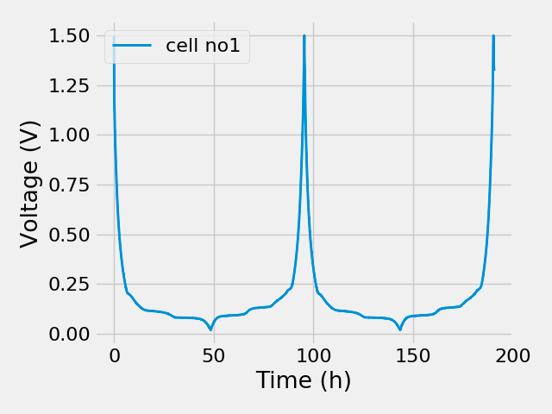
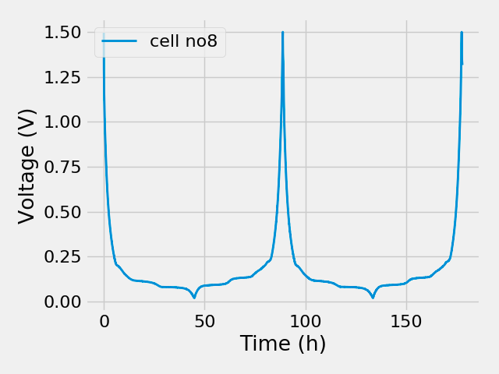

Part 2: C/50 (after preformation cycles)
T = 25 degrees, all performed after constant voltage step at 1.5 V
for at least 30 minutes

Slide 9
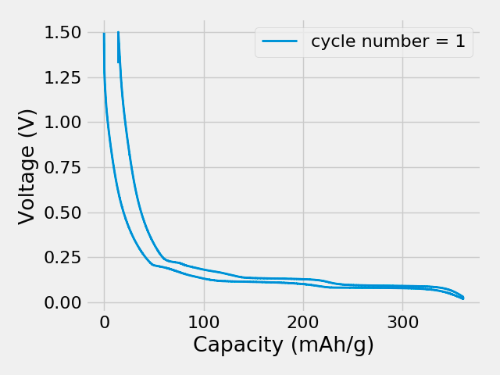

Capacity (C/50)
First cycle
Second cycle
Cell 1
T = 25 degrees

Slide 10
Determination of max and min state of charge (SOC)
Tricky:
  High SOC limit: < 0 V Li. Therefore impossible to achieve theoretical 372 mAh/g based on perfect LiC6 structure.
  Low SOC limit – possible overlap with interfacial processes (SEI formation may not be completely irreversible as commonly assumed).
  Assume the theoretical capacity as the maximum, to enable a comparison with models.
  For now, assumed the cutoff at 1.5 V corresponds to the min SOC. This may result in some small error, reflected in the position of the Stage I – Stage II plateau (theoretcially at 50% SOC).

Slide 11
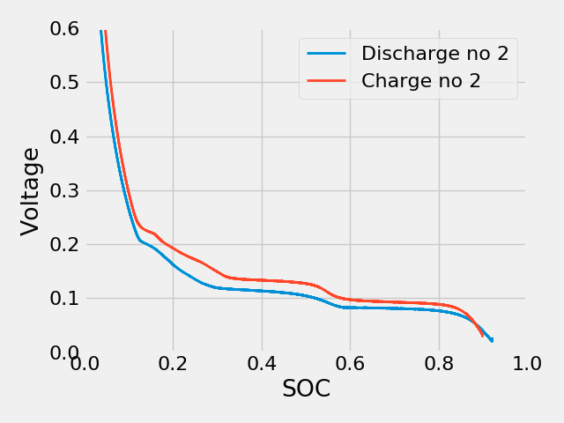
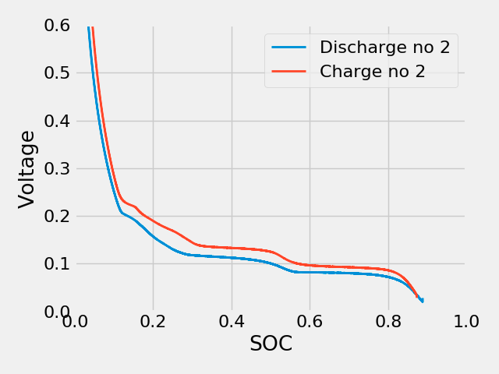
Voltage versus SOC (C/50)
Cell 3
Cell 8

Slide 12
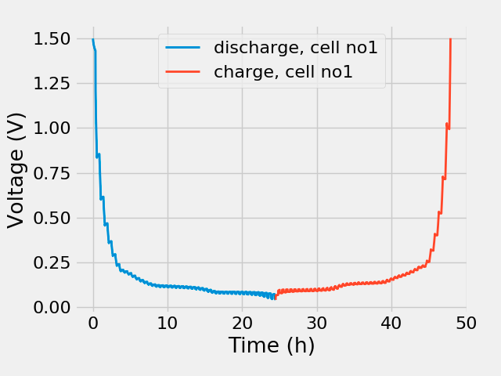
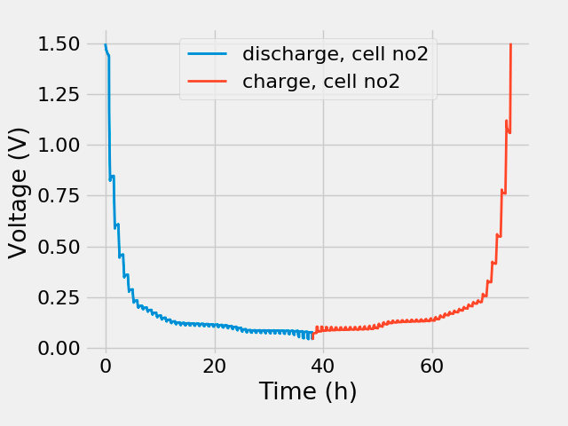
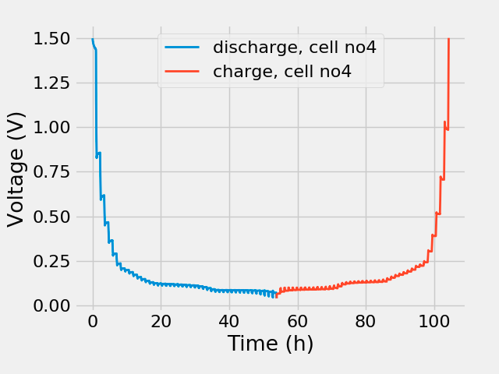
Part 3: galvanostatic intermittant titration technique (GITT)
One set of experiments with C/10 (12 minutes, 50 steps each charge and discharge) followed by variable relaxation time (20 mins, 40 mins, 60 mins)
20 mins relaxation
40 mins relaxation
60 mins relaxation

Slide 13
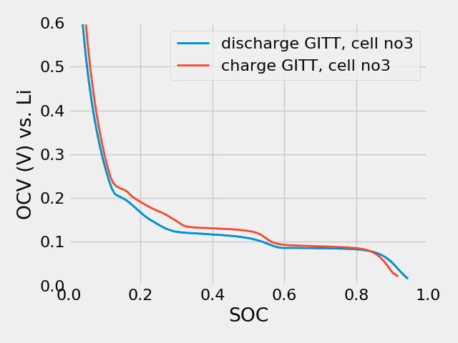
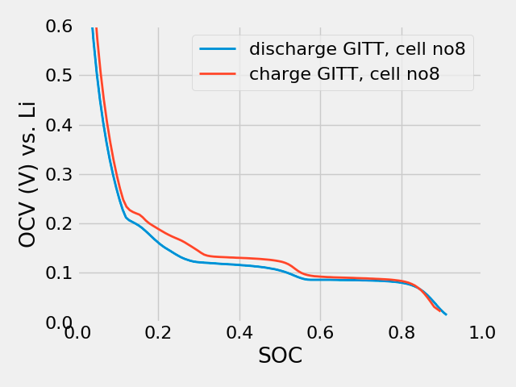
Effect of relaxation time
c.f. galvanostatic results at C/50
Note these cells were done with high resolution!

Slide 14
Part 3: dQ/dV and dV/dQ
These were just done on the second discharge and charge cycles at C/50.
Smoothing was applied with the following parameters: ADD LATER

Slide 15
Part 4: GITT
Following the procedure adopted in this paper: discharge for 12 minutes, followed by open circuit relaxation at variable times: 20 minutes, 40 minutes, 60 minutes.
The high resolution data were conducted with relaxation time = 20 minutes, and discharge steps 12 minutes at C/50 (a total of nearly 250 points each for charge and discharge).
So far conducted at T = 25 degrees, but will be repeated at other temperatures.

Slide 16
Effect of relaxation time

