Slide 1
Object storage vs Database
By Michael Moore

Slide 2
What is object Storage
Object Storage is a computer data storage architecture designed to handle large amounts of unstructured data
Files , images , videos, IOT, etc
Objects have 4 main components
I.D.(filename)
Data
Text, images, videos, blobs, etcs
Metadata (author,date_written, etc) data about the file
Attributes (Security, Who can and Cannot use the file in certain ways (read,write,execute)
The combination of the 4 components makes an unique object in the cloud

Slide 3
Object Storage(con’t)
All the space needed
Mainly Write Once Read Many Time
Versioning
Can store data for a long time
Replicate data
Security
Also makes it better for someone from a different part of the world can have access

Slide 4
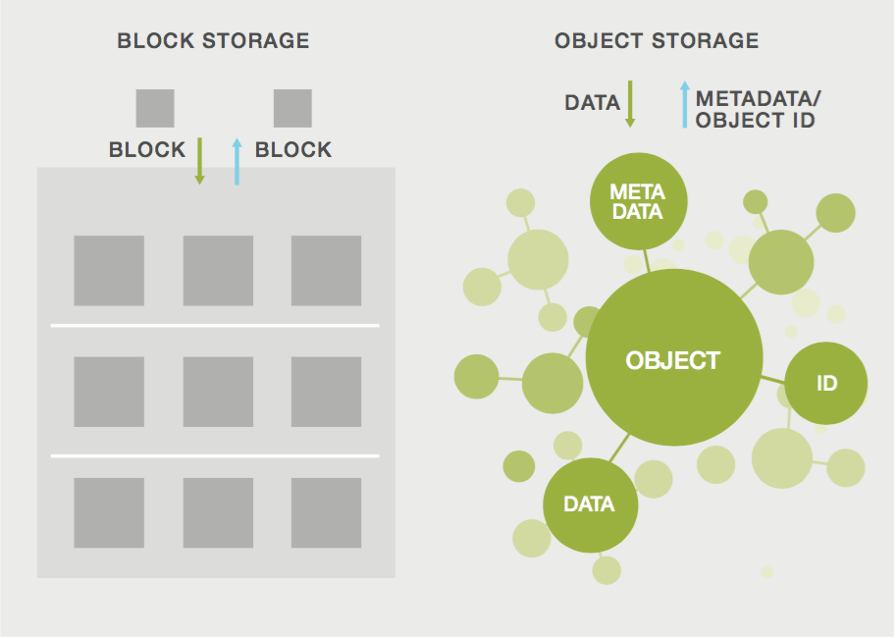

Slide 5
What is a Database
A Database is a collection of data.
Structured
Has rows and columns
Managed by a Database Management System
A Database usually stores relational tables
Uses a sql language to interact with the database
Database can do transactions, aggregations and transformation.

Slide 6
Database (con’t)
Types of database
Centralized
Cloud
Object oriented
NoSQL

