Slide 1

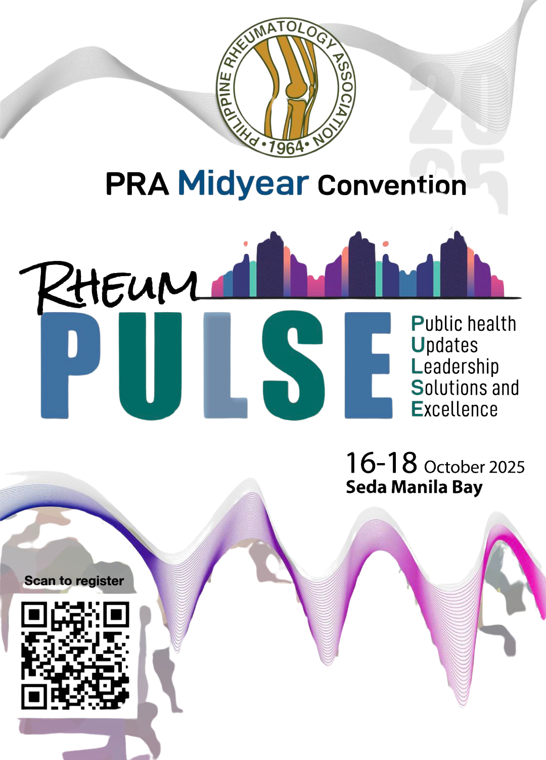



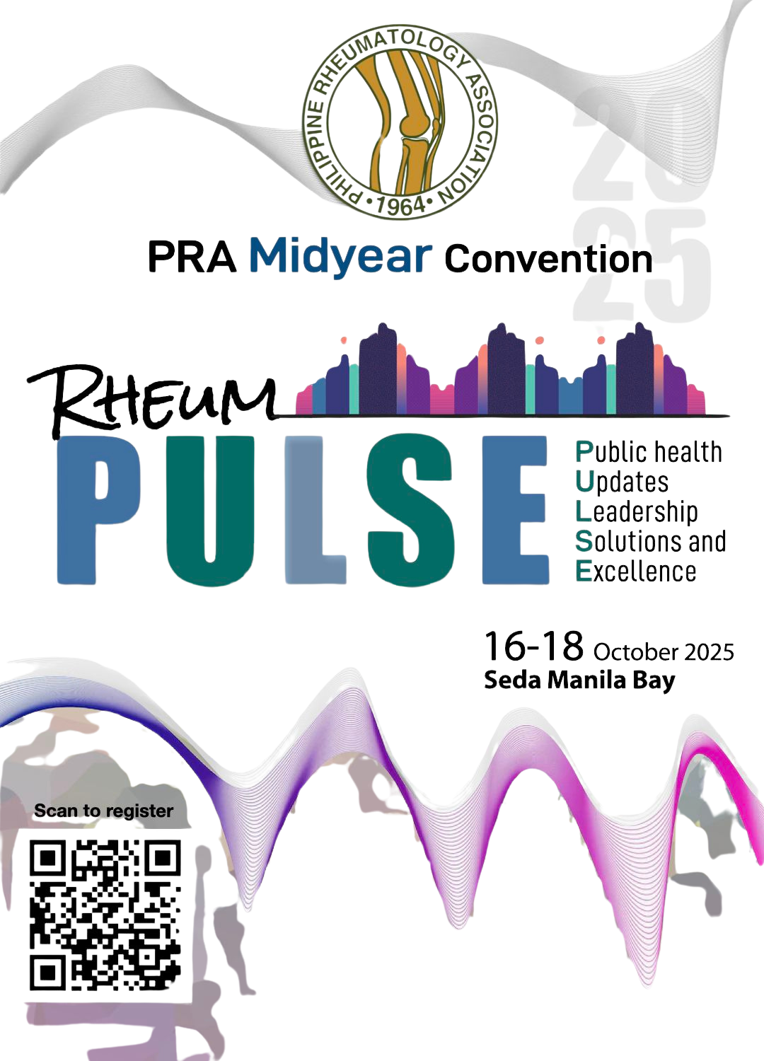
PHILIPPINE RHEUMATOLOGY ASSOCIATION
PRA Midyear Convention
October 16 - 18, 2025

Slide 2
Universal Health Care (UHC) and Electronic Medical Records (EMR)
Dr. Mike Muin
mikemuin@medprojects.com
Notes:
Welcome to this presentation on Universal Health Care and Electronic Medical Records. The UHC Law, Republic Act 11223, enacted in February 2019, establishes a framework to ensure that all Filipino citizens have equitable access to quality healthcare services. To support this ambitious goal, the UHC Law mandates the development of robust Health Information Systems, or HIS. The successful implementation of HIS is seen as the essential infrastructure of trust that allows UHC to function efficiently. Today, we will detail the specific requirements for Electronic Medical Records under UHC and discuss the real-world implications of their adoption or lack thereof.

Slide 3
The EMR Mandate and Core Components
UHC Law explicitly mandates Electronic Medical Records
Part of larger integrated system including:
  Electronic Prescription Logs (EPLs)
  Human Resource Information Systems (HRIS)
  Enterprise Resource Planning (ERP) systems
Primary functions:
  Efficient management of patient records
  Streamline healthcare service delivery
  Facilitate evidence-based decision-making
Notes:
The UHC Law explicitly mandates that Health Information Systems must include Electronic Medical Records, or EMRs. EMRs are defined as a digital version of a patient’s chart. These EMRs are part of a larger integrated system that also requires Electronic Prescription Logs, Human Resource Information Systems, and Enterprise Resource Planning systems. The primary function of these integrated systems is to enable the efficient management of patient records, streamline healthcare service delivery, and facilitate evidence-based decision-making across the Philippine health sector.

Slide 4
The Critical Requirement: Interoperability
UHC Law identifies interoperability as critical objective
Must have seamless data exchange across different platforms
Crucial for supporting continuity of care
Goal: Move away from fragmented data systems that disrupt care
Notes:
The UHC Law identifies interoperability as a critical objective. EMRs and associated HIS components are expected to be interoperable, enabling seamless data exchange across multiple platforms such as iClinicSys, iHOMIS, and PhilHealth’s eClaims system. Interoperability is crucial for supporting the continuity of care and efficient resource management across healthcare facilities. The ultimate goal is to move away from fragmented data systems that disrupt the continuity of patient care and hinder effective health system management.

Slide 5
Foundational Standards for EMR Compliance
Mandatory Adoption and Use of National Health Data Standards
  (JAO 2021-0002)
Key foundational standards:
  Client Identifier: PhilHealth ID or PSA National ID
  Messaging Standard: HL7 FHIR
  Clinical Terminology: SNOMED-CT
Standards Conformance and Interoperability Validation (SCIV) required
All systems must pass validation for compliance
Notes:
To ensure true interoperability, the Mandatory Adoption and Use of National Health Data Standards for Interoperability, outlined in JAO 2021-0002, is required. Key foundational registries and standards mandated for data exchange include the use of PhilHealth ID number or the PSA’s National ID for unique patient identification. The messaging standard is Health Level Seven Fast Healthcare Interoperability Resources, or HL7 FHIR, which is an international standard for exchanging healthcare information electronically. For clinical terminology, SNOMED-CT, or Systematized Nomenclature of Medicine Clinical Terms, is required for standardized medical documentation. Compliance with these standards is monitored through the Standards Conformance and Interoperability Validation framework.

Slide 6
EMRs and Financial Requirements
PhilHealth directed to incentivize HIS incorporation and integration
EMR systems must integrate with PhilHealth’s eClaims submission
Quality metrics linked to EMR-based evidence:
  Compliance with national practice guidelines
  Chronic disease management
  Patient outcomes
Aligns financing with clinical compliance and improved health outcomes
Notes:
PhilHealth is directed to incentivize the incorporation and integration of health information systems. EMR systems must integrate with PhilHealth’s eClaims submission system to streamline financial processes. It is recommended that PhilHealth link quality metrics, such as compliance with national practice guidelines and chronic disease management, to EMR-based evidence. This approach aligns financing with both clinical compliance and improved health outcomes, supporting a value-based care model.

Slide 7
Data Submission and National Repository
All health entities required to submit data to PhilHealth
Includes administrative, public health, medical, pharmaceutical data
National Health Data Repository (NHDR) established
NHDR serves as single point of submission
NHDR is authoritative repository of country’s health data
Data submission required for licensing and contracting arrangements
Notes:
All public and private, national and local health-related entities are required to submit health and health-related data to PhilHealth. This includes administrative, public health, medical, pharmaceutical, and health financing data. The National Health Data Repository, or NHDR, has been established as the single point of submission and authoritative repository of the country’s health and health-related data. Submission of data to the NHDR is a requirement in the licensing and contracting arrangements for health-related entities, making compliance essential for continued operations.

Slide 8
EMR Requirements in Health Systems
Stage 1: Foundational Readiness
  Baseline assessment, gaps analysis, and identification of investment needs
Stage 2: System Development and Capacity Building
  Functional EMR systems in P/CWHS facilities
  Must be capable of submitting reports to DOH/PhilHealth
Stage 3: Service Operationalization and Sustained Integration
  Validated EMR systems required
  Must link Primary Care Provider Networks to secondary and tertiary care
Patient records must be accessible throughout health system
Notes:
The realization of integrated local health systems mandates specific EMR functionality across networks. In Stage 2, called System Development and Capacity Building, functional EMR systems must be implemented among health facilities within the Province-wide or City-wide Health System, or P/CWHS, and must be capable of submitting reports to DOH and PhilHealth. In Stage 3, Service Operationalization and Sustained Integration, validated EMR systems must effectively link Primary Care Provider Networks to secondary and tertiary care providers within the P/CWHS. PCPNs, which form the foundation of Health Care Provider Networks, must ensure patient records are accessible throughout the health system.

Slide 9
Key EMR Features for UHC Success
Seamless data exchange and interoperability
Real-time information sharing capabilities
Support for referral system management
Core clinical modules:
  Laboratory and diagnostics
  Electronic prescription and dispensing
  Telemedicine
  Clinical decision support
  PhilHealth electronic claims processing
Notes:
Successful UHC implementation relies on EMRs transitioning from mere data storage tools to essential, interconnected operational platforms. The ability to exchange, interpret, and use data seamlessly is crucial for continuity of care, especially since the lack of interoperability often leads to fragmented data systems that disrupt patient care. EMRs must be capable of real-time information sharing and support patient navigation and coordination mechanisms to higher levels of care. A comprehensive HIS should encompass clinical modules such as laboratory and diagnostics, electronic prescription and dispensing, telemedicine, clinical decision support, and PhilHealth electronic claims processing.

Slide 10
Supporting Data-Driven Governance
EMRs must generate timely, accurate, and actionable data
Enables better decision-making and resource allocation
Supports evidence-informed policy and planning
Minimizes data entry burden for healthcare workers
Upholds patient privacy and confidentiality
Compliance with Data Privacy Act of 2012
Notes:
EMRs must be capable of generating timely, accurate, and actionable data. A strong and sustainable HIS ensures that health data enables better decision-making, efficient resource allocation, and improved health outcomes. The data generated are intended to guide research and evidence-informed sectoral policy and planning for UHC. Effective EMR solutions for front-line workers should maximize care delivery effectiveness and minimize the data entry burden. The system must uphold and protect patient privacy and confidentiality in compliance with the Data Privacy Act of 2012, ensuring that patient trust is maintained.

Slide 11
What Doctors Should Know: New Care Delivery Model
UHC emphasizes shift to prioritize primary care
EMRs enable Primary Care Providers as initial contact and navigator
EMRs should incorporate Clinical Practice Guidelines
Standardizes clinical care and improves quality
Reduces unexplained variation in practice
Core purpose:
  Systemic care quality and safety benefits
Notes:
Doctors, physicians, nurses, and other healthcare workers are critical users in the adoption of EMRs. Their understanding and adherence to the system are essential for UHC success. UHC emphasizes shifting the system to prioritize primary care. EMRs are critical to this shift, enabling the Primary Care Provider to serve effectively as the initial contact and navigator who guides patients toward cost-efficient and appropriate levels of care. EMRs should incorporate Clinical Practice Guidelines, which are essential for standardizing clinical care and improving the quality of care, reducing unexplained variation in practice, and managing costs. The core purpose of health information sharing is to provide systemic care quality and safety benefits to individual Filipinos.

Slide 12
Financial Accountability and Reimbursement
PhilHealth moving toward performance-driven payment mechanisms
EMRs track utilization and performance
Provider quality metrics linked to EMR-based evidence
EMRs crucial for electronic claims processing
Compliant EMR-generated submissions required for payment
Submissions must be recorded at point of care
Notes:
EMRs have a direct impact on financial accountability and reimbursement. PhilHealth is mandated to move towards performance-driven, prospective payment mechanisms like capitation and global budgets. EMRs are the platform used to track utilization and performance. PhilHealth aims to link provider quality metrics, such as adherence to guidelines and patient outcomes, to EMR-based evidence, supporting value-based care. EMRs are crucial for PhilHealth electronic claims processing and provider payment. Compliant, EMR-generated submissions recorded at the point of care are necessary to receive PhilHealth payments, making proper EMR use essential for financial sustainability.

Slide 13
Addressing the Data Burden
Current EMR implementations create significant data entry burden
Reduces healthcare workers’ capacity for direct care delivery
System should be built into end-user requirements
Goal:
  Maximize care delivery effectiveness
  Minimize data entry time and effort
Doctors’ data inputs feed National Health Data Repository
Critical role in providing timely, accurate information
Notes:
Doctors must recognize that current EMR implementations often result in a significant data entry burden that reduces their capacity for direct care delivery. They should note that the system should eventually be built into the end-user requirements for health providers and clinicians, maximizing care delivery effectiveness while minimizing data entry. The National Health Data Repository serves as the single source of truth for all health data, making doctors’ role critical in providing timely and accurate information for policy and planning. Addressing this data burden is essential to ensure that healthcare workers can focus on patient care while still contributing valuable data to the system.

Slide 14
Call to Action for Doctors (Part 1)
Champion digital adoption and transformation
Implement EMR systems that have passed validation
Use EMR real-time during patient encounters
No batch encoding after patient visits
Ensure data integrity at point of care
Use compliant, EMR-generated submissions exclusively
Review data in EMRs to maintain accuracy
Notes:
The call to action for doctors involves embracing digital transformation and ensuring rigorous data integrity. Doctors and clinicians should actively implement and utilize EMR systems that have passed validation and are SCIV compliant. They should ensure that the EMR is used real-time during patient encounters, not just for batch encoding later, which is currently a common practice hindering efficiency. Doctors must ensure data integrity by utilizing compliant, EMR-generated submissions recorded at the point of care, and require exclusive use of interoperable EMRs with no parallel non-interoperable systems. Clinicians and doctors should review the data in the EMRs to maintain accuracy and quality.

Slide 15
Call to Action for Doctors (Part 2)
Drive system improvement by articulating functional specifications
Advocate for systems with minimal data entry burden
Support incorporation of Integrated Care Pathways
Work with facility management to ensure EMR linkages
Use EMR for patient navigation and two-way referrals
Advocate for permanent positions for digital health teams
Notes:
Doctors must drive system improvement by articulating the functional specifications required for simple census tools and EMR solutions that minimize data entry burden. They should advocate for systems that incorporate Integrated Care Pathways into the workflow. Doctors should work with facility management to ensure their EMR links their Primary Care Provider Network to secondary and tertiary care providers within the Health Care Provider Network. This involves using the EMR for patient navigation and two-way referrals. Finally, doctors should push for the creation of permanent plantilla positions for digital health teams in hospitals and Rural Health Units to oversee EMR implementation and provide daily support such as configuration, data stewardship, user help, and connectivity management.

Slide 16
Benefits of Successful EMR Adoption
All stakeholders agree HIS is relevant to achieving UHC goals
Data-driven governance with timely, accurate, actionable data
Better policy decisions and resource allocation
Improved health outcomes through data coordination
Strong and interconnected referral systems
Expedites financial claims and hospital reimbursements
Financial efficiency across the healthcare system
Notes:
The benefits of successful EMR adoption are substantial. Across all surveyed sites, stakeholders including owners, implementers, and health workers uniformly agreed that HIS is either very relevant or relevant in achieving UHC goals, with 100% agreement among these groups. Strong and sustainable HIS ensures health data are timely, accurate, and actionable, enabling better policy decisions and resource allocation. Integrated systems improve health outcomes by enabling better data coordination and resource allocation. A fully functional HIS helps ensure strong and interconnected referral systems and expedites financial claims and hospital reimbursements from PhilHealth, leading to financial efficiency across the healthcare system.

Slide 17
Reality: Challenges in Implementation
Interoperability remains key challenge across integration sites
Referrals and patient history still paper-based
Proliferation of multiple systems:
  iClinicSys
  iHOMIS
  Google Forms
  Private EMRs
Healthcare workers use multiple systems simultaneously
Double or triple encoding of same information required
Notes:
Despite the mandate, the reality of implementation faces significant challenges. Interoperability remains a key challenge across all selected integration sites. For instance, referrals and patient history are often still paper-based between health centers and hospitals. There is a proliferation of multiple systems such as iClinicSys, iHOMIS, Google Forms, and private EMRs implemented concurrently, which suggests the need for a standardized system. Healthcare workers routinely face the burden of using multiple systems, often requiring double or even triple encoding of the same information. This is due partly to the lack of interoperable systems and creates significant inefficiency in the healthcare delivery process.

Slide 18
Continued Reliance on Paper Systems
Many facilities continue using paper-based systems
Causes:
  Financial constraints
  Inadequate equipment
  Poor internet connectivity
Common workaround: “Back encoding”
Data collected on paper first
Transferred to digital systems later
Undermines real-time data availability
Notes:
Many facilities continue to use paper-based systems due to financial constraints leading to inadequate equipment and poor internet connectivity. A standard workaround observed is what’s called back encoding, where staff collect data on paper first, then transfer it later to digital systems. This practice undermines the availability of real-time data and defeats the purpose of having an electronic medical record system. It also creates additional work for healthcare staff who must essentially document patient encounters twice, once on paper and again in the digital system.

Slide 19
Workforce and Financial Hurdles
Lack of human resources for HIS is pressing issue
Most ICT personnel hired under contractual arrangements
Results in high turnover and difficulty sustaining systems
Staff perform high-level ICT tasks beyond their skills
Financial constraints result in inadequate IT infrastructure
PhilHealth incentives for HIS not received by stakeholders
Some stakeholders unaware of incentivization
Notes:
The lack of human resources for health, particularly in HIS, is a pressing issue across all sites. Most ICT personnel are hired under contractual or job order arrangements, resulting in high turnover and difficulty sustaining systems. Staff often have to perform high-level ICT tasks beyond their skills and pay grade. Financial constraints result in inadequate IT infrastructure. Although PhilHealth is mandated to incentivize HIS, stakeholders reported they do not receive the said incentives, and some are even unaware that such incentivization exists. These workforce and financial hurdles create significant barriers to successful EMR implementation and sustainability.

Slide 20
Impact on Patients and Claims
Lack of interoperability affects patient care
Data duplication issues with PhilHealth ID numbers
Inconsistent patient identification across systems
Persistent problem of claim rejections
Reimbursement concerns for patients and providers
Delays in receiving healthcare funding
Financial strain on healthcare organizations
Notes:
The impact of these challenges extends directly to patients. The lack of interoperability and data duplication, such as inconsistent PhilHealth ID numbers, leads to a persistent problem of claim rejections and reimbursement concerns. This directly affects patients’ ability to acquire healthcare funding and places financial strain on healthcare organizations. When claims are rejected or delayed, patients may face unexpected out-of-pocket expenses, and healthcare facilities may struggle with cash flow issues. These problems undermine the core UHC goal of ensuring equitable access to affordable, quality healthcare services for all Filipinos.

Slide 21
Consequences of Non-Standard Systems
Current PhilHealth e-claims systems use APIs
Not compliant with standardized FHIR messaging
Risk: Proliferation of multiple non-standard API endpoints
Each system integration requires custom development
Significantly increases development costs and complexity
Reduces system reliability and data consistency
Makes maintenance and updates more difficult
Notes:
Current PhilHealth e-claims systems often use Application Programming Interfaces or APIs but are not compliant with the standardized FHIR messaging standard. The failure to adopt FHIR standards risks creating a proliferation of multiple non-standard API endpoints, meaning that each system integration requires custom development work. This significantly increases development costs and complexity while reducing system reliability and data consistency. It also makes maintenance and updates more difficult and expensive. Without standardization, the healthcare IT ecosystem becomes fragmented, with each vendor creating proprietary interfaces that don’t communicate well with other systems, perpetuating the very fragmentation that UHC aims to eliminate.

Slide 22
Cost of Non-Adoption: Systemic Impact
Fragmented data disrupts continuity of care
Non-networked facilities create health system blind spots
Loss of quality and safety benefits
Health information cannot be seamlessly exchanged
Compromises systemic care quality and safety
Impaired decision-making due to inaccessible data
Poor quality and untimely data reporting
Notes:
The costs of non-adoption extend beyond mere technological inconvenience and undermine the core objectives of UHC. Non-adoption or use of non-interoperable systems perpetuates fragmented data systems that disrupt the continuity of care. Non-networked facilities create blind spots that impede health system management. Lack of interoperability and mandatory data sharing means that health information cannot be seamlessly exchanged, which compromises systemic care quality and safety benefits for individual Filipinos. Valuable data is unavailable because it is buried in inaccessible silos. This results in poor quality and untimely generation and reporting of health and health-related data, which severely impairs data-driven management, policy decision-making, and research.

Slide 23
Cost of Non-Adoption: Operational Impact
Increased workload and inefficiency for healthcare workers
High data entry burden reduces capacity to deliver care
Double or triple encoding wastes valuable time
Resources diverted from direct patient care
Staff burnout due to administrative burden
Inability to track utilization of essential services
Hinders monitoring and evaluation efforts
Notes:
Healthcare workers routinely face the burden of using multiple systems, often requiring double or even triple encoding of the same information when interoperability is lacking. This high data entry burden reduces the capacity of health workers to deliver care. Staff burnout occurs due to the administrative burden of managing multiple non-integrated systems. Resources that should be focused on direct patient care are instead diverted to redundant data entry tasks. Non-adoption also limits the ability to track the utilization of essential primary care services, hindering monitoring and evaluation efforts essential for UHC success. The operational inefficiencies create a vicious cycle where healthcare workers become frustrated with technology that should be helping them but instead creates more work.

Slide 24
Cost of Non-Adoption: Regulatory and Financial
Licensing and contracting risk:
  Data submission via HIS required for DOH license
  Required for PhilHealth accreditation
Loss of incentives and delayed payments
PhilHealth links payment to compliant EMR submissions
Non-compliance risks delays in claims processing
Loss of performance-based incentives
Financial sustainability of healthcare facilities at risk
Notes:
The submission of health data via HIS is explicitly a requirement in the licensing and contracting arrangements for health facilities. Non-compliance can risk both a provider’s DOH license and PhilHealth accreditation, which could effectively shut down a healthcare facility’s operations. PhilHealth intends to link provider payment speed or differentials and disincentives to the exclusive use of compliant, EMR-generated submissions recorded at the point of care. Non-compliance risks delays in PhilHealth claims or loss of performance-based incentives. This puts the financial sustainability of healthcare facilities at risk, particularly smaller rural health units and municipal hospitals that depend heavily on PhilHealth reimbursements to maintain operations.

Slide 25
Summary of Key Takeaways
UHC Law requires interoperable EMRs
Implementation challenged by:
  Fragmented systems
  Severe HR shortages
  Insufficient funding and infrastructure
  Reliance on paper and double-encoding
Effective HIS essential for UHC goals
Equitable, efficient, transparent health services depend on EMR success
Notes:
Let me summarize the key takeaways from this presentation. The UHC Law fundamentally requires interoperable EMRs anchored in national standards like FHIR and SNOMED-CT. However, implementation remains challenged by fragmented systems, severe human resource shortages, and insufficient funding and infrastructure, forcing continued reliance on paper-based systems and double-encoding. Effective HIS implementation is essential for realizing UHC goals of equitable, efficient, and transparent health services. Without proper EMR adoption, the vision of universal health care for all Filipinos cannot be fully realized. The success of UHC is intrinsically linked to the success of EMR implementation across the healthcare system.

Slide 26
Priority Actions for Strengthening Implementation
Require top leadership participation in steering committees
Ensure policy continuity and enforcement
Secure dedicated HIS budget lines within DOH and PhilHealth
Link PhilHealth reimbursements to HIS adoption
Incentivize standards-compliant EMR use
Create permanent digital health positions in hospitals and RHUs
Provide ongoing EMR support, configuration, and data stewardship
Notes:
To strengthen EMR implementation and achieve UHC goals, several priority actions must be taken. First, require cabinet-level participation in inter-agency steering committees to ensure policy continuity and enforcement across government agencies. Second, secure dedicated HIS budget lines within DOH and PhilHealth appropriations to ensure sustainable funding. Third, link PhilHealth reimbursements to HIS adoption and standards-compliant EMR use to create strong financial incentives for compliance. Finally, create permanent digital health positions, or plantilla items, in hospitals and Rural Health Units to oversee EMR implementation and provide ongoing support, configuration, data stewardship, user help, and connectivity management. These actions will help transform EMR implementation from a struggling mandate to a functioning reality that supports universal health care for all Filipinos.

Slide 27
Thank You
Dr. Mike Muin
mikemuin@medprojects.com
Notes:
Thank you for your attention. The path to universal health care in the Philippines depends critically on successful EMR implementation. While challenges remain significant, with proper leadership, funding, workforce development, and standards compliance, we can build the essential infrastructure of trust that will make UHC a reality for all Filipinos. I now welcome your questions and look forward to our discussion.

